Slide 1
Mail Simulation Application Development
Presented By : -
Manohar G
A Viharika
A Sreekanth Reddy
Kunal Kashyap
K Deepthi
Manasa

Slide 2
1 Problem Statement
People use to communicate through letters and telegram which is not faster . So mailing system got introduced to over come this problem .
Mail Simulation Application is an application where user can interact with each other through mail .

Slide 3
1.1 Objective
To simulate mailing system so users can communicate easily . This application will have users and those users can communicate through mail .
This will reduce time and increase efficiency

Slide 4
2 Technology And Tools
Technologies
Backend
Spring Boot With Hibernate
Frontend
Angular 6.0
Tools
Eclipse IDE 2019-09
Visual Studio Code

Slide 5
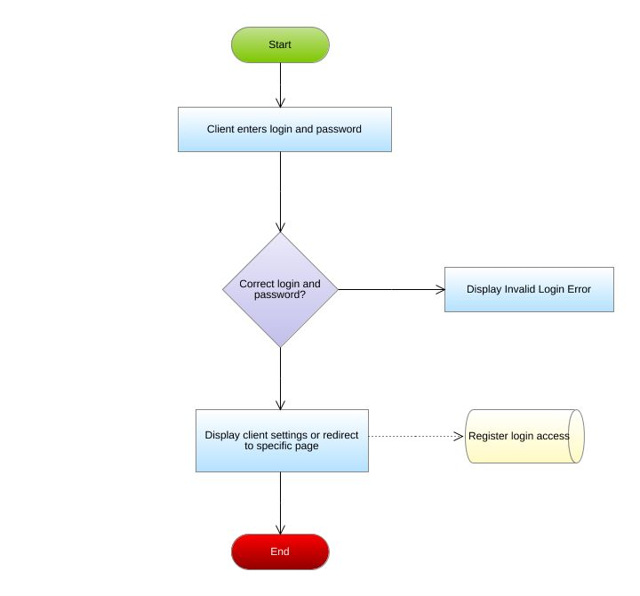
Flow-Chart

Slide 6
7-Modules
Register
Login
Forget password
Sent Mail
Compose Mail
Inbox
Delete

Slide 7
Roles
Viharika :- Front-end Register Page, Back-end Register-Controller
Deepthi :- Front end login Page , Back-end Login Controller
Manasa :- Front end Forget Password, Back-end Forget password Controller
Sreekanth :- Front end Compose mail, Back-end Compose mail Controller
Kunal Kashyap :- Front end Sent mail, Back-end Sent mail Controller
Manohar :- Front end Inbox and delete , Back-end Inbox and delete Controller

Slide 8
Conclusion
Unlike memos and business letters, which have historically been associated with a certain amount of professional decorum, email continues to enjoy widespread use as a personal tool to connect emailers with family and friends.
Many users of electronic mail become accustomed to a casual, intimate style and have difficulty switching to a more professional mode of communication.

Slide 9
Thank you

