Slide 1

Pankaj Kumar Yadav, Harshada Gore, Prince Kumar Jha, Satyajit Mohanty
Capstone Project-3
CARDIOVASCULAR RISK PREDICTION

Slide 2
About Project:
The dataset is from an ongoing cardiovascular study on residents of the town of Framingham, Massachusetts. The classification goal is to predict whether the patient has a 10-year risk of future coronary heart disease (CHD). The dataset provides the patients’ information. It includes over 4,000 records and 15 attributes.

Slide 3

Points for Discussion :
Problem Statement
DATA DESCRIPTION
Data Cleaning
Extra Data Analysis(EDA)
FEATURE ENGINEERING/SELECTION
Splitting Data
MODELLING AND PREDICTING WITH MACHINE LEARNING
MODELS
Conclusion

Slide 4

Problem Statement
Perform classification analysis using multiple models to predict risk of future coronary heart disease (CHD) and compare the evaluation metrics for all of them to find the best model.
Predict the overall risk of heart disease using Classification regression
Data balancing for Train Model
Getting accuracy score of several machine learning model.

Slide 5
DATA DESCRIPTION
The dataset provides the patients’ information. It includes over 4,000 records and 15 attributes.
VARIABLES: - EACH ATTRIBUTE IS A POTENTIAL RISK FACTOR. THERE ARE BOTH DEMOGRAPHIC, BEHAVIORAL, AND MEDICAL RISK FACTORS
DEMOGRAPHIC
1. Sex: male or female ("M" or "F")
2. Age: Age of the patient;(Continuous - Although the recorded ages have been truncated to whole numbers, the concept of
age is continuous)
BEHAVIORAL
3. is_smoking: whether or not the patient is a current smoker ("YES" or "NO")
4. Cigs Per Day: the number of cigarettes that the person smoked on average in one day. (Can be considered continuous as one can have any number of cigarettes, even half a cigarette.)

Slide 6
MEDICAL(HISTORY)
5. BP Meds: whether or not the patient was on blood pressure medication (Nominal)
6. Prevalent Stroke: whether or not the patient had previously had a stroke (Nominal)
7. Prevalent Hyp: whether or not the patient was hypertensive (Nominal)
8. Diabetes: whether or not the patient had diabetes (Nominal)
MEDICAL(CURRENT)
9. Tot Chol: total cholesterol level (Continuous)
10. Sys BP: systolic blood pressure (Continuous)
11. Día BP: diastolic blood pressure (Continuous)
12. BMI: Body Mass Index (Continuous)
13. Heart Rate: heart rate (Continuous - In medical research, variables such as heart rate though in fact discrete, yet are considered continuous because of large number of possible values.)
14. Glucose: glucose level (Continuous)
PREDICT VARIABLE (DESIRED TARGET)
15. TenYearCHD: 10-year risk of coronary heart disease CHD (binary: 1 means “Yes”, 0 means “No”) - DV

Slide 7
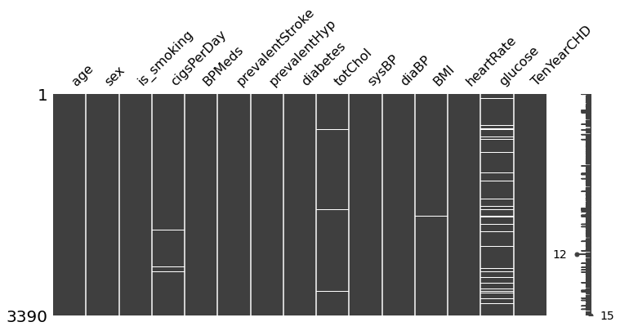
DATA EXPLORATION
This Dataset has 3390 observations in it with 17 columns(features)
Before any analysis, we just wanted to take a look at the data. So, we used the info () method.
There are a total of 16 features and 1 target variable. Also, there are some missing values so we need to take care of null values. Next, we used describe() method.
MISSING VALUE ANALYSIS
These trends give an idea about how the features are correlated with one another

Slide 8
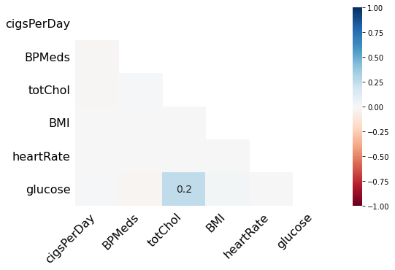
But to get a better idea about correlations we need to use heatmaps.
There is no strong Correlation between any features.

Slide 9
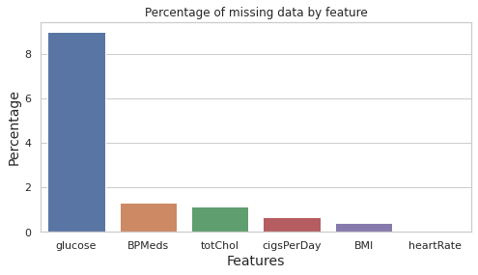
LET'S CHECK PERCENTAGE OF MISSING DATA OF EACH FEATURES
At 8.97%, the blood glucose entry has the highest percentage of missing data. The other features have very few missing entries.
BPMeds have near to 1.29% of missing data
totChol has near to 1.12% missing data.
cigsPerDay has near to 0.64% missing data.
BMI has near to 0.41% missing data.
heartRate has near to 0.02% missing data.
Since the missing entries account for only 11% of the total data so, we can drop these entries without losing a lot of data.

Slide 10
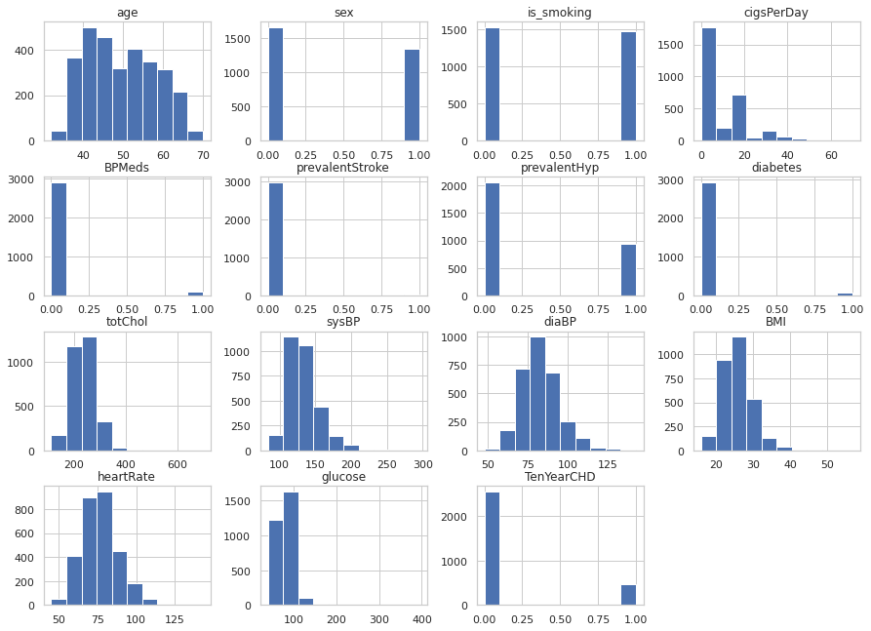
NOW, LET'S VISUALIZE DATA DISTRIBUTION
From above distribution plot we can say that the data on the prevalent stroke, diabetes, and blood pressure meds(BPMeds) are poorly balanced.

Slide 11
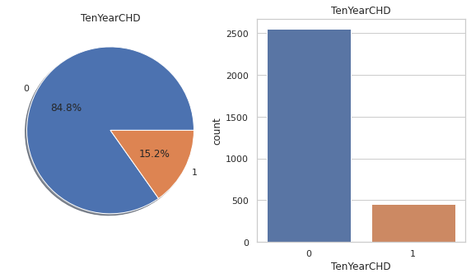
TARGET VARIABLE ANALYSIS
0 --> Person do not have risk of coronary heart disease
1 --> Person has risk of coronary heart disease
There are 2547 patients without heart disease and 457 patients with the disease.
We can see above that we have the imbalanced data set as the number of people without the disease greatly exceeds the number of people with the disease.

Slide 12
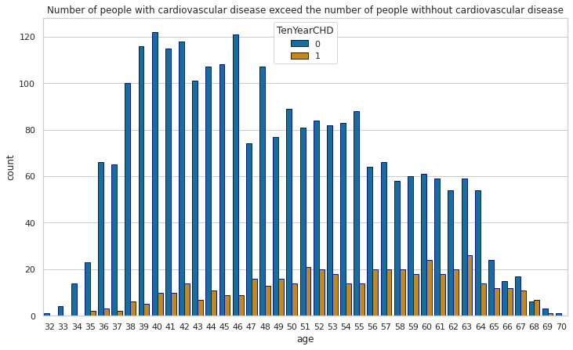
Let's look at the number of people with cardiovascular disease exceed the number of people without
cardiovascular disease respect to age.
As we can see in above plot The people with the highest risk of developing heart disease are between the ages of 51 and 63.
Because the number of sick people generally increases with age.

Slide 13
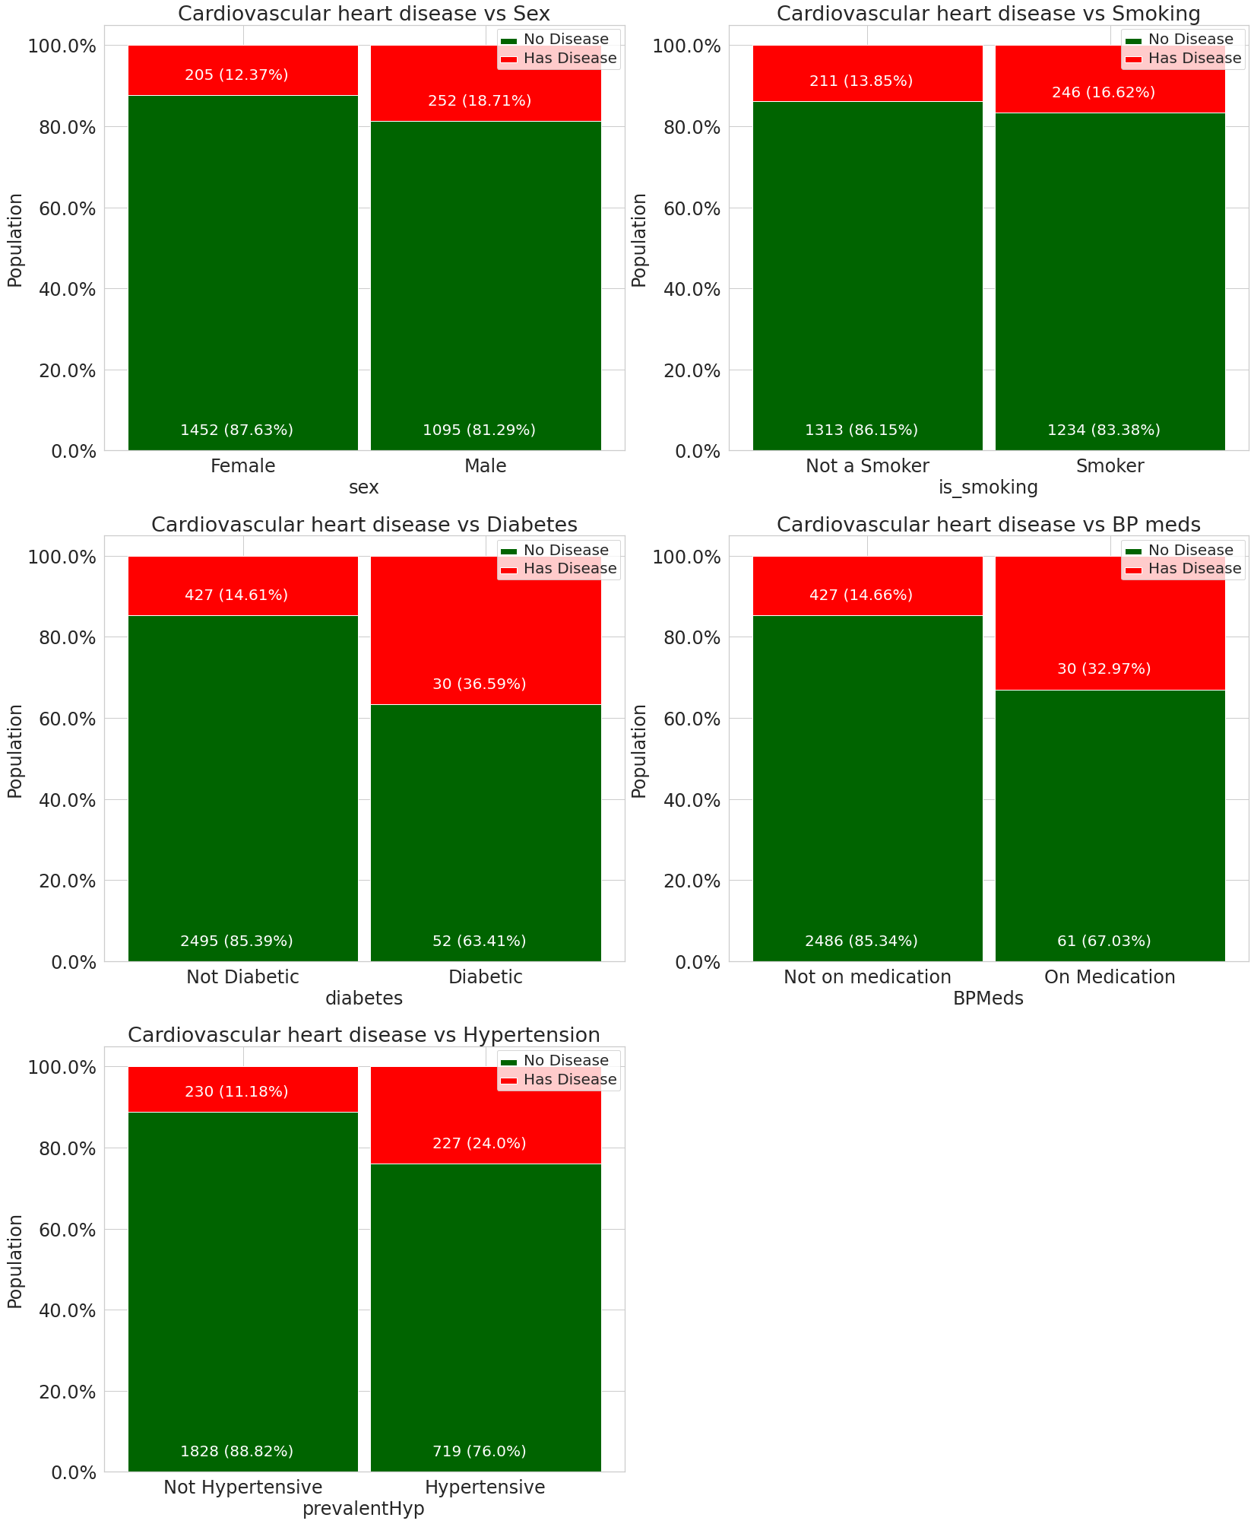
CATEGORICAL VARIABLE COMPARISONS WITH TARGET VARIABLE(TENYEARCHD)
From the above categorical variable comparison plot we can conclude that,
Slightly more males are suffering from Cardiovascular heart disease than females.
The people who have Cardiovascular heart disease is almost equal between smokers and non-smokers.
The percentage of people who have Cardiovascular heart disease is higher among the diabetic patients and also those patients with prevalent hypertension have more risk of Cardiovascular heart disease compare to those who don't have hypertensive problem.
The percentage of people who are on medication of blood pressure have more risk of Cardiovascular heart disease compare to those who are not on medication

Slide 14
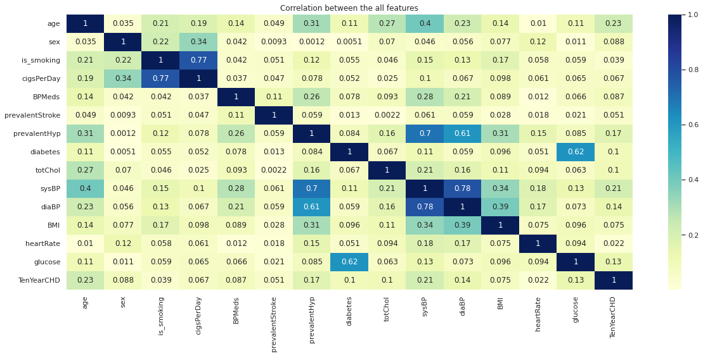
NOW, LET'S SEE THE CORRELATION BETWEEN THE ALL FEATURES
From the above correlation plot we can conclude that,
There are no features with more than 0.2 correlation with the Ten-year risk of developing CHD and this shows that the features a poor predictor. However, the features with the highest correlations are age, prevalent hypertension(prevalentHyp) and systolic blood pressure(sysBP).
Also, there are a couple of features that are highly correlated with each other and it makes no sense to use both of them in building a machine learning model.

Slide 15
These includes:
Blood glucose and diabetes;
systolic and diastolic blood pressures;
cigarette smoking and the number of cigarettes smoked per day.
Therefore, we need to carry out feature selection to pick the best features.
FEATURE ENGINEERING/SELECTION
Tree-based: SelectFromModel
SelectFromModel is an Embedded method. Embedded methods use algorithms that have built-in feature selection
methods.
Here,
We have used Random Forest() to select features based on feature importance. We calculate feature importance using
node impurities in each decision tree.
In Random Forest, the final feature importance is the average of all decision tree feature importance.
The top features are:
1. Age
2. Total cholesterol
3. Systolic blood pressure
4. Diastolic blood pressure
5. BMI
6. Heart rate
7. Blood glucose

Slide 16
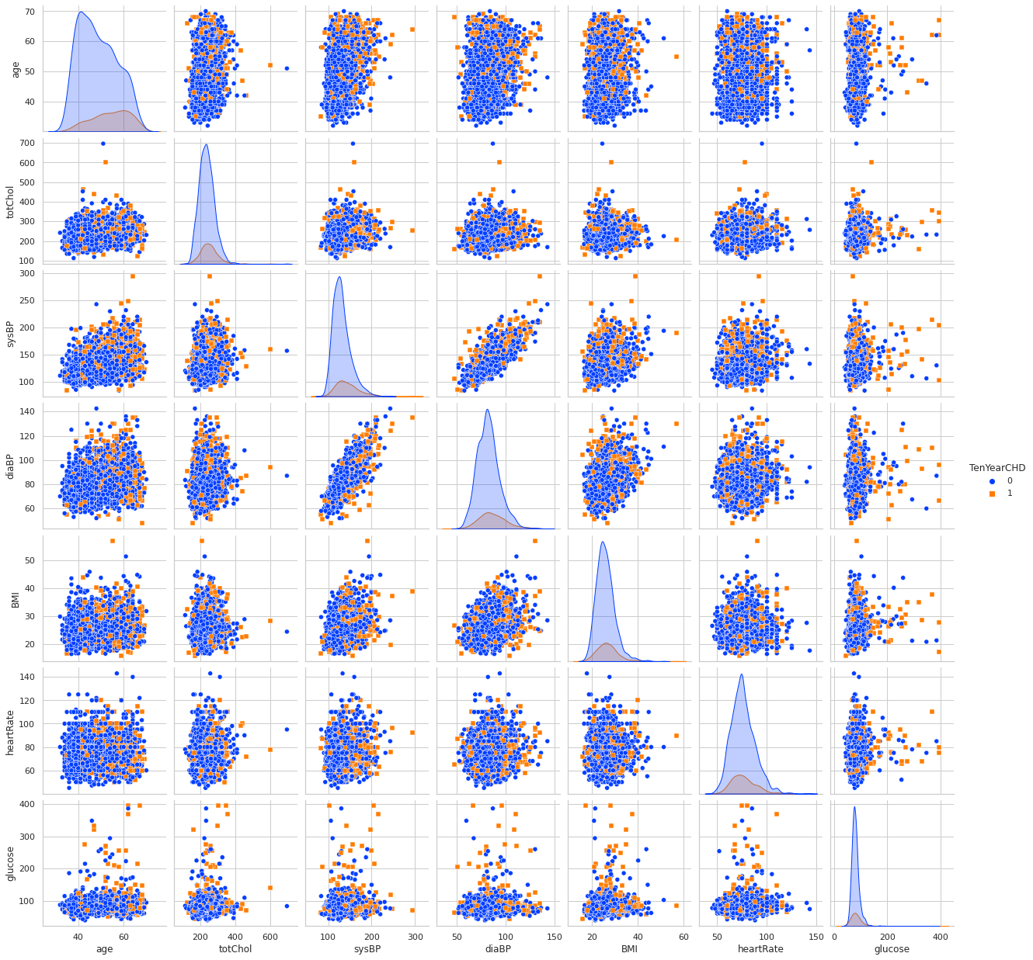
LET’S VISUALIZE THROUGH PLOTTING PAIR PLOT OF TOP FEATURES VS TARGET VARIABLE
So, we can easily find relation between all features with target variable

Slide 17
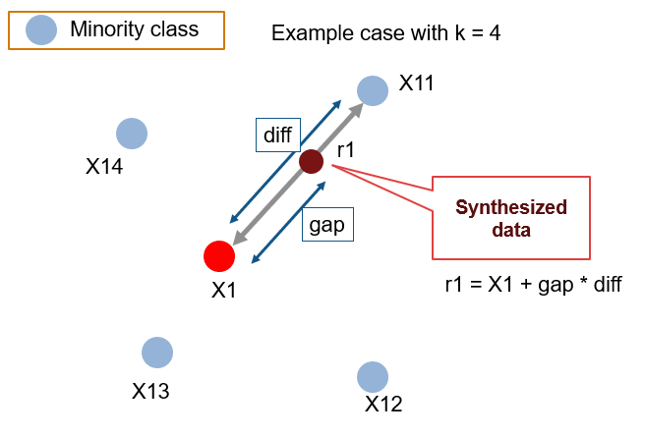
MODELLING AND PREDICTING WITH MACHINE LEARNING
Since our dataset is imbalanced i.e. for every positive case there are about 5-6 negative cases. We may end up with a classifier that is biased to the negative cases. The classifier may have a high accuracy but poor a precision and recall.
To handle this problem, we will balance the dataset using the Synthetic Minority Oversampling Technique(SMOTE).
SMOTE: Synthetic Minority Oversampling Technique
SMOTE is an oversampling technique where the synthetic samples are generated for the minority class. This
algorithm helps to overcome the overfitting problem posed by random oversampling. It focuses on the
feature space to generate new instances with the help of interpolation between the positive instances that lie
together.

Slide 18
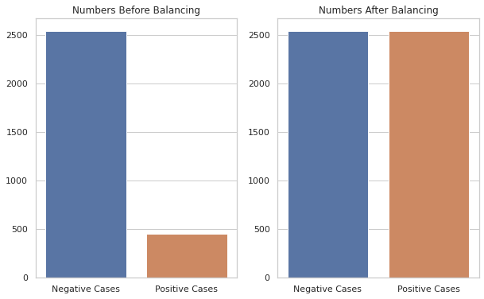
As seen after applying SMOTE, the new dataset is much more balanced.

Slide 19
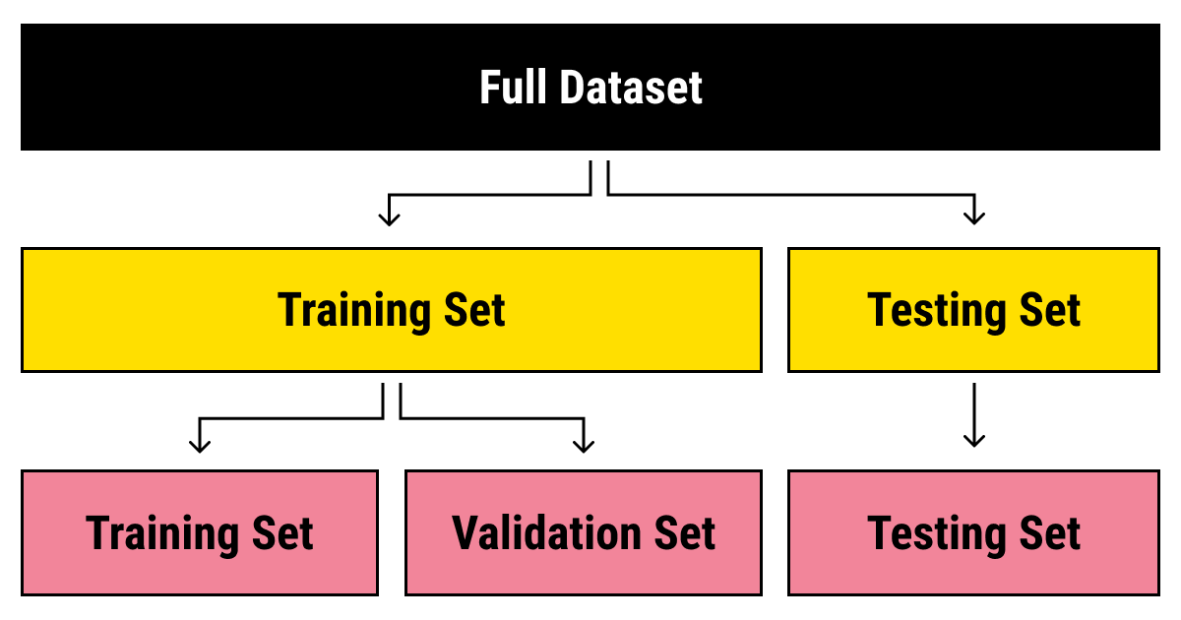
Splitting Data
Data splits into training dataset and testing dataset.
Training dataset is for making algorithm learn and train model.
Test dataset is for testing the performance of train model.
Here 80% of data taken as training dataset & remaining 20% of dataset used for testing purpose.
Training features have 4075 records and Testing features have 1019 records.

Slide 20
MODELS
The four algorithms that we will be using are:
1. Logistic Regression
2. Random Forrest
3. XGBoost
4. Support Vector Machine
Here, we will be using GridsearchCV search algorithm for above algorithms
LOGISTIC REGRESSION
Logistic regression aims to measure the relationship between a categorical dependent variable and one or more independent variables (usually continuous) by plotting the dependent variables' probability scores.

Slide 21
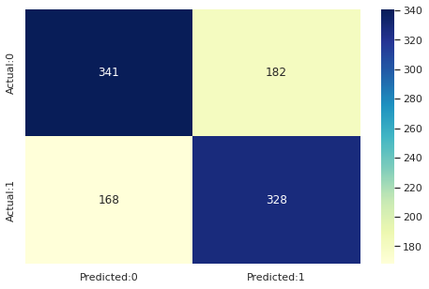
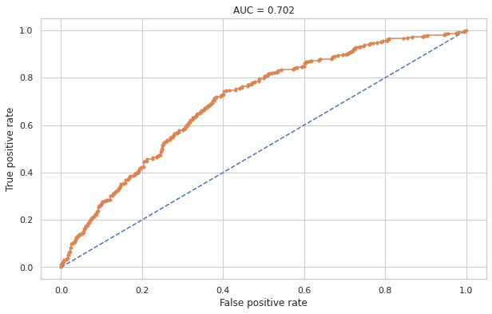
Confusion matrix of Logistic Model
Auc Score of Logistic Model
Using logistic regression, we get an accuracy of 65.95%

Slide 22
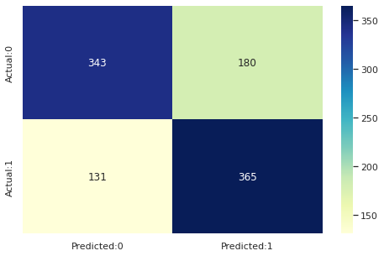
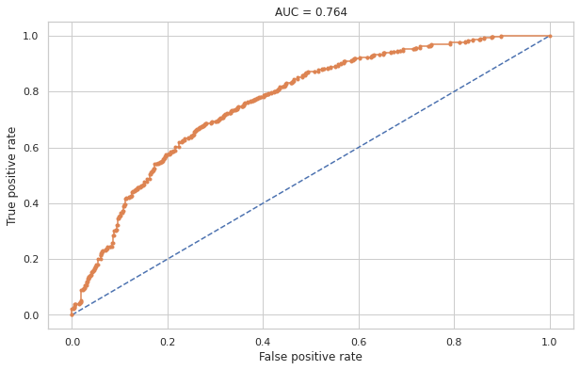
RANDOM FOREST
Random forests are a way of averaging multiple deep decision trees, trained on different parts of the same training set, with the goal of reducing the variance. This comes at the expense of a small increase in the bias and some loss of interpretability, but generally greatly boosts the performance in the final model
Confusion matrix of Random Forest
Auc Score of Logistic Model
Using Random Forest, we get an accuracy of 68.4%

Slide 23
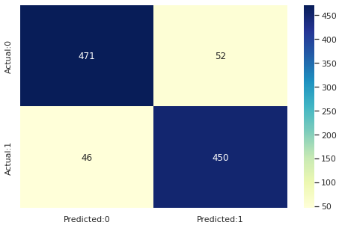
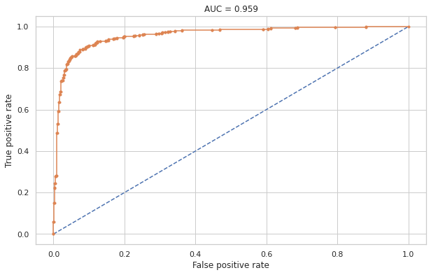
XGBOOST
XGBoost stands for extreme Gradient Boosting. The name xgboost, though, actually refers to the engineering goal to push the limit of computations resources for boosted tree algorithms
Confusion matrix of XG boost Classifier
Auc score of XG boost Classifier
Using XG boost we get an accuracy of 89.7%

Slide 24

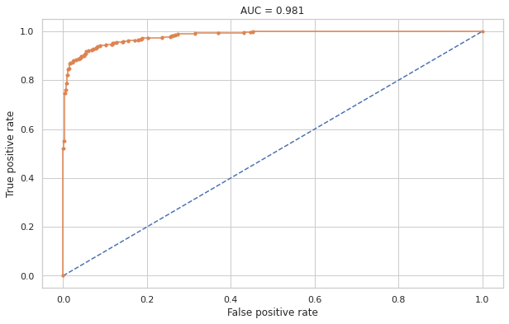
SUPPORT VECTOR MACHINE
Support vector machines (SVMs) are powerful yet flexible supervised machine learning algorithms which are used both for classification and regression. But generally, they are used in classification problems.
An SVM model is basically a representation of different classes in a hyperplane in multidimensional space. The hyperplane will be generated in an iterative manner by SVM so that the error can be minimized. The goal of SVM is to divide the datasets into classes to find a maximum marginal hyperplane (MMH).
Confusion matrix of SVM
Auc score of SVM
Using Support Vector Machine, we get an accuracy of 92.64%.

Slide 25
LET’S COLLECT ALL OUR BEST MODELS
Creating data frame which shows the performance metrics of each model
 | Test Accuracy | Precision | Recall | F1 Score | AUC
Logistic regression | 0.66 | 0.64 | 0.67 | 0.66 | 0.71
Random Forest | 0.68 | 0.66 | 0.74 | 0.70 | 0.76
XG Boost | 0.90 | 0.88 | 0.91 | 0.90 | 0.96
Support vector machine | 0.93 | 0.92 | 0.93 | 0.93 | 0.98
Observation from above table:
XG Boost, Support vector machine gives highest Accuracy, Recall, Precision and AUC score.
Highest recall is given by Support vector machine
Highest AUC is given by Support vector machine
Overall, we can say that Support vector machine is the best model that can be used for the risk prediction of Cardiovascular heart disease.

Slide 26
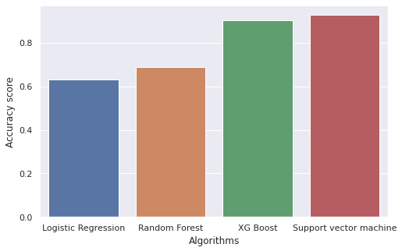
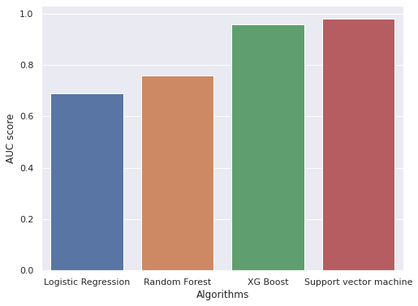
LET'S PLOT THE ACCURACY AND AUC SCORE GRAPH OF EACH ALGORITHM
Accuracy Score plot
AUC Score plot
From both the graphs we can say that the best performing model is Support Vector Machine algorithm.

Slide 27
Conclusion
The people who have Cardiovascular heart disease is almost equal between smokers and non smokers.
The top features in predicting the ten year risk of developing Cardiovascular Heart Disease are 'age', 'totChol', 'sysBP', 'diaBP', 'BMI', 'heartRate', 'glucose'.
The Support vector machine with the radial kernel is the best performing model in terms of accuracy and the F1 score and Its high AUC-score shows that it has a high true positive rate.
Balancing the dataset by using the SMOTE technique helped in improving the models' sensitivity.
With more data(especially that of the minority class) better models can be built.

Slide 28



