Slide 1
REPaL: Reproduction and Extension —
Zero-Shot Relation Extraction
COMP8240 Project Update — Manohar Naidu Bheesetti — 2026-10-10
Notes:
Before recording: replace every amber [FILL] box in slides 6, 7, 8, 9.

Slide 2
Reproducing and Extending REPaL
PAPER
“
EMNLP 2024 · Zhou et al. · UIUC + UVA
No labelled relation instances.
TASK
Zero-shot relation extraction from a written definition
WHY CHOSEN
Public code and data; can be pointed at new domains
2
Notes:
TIMING: 0:00–0:30
[Face in corner. Screen: title slide, then the authors' repo `github.com/KevinSRR/REPaL` beside your fork `github.com/ManoharNaidu/REPaL`.]
Hi, I'm Manohar, and this is my COMP8240 project update. I'm reproducing and extending REPaL, an EMNLP 2024 paper by Zhou and colleagues at the University of Illinois and the University of Virginia. It does zero-shot relation extraction: finding the relation between two entities in a sentence, using only a written definition of the relation and no labelled examples. I chose it because the authors released their code and data, and it can be pointed at new domains.

Slide 3
The paper's datasets
DefOn-FewRel
DefOn-WikiZSL
Built from FewRel · Wikipedia sentences
Built from WikiZSL · Wikidata
80 relations
3 × 15 relations
5 held-out test groups
3 test groups of 15 relations
Evaluation: each test relation is the target in turn, the others are negatives; precision, recall and F1 are averaged.
3
Notes:
TIMING: 0:30–1:15
[Screen: a slide with FewRel and WikiZSL.]
The paper tests on two datasets built from existing resources. DefOn-FewRel comes from FewRel, eighty relations over Wikipedia sentences, where the authors hold out five groups of relations as test sets. DefOn-WikiZSL comes from WikiZSL, built from Wikidata, with three groups of fifteen relations. Each comes with a large pool of unlabelled sentences. The results are precision, recall and F1: each test relation is treated in turn as the target, the other test relations act as negatives, and the scores are averaged.

Slide 4
How REPaL works
1
2
3
Write examples
Train a small model
Feedback round
An LLM reads the definition and writes tagged example sentences
RoBERTa-large, fine-tuned for NLI, judges sentence vs. definition
A sample of its predictions returns to the LLM: new examples and negatives, then retrain
No human-labelled training data.
4
Notes:
TIMING: 1:15–2:45 (part 1)
[Screen: architecture slide first (three boxes: language model writes examples, small model is trained, feedback round), then the terminal.]
REPaL has three steps. First, a large language model, GPT-4o in the paper, reads the relation definition and writes example sentences with the two entities tagged. Second, a small model, RoBERTa-large fine-tuned for natural language inference, learns from those examples to judge whether a sentence matches the definition. Third, a feedback round: the small model labels unlabelled sentences, a sample of its predictions goes back to the language model, which writes new examples and new negative definitions aimed at the model's mistakes, and the small model is retrained. No human-labelled training data is used.
The authors published their code on GitHub, and I forked it. Their shell scripts had placeholders, so I wrote one Python driver that runs every split and collects the results.

Slide 5
Code and a finished run
Authors' code is public; I forked it.
One Python driver replaces the authors' shell scripts and runs every split.
$ python run_experiments.py --dry-run \
--datasets fewrel_defon --splits 1 \
--stages initial \
--data-root reproduce_main_data/data \
--device-profile gpu
$ tail -n 5 \
results/fewrel_defon_1/initial/run.log
$ cat \
results/fewrel_defon_1/initial/metrics.json
Finished run — one split takes hours.
5
Notes:
TIMING: 1:15–2:45 (part 2)
[Terminal: run the pre-typed `--dry-run`, then `tail`, then `cat metrics.json`.]
This is the command, the training log, and the final precision, recall and F1 for one split. It's a finished run, because one split takes hours.

Slide 6
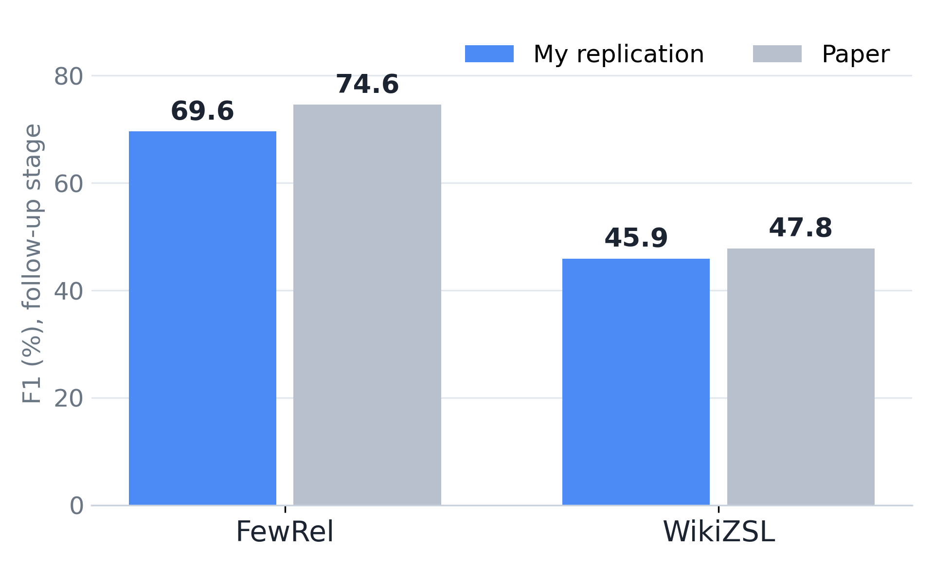
Replication status
Follow-up F1 (%)
Mine
Paper
FewRel
69.6
74.6
WikiZSL
45.9
47.8
All eight splits finished, using the authors' cached GPT-4o examples.
Run on rented cloud GPUs:
[FILL: GPU model, Python, PyTorch]
6
Notes:
TIMING: 2:45–3:30
[Screen: results slide, FewRel and WikiZSL rows highlighted.]
The code works. I ran it on rented cloud GPUs: [FILL: GPU model, Python version, PyTorch version]. All eight splits finished, using the authors' cached GPT-4o examples. "Initial" is the first stage of the pipeline; "follow-up" adds the feedback round, and that is the number the paper reports. On FewRel I get 69.6 F1 against the paper's 74.6, and on WikiZSL 45.9 against 47.8. So FewRel is about five points lower and WikiZSL is close. Feedback helps on FewRel but not on WikiZSL, and results vary a lot between splits.
[OPTIONAL, only after you confirm your `initial` stage is the paper's no-feedback stage: "In the paper, one feedback round adds about 4.6 F1 on FewRel. In my runs it adds about 4.7."]

Slide 7
New datasets
SemEval-2010 Task 8
NYT
arXiv — my own dataset
8,851
[FILL: N]
sentences
See next slide
sentences · 17 directed relations · “Other” removed
[FILL: K]
relations
SemEval example: “financial stress is one of the main causes of divorce.” → cause-effect
19 → 31
≈ 47
Qwen2.5
SemEval F1, with feedback
NYT F1
local model replaces GPT-4o
7
Notes:
TIMING: 3:30–4:20
[Screen: results slide, SemEval and NYT rows; then a SemEval example sentence.]
For new data I use two existing datasets and one I'm building. The existing ones are SemEval-2010 Task 8 and NYT, both from FewRel 2.0, which I converted to REPaL's format. SemEval has 8,851 sentences and 17 directed relations, such as cause-effect, with the "Other" class removed. NYT has [FILL: N] sentences and [FILL: K] relations. My OpenAI credits ran out, so these runs use a local Qwen model instead of GPT-4o. On SemEval, F1 is 19, rising to 31 with feedback; on NYT it is about 47. The SemEval problem is low recall, not mixed-up relation directions. My proposal also listed BioCreative CDR. I did not use it; I ran NYT instead, which is in the same FewRel 2.0 format as SemEval.
[CDR sentences: the default is facts only. If you find a real reason in your notes or git history, replace the first clause of the last sentence with it.]

Slide 8
Own dataset: arXiv scientific literature
397
2,846
6
100
abstracts
sentences
relations
sentence annotation sheet
RELATIONS
evaluated_on · outperforms · achieves_result · builds_on · applied_to_task · uses_component
Annotation so far:
[FILL: N labelled]
sentences
If none yet: “The annotation sheet is ready, and labelling starts next.”
8
Notes:
TIMING: 4:20–4:50
[Screen: `arxiv_re/README.md` counts table, then the annotation sheet.]
My own dataset is on scientific papers. I collected 397 arXiv abstracts from five categories, using the official API, and split them into about 2,850 sentences. I defined six relations, such as evaluated-on, outperforms and builds-on, and prepared a 100-sentence annotation sheet. So far I have labelled [FILL: N] sentences. The hard part is finding entities in scientific text without a trained tagger.
[If you have labelled none, replace the "So far I have labelled" sentence with: "The annotation sheet is ready, and labelling starts next."]
[Add ONE sentence if true: "A second annotator has labelled [M] of the same sentences, and agreement is kappa [X]." OR "A second annotator will label the same sentences next, and kappa will follow."]

Slide 9
Wrap-up
Replication works
1
Two extra datasets are done
2
Own dataset is built and
3
[FILL: partly labelled / ready to label]
Next: finish annotation, run REPaL on arXiv.
9
Notes:
TIMING: 4:50–5:00
[Face in corner, back to the title slide.]
To sum up: the replication works, two extra datasets are done, and my own dataset is built and [FILL: partly labelled / ready to label]. Next, I'll finish annotating and run REPaL on it. Thanks for watching.

Slide 10
Backup — verified facts
NOT FOR THE 5-MINUTE RECORDING
Local Qwen: credits ran out; SemEval and NYT used Qwen2.5-32B. Qwen3-32B on SemEval: 25.1 initial, 19.6 follow-up.
Archived GPT-4o SemEval run: 35.7 initial, stopped when credits ran out. Single runs: only a hint.
Runs: 26 finished without errors; nyt_qwen3 was not run, on purpose.
Low F1 (19) next to P (45), R (20): the paper averages P, R and F1 over test iterations.
SemEval hypothesis (untested): model-written entities ~4–5 tokens; SemEval's are single words.
Pool size: paper uses 10,000 unlabelled per group. My 10k run (71.6 / 68.1) mixes GPT-4o seeds, Qwen follow-up.
Group sizes (paper): 5 groups of 14 FewRel relations, 3 groups of 15 WikiZSL relations.
Not done yet: finish annotation, REPaL on the arXiv set, LLM-as-a-judge.
10
Notes:
TIMING: backup — not for the 5-minute recording
- Why local Qwen: the OpenAI credits ran out. SemEval and NYT used Qwen2.5-32B; one SemEval comparison used Qwen3-32B (25.1 initial, 19.6 follow-up). An archived GPT-4o SemEval run reached 35.7 at the initial stage and stopped when credits ran out. That hints that the generating model matters, but these are single runs.
- 26 runs finished without errors. `nyt_qwen3` was not run, on purpose.
- Why F1 (19) looks low next to precision (45) and recall (20): the paper averages precision, recall and F1 over the test iterations, so mean F1 is not the F1 of the mean precision and recall.
- Why a Python driver: the original shell scripts had placeholders (confirm from the repo).
- Newer PyTorch: your project notes say newer GPUs need a newer PyTorch build than the authors pinned. Confirm before saying it.
- SemEval hypothesis (untested): model-written examples use longer entity phrases (about 4-5 tokens) than SemEval's single-word entities.
- Pool size: the paper down-samples 10,000 unlabelled instances per test group (section 4.1). Your project notes say the released data uses a 100k pool. The 10k experiment (71.6 initial, 68.1 follow-up on two splits) mixes cached GPT-4o seeds with Qwen follow-up, so it is not a clean comparison.
- Group sizes (paper): 5 groups of 14 FewRel relations and 3 groups of 15 WikiZSL relations.
- Not done yet: finishing annotation, REPaL on the arXiv set, and the LLM-as-a-judge evaluation from the proposal.

