Slide 1

CS6510 Applied Machine Learning Course Introduction
5 Aug 2017
Vineeth N Balasubramanian

Slide 2

A few (not so, yet) recent quotes
“A breakthrough in machine learning would be worth ten Microsofts” (Bill Gates, Chairman, Microsoft)
“Machine learning is the next Internet” (Tony Tether, Director, DARPA)
Machine learning is the hot new thing” (John Hennessy, President, Stanford)
“Web rankings today are mostly a matter of machine learning” (Prabhakar Raghavan, ex-Dir. Research, Yahoo)
“Machine learning is going to result in a real revolution” (Greg Papadopoulos, CTO, Sun)
“Machine learning is today’s discontinuity” (Jerry Yang, ex-CEO, Yahoo)

Slide 3

What is Machine Learning?

Slide 4
What is Machine Learning?
Making predictions or decisions from data
“Programming computers to optimize a performance criterion using example data or past experience” (Ethem Alpaydin, Machine Learning, 2010)
“A computer program is said to learn from experience E with respect to some class of tasks T and performance measure P, if its performance at tasks in T, as measured by P, improves with experience E.” (Tom Mitchell, Machine Learning, 1997)
“Learning general models from a data of particular examples”
“Build a model that is a good and useful approximation to the data.“

Slide 5
Today
Traditional Programming
Machine Learning
Data
Computer
Output
Program
Data
Computer
Program
Output
Source: Domingos

Slide 6
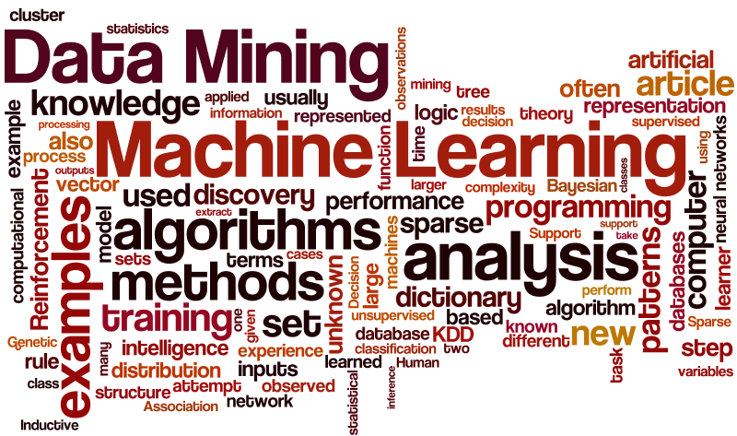
Related Terms
Machine Learning, Data Mining, Knowledge Discovery, Artificial Intelligence, Statistical Learning, Pattern Recognition, Computational Learning

Slide 7
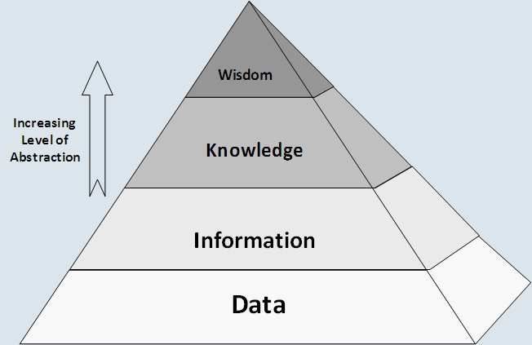
When is Machine Learning Used?
Human expertise does not exist
E.g. navigating on Mars
Humans are unable to explain their expertise
E.g. speech recognition
Solution changes in time
E.g. routing on a computer network
Solution needs to be adapted to particular cases
E.g. user biometrics
Data is cheap and abundant; knowledge is expensive and scarce

Slide 8

Applications of Machine Learning

Slide 9
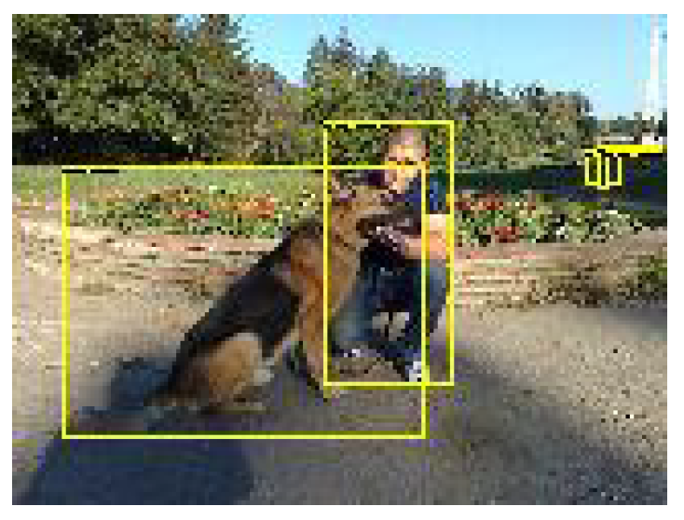
Applications of Machine Learning

Slide 10
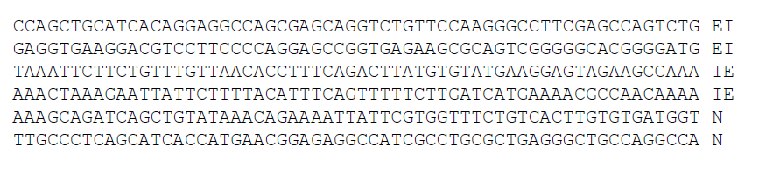
Applications of Machine Learning

Slide 11
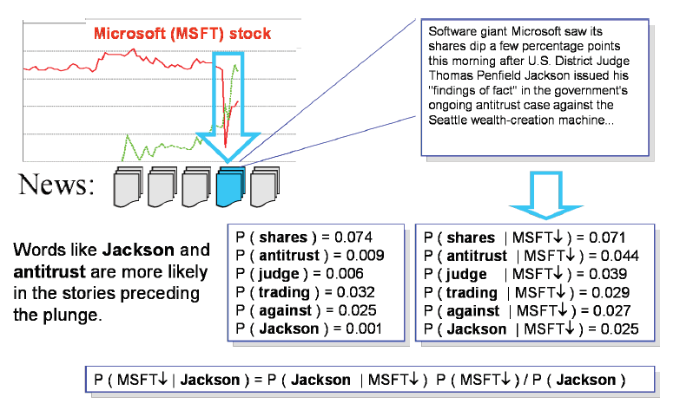
Applications of Machine Learning

Slide 12

Applications of Machine Learning

Slide 13
More ML Applications
Science (Astronomy, neuroscience, medical imaging, bio-informatics)
Environment (energy, climate, weather, resources)
Retail (Intelligent stock control, demographic store placement)
Manufacturing (Intelligent control, automated monitoring, detection methods)
Security (Intelligent smoke alarms, fraud detection)
Marketing (promotions, ...)
Management (Scheduling, timetabling)
Finance (credit scoring, risk analysis...)
Web data (information retrieval, information extraction, ...)

Slide 14
More Recent ML Applications
AlphaGo!
Automating Employee Access Control
Identifying whales in ocean based on audio recordings
Predict wait times for patients in emergency rooms
Extract heart failure diagnosis criteria from free-text physician notes
Predicting hospital readmissions
Is (s)he a pyschopath?
Source: http://www.forbes.com/sites/85broads/2014/01/06/six-novel-machine-learning-applications/#6b6f9a9e67bf

Slide 15
When are ML algorithms not needed?
When the relationships between all system variables (input, output, and hidden) is completely understood!
This is NOT the case for almost any real system!

Slide 16
Overview of ML
Supervised learning
Predict an output y when given an input x
For categorical y : classification.
For real-valued y : regression.
Unsupervised learning
Create an internal representation of the input, e.g. clustering, dimensionality
This is important in machine learning as getting labels is often difficult and expensive
Other settings of ML
Reinforcement learning (learning from “rewards”)
Semi-supervised learning (combines supervised + unsupervised)
Active learning, Transfer learning, Structured prediction

Slide 17
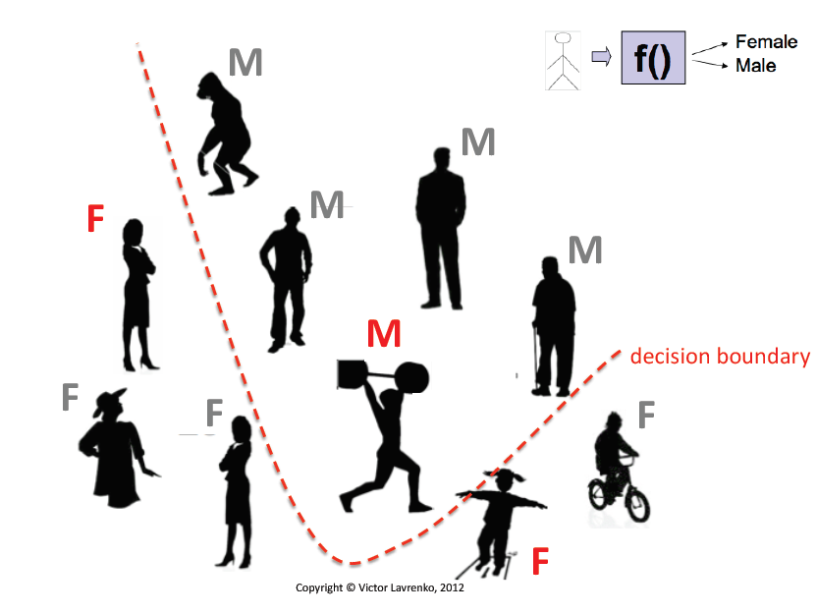
Classification (Supervised Learning)

Slide 18
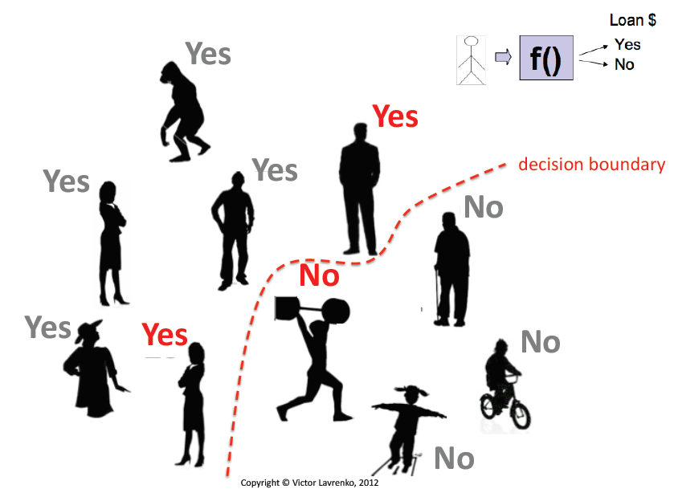
Classification (Supervised Learning)

Slide 19
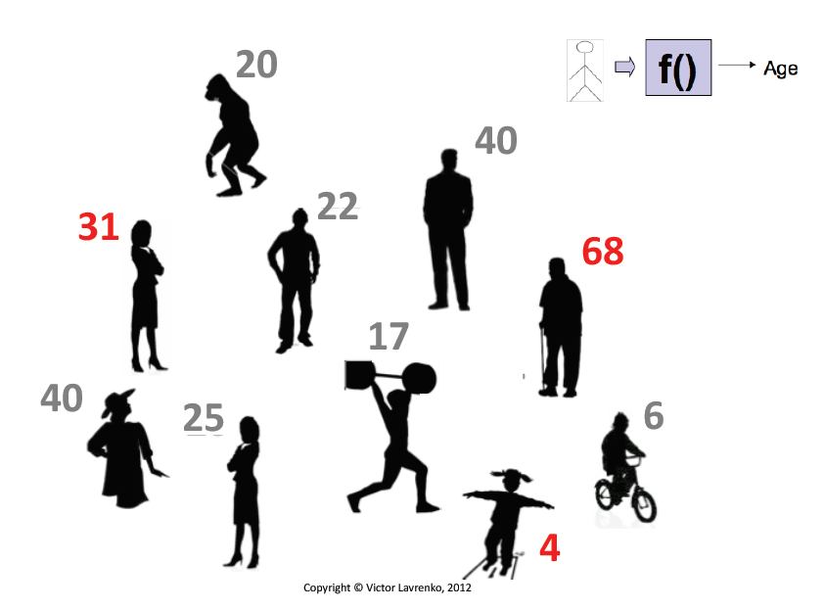
Regression (Supervised Learning)

Slide 20
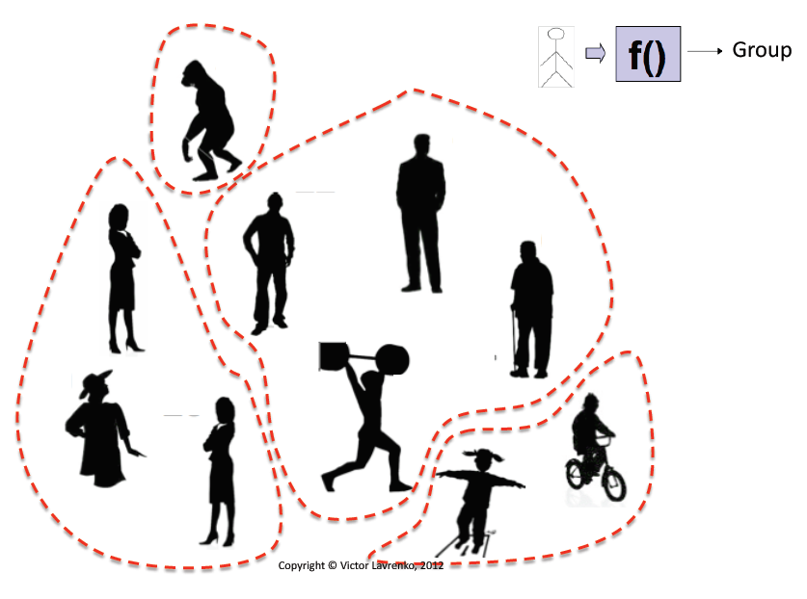
Clustering (Unsupervised Learning)

Slide 21
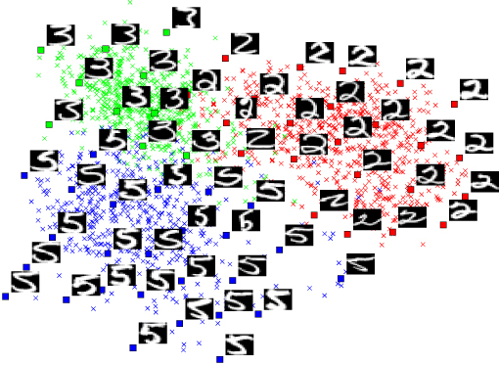
Dimensionality Reduction (Unsupervised Learning)
Large sample size is required for high-dimensional data
Query accuracy and efficiency degrade rapidly as the dimension increases
Strategies
Feature reduction
Feature selection
Manifold learning
Kernel learning

Slide 22
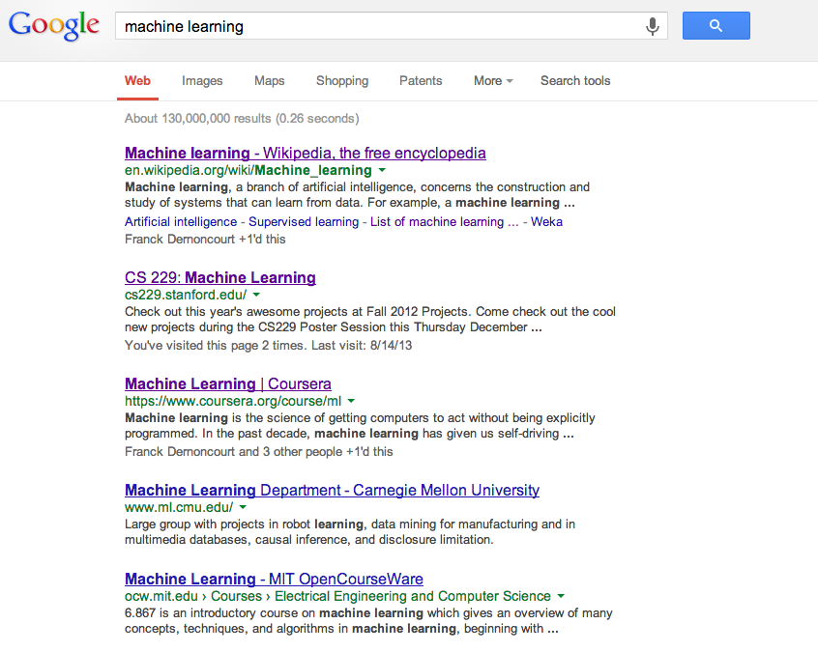
Other Settings: Ranking (Supervised Learning)
Given a query and
a set of web pages,
rank them according
to relevance
Other applications
User preference, e.g. Netflix “My List” -- movie queue ranking
Flight search (search in general)
…

Slide 23
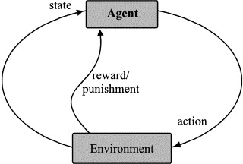
Other Settings: Reinforcement Learning
Learning a policy: A sequence of outputs
No supervised output but delayed reward
E.g. Game playing
E.g. Robot in a maze
Multiple agents, partial observability, ...
Example (Simple Demo):
https://www.youtube.com/watch?v=DCjbk4m1G6I

Slide 24
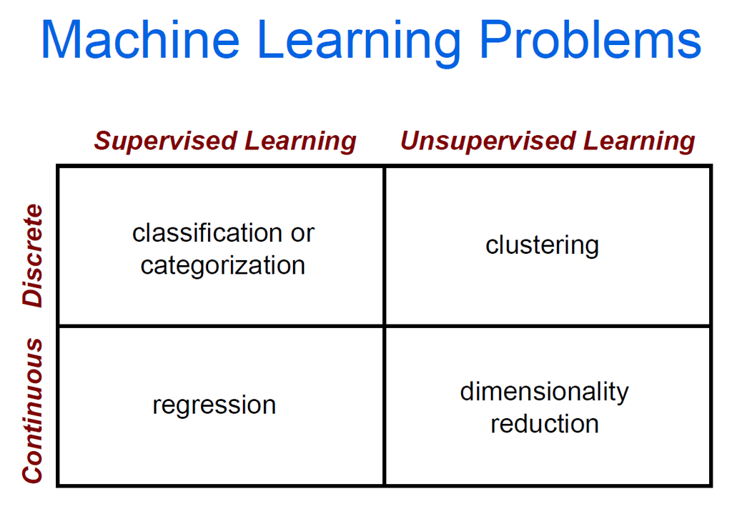
ML Problems

Slide 25
ML in Practice
Understanding domain, prior knowledge, and goals
Data integration, selection, cleaning, pre-processing, etc.
Learning models
Interpreting results
Consolidating and deploying discovered knowledge
Loop

Slide 26
Training and Testing ML Models
Data acquisition
Practical usage
Universal set
(unobserved)
Training set (observed)
Testing set (unobserved)

Slide 27
Training and Testing ML Models
Training is the process of making the system able to learn.
No free lunch rule:
Training set and testing set may not come from the same distribution
Need to make some assumptions or bias

Slide 28
Types of Models
Inductive vs Transductive Learning
Online vs Offline Learning
Generative vs Discriminative Models
Parametric vs Non-Parametric Models

Slide 29
ML Datasets
UCI Repository: http://www.ics.uci.edu/~mlearn/MLRepository.html
Statlib: http://lib.stat.cmu.edu/
Kaggle
Many more…

Slide 30
ML Resources
MOOCs
Coursera, EdX, Udacity
Conferences/Journals
JMLR, Machine Learning, IEEE Transactions on Neural Networks and Learning Systems, IEEE Transactions on Pattern Analysis and Machine Intelligence, Annals of Statistics
ICML, NIPS, KDD, IJCAI, AAAI, ICDM

Slide 31
Mathematical Basis
Functions, Logarithms and Exponentials
Vectors, Dot Products, Orthogonality
Matrices, Matrix Operations, Linear Transformations, Eigendecomposition
Calculus, Differentiation, Integration
Probability and Statistics
Functional Analysis, Hilbert Spaces

Slide 32
Course Details
Available at: https://goo.gl/q6dNoP

Slide 33
Topics not to be covered (likely)
Deep Learning (not in its “depth”, at least)
Bayesian Networks (not in depth)
Reinforcement Learning
Learning Theory

Slide 34
Programming
Python
Libraries
Numpy, Scipy – numerical/scientific computing, linear algebra
Matplotlib – for plotting
Scikitlearn – for machine learning

Slide 35
Foundational Reading/Follow-up
Math
Part 1 of Deep Learning book: http://www.deeplearningbook.org/
Essence of linear algebra: http://youtu.be/kjBOesZCoqc
Essence of calculus: https://goo.gl/Hnk1jA
Programming
Learn Python
https://try.jupyter.org/
https://docs.python.org/3/tutorial/
Video Tutorials: https://www.youtube.com/watch?v=cpPG0bKHYKc
Play with Numpy

