Slide 1

CS6510 Applied Machine Learning Classifier Evaluation
5 Aug 2017
Vineeth N Balasubramanian

Slide 2
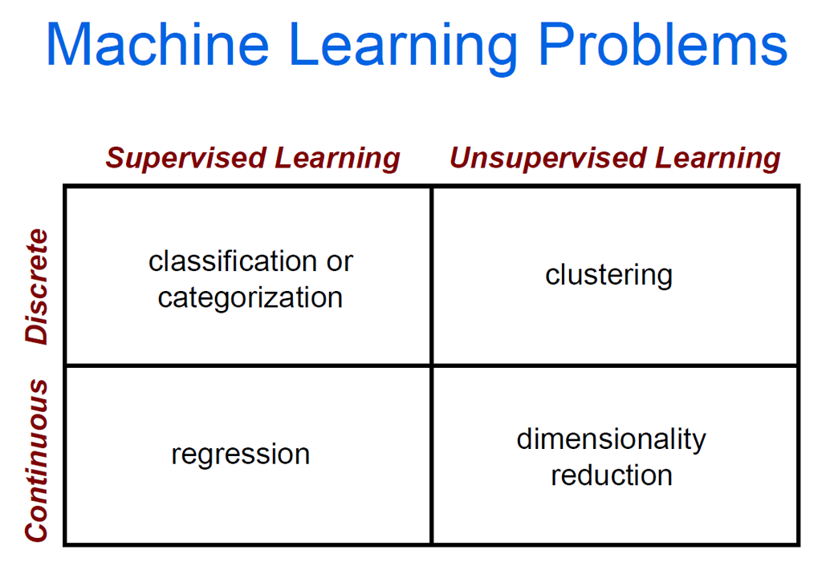

ML Problems: Recall

Slide 3
Classification Methods
k-Nearest Neighbors
Decision Trees
Naïve Bayes
Support Vector Machines
Logistic Regression
Neural Networks
Ensemble Methods (Boosting, Random Forests)
How to evaluate?

Slide 4
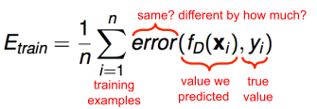
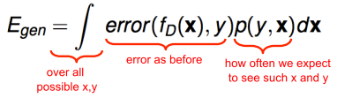
Training vs Generalization Error
Training Error
Not very useful
Relatively easy to obtain low error
Generalization Error
How well we do on future data
How to compute generalization error?

Slide 5
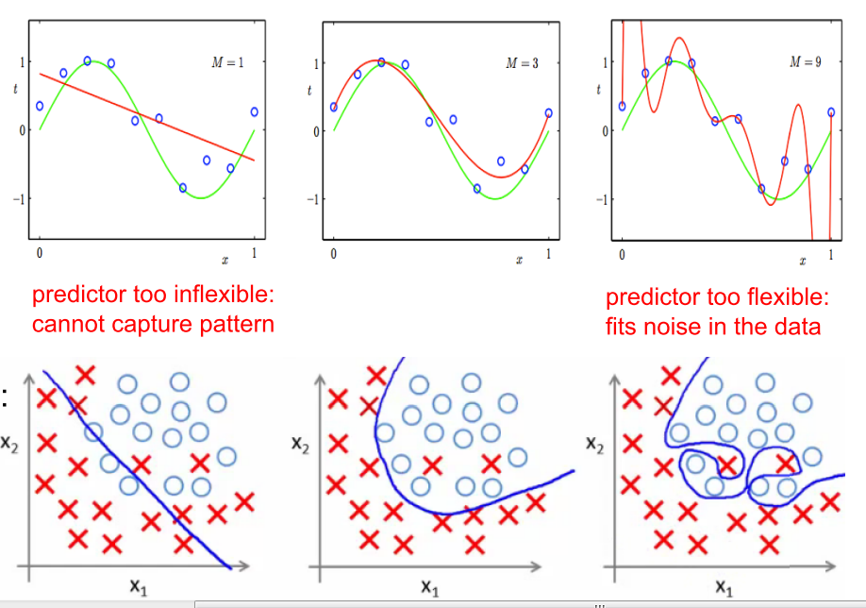
Underfitting and Overfitting
Regression
Classification

Slide 6
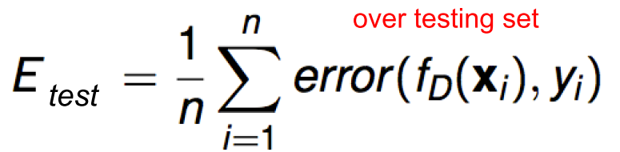
Estimating Generalization Error
Testing Error
Set aside part of training data (testing set)
Learn a predictor without using any of this test data
Predict values for testing set, compute error
This is an estimate of generalization error

Slide 7
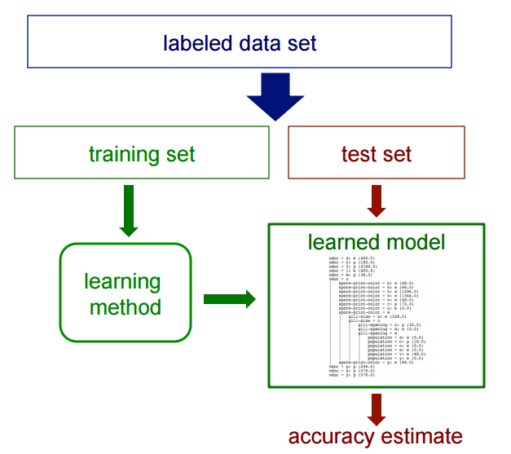
Estimating Generalization Error
Getting an unbiased estimate of the accuracy of a learned model

Slide 8





Example: Image Classification
Training Images
Training
Training Labels
Image Features
Classifier Training
Trained Classifier
Testing
Image Features
Trained Classifier
Prediction
Outdoor
Source: Derek Hoiem

Slide 9
Training, Validation, Test Sets
Training set
NB: Count frequencies, DT: Pick attributes to split on
Validation set
Run multiple trials and average
Testing set
Pick best-performing algorithm (NB vs DT vs..)
Fine-tune parameters (Tree depth, k in kNN, c in SVM)

Slide 10
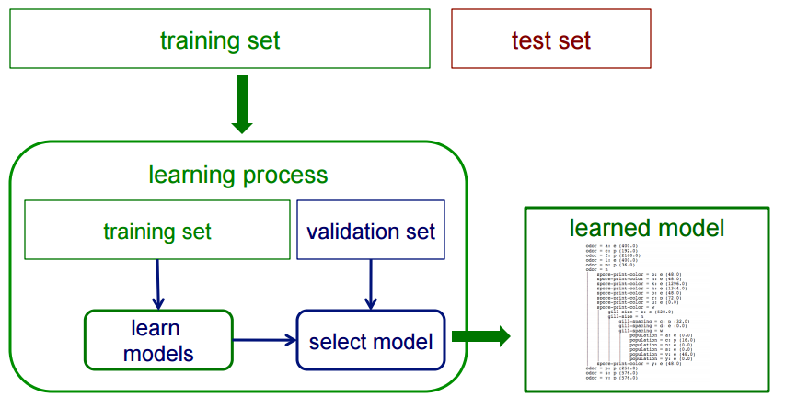
Use of Validation Sets
If we want unbiased estimates of accuracy during the learning process:

Slide 11
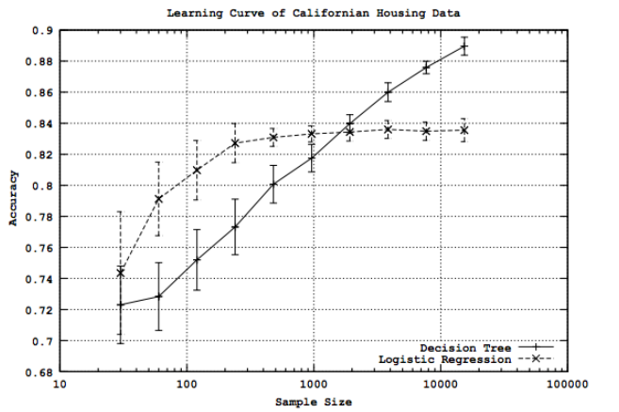
Choosing Training, Validation, Test Sets
Split randomly to avoid bias
Large test set -> estimate future error as accurately as possible (vs) Large training set => better estimates
How large should a training set be?
Study accuracy/error (vs) training set size
Courtesy: Perlich et al. Journal of Machine Learning Research, 2003

Slide 12
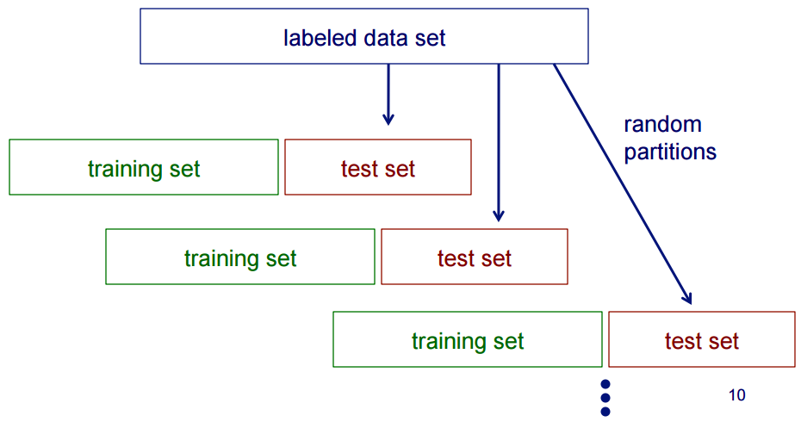
Random Resampling
We can artificially increase training set size using random resampling:

Slide 13
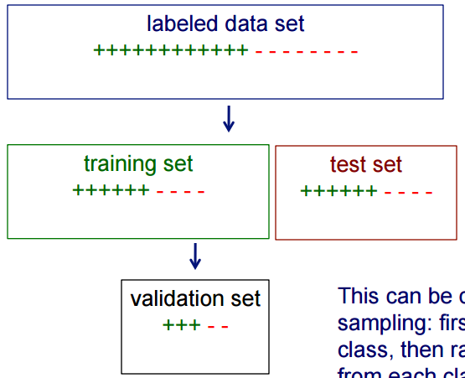
Stratified Sampling
When randomly selecting training or validation sets, we may want to ensure that class proportions are maintained in each selected set
This can be done via stratified sampling: first stratify instances by class, then randomly select instances from each class proportionally.

Slide 14
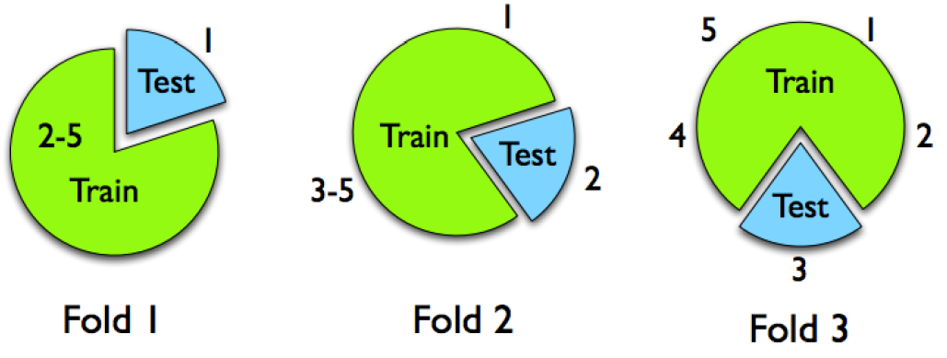
Model Selection
Resubstitution
K-fold cross-validation
Leave-one-out
N-fold cross-validation

Slide 15
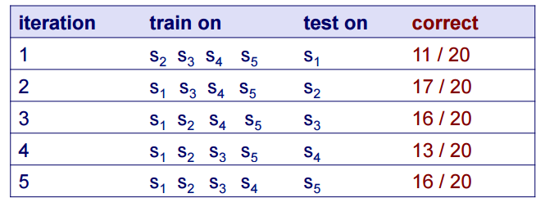
Cross-Validation: Example
Suppose we have 100 instances, and we want to estimate accuracy with cross validation
Classification Accuracy = 73/100 = 73%
Note: Whenever we use multiple training sets, as in CV and random resampling, we are evaluating a learning method as opposed to an individual learned model

Slide 16
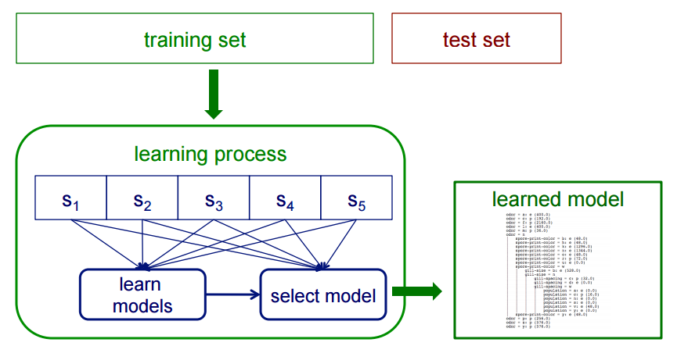
Cross-Validation: Example
Instead of a single validation set, we can use cross-validation within a training set to select a model (e.g. to choose the best k in k-NN)

Slide 17
Evaluation Measures
Classification
How often we classify something right/wrong
Regression
How close are we to what we’re trying to predict
Ranking/Search
How correct are the top-k results?
Clustering
How well we describe our data (Not straightforward)

Slide 18
Is accuracy adequate?
Accuracy may not be useful in cases where
There is a large class skew
Is 98% accuracy good if 97% of the instances are negative?
There are differential misclassification costs – say, getting a positive wrong costs more than getting a negative wrong
Consider a medical domain in which a false positive results in an extraneous test but a false negative results in a failure to treat a disease
We are most interested in a subset of high-confidence predictions

Slide 19

Classification Error: Beyond Accuracy
Evaluating Learning Algorithms: A Classification Perspective
Nathalie Japkowicz & Mohak Shah
Cambridge University Press, 2011
Good tutorial on the topic: http://www.icmla-conference.org/icmla11/PE_Tutorial.pdf

Slide 20
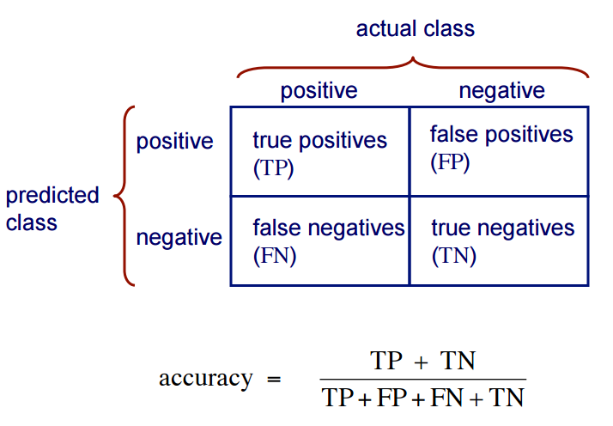
Classification Error: Beyond Accuracy
In 2-class problems:

Slide 21
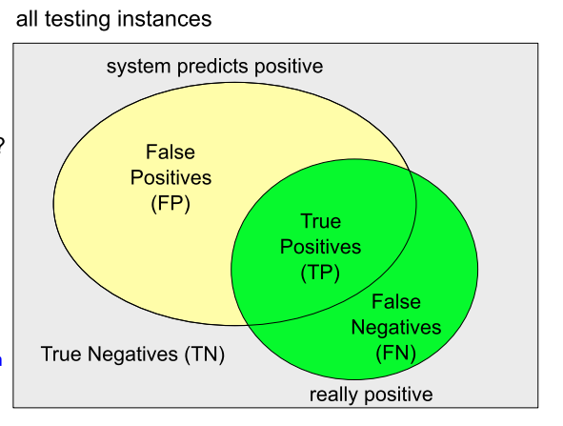
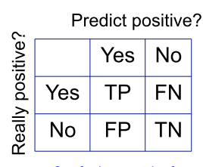
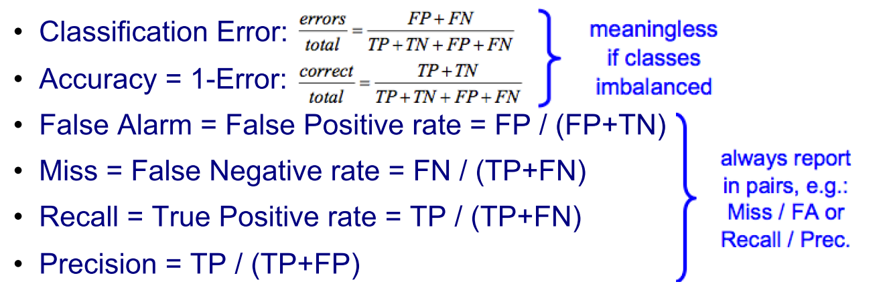
Classification Performance Measures
True Positive Rate also called “Sensitivity”
“Specificity” = 1 – False Alarm
“Sensitivity” = Probability of a positive test given a patient has the disease
“Specificity” = Probability of a negative test given a patient is well

Slide 22
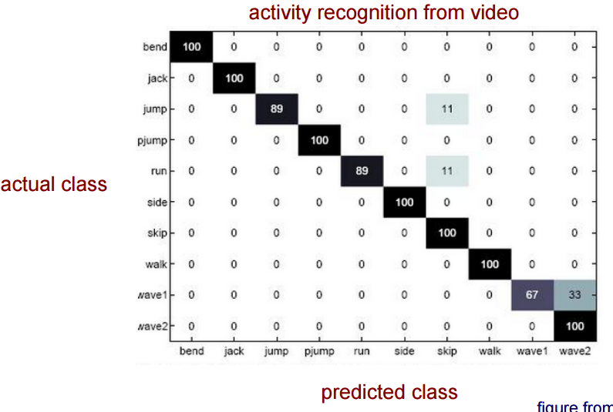
Classification Error: Beyond Accuracy
For multi-class problems?
Confusion Matrix
Courtesy: vision.jhu.edu

Slide 23
Utility and Cost
Sometimes, there is a cost for each error
E.g. Earthquake prediction
False positive: Cost of preventive measures
False negative: Cost of recovery
Detection Cost (Event detection)
Cost = C_{FP} * FP + C_{FN} * FN
F-measure (Information Retrieval)
F1 = 2/(1/Recall + 1/Precision)

Slide 24
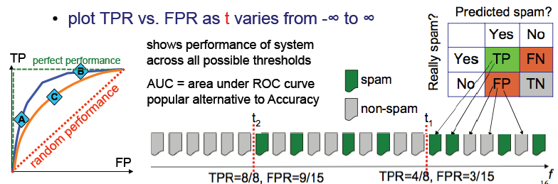
ROC Curves
Many algorithms compute “confidence” f(x)
Threshold to get decision: spam if f(x) > t, non-spam if f(x) <= t
Threshold to determines error rates
Receiver Operating Characteristic (ROC)

Slide 25
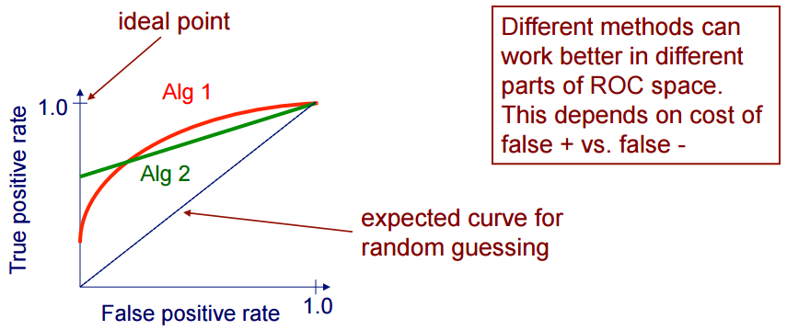
ROC Curves
A Receiver Operating Characteristic (ROC) curve plots the TP-rate vs. the FP-rate as a threshold on the confidence of an instance being positive is varied

Slide 26
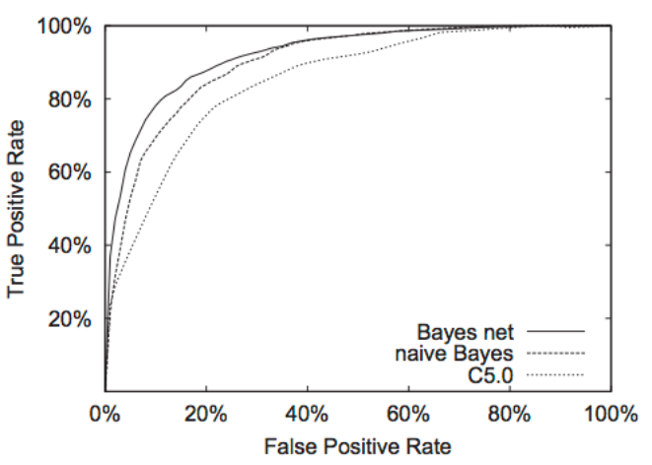
ROC Curve: Example
Courtesy: Bockhorst et al., Bioinformatics 2003

Slide 27
ROC Curve: Algorithm
Sort test-set predictions according to confidence that each instance is positive
Step through sorted list from high to low confidence
Locate a threshold between instances with opposite classes (keeping instances with the same confidence value on the same side of threshold)
Compute TPR, FPR for instances above threshold
Output (FPR, TPR) coordinate

Slide 28
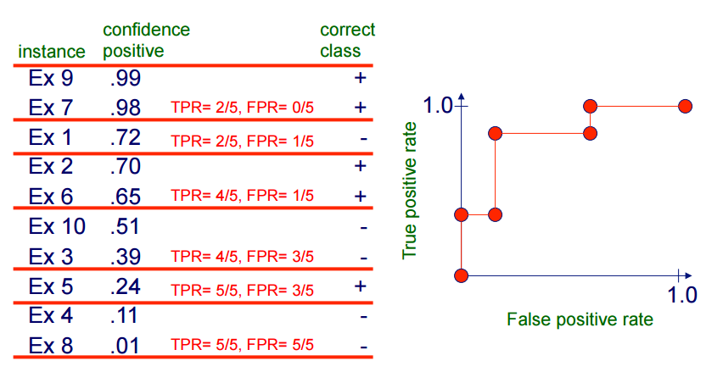
Plotting an ROC Curve

Slide 29
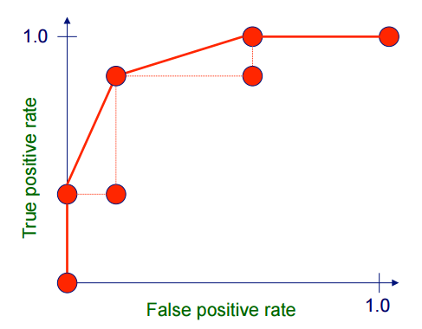
Plotting an ROC Curve
Can interpolate between points to get convex hull

Slide 30
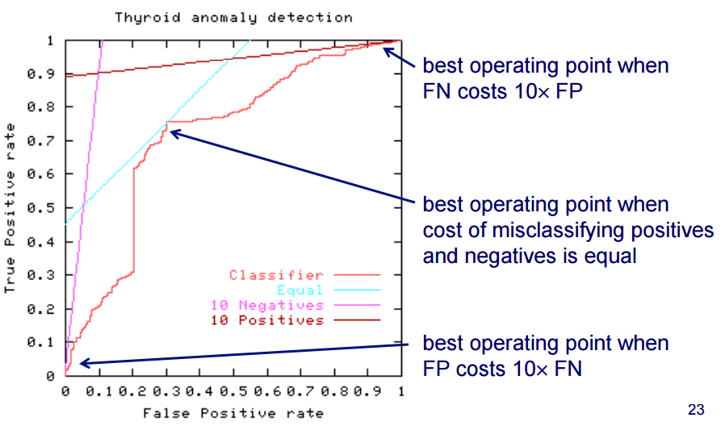
ROC Curves and Misclassification Costs

Slide 31
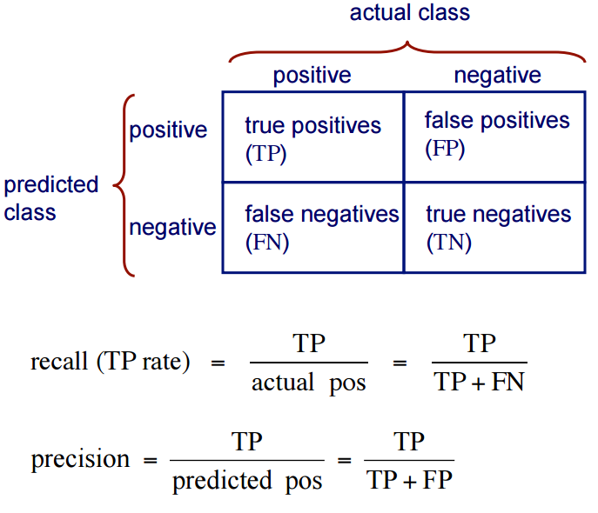
Recall: Precision-Recall

Slide 32
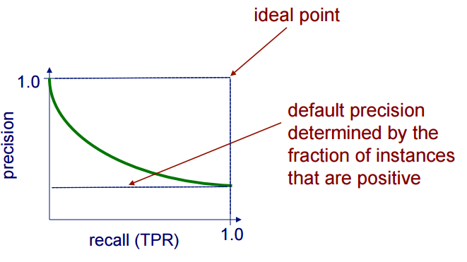
Precision/Recall Curves
A precision/recall curve plots the precision vs. recall (TP-rate) as a threshold on the confidence of an instance being positive is varied

Slide 33
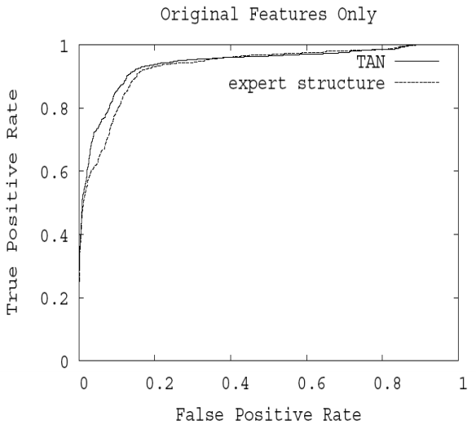
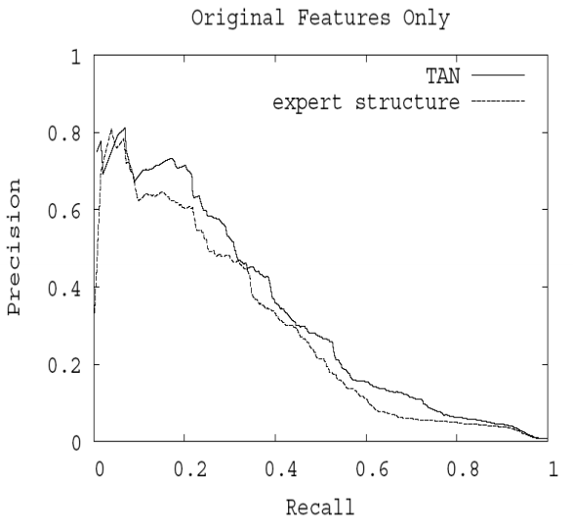
ROC + PR Curves: Example
Courtesy: Page, Univ of Wisconsion-Madison

Slide 34
ROC + PR Curves: Summary
Both
Allow predictive performance to be assessed at various levels of confidence
Assume binary classification tasks
Sometimes summarized by calculating area under the curve
ROC curves
Insensitive to changes in class distribution (ROC curve does not change if the proportion of positive and negative instances in the test set are varied)
Can identify optimal classification thresholds for tasks with differential misclassification costs
Precision/Recall curves
Show the fraction of predictions that are false positives
Well-suited for tasks with lots of negative instances. Why?

Slide 35

Other Performance Measures
Kullback-Leibler Divergence:
Gini Statistic:
2 * AUC – 1
F-score: Harmonic mean of precision and recall
(2 * precision * recall)/(precision+recall)
Akaike Information Criterion:
AIC = 2k – 2 ln (L), where L is the max value of the likelihood function for the model, and k is the number of model parameters

Slide 36
Pitfalls
Is my held-aside test data really representative of going out to collect new data?
Even if your methodology is fine, someone may have collected features for positive examples differently than for negatives – should be randomized
Example: samples from cancer processed by different people or on different days than samples for normal controls

Slide 37
Pitfalls
Did I repeat my entire data processing procedure on every fold of cross-validation, using only the training data for that fold?
On each fold of cross-validation, did I ever access in any way the label of a test case?
Any preprocessing done over entire data set (feature selection, parameter tuning, threshold selection) must not use labels from test set

Slide 38
Pitfalls
Have I modified my algorithm so many times, or tried so many approaches, on this same data set that I (the human) am overfitting it?
Have I continually modified my preprocessing or learning algorithm until I got some improvement on this data set?
If so, I really need to get some additional data now to at least test on

Slide 39

Confidence Intervals on Error
Given the observed error (accuracy) of a model over a limited sample of data, how well does this error characterize its accuracy over additional instances?
Suppose we have
a learned model h
a test set S containing n instances drawn independently of one another and independent of h
h makes r errors over the n instances
Our best estimate of the error of h is:

Slide 40
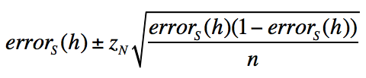
Confidence Intervals on Error
With approximately N% probability, the true error lies in the interval
where z_{N} is a constant that depends on N (e.g. for 95% confidence, z_{N} =1.96)
How did we get this?

Slide 41
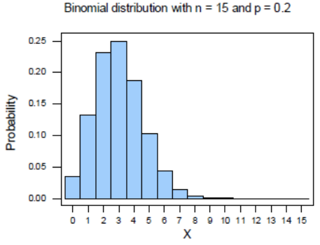
Confidence Intervals on Error
Our estimate of the error follows a binomial distribution given by n and p (the true error rate over the data distribution)
Simplest (and most common) way to determine a binomial confidence interval is to use the normal approximation

Slide 42
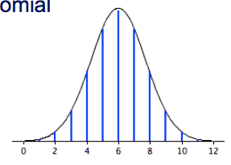
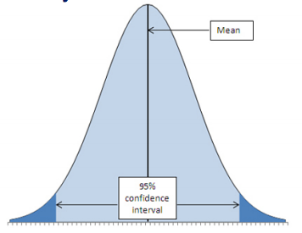
Confidence Intervals on Error
When n ≥ 30, and p is not too extreme, the normal distribution is a good approximation to the binomial
We can determine the N% confidence interval by determining what bounds contain N% of the probability mass under the normal

Slide 43
Empirical Confidence Bounds
Bootstrapping: Given n examples in data set, randomly, uniformly, independently (with replacement) draw n examples – bootstrap sample
Repeat 1000 (or 10,000) times:
Draw bootstrap sample
Repeat entire cross-validation process
Assuming 95% confidence interval
Lower (upper) bound is result such that 2.5% of runs yield lower (higher)

Slide 44
Comparing Learning Systems
How can we determine if one learning system provides better performance than another for a particular task? across a set of tasks / data sets?

Slide 45
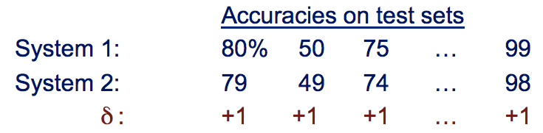
Motivating Example
Mean accuracy for System 1 is better, but the standard deviations for the two clearly overlap
Notice that System 1 is always better than System 2

Slide 46
Comparing Learning Systems
consider δ’s as observed values of a set of i.i.d. random variables
Null hypothesis: the 2 learning systems have the same accuracy
Alternative hypothesis: one of the systems is more accurate than the other
Hypothesis test:
Use paired t-test to determine probability p that mean of δ’s would arise from null hypothesis
If p is sufficiently small (typically < 0.05) then reject the null hypothesis

Slide 47

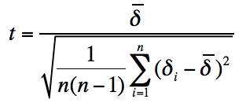
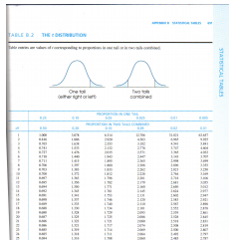
Comparing Systems using a Paired t-Test
Calculate the sample mean
Calculate the t-statistic
Determine the corresponding p-value, by looking up t in a table of values for the Student's t-distribution with n-1 degrees of freedom

Slide 48
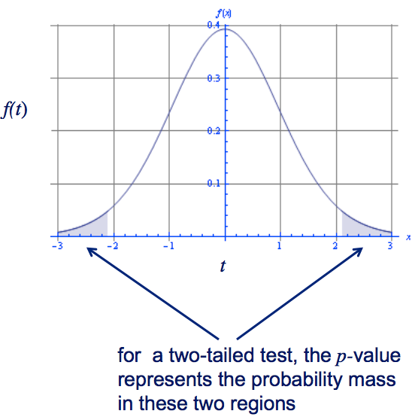
Comparing Systems using a Paired t-Test
The null distribution of our t statistic looks like this
The p-value indicates how far out in a tail our t statistic is
If the p-value is sufficiently small, we reject the null hypothesis, since it is unlikely we’d get such a t by chance

Slide 49
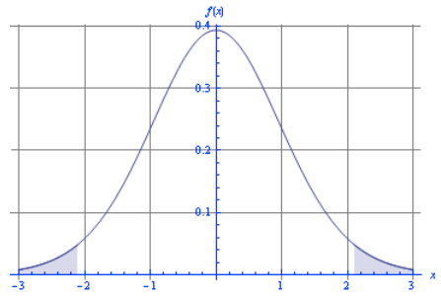
Why do we use a two-tailed test?
A two-tailed test asks the question: is the accuracy of the two systems different
A one-tailed test asks the question: is system A better than system B
A priori, we don’t know which learning system will be more accurate (if there is a difference) – we want to allow that either one might be

Slide 50
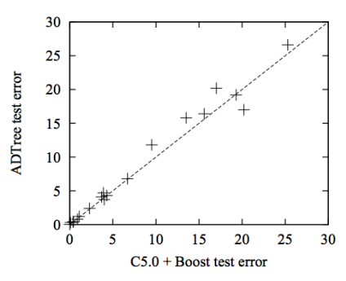
Pairwise Method Comparison
We can compare the performance of two methods A and B by plotting (A performance, B performance) across numerous data sets
Courtesy: Freund & Mason, ICML 1999

Slide 51
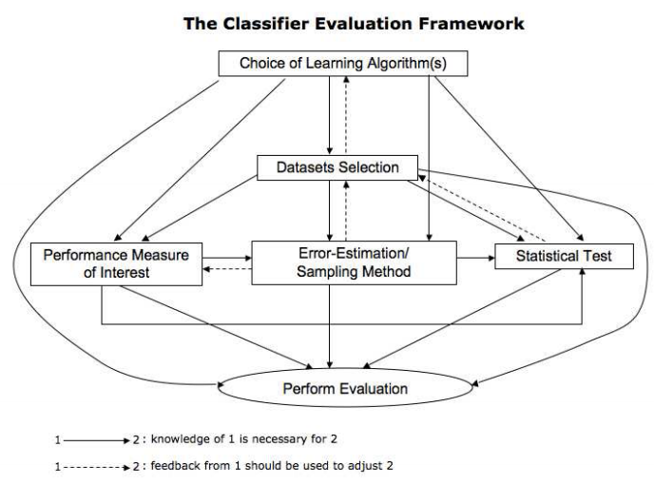
Classifier Evaluation

Slide 52
Summary
Rigorous statistical evaluation is extremely important in experimental computer science in general and machine learning in particular
How good is a learned hypothesis?
How close is the estimated performance to the true performance?
Is one hypothesis better than another?
Is one learning algorithm better than another on a particular learning task?

Slide 53
References
Key References
Chapter 4, Introduction to Data Mining by Tan, Steinbach and Kumar
http://www-users.cs.umn.edu/~kumar/dmbook/index.php
Chapter 5 (‘Evaluating Hypotheses’), Machine Learning by Tom Mitchell
http://www.cs.cmu.edu/~tom/mlbook.html
Other Recommended References
http://www.icmla-conference.org/icmla11/PE_Tutorial.pdf (Tutorial on Performance Evaluation of Classifiers)

Slide 54
Homework
Go through recommended reading materials
HW1 to be shared soon

