Slide 1

Project review
(22AIE201 FUNDAMENTALS OF AI)
Solving Tic-Tac-Toe: Autonomous Mastery through Self-Play with a Rainbow DQN Agent
TEAM -3
B Sainath Reddy (CB.SC.U4AIE24309)
K Pushpak Siva Sai (CB.SC.U4AIE24328)
P Manohar (CB.SC.U4AIE24339)
P Mrudula (CB.SC.U4AIE24340)

Slide 2
PRESENTATION OUTLINE
Introduction
Problem Statement
Objective
Methodology
Results
Conclusion
Future scope
References

Slide 3
INTRODUCTION
The Setup: Self-Play
  We create two AIs, 'X' and 'O'.
  They play against each other thousands of times.
  They only get a reward at the very end of the game:
    +1 for winning
    -1 for losing
    0 for a draw
The Challenge: Sparse Rewards
  The AI makes several moves without any feedback and only finds out if they were good or bad at the very end. It has to deduce which of the earlier moves led to the win or loss.
Markov Decision Process (MDP): We're formally solving an MDP. Tic-Tac-Toe is a finite, deterministic MDP because there's a limited number of states, and each action leads to a predictable next state. The components are:
  States (S): All possible board configurations.
  Actions (A): Placing a mark in an empty square.
  Rewards (R): The +1, -1, or 0 at the end of the game.
Code Connection: The TicTacToe class perfectly defines our MDP environment. get_state() provides the state s, available_moves() gives the action space A, and make_move() transitions us to the next state s'.

Slide 4
Dueling Deep Q-Network (DQN)
What's a DQN?
A neural network that learns a function called Q(s, a).
  s (state): The current board layout.
  a (action): The move to make.
  Q(s, a): The network's best guess of the total future reward if we make move a from board s. The AI's goal is to always pick the move with the highest Q-value.
Our Upgrade: Dueling DQN
  A standard DQN has one output. A Dueling DQN splits the brain into two parts for a smarter decision.
  1. The Value Stream (Vibe Check):
    Asks: "Overall, is this board position good for me?"
    It outputs a single number, V(s), representing the value of the current state.
  2. The Advantage Stream (Move Hype):
    Asks: "How much better is this specific move compared to the others?"
It outputs a value for each possible move, A(s, a), representing the advantage of taking that action.

Slide 5
Problem Statement
To engineer a deep reinforcement learning agent, leveraging state-of-the-art techniques, to autonomously solve the game of Tic-Tac-Toe via self-play. The agent's success is validated by its convergence to the game-theoretic optimal strategy, achieving a perfect and unbeatable 100% win rate.

Slide 6
OBJECTIVE
To design and implement a sophisticated deep reinforcement learning agent by successfully integrating a suite of state-of-the-art algorithms, including Double Dueling Q-Networks, Prioritized Experience Replay, and Noisy Networks for intelligent exploration.
To enable the agent to learn and master the complex, strategic environment of Tic-Tac-Toe entirely through a self-play mechanism, allowing it to discover optimal strategies without any human data, rules, or intervention.
To rigorously evaluate the agent's learning process and performance through a comprehensive set of metrics, demonstrating the significant advantages in learning efficiency and strategic capability over simpler, traditional reinforcement learning models.

Slide 7
METHODOLOGY
1. The Environment: Self-Play Arena
A standard 3x3 Tic-Tac-Toe game was established as the learning environment.
Two identical agents, Player X and Player O, were created to compete against each other.
The environment provides the state (the board layout) and assigns rewards at the end of each game: +1 for a win, -1 for a loss, and 0 for a draw.
2. The Agent: Advanced AI Architecture
Our DQN Agent was built with a state-of-the-art architecture, not a simple model.
Core Model: A Deep Q-Network (DQN) serves as the agent's brain, using a neural network to predict the best possible move.
Network Design(Dueling DQN): This advanced design helps the agent better understand the value of being in a certain state, separate from the advantage of a specific move.
Intelligent Exploration(Noisy Linear): Instead of basic random moves (epsilon-greedy), we used Noisy Networks. This forces the agent to explore in a smarter, more structured way, leading to faster learning.
3. The Process: The Learning Loop
Play & Store
Prioritize (Replay Memory)
Learn (optimize_model)
Repeat
4. The Goal: Performance & Evaluation

Slide 8
Results
Feature | Journal Paper (Ho et al., 2022) | Our Framework and Results
Core Algorithm | Tabular Q-Learning | Deep Q-Network (DQN) with Rainbow enhancements
Key Techniques | Epsilon-Greedy Strategy | Double DQN, Dueling DQN, Prioritized Experience Replay, Noisy Networks
Training Games | 300,000 | 25,000
Exploration Strategy | Epsilon-Greedy (simple random chance) | Noisy Networks (learnable, intelligent exploration)
Final Result | ~90% Win/Tie Rate | 100% Win Rate
Stability | Stable, but suboptimal performance. | Achieved perfect performance, though with some loss instability (a common trait in complex models on simple problems).

Slide 9
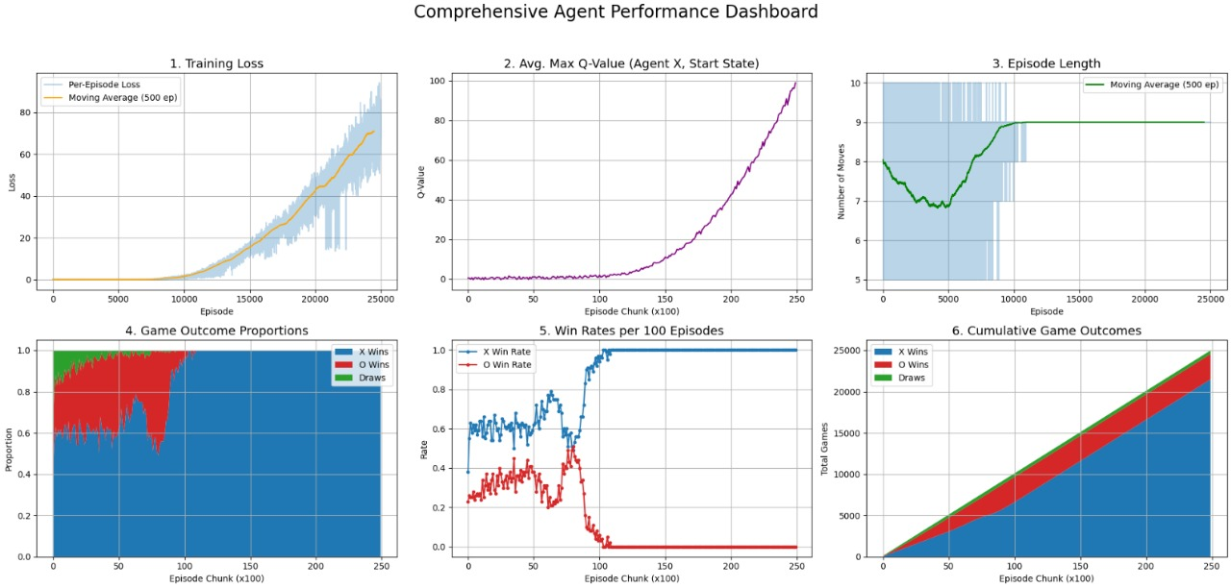
Results

Slide 10
Conclusion
The agent successfully solved Tic-Tac-Toe, achieving a perfect 100% win rate.
It achieved this mastery autonomously through self-play, without human data.
The project validated the power of our Dueling DQN architecture, enhanced with NoisyLinear layers and Prioritized Experience Replay.
This advanced DQN Agent proved far more efficient and effective than traditional methods.
The Secret Sauce: The synergy of advanced DRL techniques was key:
  Dueling DQN for more accurate state-value estimation.
  NoisyNets for efficient, state-dependent exploration.
  PER for focusing on high-impact learning experiences.
  Double DQN for mitigating overestimation bias and ensuring stable training.

Slide 11
Future Scope
Apply this advanced agent to solve more complex games like Connect Four.
Perform an ablation study to measure the exact impact of each algorithm we used.
Adapt the agent to solve real-world optimization problems like route planning.

Slide 12
REFERENCES
Sutton, R. S., & Barto, A. G. (2018). Reinforcement learning: An introduction. The MIT Press.
Mnih, V., Kavukcuoglu, K., Silver, D., Rusu, A. A., Veness, J., Bellemare, M. G., ... & Hassabis, D. (2015). Human-level control through deep reinforcement learning. Nature, 518(7540), 529-533.
Van Hasselt, H., Guez, A., & Silver, D. (2016, March). Deep reinforcement learning with double q-learning. In Proceedings of the AAAI conference on artificial intelligence (Vol. 30, No. 1).
Wang, Z., Schaul, T., Hessel, M., Van Hasselt, H., Lanctot, M., & De Freitas, N. (2016, June). Dueling network architectures for deep reinforcement learning. In International conference on machine learning (pp. 1995-2003). PMLR.
Hessel, M., Modayil, J., Van Hasselt, H., Schaul, T., Ostrovski, G., Dabney, W., ... & Silver, D. (2018). Rainbow: Combining improvements in deep reinforcement learning. In Proceedings of the AAAI conference on artificial intelligence (Vol. 32, No. 1).

