Slide 1
Job Application Tracker
✦ PROJECT OVERVIEW
Architecture: Production-ready MERN Stack (MongoDB, Express, React, Node.js)
Core Scope: Automated 4-stage pipeline (Applied, Interview, Offer, Rejected)
AI Integration: Live Google Gemini 3.5 Flash LLM for customized preparation
Smart Sync: Unified calendar syncing interviews and skill learning schedules
Security: JWT token authentication, bcrypt password hashing & data isolation
Project Type: Course Project for Full Stack Frameworks
✦ PROJECT CREDENTIALS
Candidate Name: Manohar Ravva
Roll No: CB.SC.U4CSE24040
Degree / Branch: B.Tech - CSE
Project Role: Full-Stack Web Development
Department: Dept. of Computer Science & Engineering

Slide 2
01 / THE CHALLENGE & THE VISION
Problem Statement & Project Objective
❌ BEFORE : THE FRAGMENTED HUNT
• Disorganized Manual Records: Candidates juggle job listings across emails, WhatsApp, and spreadsheets with zero centralized workflow.
• Missed Interviews & Deadlines: Without unified alerts, critical coding assessments, technical interviews, and follow-ups get missed.
• Untracked Skill Gaps: Rejections happen without actionable feedback or structured tracking of what technical skills are missing.
• Generic Interview Prep: Candidates study generic topics instead of tailored, role-specific roadmaps for target companies.
✅ AFTER : UNIFIED INTELLIGENT PLATFORM
✓ Automated Pipeline Stages: Single dashboard managing Applied, Interview, Offer, and Rejected workflows with live metric counters.
✓ Synchronized Timeline Calendar: Visual interactive calendar plotting scheduled interview dates alongside skill learning milestones.
✓ Targeted Skills Roadmap: Dual-category section for 'Skills Learnt' and 'To-Learn' with start dates syncing to calendar.
✓ Google Gemini AI Career Coach: Generates custom day-by-day study schedules and tailored technical mock questions for any role & firm.

Slide 3
02 / SYSTEM DESIGN & STACK
Full-Stack Technology & System Architecture
FRONTEND LAYER
React 19 & Vite
• React Component Architecture
• Vite Blazing Fast HMR Tooling
• Axios JWT Bearer Interceptors
• Context API (Auth & Themes)
• Lucide Modern Vector Icons
• Responsive Dark/Light System
BACKEND REST API
Node.js & Express
• Express Modular Route Handlers
• JWT Token Issuance (30d TTL)
• Bcrypt 10-Salt Password Hashing
• Mongoose 9 Modern Async Hooks
• Aggregation Pipeline for Stats
• Proxy & CORS Enabled Gateway
DATABASE LAYER
MongoDB Atlas (NoSQL Cloud)
• Document Data Storage (BSON/JSON)
• Users Collection (Isolated Auth)
• Applications Collection (CRUD)
• Skills Collection (Roadmap & Dates)
• Automatic Dynamic Lazy Indexing
• MongoDB Compass Visual Inspector
AI INTELLIGENCE
Google Gemini LLM
• Gemini 3.5 Flash Generative API
• Structured JSON Output Mode
• Multi-model Resilient Retry Engine
• Role & Firm Curriculum Mapping
• Offline Expert Engine Fallback
• 1-Click Skill Sync to Calendar

Slide 4
03 / CAPABILITIES & IMPACT
Core Features & Implemented Outcomes
📊 Application Tracking Pipeline
• 4 Lifecycle Stages: Applied, Interviewing, Offer, and Rejected.
• Live Aggregation Cards calculating totals and stage breakdowns in real-time.
• Search & Filter: Rapid fuzzy search by company/role and stage filtering.
• Quick Status Workflow: 1-click status update without reloading.
📅 Unified Activity Calendar
• Visual monthly grid synchronizing scheduled job interviews.
• Automatic plotting of To-Learn skills by their chosen start date.
• Day Inspector: Click any cell to view scheduled tasks, notes, and details.
• Navigation controls with instant 'Today' focus and stage filters.
🎓 Skills Mastery & Learning Roadmap
• Dedicated 'Skills Learnt' section with proficiency levels (Beginner, Intermediate, Advanced).
• Actionable 'To-Learn' list with mandatory Start Dates synced to calendar.
• 1-Click Mastery Toggle (✓) to promote skills once acquired.
• Category tags: Frontend, Backend, Database, DevOps, Embedded, Core CS.
🤖 Google Gemini AI Prep Copilot & Theming
• Custom Day-by-Day Preparation Plans tailored to specific roles & companies.
• Curated mock interview questions with STAR method evaluation tips.
• Direct 'Add to Skills' button pushing AI recommendations to your roadmap.
• Cinematic Midnight Dark / Crisp Modern Light Theme toggle with persistent storage.

Slide 5
04 / CONCLUSION & REPOSITORY
Project Summary & Presenter Details
✦ MY DETAILS
Name: Manohar Ravva
Department: Computer Science & Engineering
Degree: Bachelor of Technology (B.Tech)
Project Title: Job Application Tracker with AI Copilot
Specialization: Full-Stack Web Development & Cloud Systems
"Empowering job seekers to organize less and achieve more."
✦ DELIVERABLES & REPOSITORY
GitHub Repository: github.com/ManoharRavva0306/job-application-tracker
REST API Endpoints: /api/auth, /api/applications, /api/skills, /api/ai
NoSQL Database: MongoDB Atlas (Cloud Cluster) with Compass visual management
AI Provider: Google Gemini 3.5 Flash via Generative API
Live Deployment: Vercel (Frontend) + Render (API) + MongoDB Atlas

Slide 6
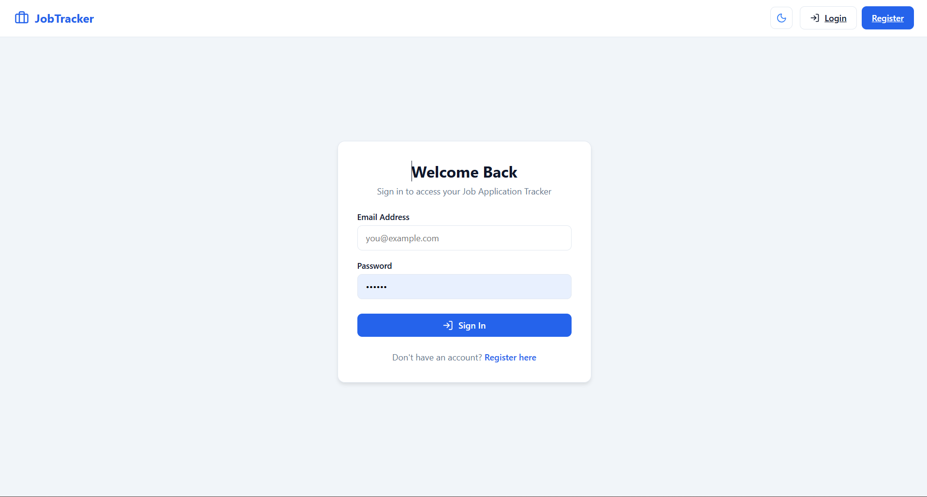
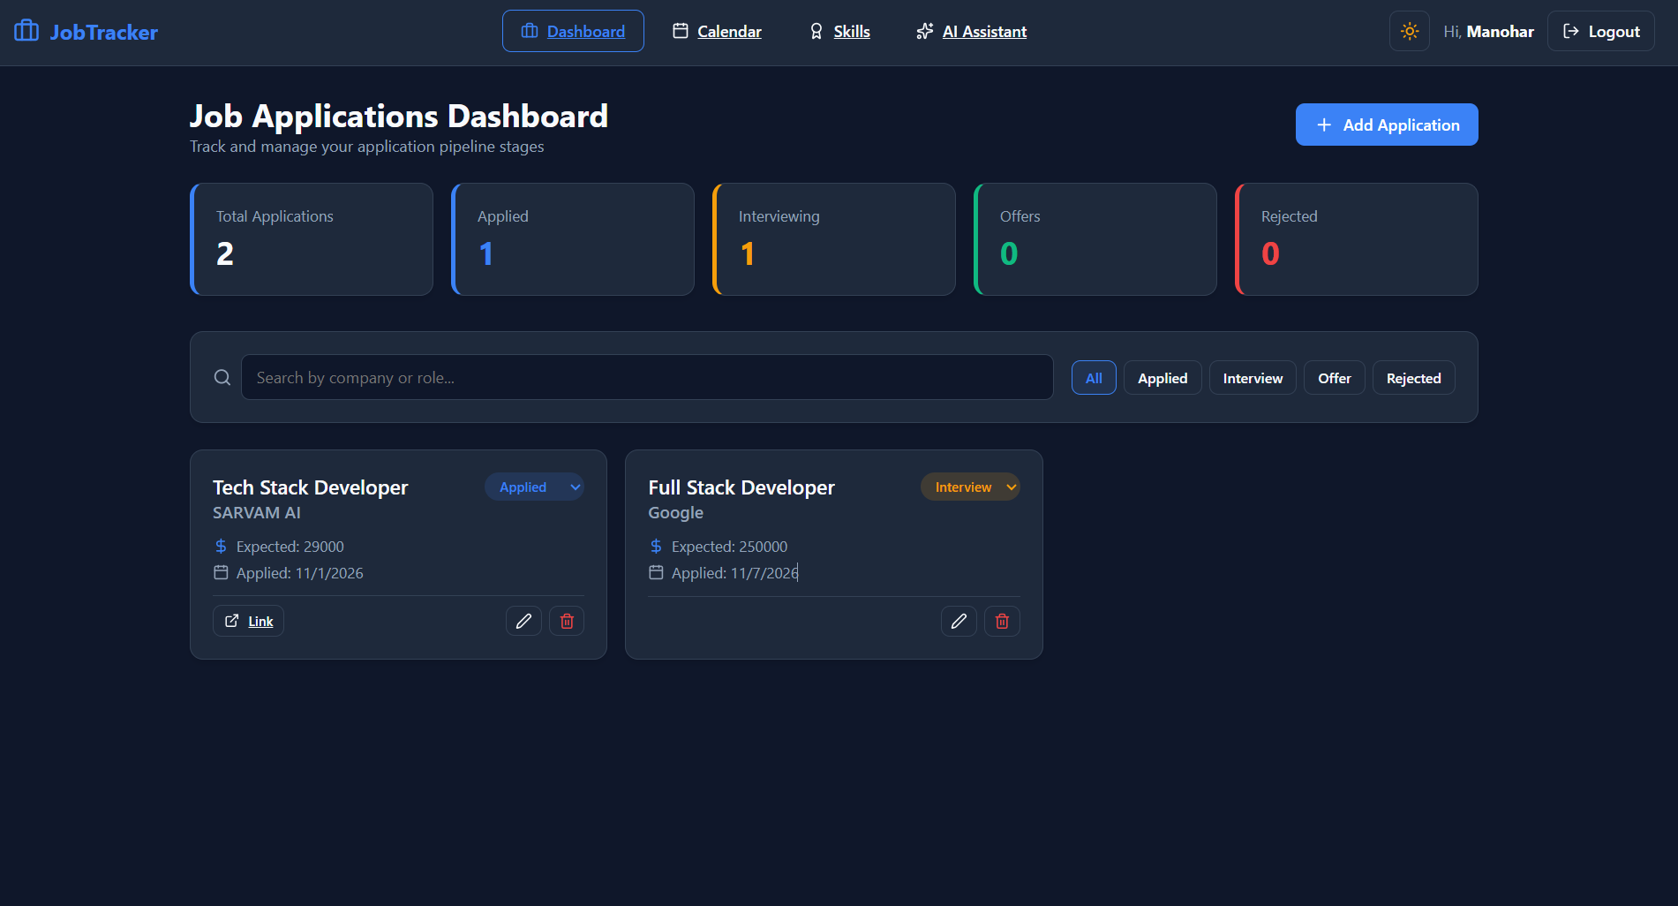
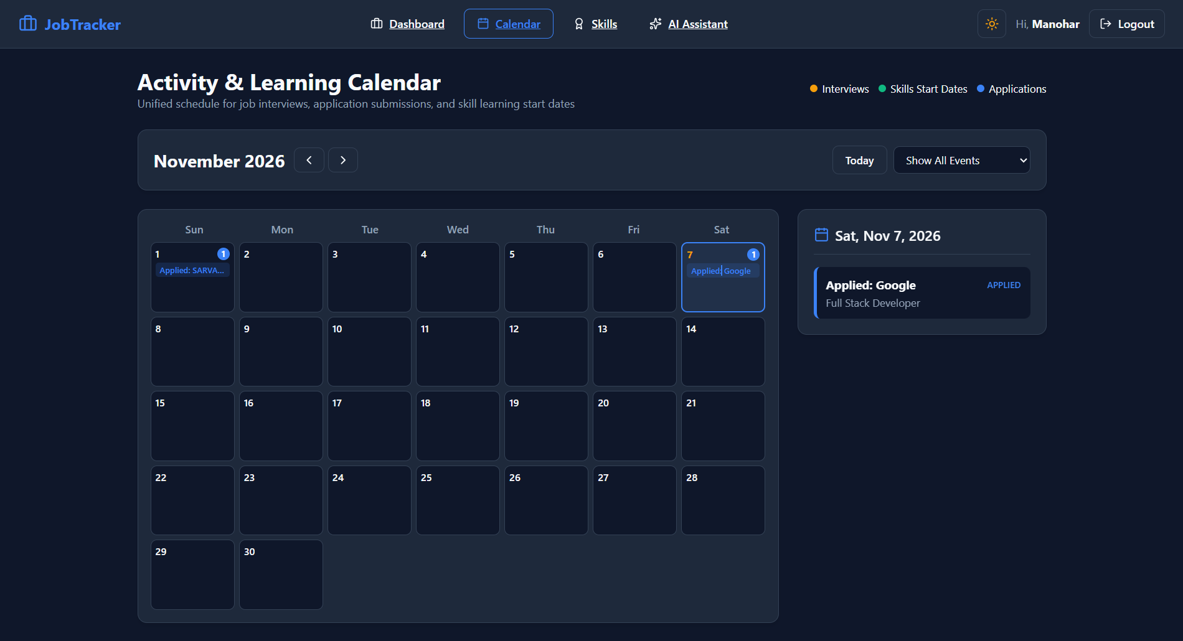
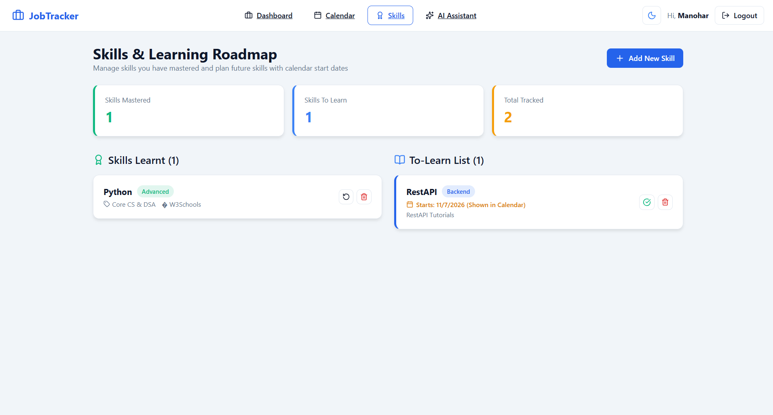

Slide 7
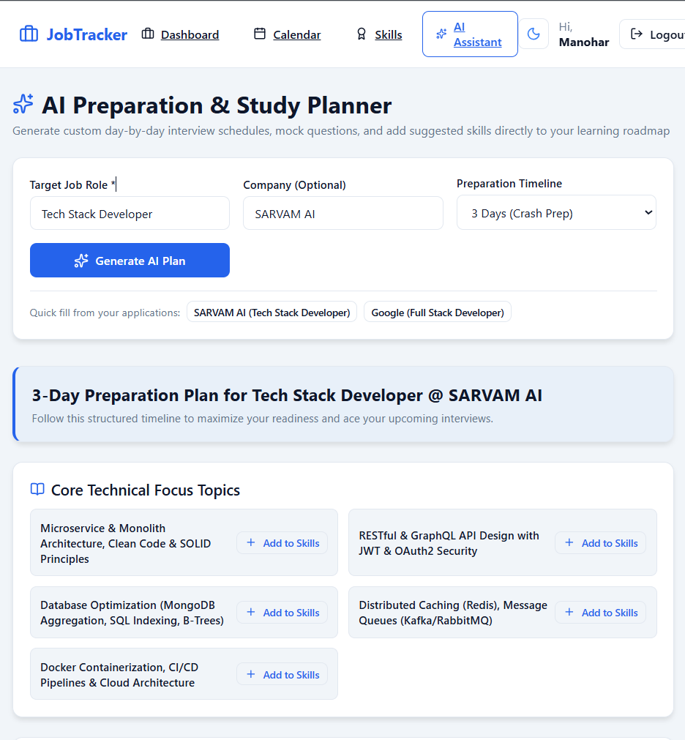
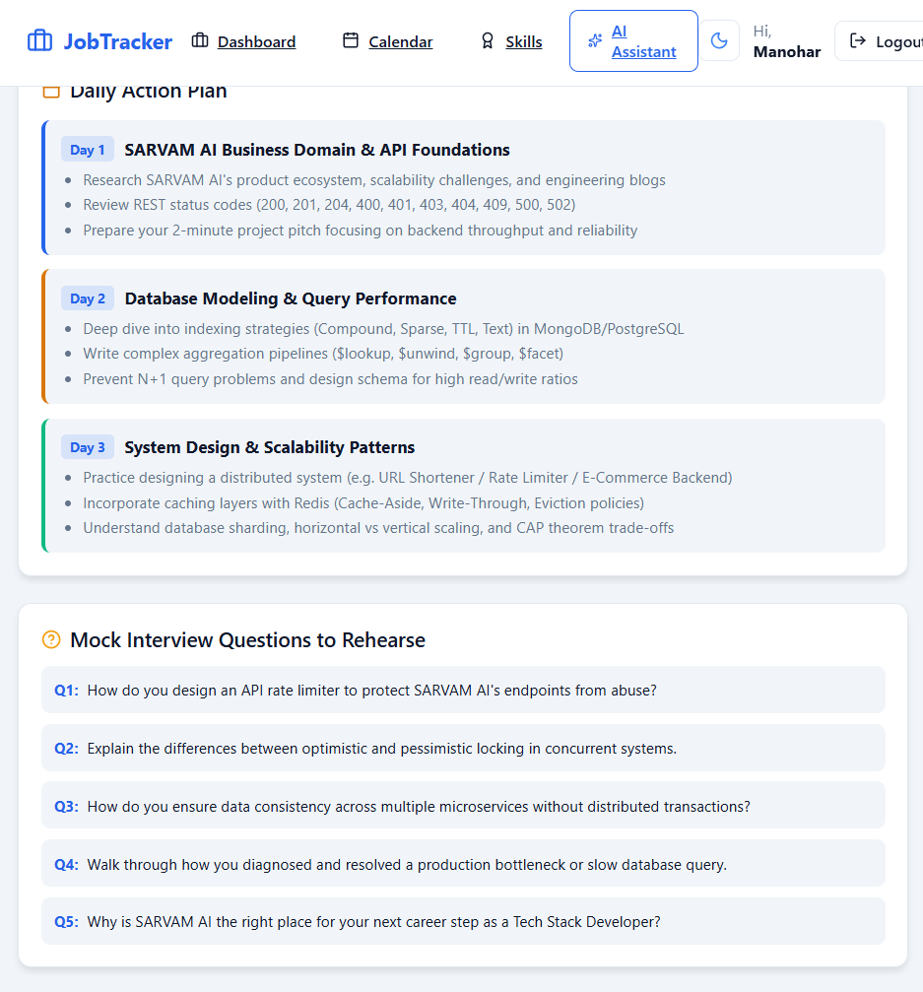

Slide 8
THANK YOU

