Slide 1



Theatre Ticket Booking App REVIEW -3
BY:
MADHAV S – 23CDR083
MONOHARAN R - 23CDR088
NIRMAL P - 23CDR111

Slide 2
Problem Description
Theatre tickets can be book quickly by using our app we also giving loyality points to the customer.
We also offering snacks while booking the tickets.
The ticket can be seld by online easily and fastly.
We also giving efficient user interface for our app

Slide 3
Types of Modules
User Registration & Authentication Module
Movies & Actors Search Module
Tickets & Snacks Booking Module
Movies Records & History Module
Notification & Reminder Module
User Interface Module
3

Slide 4
User Registration & Authentication Module
Handles secure registration and login for users.
Ensures role-based access and personalized dashboard.
Protects user data using encryption and authentication methods.
Enables account management features like password reset and profile update.
4

Slide 5
Movie & Actor search Module
Allows users to view their movie details.
Monitors seat allocation and seat availability.
Generates notification after booking tickets.
Helps users to see about movie details and actor details.
5

Slide 6
Ticket and Snacks Booking Module
Users can see the snacks availabitity in easy way.
Tickets can be easily booked.
Help users to track their snacks.
User can easily cancel their ticket.

Slide 7
Movie Records and History Module
Stores the detail information about movie.
Displays the number of seat booked.
Acts as a centralized repository for quick reference.
Assists users to see their past action on the website.

Slide 8
Notification and Reminder Module
Provides advance notification after booking seats.
Gives the reminder before the theatre timing.
Includes signup and login notification.
Encourages privacy among the users.

Slide 9
User Interface Module
Provides the best ui design for the website
Gives the better experience across other app
Also better user module for the app

Slide 10
Feasibility
Technical Feasibility
Built using MERN stack(XAMPP DB,Python,React,Node)
Scalable and responsive design
Integration with API for notification and data handling
Operational Feasibility
Easy to use for movies lovers
Reduces manual work and appointment wait times
Enhance users satisfaction and increase theatre efficency
Economic Feasibility
Cost-effective development and deployment
Low maintenance with high scalability

Slide 11
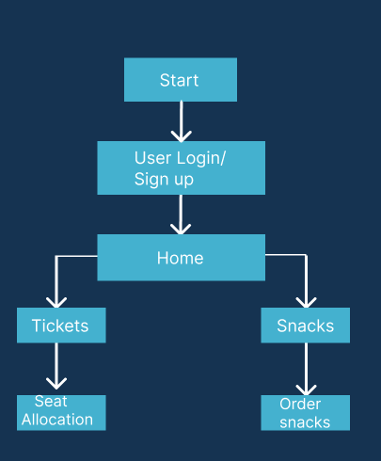
Implementation

Slide 12
Frontend :
Html for component-based architecture, fast rendering, and powerful routing.
Bootstrap for responsive UI design and consistent layout.
Features:
Clean and modular code structure with reusable components.
Role-specific dashboards for tickets and snacks.
Reactive Forms for user input and validation.
Html Routing for seamless navigation.
Bootstrap modals, alerts, and toasts for user interaction and notifications.

Slide 13
Backend :
Restful API endpoints for handling:
User authentication and roles.
Appointment booking and snacks reservation.
Notification triggers and report access.
Database :
MYSQL document-based storage.
Stores: Users profiles.
Booking history and plans.
Availability and snacks reservation data.

Slide 14
Security:
JWT for stateless user authentication.
HTTPS protocol for encrypted data transfer.
Input validation and sanitization using Angular Forms and Express middleware.
Notification System:
Scheduled reminders through:
Email (SendGrid API).
SMS (Twilio API).
Real-time alerts on the dashboard using Angular services.

Slide 15
Advantage
Reduces wait times and backend workload.
Easy access to movie details and cast from any device.
Real-time information about movie and set availability.
Disadvantage
Development and deployment of the app might require investment.
Movies tickets can we easily selled.

Slide 16
Thank you!

