Slide 1


Comparative Analysis of an Ensemble of Multi-View Deep Learning Models for Future Price Prediction of Pre-Owned Cars
Student Name: Bethu Manohar
Regd. NO: 12100789, ROLL No: RK21UTA01
Course Code : CSE461
Current mobile: +91 7222823999
Email: bethu.12100789@lpu.in
Submitted To: Mr. Himanshu
Dept: CSE Data Science Upgrad
University: Lovely Professional University Jalandhar Punjab India

Slide 2
Content of Presentation
Introduction
Aim
Literature Review
Research Gap
Objective
Project timeline
Research Methodology
Implementation
Results
Limitations
Conclusion

Slide 3
Introduction
The demand for personal vehicles is rising, but new cars are becoming unaffordable for many people. This has led to growth in the used car market, especially in countries like India. However, the used car market is largely unorganized, leading to inconsistent pricing and potential fraud.
Traditional methods for estimating used car prices are often inaccurate and subjective. Accurate and fair price prediction is essential for buyers, sellers, and intermediaries.
Machine learning and deep learning techniques offer the ability to model complex, non-linear relationships in data.
This project aims to build a robust, data-driven system for predicting used car prices using a hybrid of machine learning and deep learning techniques.
Deploying this system as a web application ensures accessibility, allowing users to get real-time price predictions based on car features.

Slide 4
AIM
The primary aim of the project is to develop a hybrid system that accurately predicts the resale prices of pre-owned cars, enabling fair transactions in the used vehicle market. The system combines machine learning and deep learning techniques and is accessible through a web application. The project focuses on the following key functionalities:
  Feature Extraction using Deep Learning: To capture complex patterns in the data using CNN, RNN, and LSTM architectures.
  Hybrid Prediction using Random Forest: To improve accuracy by combining extracted deep features with tree-based regression.
  Real-time Web Application: To allow users to input vehicle attributes (e.g., brand, year, engine, mileage) and receive instant price predictions via a user-friendly Flask interface.
With these, the system provides a reliable and scalable solution for buyers, sellers, and dealerships to make data-driven decisions in the used car market.

Slide 5
Literature Survey
Used Car Price Prediction Using Machine Learning (Kumar et al., 2020)
This study applied algorithms like Linear Regression and Random Forest to predict car prices based on historical data. The research demonstrated how feature selection and model tuning significantly improve performance in regression tasks.
Deep Learning for Vehicle Price Estimation (Sharma & Mehta, 2021)
This work explored Convolutional Neural Networks (CNNs) and Recurrent Neural Networks (RNNs) for understanding complex patterns in used car datasets. It found that CNNs effectively handle structured tabular data when reshaped, improving predictive accuracy.
Hybrid Deep Learning and Ensemble Models (Chen et al., 2022)
The authors proposed combining feature extraction from deep learning models with Random Forest for final prediction. This hybrid architecture yielded higher R² scores and robustness against overfitting, emphasizing its effectiveness in real-world scenarios.

Slide 6
Research Gap
Identifying the research gap helps justify the need for this project and highlights how it contributes beyond existing solutions. Key gaps identified include:
Lack of Hybrid Models in Price Prediction:
Most existing used car price prediction systems rely solely on either machine learning or deep learning. Very few leverage the strengths of both in a hybrid format to enhance prediction accuracy and generalization.
Limited Use of Sequential Modeling Techniques:
Time-related features such as vehicle age or historical trends are often overlooked. There's minimal use of models like LSTM or RNN, which are better suited for capturing sequential patterns.
Absence of Real-time, User-Interactive Platforms:
Many studies provide offline prediction results and lack real-time user interaction. There is a gap in integrating trained models into accessible, intuitive web applications for public use.

Slide 7
Objective
Develop a Hybrid Prediction Model
To design and implement a hybrid model that combines deep learning (CNN, RNN, LSTM) for feature extraction and Random Forest for final car price prediction.
Ensure High Accuracy and Generalization
To achieve strong predictive performance across different types of vehicles using R² score, MAE, and RMSE as evaluation metrics.
Implement Advanced Feature Engineering
To enhance model input by engineering features like vehicle age, log-transformed kilometers driven, and encoded categorical attributes.
Deploy a User-Friendly Web Application
To create a real-time, accessible Flask-based web interface that allows users to input car details and receive instant price predictions.

Slide 8
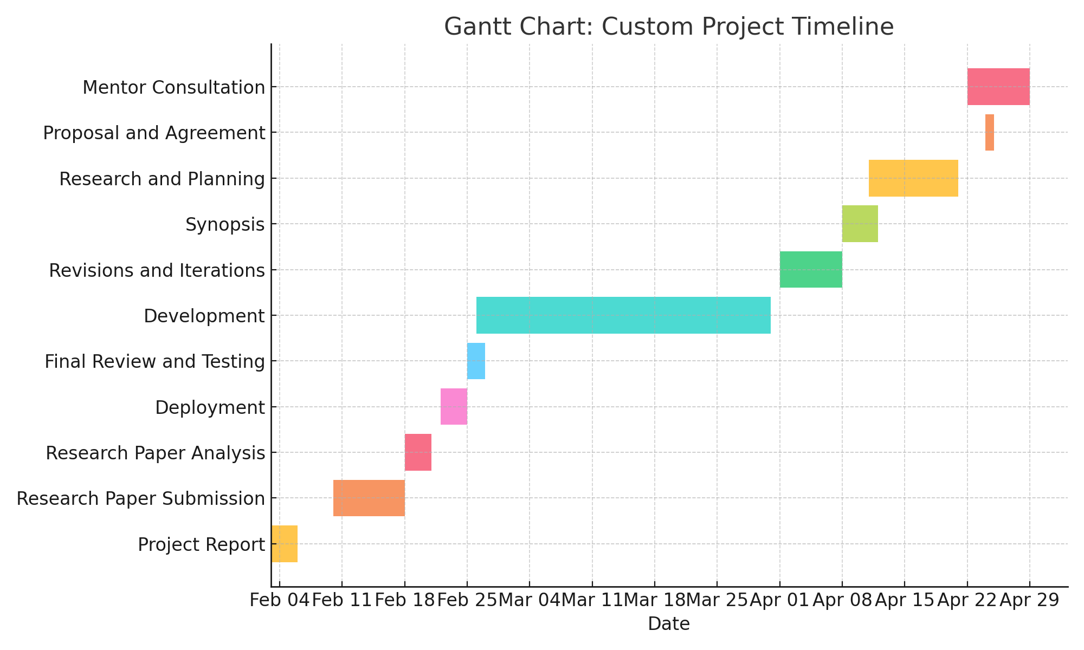
Project timeline

Slide 9
Research Methodology
Data Collection and Preprocessing:
Webscraped car listings from the CarDekho website. Cleaned and preprocessed the data by handling missing values, encoding categorical variables, scaling numerical features, and engineering new features like car age and log-kilometers.
Model Development:
Designed deep learning models (CNN, RNN, LSTM) to extract complex features from the processed dataset. Combined these with Random Forest regressors to form hybrid models, optimizing for accuracy and generalization.
System Integration and Application Development:
Integrated trained models into a Flask-based web application. Created an interactive frontend that collects user input and delivers predictions using the backend inference engine.
Testing and Evaluation:
Evaluated models using performance metrics such as R² Score, Mean Absolute Error (MAE), and Root Mean Squared Error (RMSE) on the test dataset to ensure robustness and accuracy.

Slide 10
Implementation steps
Data Collection: Scraped used car listings from CarDekho.
Preprocessing: Cleaned data, extracted features like engine capacity, car age, log-kilometers
Modeling: Trained deep learning (LSTM, CNN, RNN) and hybrid (LSTM+RF, CNN+RF, RNN+RF) models; used ensemble for better accuracy
Backend: Flask API for model serving and prediction logic
Frontend: HTML + Bootstrap form for user input and displaying predicted prices

Slide 11
Results
Accurate Predictions: The system delivers reliable used car price estimates using deep learning and hybrid models, with performance validated across diverse car brands and models.
Smooth Integration: All models are integrated into a Flask-based web app with a clean interface, allowing users to input car details and get instant predictions.
Fast & Scalable: Models load efficiently, predictions are generated in real-time, and the app performs consistently across devices and browsers.

Slide 12
Limitations
Limited Deployment: The system currently runs locally and is not yet deployed to a public cloud or hosting service.
Static Dataset: The models are trained on web-scraped data and may not adapt well to newly released car models or changing market trends.
Model Generalization: Predictions may be less accurate for rare brands or car configurations not well represented in the training data.
No User Feedback Loop: The system doesn’t currently learn from user corrections or feedback for continuous improvement.

Slide 13
Future Scope
Cloud Deployment: Host the app on platforms like AWS or Heroku to make it publicly accessible.
Live Market Integration: Connect with APIs for real-time car listings and market prices to improve prediction accuracy.
User Feedback Loop: Implement feedback-based model refinement to continuously improve predictions.
Mobile App Version: Develop a mobile-friendly version for broader accessibility and convenience.
Advanced Visual Analytics: Add dashboards for trends, price comparisons, and model insights.

Slide 14
Conclusion
All-in-One Tool: The app provides users with a smart platform to estimate used car prices based on real data and AI models.
Smart Assistance: Uses deep learning and hybrid models to deliver accurate and consistent predictions.
User-Friendly: Designed for ease of use, making it accessible to both tech-savvy and non-technical users.
Scalable: Built with flexibility to integrate more features like real-time data and cloud hosting.
Saves Time & Money: Helps users make better pricing decisions quickly, reducing guesswork and research time.

Slide 15
THANK YOU

