Slide 1
PSCS190-Real time Mapping of Epidemic Spread
PIP104 University Project-II
Review-4
Batch Number:ISE 11
Under the Supervision of,
Dr. Selvaraj Poornima
School of Computer Science & Engineering
Presidency University
Manohar C - 20211ISE0027
Nydile M C - 20211ISE0001
Sanath Kumar P S - 20211ISE0046
Adithya N S - 20201ISE0030
Name of the Program: B.TECH. INFORMATION SCIENCE &ENGINEERING
Name of the HoD:Dr. Pallavi R
Name of the Program Project Coordinator:Srinivas Mishra
Name of the School Project Coordinators: Dr. Sampath A K, Dr. Abdul Khadar A and Mr. Md Zia Ur Rahman

Slide 2
Introduction
The Real-Time Epidemic Mapping Platform (RTEMP) addresses critical gaps in traditional epidemic management systems, which rely on manual reporting, centralized data collection, and retrospective analysis. These methods often result in delayed recognition and response to outbreaks, leading to rapid disease transmission and higher morbidity and mortality rates. RTEMP leverages geolocation data for real-time mapping of disease transmission, providing detailed insights into hotspots and high-risk areas at a granular level. Powered by machine learning algorithms, it predicts outbreaks by analyzing diverse datasets, including historical patterns, population mobility, and environmental factors. This proactive approach enables targeted interventions such as localized lockdowns, vaccination drives, and testing efforts. By optimizing resource allocation and reducing healthcare system strain, RTEMP redefines epidemic control and sets a new standard for safeguarding global health against future pandemics.

Slide 3
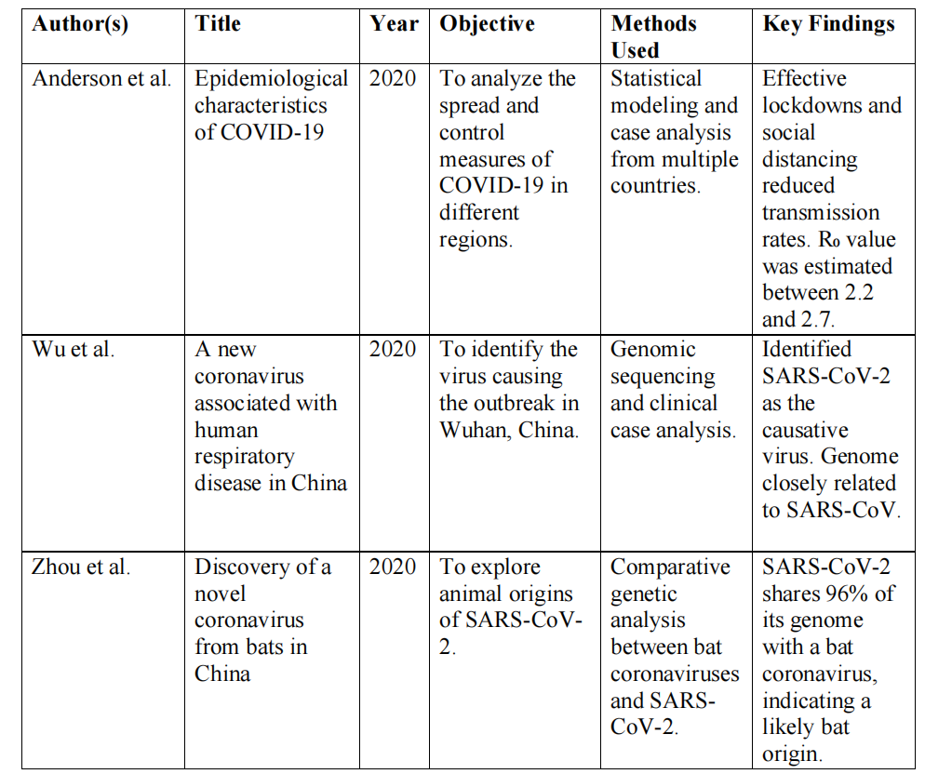
Research Review

Slide 4
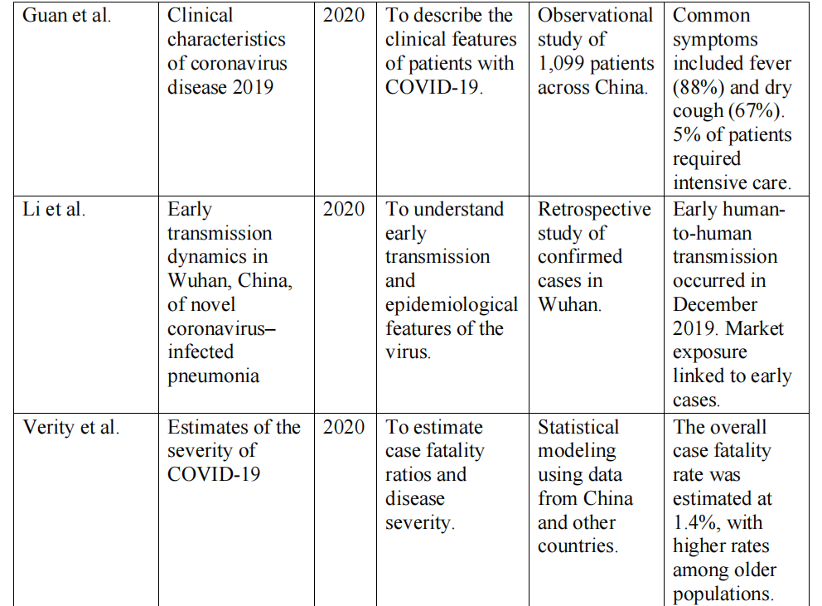
Continued..

Slide 5
RESEARCH GAPS
Sl. No. | Paper Title | Authors (Year) | Limitations (Research Gaps)
1 | Real-Time Disease Tracking Systems | Johnson et al. (2020) | Traditional tracking systems lack real-time geospatial insights, leading to delayed responses and ineffective resource allocation during outbreaks.
2 | Predictive Models for Epidemic Spread | Wang et al. (2019) | Machine learning models often rely on incomplete or outdated datasets, reducing the accuracy of outbreak predictions and limiting proactive measures.
3 | Challenges in Geospatial Disease Surveillance | Patel and Singh (2018) | Existing geospatial tools are unable to provide granular, community-level insights, which are crucial for targeted interventions in densely populated areas.
4 | Centralized Epidemic Reporting Platforms | Ahmed et al. (2020) | Centralized data collection delays the dissemination of critical information to local stakeholders, hindering timely responses at the community level.
5 | Integration of Mobile Data in Epidemic Monitoring | Chen et al. (2019) | Limited integration of real-time mobile and IoT data into surveillance systems restricts the ability to track population movement and disease spread effectively.

Slide 6
Sl. No. | Paper Title | Authors (Year) | Limitations (Research Gaps)
6 | Visualization Techniques in Public Health Monitoring | Lopez and Carter (2020) | Epidemic visualization tools lack interactivity and often present static data, which reduces their effectiveness in aiding decision making in dynamic outbreak scenarios.
7 | Social Media as a Tool for Epidemic Awareness | Smith and Zhao (2018) | Data from social media platforms can be unreliable and prone to misinformation, making it difficult to incorporate into real-time epidemic mapping systems.
8 | Addressing Data Privacy in Epidemic Monitoring | Kumar and Banerjee (2021) | Ensuring data privacy while collecting real-time location-based information is a significant challenge, often leading to limited public trust and participation.
9 | Resource Allocation During Health Crises | Torres et al. (2019) | Lack of predictive tools for hotspot identification hampers efficient allocation of medical resources, resulting in suboptimal responses during epidemics.
10 | Automation in Epidemic Control System | Liu et al. (2020) | Automated systems for epidemic control face challenges in adapting to rapidly evolving pathogens, leading to reduced efficacy in real-time outbreak management.

Slide 7
Proposed Methodology
➢ Predictive Power: Machine learning algorithms play a crucial role in enhancing the
predictability of epidemic scenarios, analyzing diverse datasets to forecast potential
outbreaks with impressive accuracy.
➢ Proactive Decision-Making: By predicting surges in cases, the platform empowers
decision-makers to prepare effectively, ensuring that healthcare systems can handle
increased demand without becoming overwhelmed.
➢ Dynamic Adaptation: The technology is not static; it adapts to changing outbreak
dynamics, continuously refining its models for the most relevant and accurate insights.
➢ Integrated Healthcare Platform: The methodology promotes a comprehensive
healthcare platform that combines mathematical modeling and machine learning with
practical healthcare functionalities to improve epidemic management.
➢ Efficient Appointment Management: Doctors can manage their appointments more
effectively, with the ability to accept or decline based on real-time epidemic data,
enhancing their workflow and responsiveness.

Slide 8
Continued..
➢ Actionable Insights for Patients and Doctors: By providing actionable data, the
platform enables both healthcare professionals and patients to make informed
decisions, fostering better health outcomes.
➢ Seamless Data Management: The method ensures that epidemic data is collected,
visualized, and managed smoothly, bridging gaps in epidemic control through timely
and accurate information.
➢ Technological Integration: The combination of technological advancements with
healthcare practices paves the way for improved epidemic tracking and response
strategies.
➢ Real-Time Tracking: Innovations in epidemic mapping, such as geospatial
visualization, enhance real-time tracking of outbreaks, making it easier to monitor and
respond to health crises.
➢ Challenges Ahead: Despite the benefits, effective data integration remains a
significant challenge, highlighting the need for ongoing development and
collaboration in technology and healthcare.

Slide 9
Objectives
The objective is to create an integrated healthcare platform that optimizes pandemic response. Incorporating mathematical modeling and machine learning, the system empowers doctors to efficiently manage appointments and input epidemic-related data. Patients can easily register, book appointments, track statuses, and update their recovery status. The dashboard offers a comprehensive view of epidemic details with day and month-wise filtering, accompanied by downloadable patient information and graphical representations for informed decision-making. This platform aims to streamline healthcare management, fostering a proactive, data-driven approach to epidemic control and patient care.

Slide 10
SYSTEM DESIGN & IMPLEMENTATION
1. Frontend:
Built with HTML, CSS, Bootstrap, and JavaScript.
Templates stored in the templates directory.
2. Backend:
Developed using Flask (app.py).
Routes defined for API calls and web page rendering.
3. Data Processing:
CSV datasets processed using Pandas.
DataGen.py for generating additional data or preprocessing existing datasets.
4. Machine Learning:
Pre-trained model (epidemic_model.pkl) loaded using Scikit-learn and Pickle.
Location-based predictions through lan&lon.py.
5. Static Files:
Stored in the static folder (e.g., CSS, images, JavaScript).

Slide 11
Continued…
Detailed Design
1. Data Flow:
User inputs are processed by Flask routes.
Relevant data is fetched and processed using Pandas.
Responses include predictions, visualizations, or raw data.
2. API Routes:
GET /: Homepage displaying summary data.
POST /predict: Handles prediction requests.
GET /visualize: Serves data visualizations.
3. Error Handling:
Custom error pages for 404 and 500 errors.
Logging critical errors for debugging.
4. Security:
Input validation.
Secure handling of file uploads and sensitive data.

Slide 12
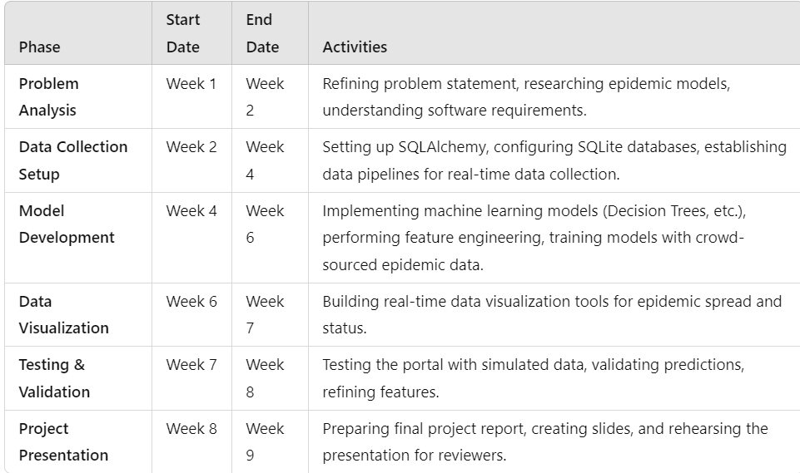
Timeline of Project

Slide 13
Outcomes
Real-Time Epidemic Tracking
Predictive Outbreak Management
Efficient Appointment Management
Comprehensive Patient Tracking
Enhanced Decision-Making
Resource Optimization
Targeted Interventions
Data Integration and Visualization
Improved Healthcare System Responsiveness
Scalability and Security

Slide 14
Conclusion
In conclusion, the proposed integrated healthcare platform emerges as a transformative solution to the existing challenges in epidemic management. By blending mathematical modeling, machine learning, and practical healthcare functionalities, the system addresses crucial gaps, offering efficient appointment management for doctors and active patient engagement. Despite potential drawbacks such as technological barriers and data security concerns, the platform's overarching goal is to optimize pandemic response, foster a resilient healthcare system, and enhance overall epidemic control and patient care. With its data-driven approach, this platform signifies a significant leap towards a proactive and adaptive healthcare landscape.

Slide 15
References
[1] Flu Near You: Crowdsourced Symptom Reporting Spanning 2 Influenza Seasons.
[2] Real-Time Epidemic Forecasting for Pandemic Influenza.
[3] Crowdsourcing Public Health Data for Efficient Monitoring of Seasonal Influenza: A
Case Study of Flu Detector in Italy.
[4] A Platform for Crowd-Sourced Surveillance of Infectious Diseases in Resource_x0002_Constrained Settings.
[5] Integrating Digital and Genetic Data to Improve Real-Time Epidemic Prediction.
[6] Harnessing Mobile Phones for Population-Level Epidemiological Surveillance: Systems,
Ethics, and Data Sharing Challenges.
[7] Using Crowdsourced Data for Real-Time Estimation of Influenza Epidemics: A Finnish
Case Study.
[8] Big Data for Infectious Disease Surveillance and Modeling.
[9] G. Arfken, H.J. Weber, Mathematical Methods for Physicists, 4th edn, Academic Press,
San Diego, CA.
[10] J. Besag, Spatial interaction and the statistical analysis of lattice systems, Journal of the
Royal Statistical Society 36.

Slide 16
Continued…
[11] J. Besag, On a system of two-dimensional recurrence equations, Journal of the Royal
Statistical Society 43.
[12] J. Besag, C. Kooperberg, On conditional and intrinsic autoregressions, Biometrika 82.
[13] J. Besag, J.C. York, A. Mollie, Bayesian image restoration, with two applications in
spatial statistics (with discussion), Annals of the Institute of Statistical Mathematics 43.
[14] N.G. Best, K. Ickstadt, R.L. Wolpert, D.J. Briggs, Combining models of health and
exposure data: The SAVIAH study, in: P Elliott, JC Wakefield, NG Best, DJ Briggs (Eds.),
Spatial Epidemiology: Methods and Applications, Oxford, University Press, Oxford, New
York, 2000, pp. 393–414.

Slide 17
Publication Details
Title: Real time mapping of Epidemic Spread
Authors: Manohar C, Adithya N S, Sanath Kumar P S, Nydile M C
Published URL : https://ijirt.org/Article?manuscript=172260
Publication Date : 08-Jan-2025

Slide 18
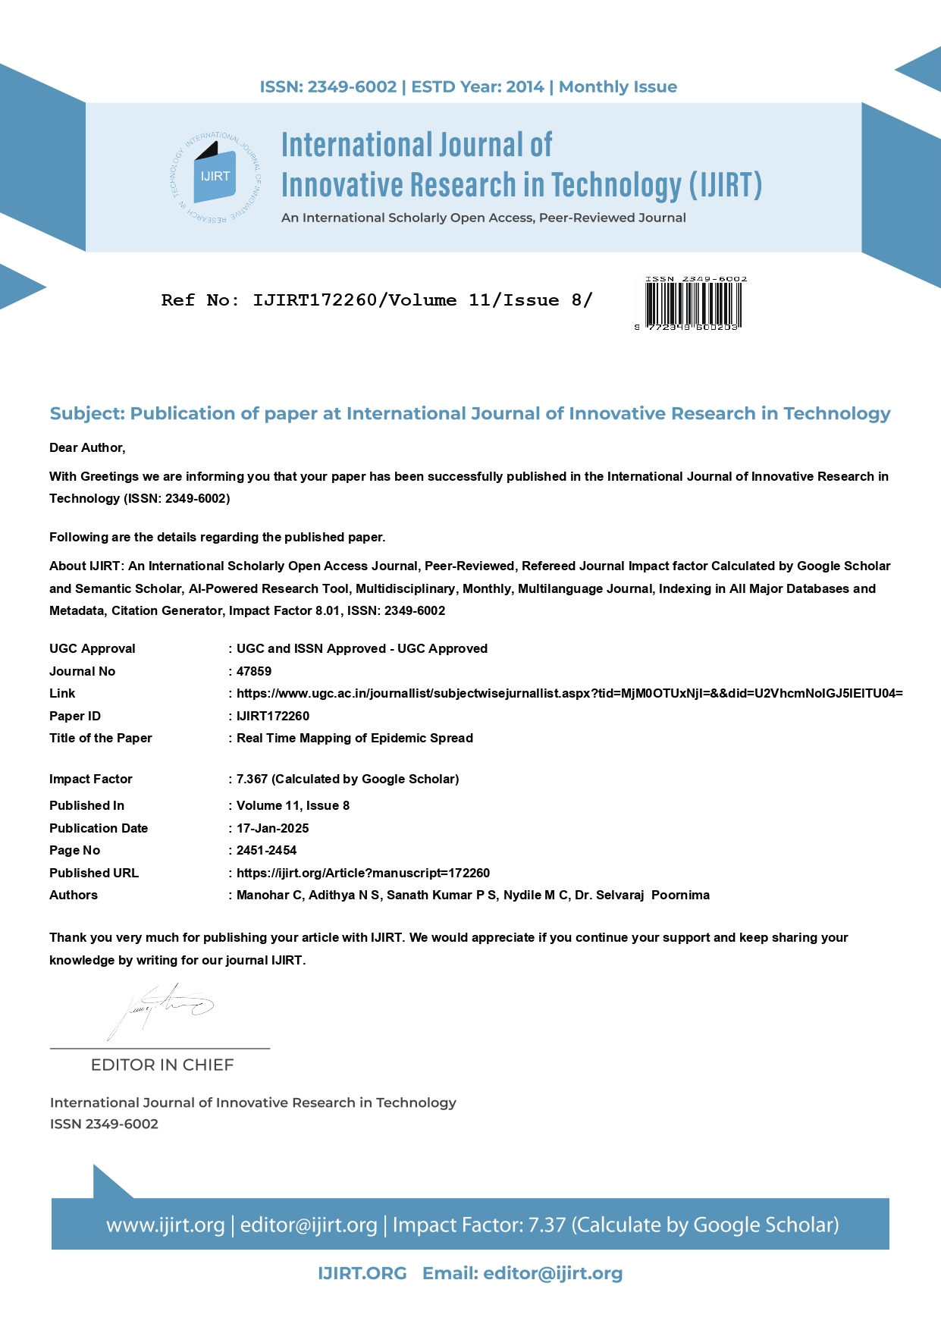

Slide 19

Achievements (if any)

Slide 20
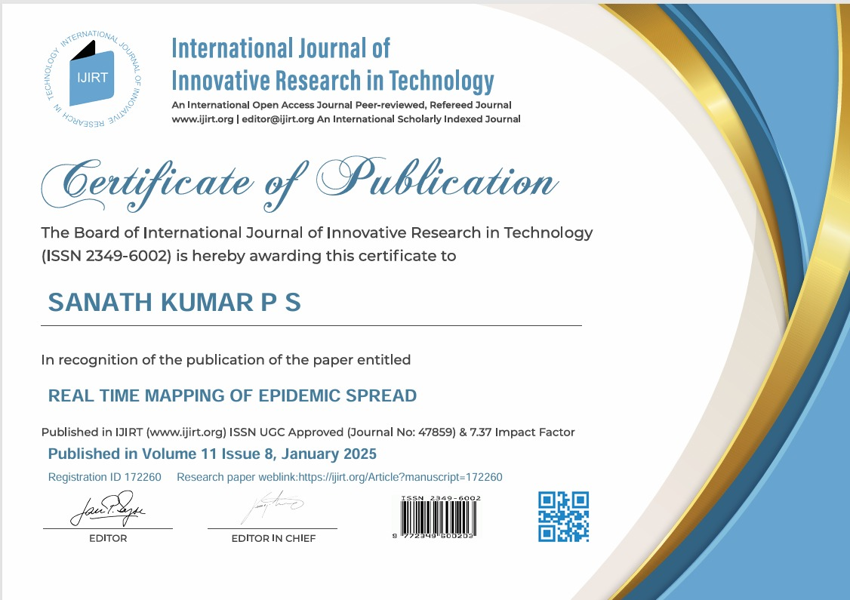

Slide 21


Slide 22


Slide 23

Thank You

