Slide 1

Food Delivery Performance & Friction Analysis
Optimizing Delivery Durations, Vehicle Fleet Efficiency, and Weather/Traffic Resilience
OPERATIONS ANALYTICS TEAM

Slide 2

Executive Summary & Project Scope
Core Objective
Identify and quantify operational bottlenecks driving food delivery latency across fleet, environment, and human factors.
Dataset Dimensions
Multi-variable evaluation spanning delivery duration, prep time, vehicle type, weather conditions, traffic levels, and courier experience.
Primary Finding: Severe weather and evening traffic spikes account for over 40% of delivery delay variance. Bike fleet efficiency decays rapidly beyond 12 km.

Slide 3
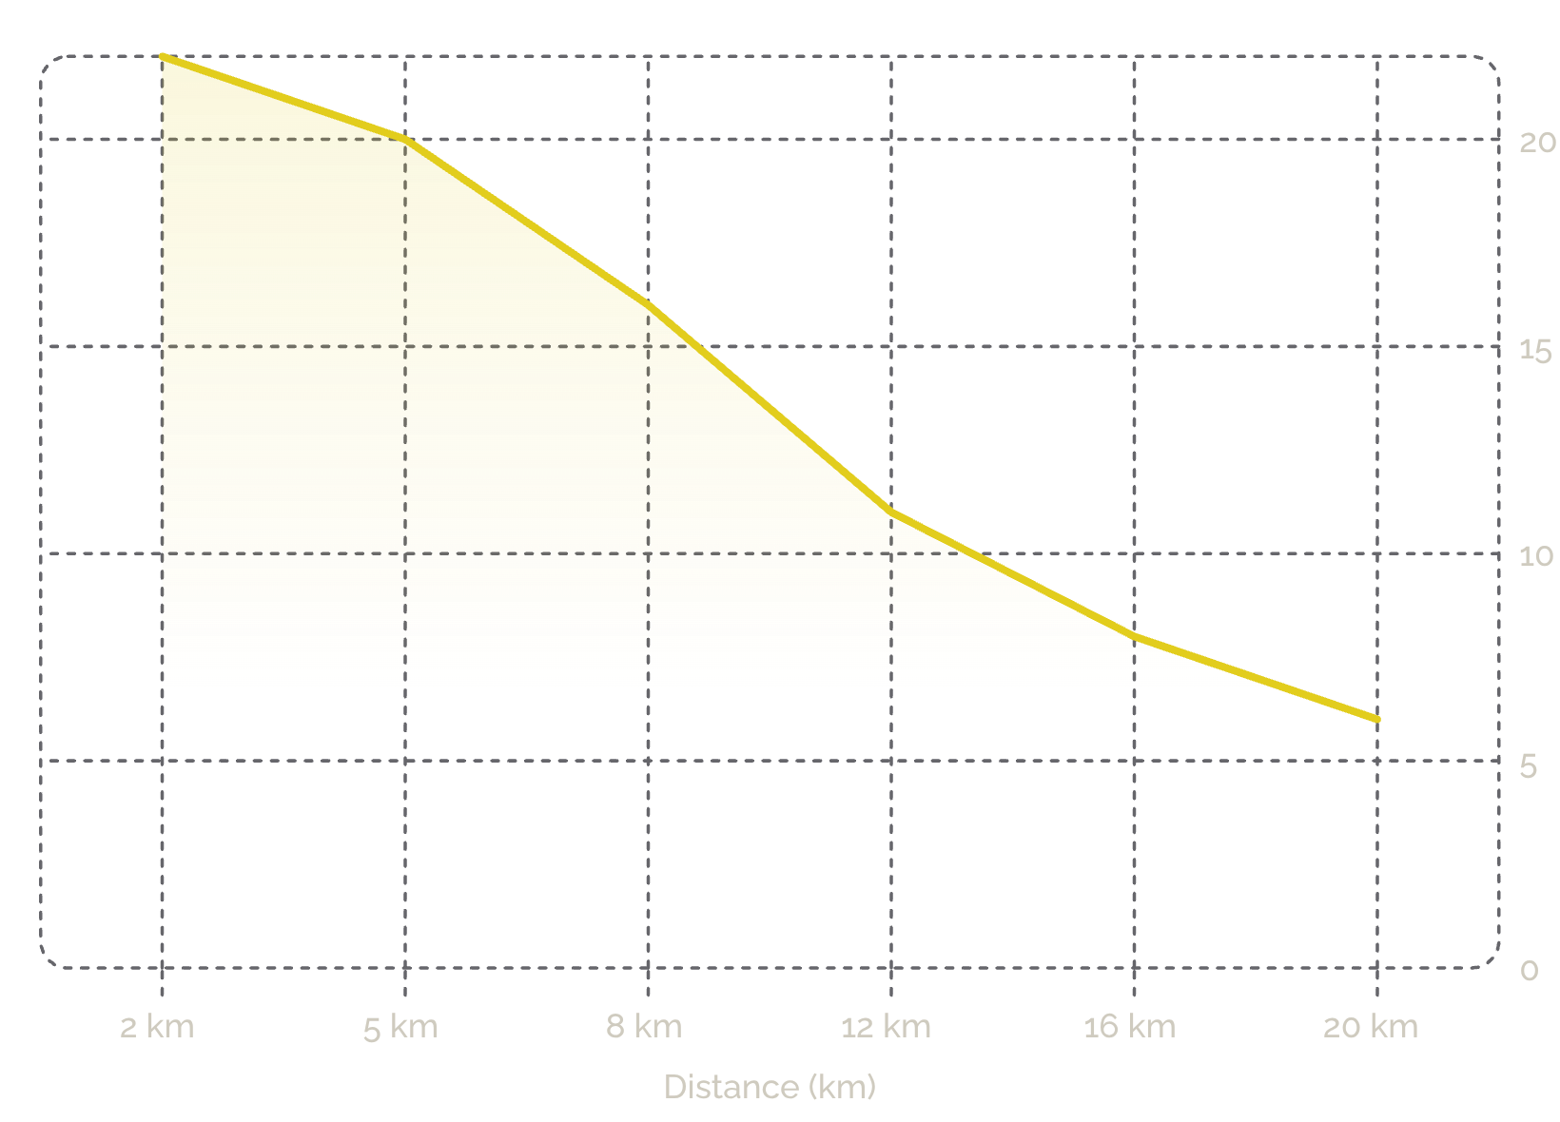

Vehicle Fleet Scaling & Route Efficiency
Key Fleet Insights
Bikes: Short-Range Specialists
Cars & Scooters: Long-Distance Stability
Dominate under 5 km with high agility, but speed decays exponentially past 12 km.
Maintain consistent travel speeds across all long-distance routes, outperforming bikes beyond 12 km.

Slide 4
Environmental Impact: Weather & Traffic Delays
Automobiles Lead Resilience
Two-Wheelers Most Vulnerable
Cars demonstrate the highest weather resilience, significantly outperforming two-wheelers in extreme conditions.
Bikes and scooters face disproportionate delay penalties during snow and heavy rain events.

Slide 5

Peak Operational Hours & Bottleneck Matrix
Evening Peak (6pm–9pm)
Late-Night Window (9pm–12am)
Highest congestion, longest delays, greatest ETA variance.
Highest predictability and lowest standard deviation in delivery times — ideal for reliability-focused dispatch.

Slide 6
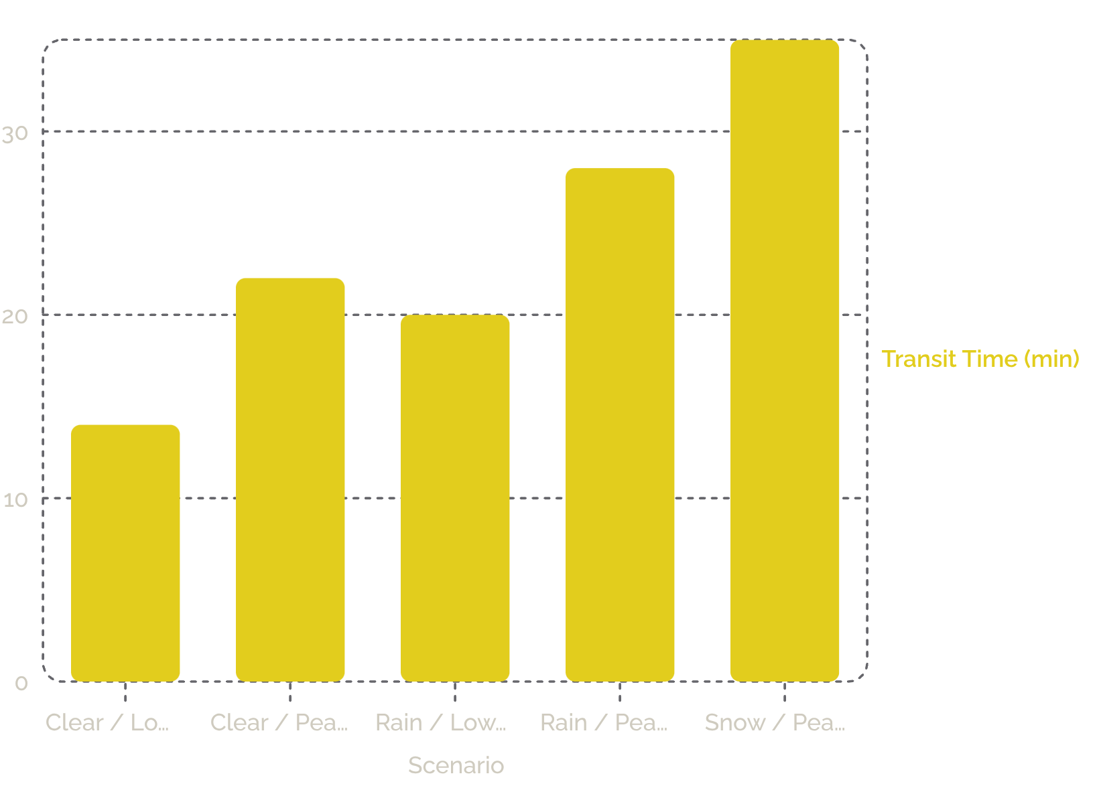
Kitchen Preparation vs. Transit Stage Split
Latency Driver Analysis
Kitchen preparation time remains remarkably stable at ~17 minutes across all conditions — confirming that environmental transit factors, not kitchen operations, are the primary drivers of total order latency.
Transit time varies by up to 150% across weather and traffic scenarios, while prep time variance is under 6%.

Slide 7
Courier Experience as a Mitigation Factor
Route Optimization
Training Opportunity
Senior couriers consistently select faster alternate routes during congestion events.
Veteran route strategies represent an underutilized asset for onboarding and training programs.

Slide 8



Multi-Factor Operational Bottleneck Summary
When long distances, high prep times, and severe weather converge, delays compound non-linearly_creating critical friction zones that demand targeted intervention.
Long Distance (>12 km)
Severe Weather Events
Bike fleet efficiency collapses; cars and scooters required to maintain service levels.
Snow and heavy rain amplify transit delays by up to 43% when combined with peak traffic.
Evening Traffic Peaks
6pm–9pm window drives the highest daily friction — dynamic EDT adjustments essential.

Slide 9


Strategic Recommendations & Action Plan
Fleet Re-Allocation
1
Restrict bike deliveries to distances under 5 km. Prioritize car dispatch during rain and snow events to preserve on-time performance.
Dynamic Dispatch Routing
2
Implement algorithmic EDT adjustments during evening high-traffic windows (6pm–9pm) to improve ETA accuracy and customer satisfaction.

Slide 10
Conclusion & Next Steps
Expected Operational Impact
Reduced Delivery Delay
Improved ETA Accuracy
Scalable Training Framework
Targeted fleet re-allocation and dynamic EDT adjustments projected to reduce median delay by 15–20%.
Weather-aware and traffic-aware dispatch models will tighten prediction confidence intervals across all vehicle types.
Veteran-driven onboarding reduces ramp-up time for new couriers and standardizes best-practice routing behavior.

