Slide 1

Interactive Quiz System Using Inline Functions
DSA0105-OBJECT ORIENTED PROGRAMMING WITH C++
Presented by:
K.Pavithra(192472155)
V.Pallavi(192372113)
A.Satya Manoj(192425370)
K.Niveditha(192372275)
Guided by:
Mr. JEGADEESH K
Industrial Professional
Coimbatore

Slide 2


ABSTRACT
The system contains multiple difficulty levels, such as Beginner, Intermediate, and Advanced.
Users answer multiple-choice questions, and the system calculates the score automatically.
Inline functions are used for simple operations like score calculation and result display.
Inline functions reduce function call overhead and improve execution speed.
It compares the performance of inline functions with conventional function-based implementation.

Slide 3
PROBLEM STATEMENT
Traditional quiz systems use conventional function calls for every operation.
Frequent function calls increase processing time due to function call overhead.
Existing systems may execute simple tasks less efficiently.
Slow execution can reduce the responsiveness of the quiz application.
Many systems do not optimize score calculation and result generation.
Lack of optimization affects overall system performance.

Slide 4
OBJECTIVES
To develop an interactive quiz system with multiple difficulty levels.
To evaluate users' knowledge through automated assessment.
To implement inline functions for score calculation and result generation.
To compare the execution performance of inline functions with normal functions.
To reduce processing time and improve the efficiency of the quiz application.
To provide instant feedback and final scores to users.

Slide 5
PROPOSED SYSTEM
Develop a user-friendly interface to conduct interactive quizzes.
Use inline functions in C++ to check answers and calculate scores.
Display multiple-choice questions with options for users to select.
Provide instant feedback for correct and incorrect answers.
Display the final score and performance at the end of the quiz.

Slide 6
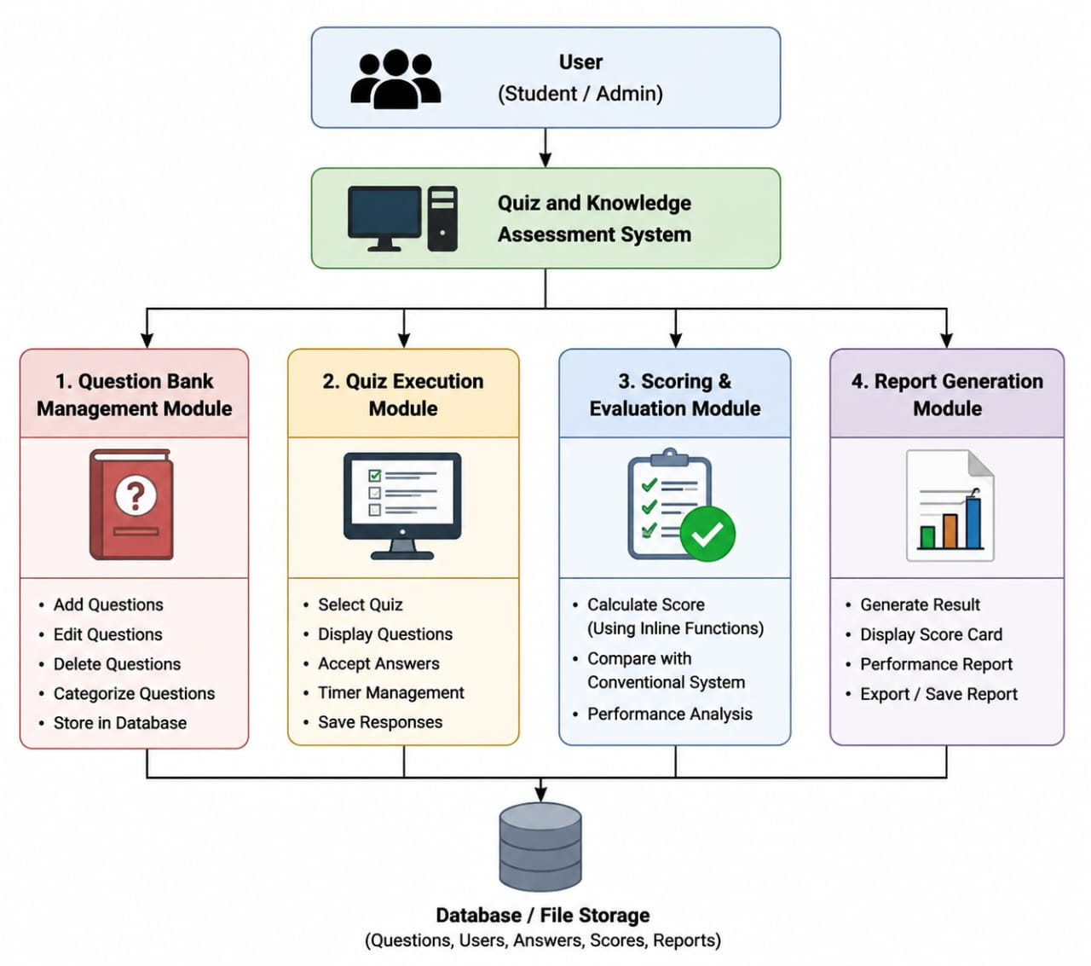
ARCHITECTURE DIAGRAM

Slide 7
MODULES
MOULE-1 Question Bank Management Module
MODULE-2 Quiz Execution Module
MODULE-3 Scoring & Evaluation Module
MODULE-4 Report Generation Module

Slide 8
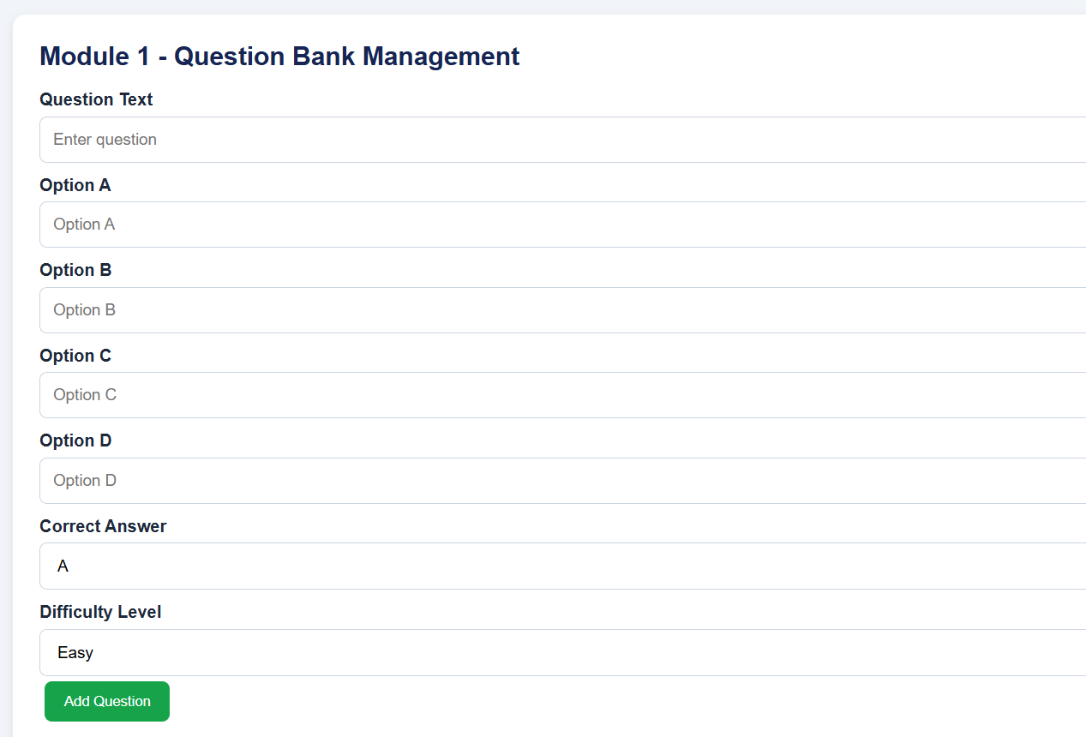
MODULE-1
Question Bank Management Module
Role:
This module manages all quiz questions and organizes them according to difficulty levels. It acts as the foundation of the quiz system by maintaining the question database.
How it Works:
Stores quiz questions in the system.
Organizes questions into Beginner, Intermediate, and Advanced levels.
Allows adding, editing, and deleting questions.
.

Slide 9
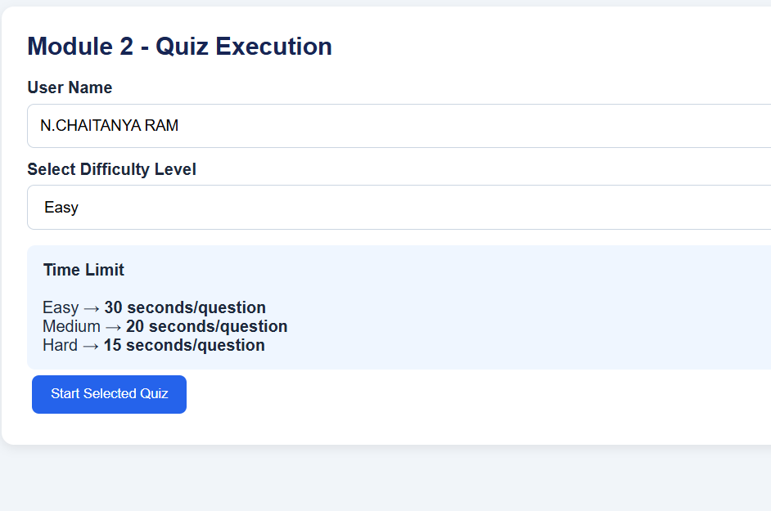
MODULE-2
Quiz Execution Module
Role:
This module conducts the quiz by presenting questions to the user and collecting responses in an interactive manner.
How it Works:
Displays one question at a time.
Accepts the user's answer.
Compares the answer with the correct answer.
Moves to the next question automatically.

Slide 10
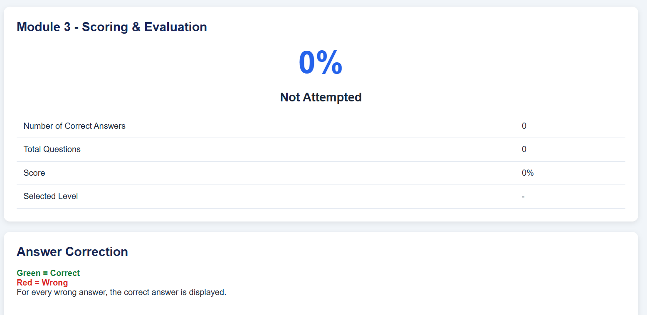
MODULE-3
Scoring & Evaluation Module
Role:
This module evaluates the user's performance by calculating scores and analyzing quiz results using inline functions.
How it Works:
Calculates marks for correct answers.
Uses inline functions for faster score computation.
Counts correct and incorrect responses.
Determines the final score and percentage.
Displays the performance level and pass/fail result.

Slide 11
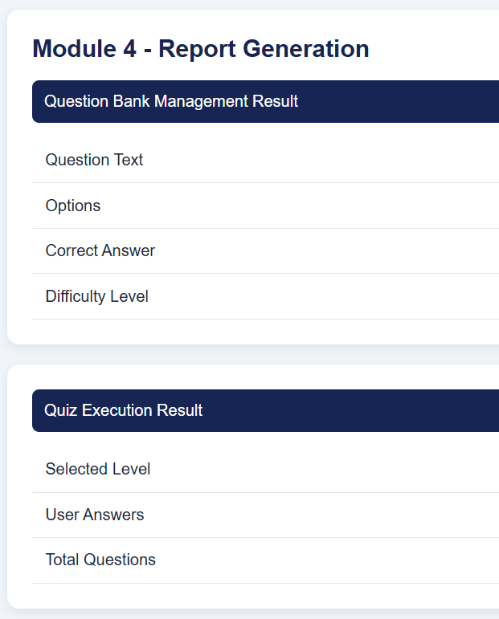
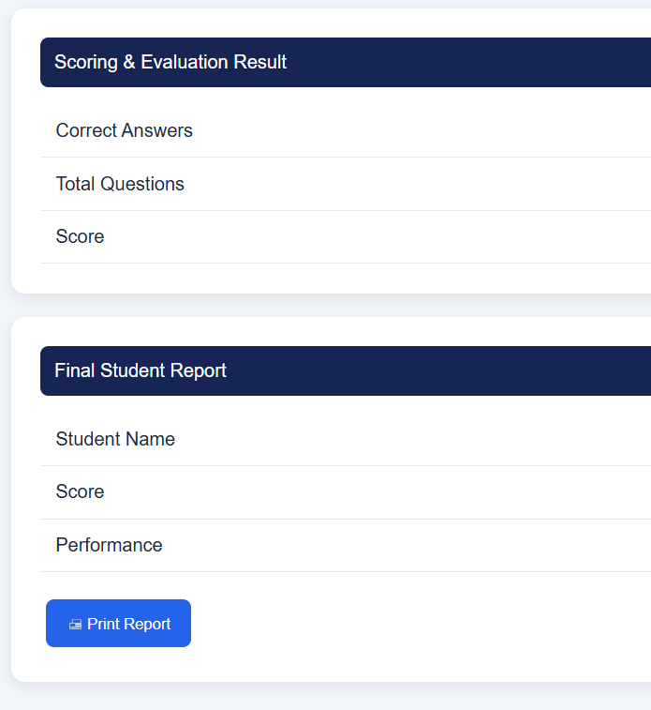
MODULE-4
Report Generation Module
Role:
This module generates the final assessment report and provides detailed feedback about the user's performance.
How it Works:
Generates the final quiz report.
Displays total score and percentage.
Shows correct and incorrect answer counts.
Presents the final assessment summary to the user.

Slide 12
ADVANTAGES
Fast Execution: Inline functions can reduce function-call overhead for small operations.
Instant Feedback: Provides immediate results for selected answers.
Automatic Scoring: Calculates scores accurately and quickly.
Easy to Use: Offers a simple and interactive quiz interface.
Improved Learning: Helps students test their knowledge and improve their performan

Slide 13
CONCLUSION
Implemented inline functions to improve execution speed.
Reduced function call overhead compared to conventional functions.
Enabled automatic score calculation and instant result generation.
Provided multiple quiz levels for better knowledge assessment.
Improved overall system performance and processing efficiency.

Slide 14
REFERENECES
Khan, M. S., Ahmad, A., & Humayoun, M. (2022). Building an Effective Automated Assessment System for C/C++ Introductory Programming Courses in ODL Environment. arXiv.
Alonso-Fernandez, F., & Bigun, J. (2022). Continuous Examination by Automatic Quiz Assessment Using Spiral Codes and Image Processing. arXiv.
Raina, V., & Gales, M. (2022). Multiple-Choice Question Generation: Towards an Automated Assessment Framework. arXiv.
Goodfellow, M., Booth, R., Fagan, A., & Lambert, A. (2025). AutoMCQ: Automatically Generate Code Comprehension Questions Using GenAI. arXiv.

Slide 15


