Slide 1
Ideate and implement a system to enhance the quality of education in rural areas.
PIP 4004 UNIVERSITY PROJECT
Review-3
Batch Number: GCAI-20
Under the Supervision of,
Ms. Kayalvizhi
Assistant Professor, School of Computer Science and Engineering
Presidency University
Roll Number | Student Name
20211CAI0068 20211CAI0154 20211CAI0100 20221LCA0008 | Veeresh B Manoj J R K Sainath Kushal M P
Name of the Program: Computer Science And Engineering in AIML
Name of the HoD: Dr. Zafar Ali Khan
Name of the Program Project Coordinator: Dr. Afroz Pasha
Name of the School Project Coordinators: Dr. Abdul Khadar A

Slide 2
Github link
https://github.com/Manoj-CAI0154/Ideate-and-implement-a-system-to-enhance-the-quality-of-education-in-rural-areas

Slide 3
Introduction
Education is a fundamental right and a crucial driver of social and economic development. However, rural areas often face significant challenges in delivering quality education due to a lack of infrastructure, skilled teachers, and access to modern learning resources.
To bridge this gap, an innovative system must be ideated and implemented to enhance the quality of education in rural areas. This system should leverage technology, community participation, and efficient resource management to provide students with engaging, effective, and sustainable learning experiences.
This paper explores the key components of such a system, including its design, implementation strategies, and potential impact on rural education.

Slide 4
Dataset
https://github.com/Manoj-CAI0154/Ideate-and-implement-a-system-to-enhance-the-quality-of-education-in-rural-areas

Slide 5
Literature Review
Improving education in rural areas has been a subject of extensive research, with various studies highlighting key challenges and proposing innovative solutions. This literature review explores existing works related to rural education enhancement, focusing on technological integration, teacher training, community involvement, and policy interventions.
Challenges in Rural Education.
Role of Technology in Enhancing Rural Education.
Teacher Training and Capacity Building.
Community Involvement and Localized Solutions.
Government Policies and Public-Private Partnerships.

Slide 6
Proposed Method
To bridge the educational gap in rural areas, a multi-dimensional approach is necessary, combining technology, teacher training, community participation, and policy support.
Implementation of Smart Classrooms and Digital Learning
Teacher Training and Skill Development
Community and Parental Engagement
Affordable and Scalable Infrastructure Development
Government Policy Integration and Financial Support

Slide 7
Objectives
Improve Access to Quality Education
Enhance Teacher Training and Capacity Building
Promote Community and Parental Involvement
Strengthen Government and Policy Support
Bridge the Digital Divide in Rural Education
Develop Sustainable and Scalable Learning Models
Improve Student Learning Outcomes

Slide 8
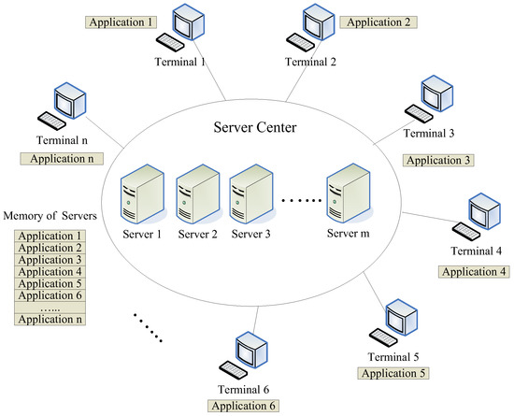
ARCHITECTURE

Slide 9
Methodology
Needs Assessment and Data Collection
System Design and Planning
Implementation Phase
Monitoring and Evaluation
Scaling and Policy Integration
+--------------------------------+
| Needs Assessment & Research |
+--------------------------------+
↓
+--------------------------------+
| System Design & Planning |
+--------------------------------+
↓
+--------------------------------+
| Implementation Phase |
| - Technology Deployment |
| - Teacher Training |
| - Community Engagement |
| - Infrastructure Enhancement |
+--------------------------------+
↓
+--------------------------------+
| Monitoring & Evaluation |
| - AI Analytics |
| - Feedback & Assessments |
| - Performance Measurement |
+--------------------------------+
↓
+--------------------------------+
| Scaling & Policy Integration |
| - Government Partnerships |
| - Public-Private Funding |
| - Expansion to More Areas |
+--------------------------------+

Slide 10
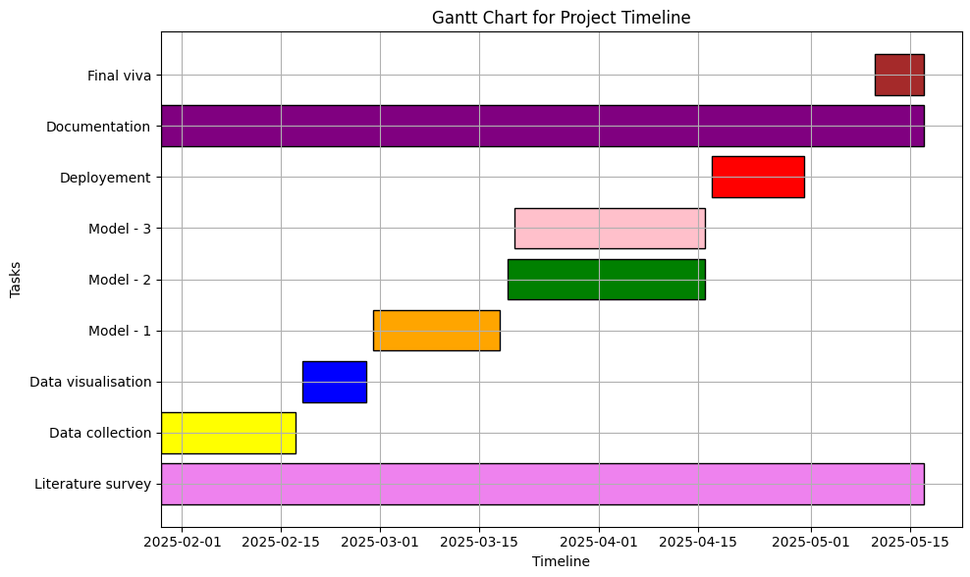
Timeline of the project

Slide 11
Expected Outcomes
Implementing the proposed system for enhancing rural education is expected to yield significant improvements in accessibility, quality, and sustainability.
Improved Access to Education
Enhanced Learning Outcomes
Better-Trained Teachers
Stronger Community Participation
Bridging the Digital Divide
Sustainable and Scalable Education Model
Long-Term Socioeconomic Benefits

Slide 12
Conclusion
✔ Bridging the Education Gap: The proposed system effectively addresses rural education challenges through technology, teacher training, and community involvement.
✔ Improved Learning Outcomes: Digital learning tools and modern teaching techniques will enhance student engagement, literacy, and academic performance.
✔ Empowered Teachers: Continuous training and incentives will improve teacher effectiveness and retention in rural schools.
✔ Stronger Community Participation: Increased parental and local involvement will create a supportive learning environment for students.
✔ Sustainable and Scalable Model: The system can be replicated across different rural regions through public-private partnerships and government support.
✔ Long-Term Socioeconomic Impact: Higher education levels will lead to better employment opportunities, economic growth, and reduced rural-urban disparities.
✔ Policy Integration for Lasting Change: Government collaboration will ensure the model's sustainability and long-term success.

Slide 13
References (IEEE Paper format)
Swargiary, Khritish, and Kavita Roy. "Literacy rate in India in 2022." ACADEMICIA: An International Multidisciplinary Research Journal 12.8 (2022): 87-93.
Wood, Richard Mark. "A review of Education differences in Urban and Rural areas." International Research Journal of Educational Research 14.2 (2023): 1-3.
Choudhary, Richa. "Impact Assessment of Tech-Driven Learning Acceleration Programme in Rural Region of India." Online Submission (2023).
McCall, Andrei. "Impact of Community-Based Education on Empowering Women in Rural and Underserved Areas." (2024).
Das, Namita Kumari, Snehaprava Sahoo, and Lopamudra Pati. "Online learning: Challenges for education in rural and remote areas." suicide 8.7 (2021).
Chauhan, Prithiviraj Singh. "English Language Teaching to Rural Students: Challenges and Strategies." The Criterion: An International Journal in English 12.1 (2021): 211-219.
Sharma, Sujeet Kumar, et al. "Challenges common service centers (CSCs) face in delivering e-government services in rural India." Government Information Quarterly 38.2 (2021): 101573.

Slide 14
Thank You

