Slide 1
PROJECT TITLE : Integrated Crop Protection Management
PIP2001 Capstone Project
Review-1
Batch Number: CAI-G22
Under the Supervision of,
Dr./Mr./Ms./Prof.
Professor / Associate Professor / Assistant Professor
School of Computer Science and Engineering
Presidency University
Roll Number | Student Name
20211CAI0154 20211CAI0068 20211CAI0100 20221LCA0008 | MANOJ J R VEERESH B K SAINATH Kushal M P
Name of the Program: CAI
Name of the HoD: Dr. Zafar Ali Khan N- Asso. Prof - SCSE
Name of the Program Project Coordinator: Dr. Afroz Pasha – Asst. Prof - SCSE
Name of the School Project Coordinators: Dr. Sampath A K / Dr. Abdul Khadar A / Mr. Md Ziaur Rahman
UNDER THE GUIDE OF : Dr.Mohammadi Akheela Khanum
UNDER THE REVIEW OF : Dr. Alamelu J Mangai

Slide 2
Introduction
Agriculture is the backbone of the Indian economy, supporting more than half of the country’s workforce.
Farmers often contend with unpredictable monsoons, fluctuating market demands, inefficient crop planning, and poor soil management, all of which result in reduced yields and lower income.
To address these pressing challenges, we propose AgroDoc, an innovative mobile application designed to empower farmers with advanced technological tools. By the power of Artificial Intelligence (AI) and Machine Learning (ML), AgroDoc provides farmers with predictive insights and real-time recommendations to optimize their agricultural practices.
AgroDoc aims to revolutionize traditional farming by introducing an intelligent, easy-to-use platform that delivers critical information directly to the farmer's fingertips.
In doing so, the application addresses the core challenges of modern agriculture, enhancing productivity, profitability, and sustainability in farming practices. AgroDoc stands as a transformative solution to elevate the future of agriculture in India.

Slide 3
Literature Review
SL NO | Title of the paper and year | Authors | Methodology used | Advantages | Disadvantages
01 | Soil Quality Prediction Using Deep Learning, YAER: 2023 | C. V. Suresh BabuYadavamuthiah K | The paper employs deep learning techniques, combining Long Short-Term Memory networks and Convolutional Neural Networks to predict soil quality. The LSTM captures temporal relationships among variables, while the CNN extracts features from soil samples. The dataset includes various physical, chemical, and biological soil parameters. The model uses cross-validation to ensure consistent performance. | High accuracy in predicting soil 2) quality Ability to capture non-linear relationships in complex soil data Can process a variety of data sources | Requires large datasets, which can be difficult to obtain and curate Risk of overfitting if not properly managed Complexity in integrating multiple data sources and ensuring model interpretability.
02 | Soil Quality Prediction Using Deep Learning YEAR: 2023 | C. V. Suresh Babu Yadavamuthiah K, | The paper utilizes deep learning models, specifically a combination of Long Short-Term Memory (LSTM) networks and Convolutional Neural Networks (CNNs). LSTMs capture temporal dependencies in data, while CNNs extract features from soil samples. | High accuracy in predicting soil quality compared to conventional machine learning methods Ability to capture complex, non-linear relationships in the data. | Data acquisition challenges: Requires large, high-quality datasets, which are difficult to obtain and curate Overfitting risks: Deep learning models can be prone to overfitting, requiring careful regularization and tuning.
03 | AI and machine learning for soil analysis YEAR: 2023 | Muhammad Awais, Syed Muhammad Zaigham Abbas Naqvi | There are diverse meth- ods that have been reported to measure SWC and have their own pros and cons. One of the basic, or so-called absolute, methods of measuring SWC is the gravimetric method (GM), which is noncalibrated and the most basic method. | 1.Real time 2.Non-destructive High resolution. 3.Absolute results. | 1.Result affected by soil types 2.Consider only elastic collisions 3.complex,Non-colibrated

Slide 4
Literature Review
04 | Rainfall Prediction Using Machine Learning YEAR : 2023 | Botsa Hima Bindu | Data collection, Data preprocessing, Training and testing, Evaluation | Improved prediction accuracy compared to traditional weather forecasting methods.Real-time data adaptability, allowing for dynamic and continuous rainfall predictions. | Overfitting risks, especially with more complex models like deep learning, which may not generalize well to different regions or time periods.Model selection complexity: Determining the best algorithm requires extensive testing and fine-tuning
05 | "Weather Forecasting Framework for Time Series Data using Intelligent Learning Models", published in December 2021. | Raksha S, Graceline Jasmine S L. Jani Anbarasi, | The dataset was collected from Kaggle and processed using Wiener techniques. The models were trained and tested on weather attributes like temperature, wind speed, humidity, and rainfall. A 10-fold cross-validation was performed to evaluate the models' accuracy. The Random Forest classifier achieved the highest accuracy of 89% | High accuracy: Random Forest achieved 89%, which is higher than other models tested, including KNN and SVM.Scalability: The use of Hadoop Distributed File System (HDFS) ensures efficient handling of large datasets. | Limited to structured data: The models rely on traditional weather data, and might not handle unstructured data such as images or real-time sensor input well.Accuracy limitations: Although Random Forest performs well, there is still room for improvement, as deep learning methods were not explored.
06

Slide 5
Existing method Drawback
Unpredictable Monsoon Dependency: The lack of accurate monsoon predictions can lead to poor crop planning, water shortages, or flooding, which negatively impacts crop yield.
Non-Scientific Soil Analysis : Many farmers determine soil health through visual inspection testing methods, leading to an incomplete understanding of soil nutrient levels. As a result, fertilizers are either underused, causing soil degradation, reduced fertility, and increased costs.
Ineffective Crop Selection: This can result in poor crop choices that are unsuited to the current climate, soil conditions, or market demands, ultimately reducing profitability and increasing risks.
Limited Market Awareness: This leads to uninformed decisions about what crops to plant, when to sell, and how to price, reducing farmers' earnings and exposing them to market volatility.
AgroDoc, which addresses these inefficiencies by providing real-time predictions, personalized recommendations, and easy access to critical agricultural information.

Slide 6
Proposed Method
The proposed method for AgroDoc integrates advanced technologies like Artificial Intelligence (AI) and Machine Learning (ML) to address the limitations of traditional farming practices.
Monsoon Trend Prediction Using AI and ML : Data Collection , AI/ML Models, Farmer Guidance
Soil Health Analysis and Fertilizer Recommendations : Soil Data Input: Farmers can input data such as soil type, pH level, and moisture content
AI-Based Soil Analysis: AgroDoc processes this data using AI models to evaluate soil health and predict nutrient deficiencies.
Smart Crop Recommendation System : Multi-Factor Analysis: The app considers multiple factors like climate conditions, monsoon patterns, soil health, and available resources.
Continuous Updates: Recommendations are continuously updated based on real-time weather changes, market shifts, and other relevant data.

Slide 7
Objectives
The AgroDoc project is designed with the primary goal of transforming traditional farming practices by providing farmers with cutting-edge, data-driven solutions. The specific objectives of the project are:
Optimize Fertilization for Pulses (Chickpea, Lentils):
Objective: Based on soil health predictions that detect low nitrogen levels, recommend Chickpea, Lentils, or other nitrogen-fixing legumes. These crops will enhance soil fertility by naturally replenishing nitrogen, minimizing the need for synthetic fertilizers.
Improve Soil pH Management for Oilseeds (Sunflower, Groundnut):
Objective: In areas with acidic soils (low pH), recommend crops like Sunflower and Groundnut that thrive in such conditions. Provide lime-based soil amendment strategies to adjust pH and optimize nutrient availability for these crops.
To enhance farmers' ability to predict monsoon patterns, helping them plan crop cycles effectively.
Predict Monsoon Trends for Better Crop Planning
Improve Soil Health Management and Fertilizer Use
Empower Farmers with Real-Time Alerts and Updates
Increase Farmer Profitability and Yield

Slide 8
Methodology/Modules
The methodology of AgroDoc is designed around the core functionalities that help farmers optimize their agricultural activities using AI, Machine Learning (ML), and data analysis.
he project is divided into various modules that work in unison to provide a comprehensive solution to farming challenges. Each module is focused on addressing a specific problem area, using a step-by-step approach to deliver actionable insights to the farmer.
Monsoon Trend Prediction Module: Real-time and region-specific monsoon predictions for crop planning.
Soil Health and Fertilizer Recommendation Module : ersonalized soil health reports and fertilizer recommendations for each plot of land.

Slide 9
Architecture
User Interface (UI) Layer: A mobile app with a user-friendly design, supporting multiple languages and offline functionality for farmers to access features like data input and recommendations.
Farmer Input Module: Collects essential farm data such as soil conditions, crop type, and location from the farmer.
Weather Data Integration: Gathers real-time and historical weather information via APIs from meteorological services.
Soil Health Module: Analyzes soil data using AI to provide fertilizer recommendations and predict soil health.
Monsoon Prediction System: Uses machine learning models to forecast monsoon trends based on historical weather data.
Smart Crop Recommendation Engine: Suggests optimal crops based on soil conditions, climate, and market trends using AI algorithms.

Slide 10
software components
Software :
Mobile App Development: Android Studio (for Android app development) using java
AI/ML Development: Python (for building machine learning models)
TensorFlow, Keras, for AI/ML tasks (monsoon prediction, soil health analysis, crop recommendations)
Databases: MySQL for relational databases.
APIs and Third-Party Services: OpenWeatherMap API (for monsoon and weather data
and soil data.
Google Maps API (for warehouse locations)
Custom Agriculture APIs for additional crop and soil

Slide 11
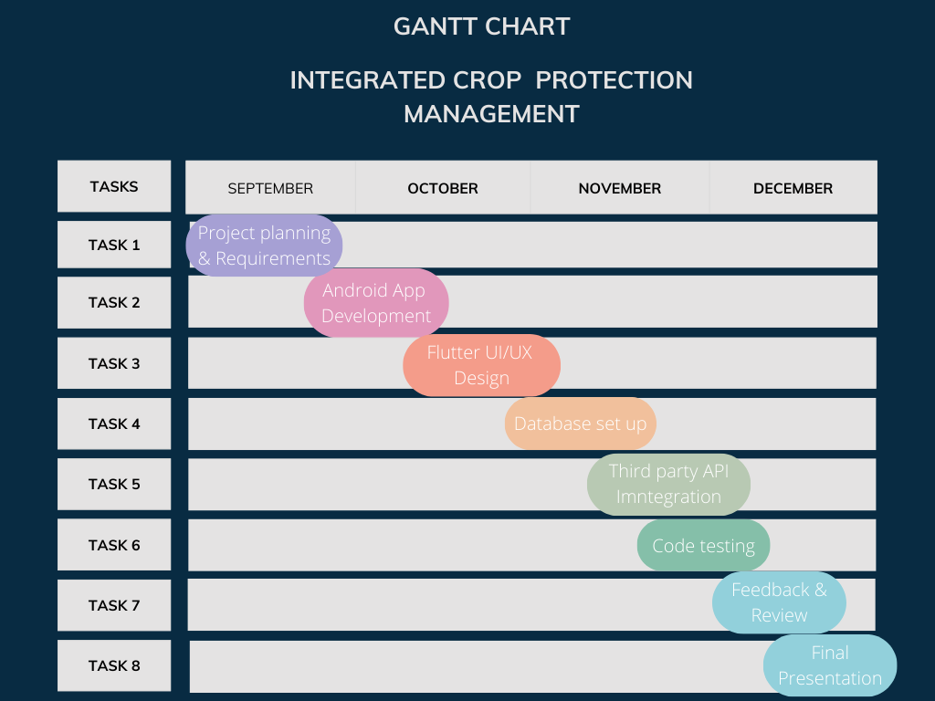
Timeline of Project

Slide 12
Expected Outcomes
Improved Crop Planning: Farmers will be able to make better crop decisions based on accurate monsoon predictions and soil health analysis, leading to optimized planting times and better yields.
Enhanced Soil Health and Fertilizer Management: With AI-driven soil health assessments, farmers will use the right type and quantity of fertilizers, reducing waste and improving long-term soil fertility.
Increased Crop Yield and Profitability: Smart crop recommendations tailored to soil, climate, and market conditions will help farmers grow crops that maximize yield and profitability.
Reduced Risk from Unpredictable Weather: Real-time monsoon and weather predictions will reduce the risks posed by erratic weather patterns, helping farmers plan their activities better.
Increased Use of Technology in Agriculture: The app will bridge the technology gap, making AI and ML-based recommendations easily accessible to farmers, promoting data-driven farming practices.
Decreased Post-Harvest Losses: By finding nearby warehouses and storage facilities, farmers can reduce losses from spoilage, improving the overall value of their harvested crops.
Higher Farmer Satisfaction: With real-time alerts and continuous support, farmers will experience improved productivity and efficiency, leading to greater satisfaction and livelihood enhancement.

Slide 13
Conclusion
The AgroDoc project aims to revolutionize farming practices in India by providing farmers with advanced, data-driven solutions powered by Artificial Intelligence (AI) and Machine Learning (ML).
By offering real-time monsoon predictions, soil health assessments, and smart crop recommendations, the app empowers farmers to make informed decisions that enhance their yields and profitability.
The integration of market sentiment analysis enables better understanding of pricing trends, optimizing the timing of crop sales.
With a user-friendly interface and offline capabilities, AgroDoc ensures accessibility for all farmers, promoting technology adoption in rural areas.
With its innovative approach, AgroDoc has the potential to significantly impact the agricultural sector and enhance the economic stability of farming communities across India.

Slide 14
Github Link
The Github link provided should have public access permission.
Github Link : https://github.com/Manoj-CAI0154/manu
CODE will be updated …

Slide 15
References
Manoj : https://www.researchgate.net/publication/372664253_Sustainable_Crop_Protection_via_Robotics_and_Artificial_Intelligence_Solutions/link/6580e9dc2468df72d3b70cbd/download
https://www.irjmets.com/uploadedfiles/paper//issue_1_january_2024/48795/final/fin_irjmets1705938824.pdf
Kushal:
https://www.researchgate.net/publication/375930584_Soil_Analysis_Using_Machine_Learning
https://www.researchgate.net/publication/263590784_Organizing_warehouse_management
Sainath :https://www.sciencedirect.com/science/article/abs/pii/S0167880997000261
https://www.taylorfrancis.com/chapters/edit/10.1201/9781351072717-2/integrated-crop-management-systems-pest-control-kamal-el-zik-raymond-frisbie
Veeresh : IRJMETS - Low cost journal with DOI |Rs. 599 publication fees |In 4 hr fast paper publication| Engineering, Scientific journal

Slide 16

Project work mapping with SDG

Slide 17
Thank You

