Slide 1
Integrated Crop Protection Management
PIP2001 Capstone Project
Review-0
Batch Number: CAI-G22
Under the Supervision of,
Dr./Mr./Ms./Prof.
Professor / Associate Professor / Assistant Professor
School of Computer Science and Engineering
Presidency University
Roll Number | Student Name
20211CAI0154 20211CAI0068 20211CAI0100 20221LCA0008 | MANOJ J R VEERESH B K SAINATH Kushal M P
Name of the Program: CAI
Name of the HoD: Dr. Zafar Ali Khan N- Asso. Prof - SCSE
Name of the Program Project Coordinator: Dr. Afroz Pasha – Asst. Prof - SCSE
Name of the School Project Coordinators: Dr. Sampath A K / Dr. Abdul Khadar A / Mr. Md Ziaur Rahman
UNDER THE GUIDE OF : Dr.Mohammadi Akheela Khanum
UNDER THE REVIEW OF : Dr. Alamelu J Mangai

Slide 2
Content
Problem Statement
Github Link
Analysis of Problem Statement
Timeline of the Project
References

Slide 3
Problem Statement Number: PSCS227
Organization:
Category (Hardware / Software / Both) : Software
Problem Description: Unpredictable Monsoon Patterns: The Indian agriculture sector is heavily dependent on the monsoon season so This unpredictability monsoon patterns makes it difficult for farmers to plan their cultivation cycles and results in significant crop losses.
Unscientific Crop Planning and Soil Health Management: Many farmers do not have access to advanced tools or knowledge for analyzing soil health and selecting crops based on scientific data. As a result, they often use inappropriate fertilizers or plant crops unsuited to local conditions, leading to poor yields.
Lack of Infrastructure Information: Farmers frequently struggle to find nearby warehouses for the storage of harvested crops, leading to post-harvest losses and logistical issues
Difficulty Level: SIMPLE

Slide 4
Github Link
The Github link provided should have public access permission.
Github Link

Slide 5
Analysis of Problem Statement
Technology Stack Components:
Frontend Development (Mobile App) : Android studio ( using java)
AI and Machine Learning : TensorFlow or PyTorch – For building and deploying machine learning models
Monsoon Prediction: Time Series Forecasting Algorithms – Models like LSTM (Long Short-Term Memory)
Soil Health Prediction: Decision Trees, Random Forests, or Gradient Boosting Models – For analyzing soil parameters and providing fertilizer recommendations.
Data Storage and Management: Mysql (or) PostgreSQL – A powerful relational database system for storing structured data, including user profiles, soil data, crop history, and warehouse information

Slide 6
Analysis of Problem Statement (contd...)
Software Requirements:
Programming Languages and Frameworks
Mobile App Development: Android Studio (for Android app development) using java
AI/ML Development: Python (for building machine learning models)
TensorFlow, Keras, for AI/ML tasks (monsoon prediction, soil health analysis, crop recommendations)
Databases: MySQL for relational databases.
APIs and Third-Party Services: OpenWeatherMap API (for monsoon and weather data)
Google Maps API (for warehouse locations)
Custom Agriculture APIs for additional crop and soil data.

Slide 7
Analysis of Problem Statement (contd...)
Hardware Requirements For Developer
Processor: Minimum of Intel i5 or equivalent AMD processor.
RAM: At least 8GB (16GB or more recommended for smoother performance, especially for running machine learning tasks and Android/iOS emulators)
Storage: SSD with at least 256GB of available space (for handling multiple projects, datasets, and application builds)
Graphics: A dedicated GPU may be necessary for training certain AI/ML models (NVIDIA GPUs are commonly used for TensorFlow/Keras models)
For Testing (Mobile Devices): At least one mid-range and one low-end Android device for testing performance across different hardware.

Slide 8
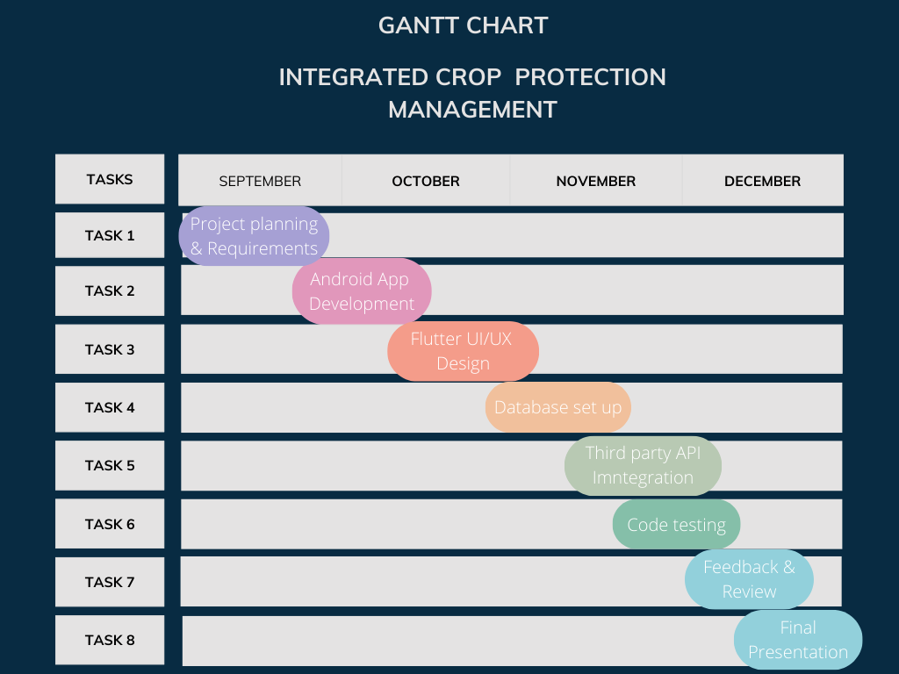
Timeline of the Project (Gantt Chart)

Slide 9
References (IEEE Paper format)
https://www.researchgate.net/publication/380385040_Integrated_Crop_Protection_Management
https://www.sciencedirect.com/topics/agricultural-and-biological-sciences/integrated-crop-management

Slide 10
Literature review
The literature supports the integration of AI and machine learning into agriculture, with proven benefits in improving crop yield, predicting weather, and optimizing resource use
There is a lack of comprehensive, easy-to-use tools that bring all these features together
AgroDoc is positioned to fill this gap by offering farmers a one-stop solution, enabling them to make informed, data-driven decisions to increase their productivity and profitability.
By combining various proven technologies in an accessible mobile app, AgroDoc can significantly enhance the farming experience and make precision agriculture accessible to even the smallest farmers in India.
This literature review provides the academic and technological foundation to support the development of AgroDoc, aligning with current research and highlighting its unique approach to addressing the needs of modern farmers.
Market Sentiment Analysis in Agriculture
Soil Health Monitoring and Fertilizer Recommendations
AI and Machine Learning in Agriculture

Slide 11


