Slide 1




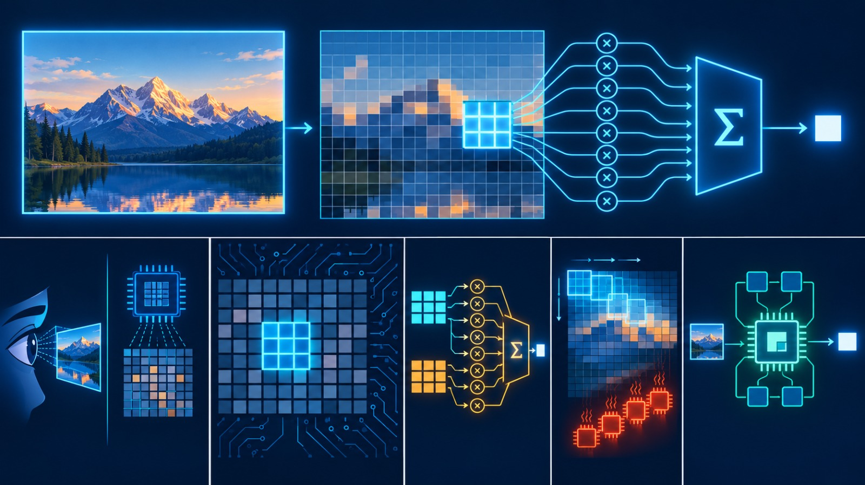

Problem Statement & Objective

Slide 2


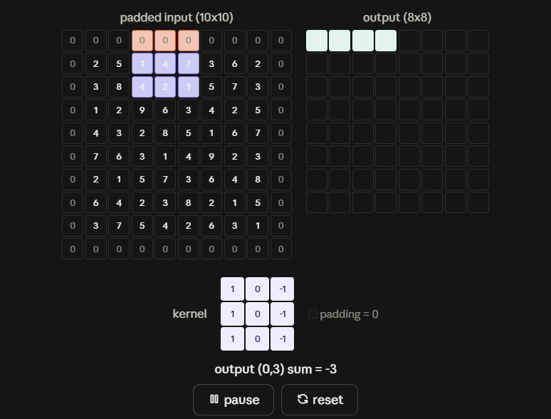
Problem Statement & Objective
Develop an efficient 8×8 convolution block using Vedic multiplication principles. The solution should achieve faster computation with optimized resource utilization while maintaining correct outputs.
Hardware Acceleration of 2D Image Convolution using Hierarchical Vedic Multiplication
Pipelined Low-Latency Edge Processing on Xilinx Artix-7 FPGA
Problem Statement:
Standard software-based spatial convolution on embedded CPUs introduces significant latency
due to sequential loop execution (\mathcal{O}(N^2\cdot K^2)) and memory-access overheads,
limiting deterministic high-throughput edge processing.
Core Bottleneck:
Conventional array/Wallace-tree multiplier structures implemented using FPGA fabric/DSP resources can introduce significant logic and accumulation delay when multiple products must be combined for convolution.
Objective:
Design a highly parallelized 2D Convolution Core leveraging Urdhva Tiryagbhyam (Vedic) multiplication to maximize arithmetic throughput, reduce multi-operand accumulation delay, and prove exact bit-level equivalence against a Python Golden Model.

Slide 3

Proposed Solution: Pipelined Vedic convolution engine
Implementation | Area (LUT) | Delay (ns) | ADP
Baseline/DSP | 0 | 22.756 | —
Conv-Vedic-KS | 1755 | 25.293 | 44,389
Conv-Vedic-RCA | 1223 | 22.682 | 27,740
Conv- Vedic-CSA_BK | 1176 | 17.002 | 19,994
VEDIC_CSA-KS | 1214 | 16.808 | 20,404
03
09

Slide 4
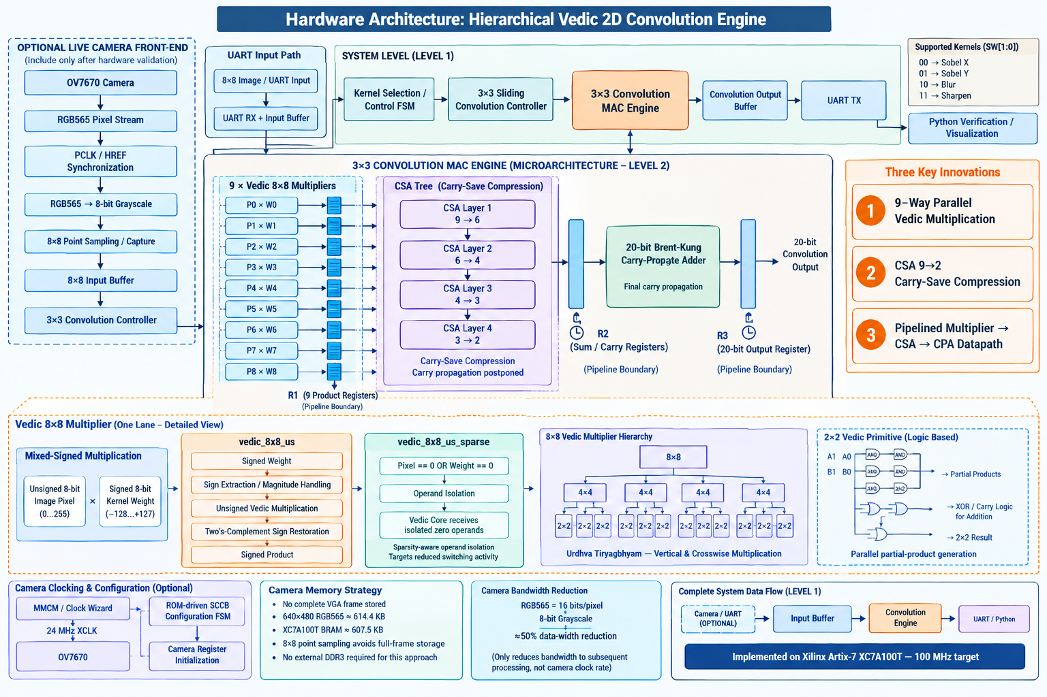
System Architecture & Workflow

Slide 5
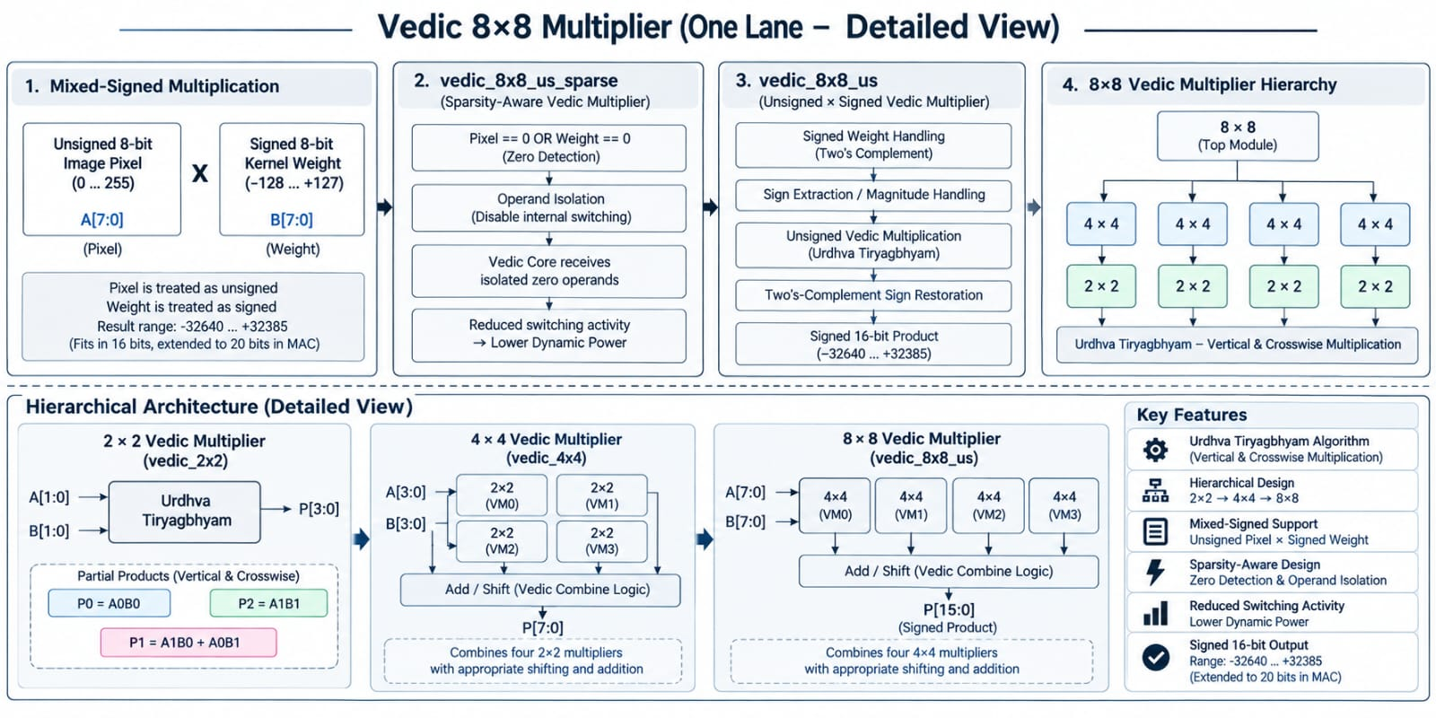
System Architecture & Workflow

Slide 6

Innovation, Novelty & Value Addition
Parameter | Reference Paper – Proposed VM | Our Proposed Design | Comparison
LUT Utilization | 79 LUTs | 50 LUTs | 36.7% fewer LUTs
Critical Path Delay | 6.56 ns | 5.725 ns | 12.7% lower delay
Operating Frequency | 150 MHz | 100 MHz | Paper uses higher clock frequency
Power | 224.72 mW | 109 mW | Low power Utilization
FPGA / Technology | Zynq UltraScale XCZU2CG | Artix-7 XC7A100T | Different FPGA technologies
Research Paper link : https://doi.org/10.1109/COMPSAC61105.2024.00071?.com

Slide 7
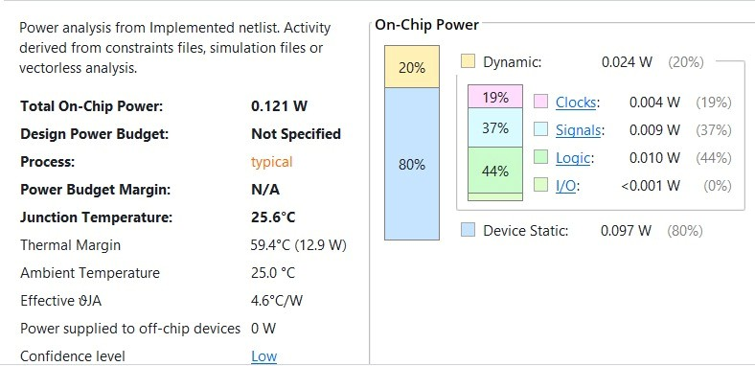
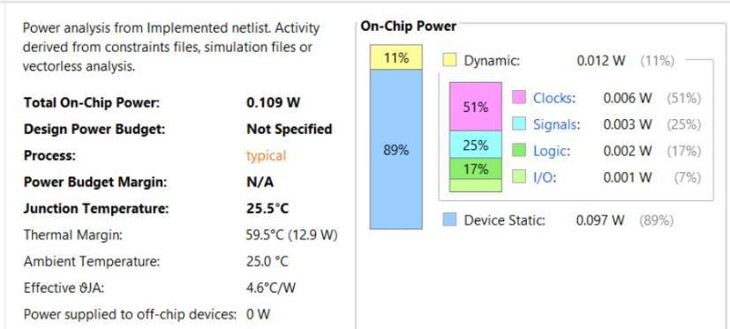

Innovation, Novelty & Value Addition
The architecture exposes parallel partial-product generation and is combined with CSA/parallel-prefix reduction to reduce carry-propagation overhead in the overall arithmetic path
Zero-operand isolation suppresses unnecessary internal switching activity, targeting dynamic-power reduction without changing numerical functionality.
Power Report without sparse
Power Report with sparse

Slide 8
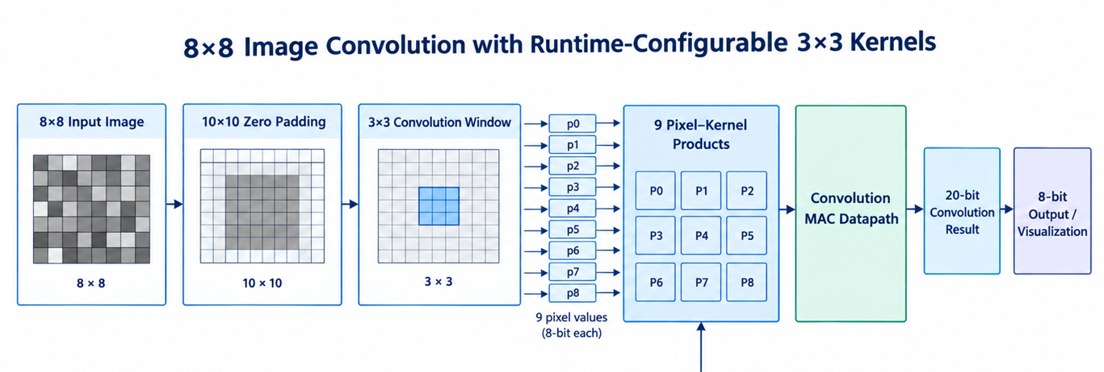
Proposed Solution: Pipelined Vedic convolution engine
Parallel 3×3 MAC datapath with pipelined arithmetic stages for high-throughput convolution.
03
09
Resource | Used
LUTs | 1,275
LUT capacity | 63,400
LUT utilization | 2.01%
LUTRAM | 66
FFs | 389

Slide 9
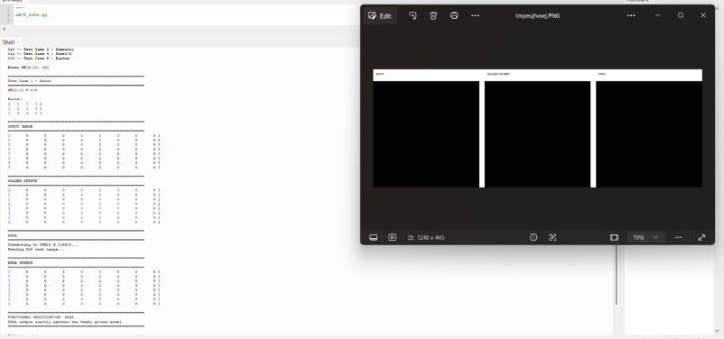
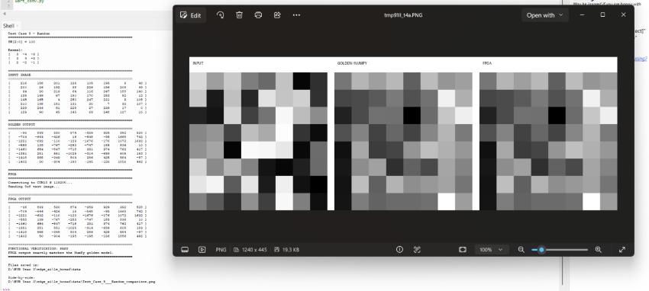
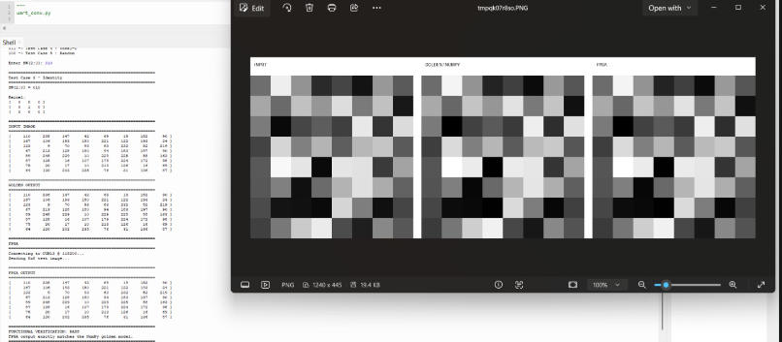
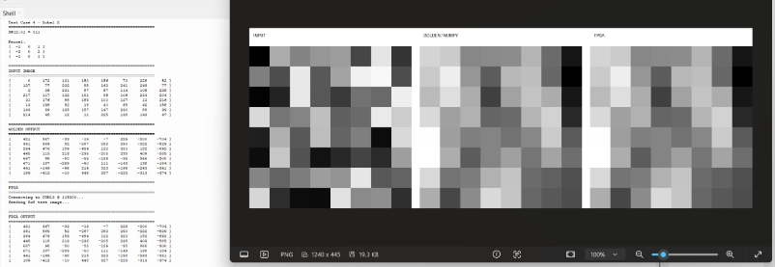
Software & Test case result

Slide 10
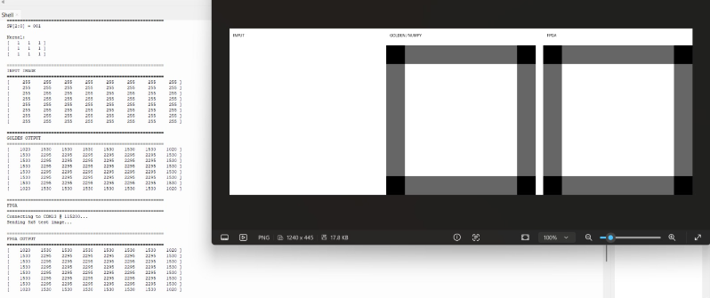
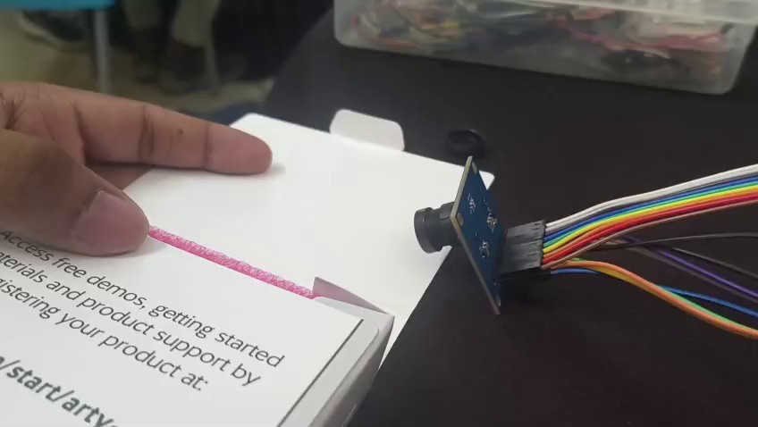
Software & Test case result

Slide 11
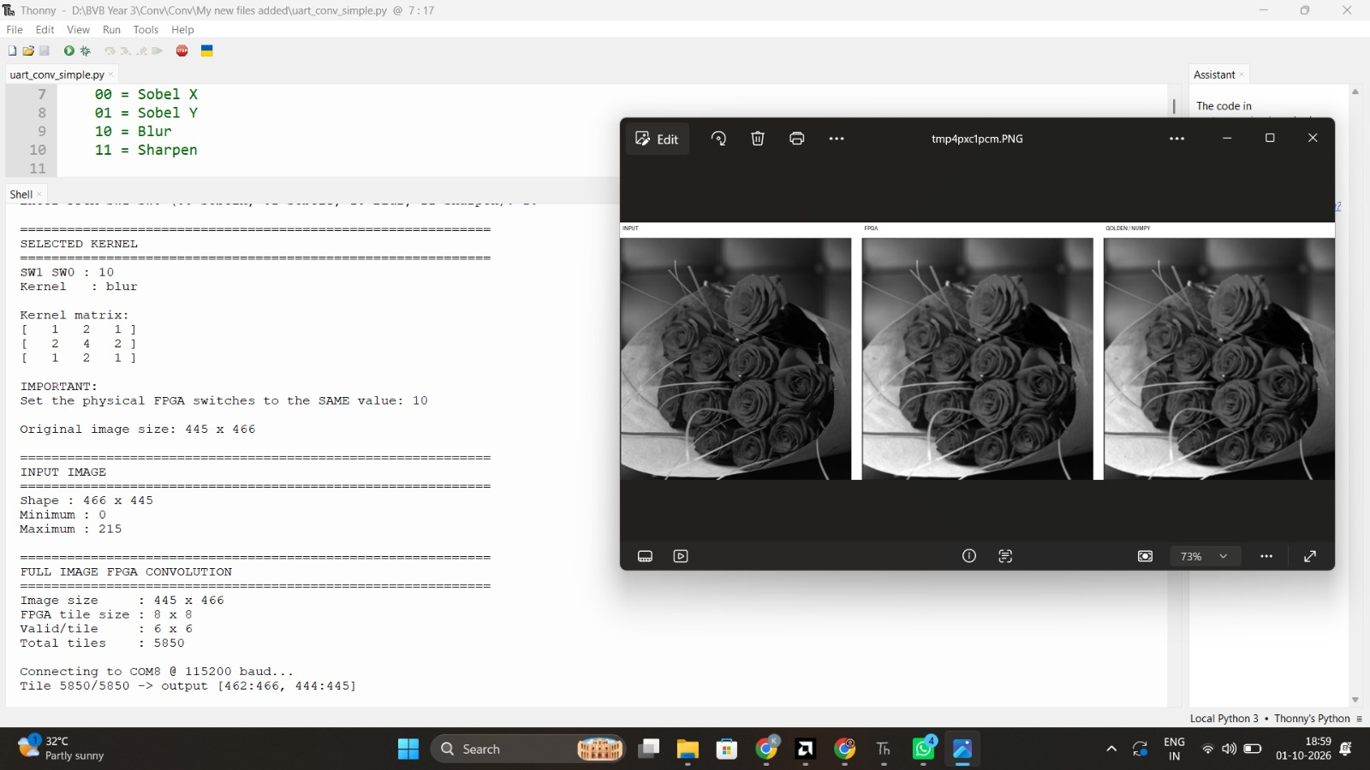
Software & Test case result

Slide 12
Team & Track Details
Track 1 — FPGA
Team Sutra-dhar
KLE Technological University, Hubballi
Team Members :
Keerti Kallur
Manoj H A
Rutvik Malali
Thank You

