Slide 1



AI-Driven Dietary Pattern Intelligence System for Personalized Nutrition Analysis and Recommendation
Manoj HT
Guide: Mahesh Ramegowda
M.Tech Data Science & Artificial Intelligence
PES University

Slide 2
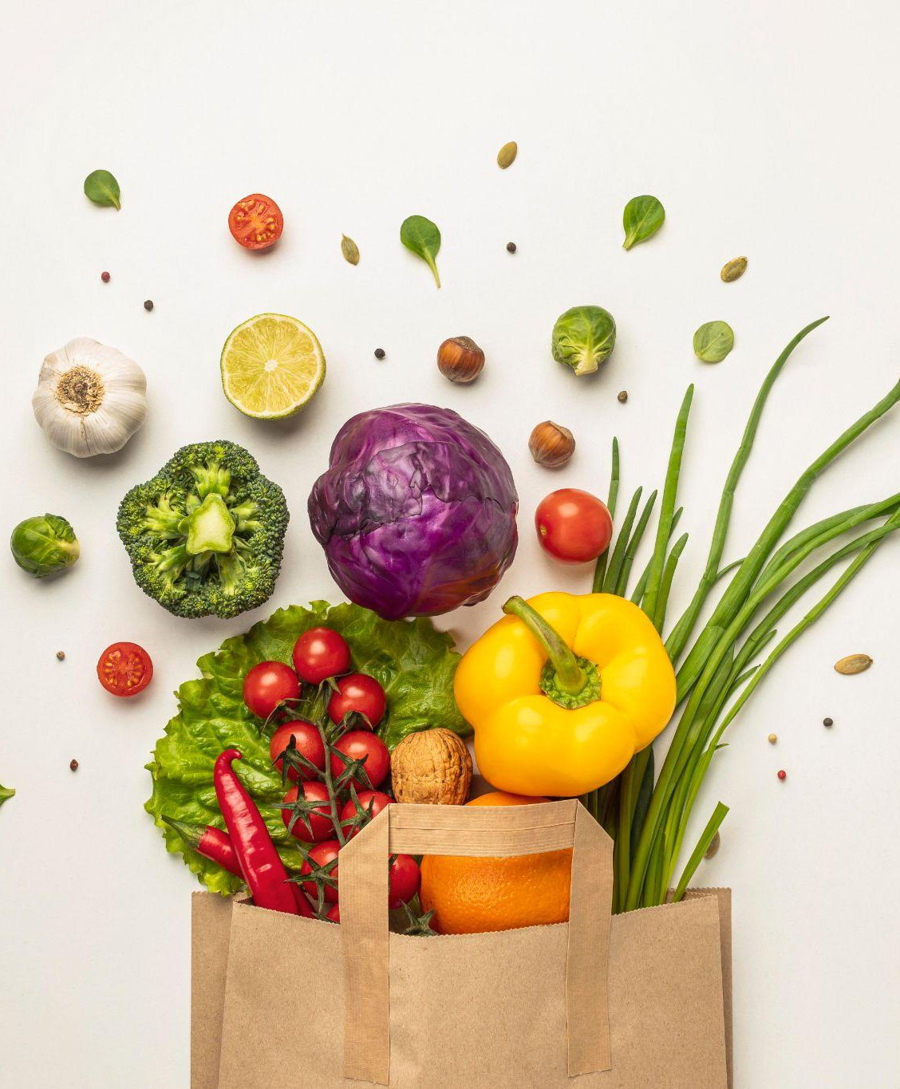
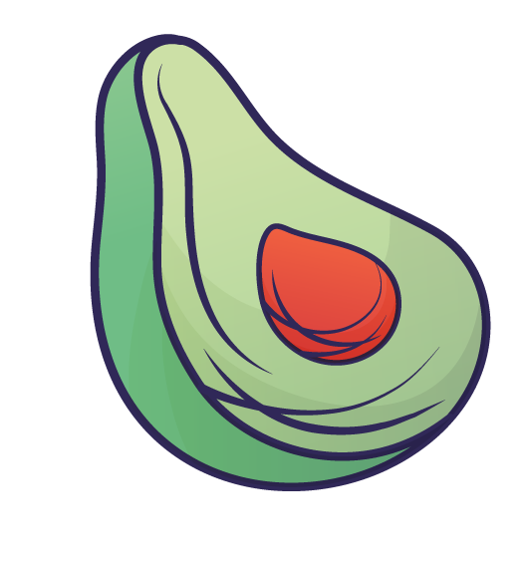
Problem Statement
Existing food tracking applications suffer from:
Manual food logging fatigue
Inconsistent user engagement
Limited support for multimodal inputs
Difficulty converting food logs into actionable dietary insights

Slide 3
Objective
Build a multimodal dietary intelligence system capable of:
Capturing meals through text, image, and voice
Automatically generating nutritional information
Maintaining dietary history
Providing AI-powered insights and recommendations

Slide 4

Project Overview
User
↓
Text Input
Voice Input
Image Input
↓
Food Understanding Layer
↓
Nutrition Mapping
↓
Meal Log Storage
↓
Monthly Dietary Analysis
↓
LLM Insights & Recommendations

Slide 5
Architecture Diagram
User Profile
Text
Voice
Image
Meal Extraction Layer
Nutrient Mapping Engine
(FoodData Central)
Meal Log Database
Meal Log Database
Monthly consolidation
Monthly consolidation
LLM Analysis Engine
Insights and Recommendation

Slide 6

Multimodal Input System
Text Input
Voice Input
Image Input
NLP-based meal extraction
Quantity identification
Food normalization
Whisper transcription
Converted to text
Processed through same NLP pipeline
Primary: prithivMLmods/Indian-Western-Food-34
Backup: microsoft/swin-tiny-patch4-window7-224
Supports:
Camera capture
File upload

Slide 7
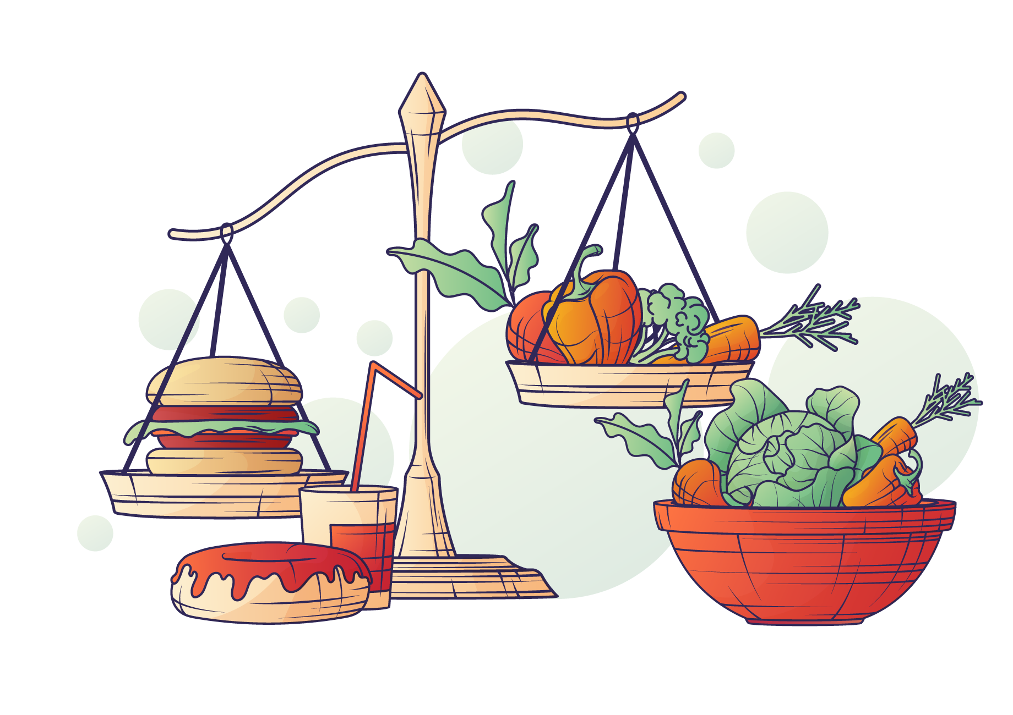

Nutritional Intelligence Layer
FoodData Central Integration
For each detected meal:
Food Item
↓
Calories
Protein
Carbohydrates
Fat
Micronutrients
Benifits
Configurable nutrient selection
Standardized nutritional database
Supports dietary trend analysis

Slide 8
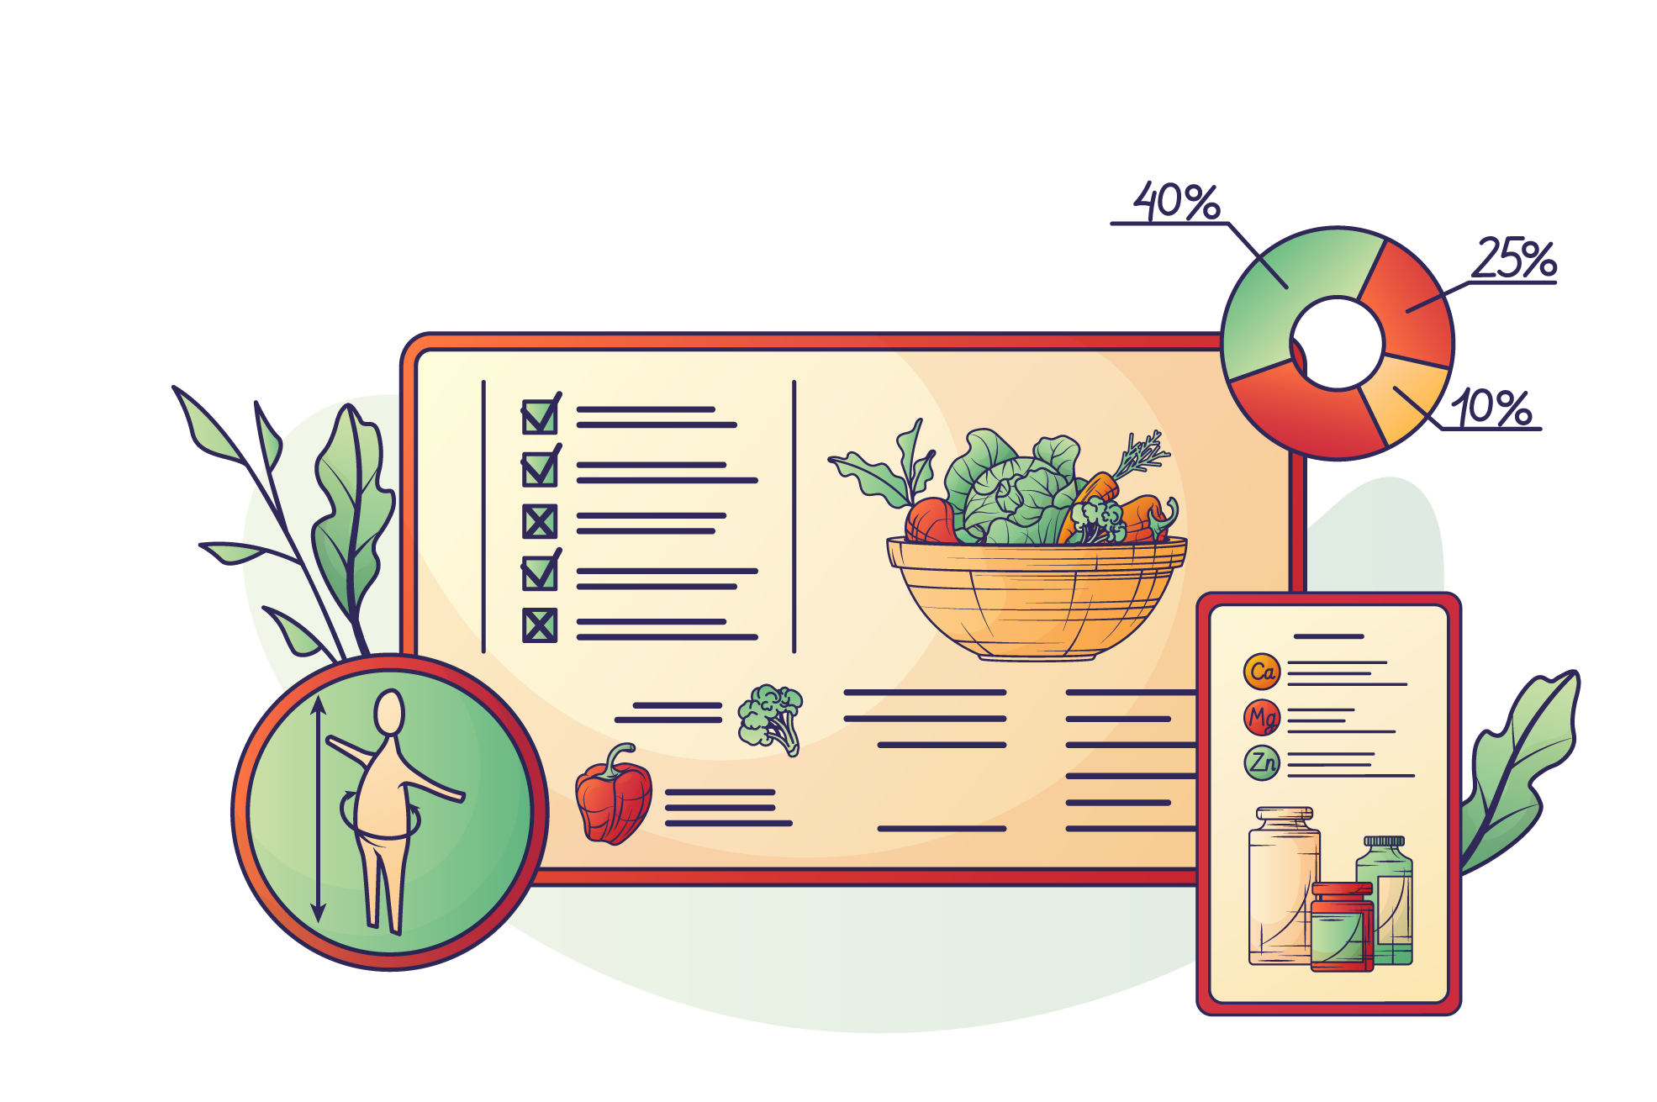
Meal Logging & History
Features:
Daily meal logging
Time-based meal categorization
Historical meal storage
Monthly dietary records

Slide 9
Dietary Pattern Analysis
Monthly Consolidation Engine
Analyzes:
Calorie trends
Protein intake
Meal consistency
Nutritional deficiencies
Dietary habits
RAG-Based Context Retrieval
Retrieves:
Historical meal patterns
Relevant nutrient summaries
User profile information

Slide 10
Recommendation Engine
Input
Output
User profile
Health information
Meal history
Nutritional trends
RAG context
Food Item
↓
Calories
Protein
Carbohydrates
Fat
Micronutrients

Slide 11
Results Obtained
Text Input | Meal extraction successful
Voice Input | Whisper transcription integrated
Image Input | Food classification working
Nutrition Mapping | FoodData Central integration working
Meal Logging | End-to-end pipeline operational
LLM Insights | Monthly recommendation generation operational

Slide 12

References
USDA FoodData Central
Food-101
Whisper Documentation
Transformers Library
PrithivML Indian-Western-Food-34 Model
Microsoft Swin Transformer Model
RAG (Retrieval-Augmented Generation) literature
Recent dietary recommendation and nutrition intelligence papers

Slide 13
Experimental Feature
WebMCP Integration
Concept:
Other AI assistants can directly submit meal entries into the system.
Benefits:
Cross-platform meal logging
Reduced manual effort
Extensible ecosystem

