Slide 1


PDS Mini Project
Group 2
By Anish, Debashish, Manoj, Nischita, Partha
Notes:
Good Morning Respected Sir, Ma’am, Today we are going to discuss wmdapca, Let us introduce ourselves, Im(admnp),

Slide 2

The Growing Need for Electric Energy
Global energy demand is rising, driven by population growth and industrialization.
Fossil fuels have been the primary energy source, but they are finite and contribute to environmental challenges.
The Problems with Conventional Energy:
Environmental Harm: Major contributor to CO2 emissions and climate change
Depleting Resources: Fossil fuel reserves are shrinking, driving costs up
Wind Energy: A Cleaner Alternative:
Renewable & Clean: No emissions and widely available.
Cost-Effective: Technological advancements have made wind energy more affordable.
Notes:
We use electric energy daily, conventional, renewable, limitations of conventional, what is renewable

Slide 3
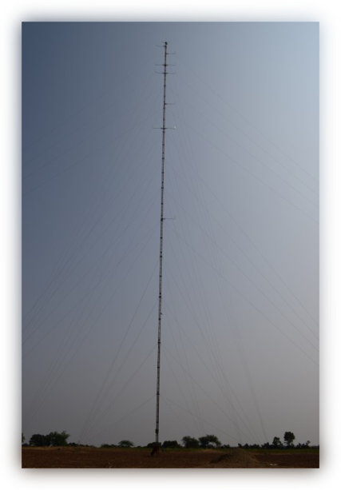

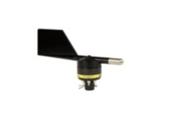
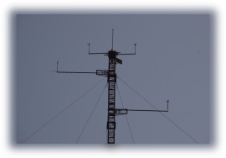
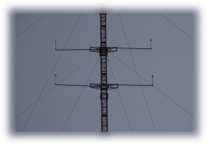
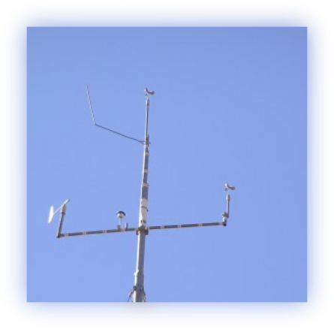
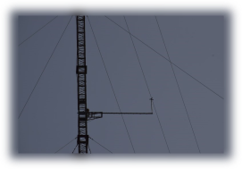
Understanding Wind Masts
A wind mast is a tall structure used to measure wind speed, direction, and other key atmospheric conditions at different heights. It provides essential data that helps in determining the viability of wind farm locations and optimizing turbine placement.
Key components
Anemometers: Measure wind speed at multiple heights.
Wind Vanes: Track the wind’s direction.
Other Sensors: Sometimes include temperature and air pressure sensors, adding context to wind data.
In this project, we focus on the choosing the right turbine model based on wind mast data and power curve analysis, to maximize energy output.
Notes:
A certain set of measurements needed for wind calculation ..

Slide 4
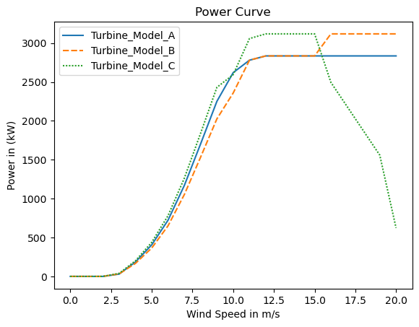
Understanding the Power Data Curve
A power curve illustrates the relationship between wind speed and the electrical output of a wind turbine. It is crucial for predicting energy production and optimizing wind turbine placement.
OEM Provided Power Curves:
Our project includes power curves for three wind turbine models provided by the OEM.
These curves help assess the performance of each model under varying wind conditions, ensuring better decision-making for installation.
Importance of Power Data Analysis:
Power curves enable us to estimate energy production efficiency
By analyzing these curves, we can determine which model performs best based on the wind data collected.
Notes:
A certain set of measurements needed for wind calculation ..

Slide 5
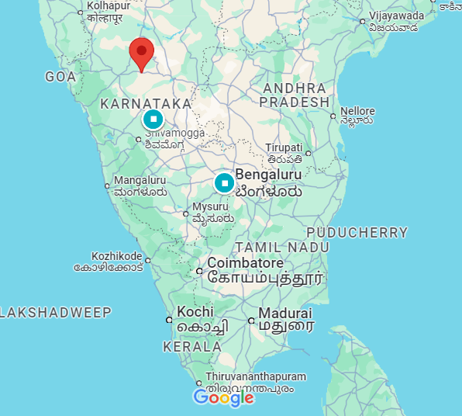
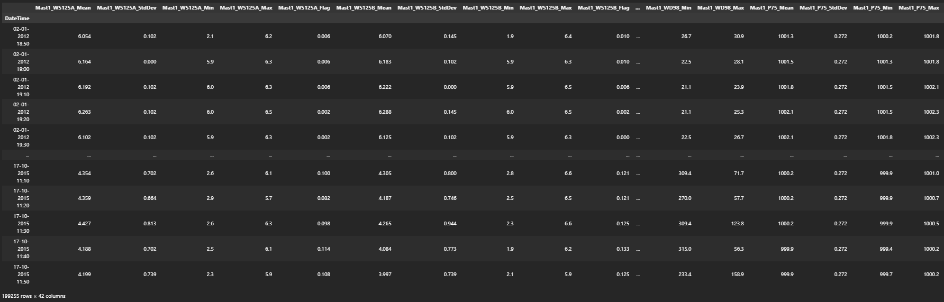
Loading ‘Mast1_zone42_wgs84_*****_******.csv’
Source: Real time meteorological mast data
How: logger which logs the information every 10 minute timestamp
What: Wind speed, Wind direction, Temperature and Pressure

Slide 6

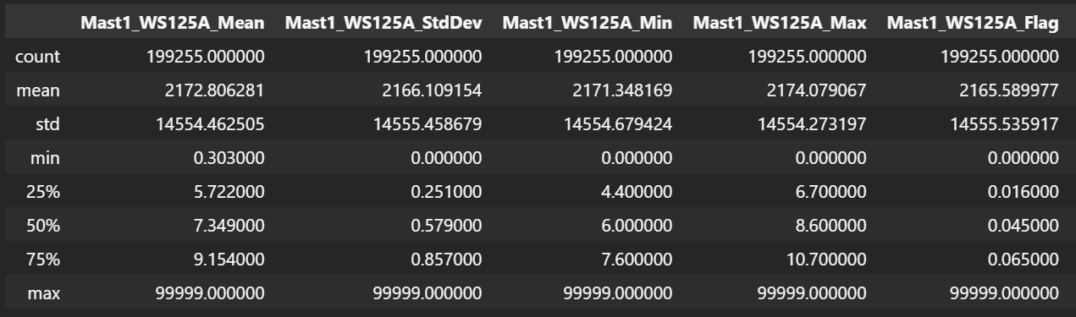
Data Cleanup:
999999 can’t be a meaningful data

Slide 7
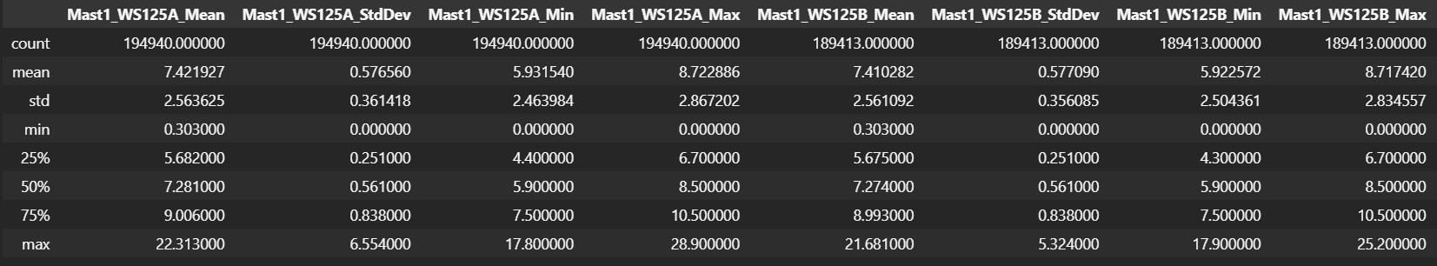
Replacing erroneous value with undefined
M1.replace(99999.000000, np.nan, inplace=True)
M1.describe()
Mean and Max values in the data now appears to be sensible

Slide 8
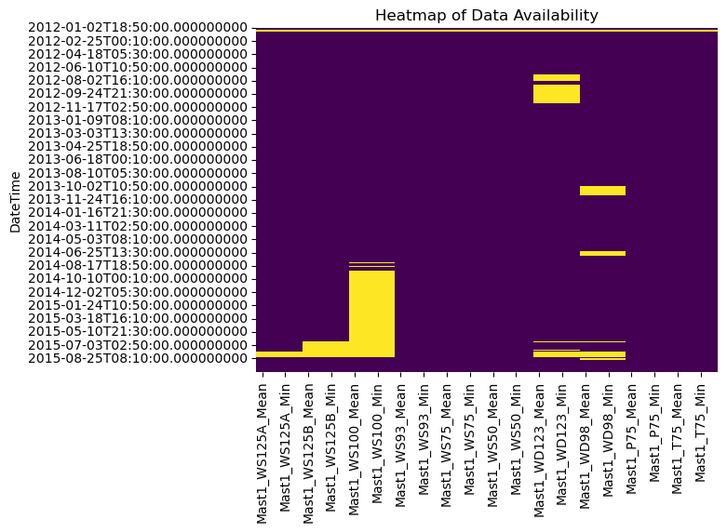
Data Availability
Yellow portion showcase the missing data in sensors

Slide 9
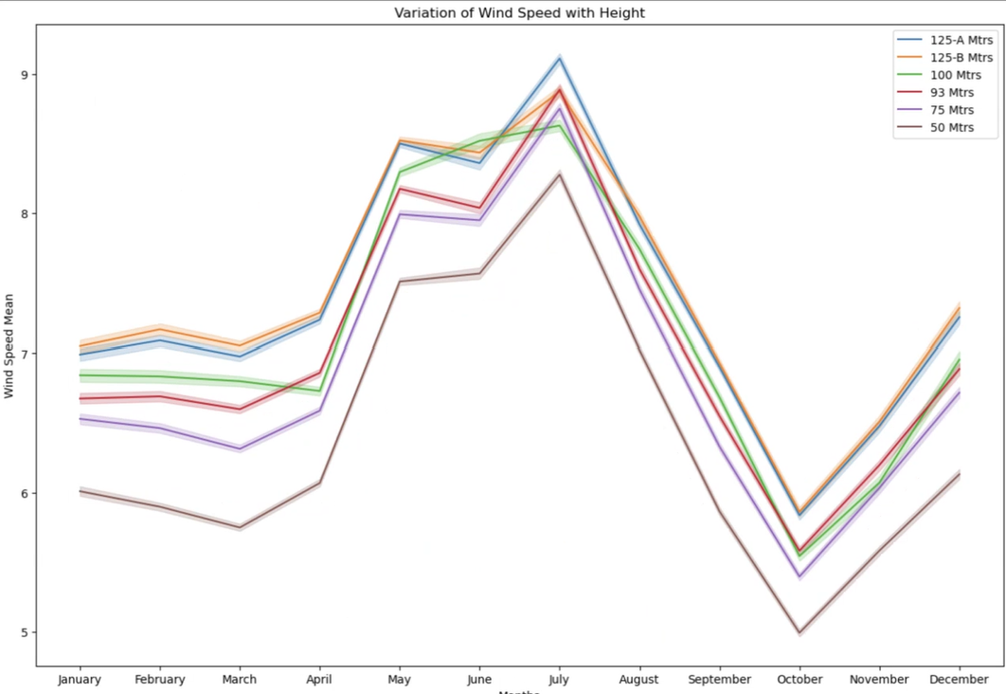
Inference of Wind Speed with Height
Wind speed in this region is seasonal
May to August is a high wind season
Wind speed increases as the height increases
100m sensor readings seemed to be erroneous, hence discarding it in further analysis
Months

Slide 10
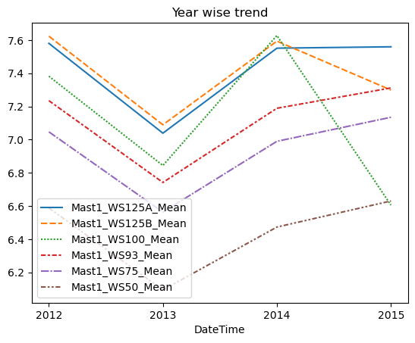
Inference of Wind Speed with Height by year
Wind speed follows same trend by year
In 2015, 100m and 125bm sensor show erroneous trend and does not match with other sensors

Slide 11
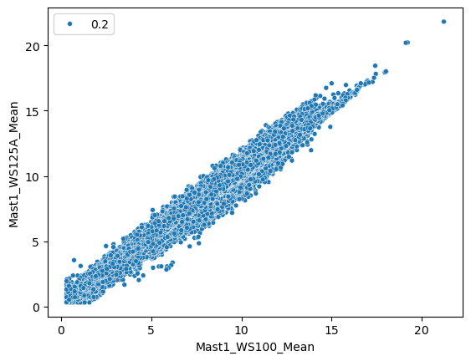
Inference of Wind Speed among 125m and 100m Sensors
Scatterplot shows few outliers
Since the amount of outliers are very few it is negligible

Slide 12
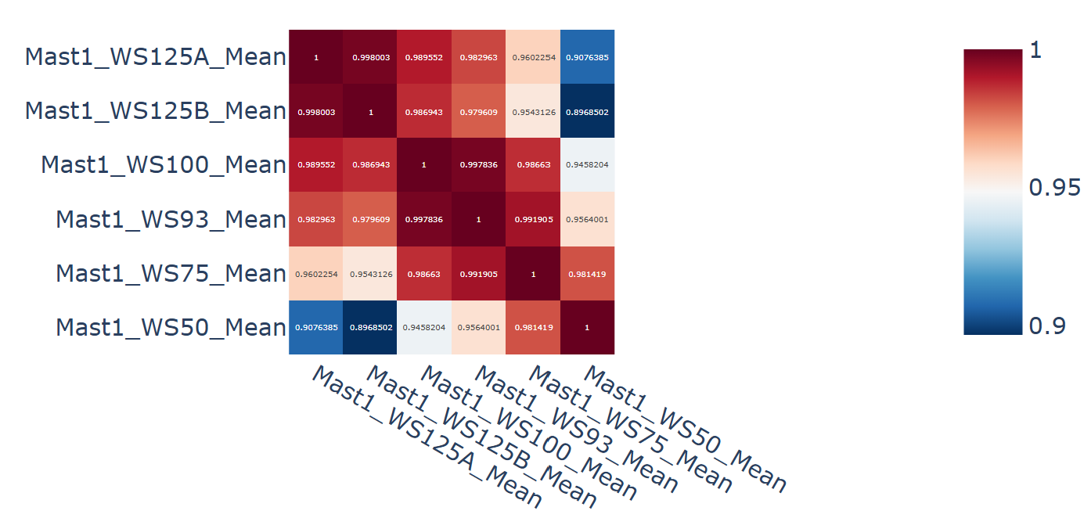
Correlation of Sensors
Correlation of wind speed sensors shows there is a strong correlation between sensors
Both Wind speed sensors that is 125A and 125B have very good correlation
This shows that there exists wind shear from the bottom to the top

Slide 13
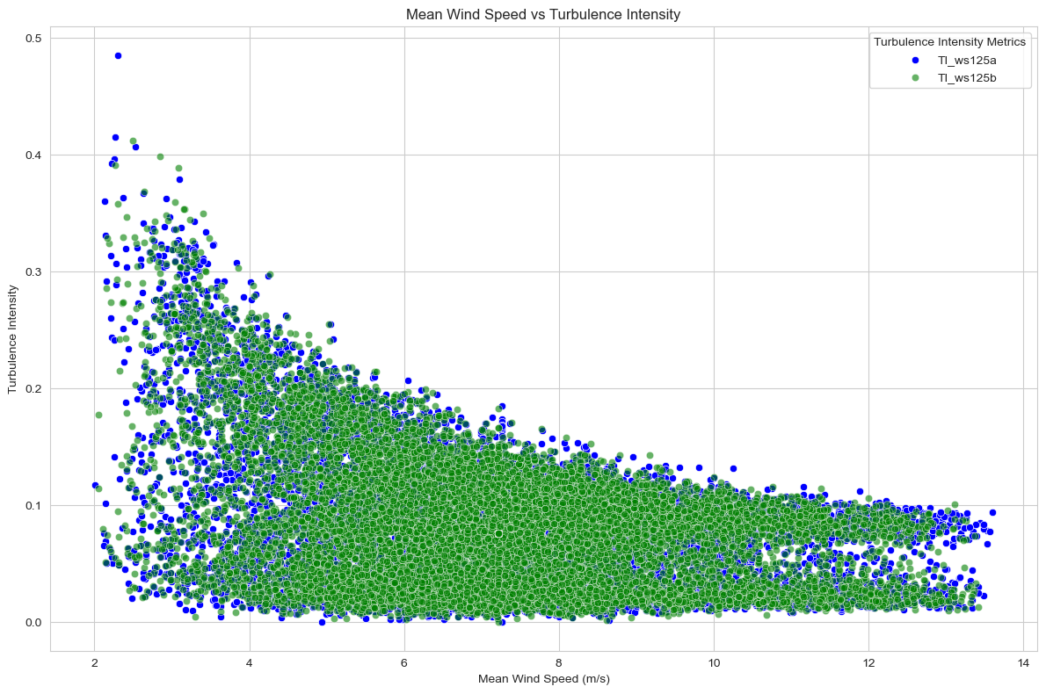
Turbulence intensity plot
Turbulence is irregularity in the wind flow
Turbulence: standard deviation/mean speed
Turbulence intensity is below 7m/s
Turbulence is low at higher wind speeds
Good sign to install wind turbine in the site

Slide 14
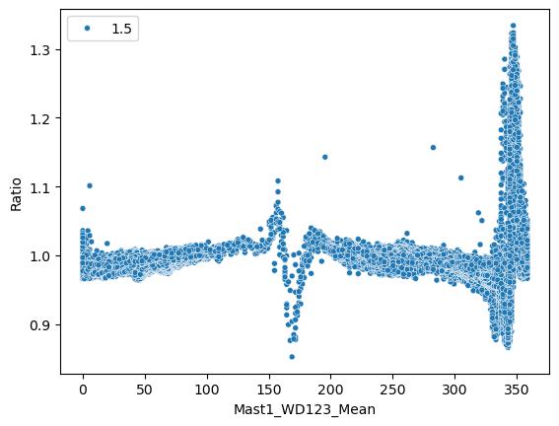
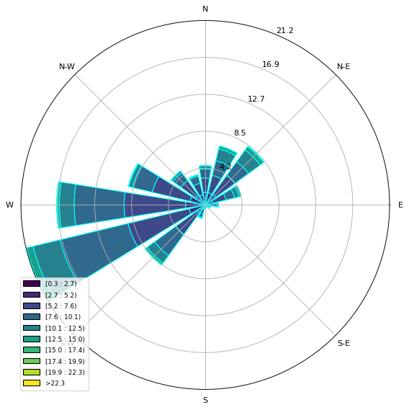
Windrose and Boom orientation findings
The boom direction of 125A and 125B sensors are found to be North-South oriented in this Mast.
The Windrose here gives information that the site has got majority of its wind coming from West and South west direction and some of the off seasonal wind coming from North-East sector

Slide 15
Windrose and Boom orientation findings
The boom direction of 125A and 125B sensors are found to be North-South oriented in this Mast.
The Windrose here gives information that the site has got majority of its wind coming from West and South west direction and some of the off seasonal wind coming from North-East sector

