Slide 1


PDS Mini Project
Group 2
By Anish, Debashish, Manoj, Nischita, Partha
Notes:
Good Morning Respected Sir, Ma’am, Today we are going to discuss wmdapca, Let us introduce ourselves, Im(admnp),

Slide 2

The Growing Need for Electric Energy
Global energy demand is rising, driven by population growth and industrialization.
Fossil fuels have been the primary energy source, but they are finite and contribute to environmental challenges.
The Problems with Conventional Energy:
Environmental Harm: Major contributor to CO2 emissions and climate change
Depleting Resources: Fossil fuel reserves are shrinking, driving costs up
Wind Energy: A Cleaner Alternative:
Renewable & Clean: No emissions and widely available.
Cost-Effective: Technological advancements have made wind energy more affordable.
Notes:
We use electric energy daily, conventional, renewable, limitations of conventional, what is renewable

Slide 3
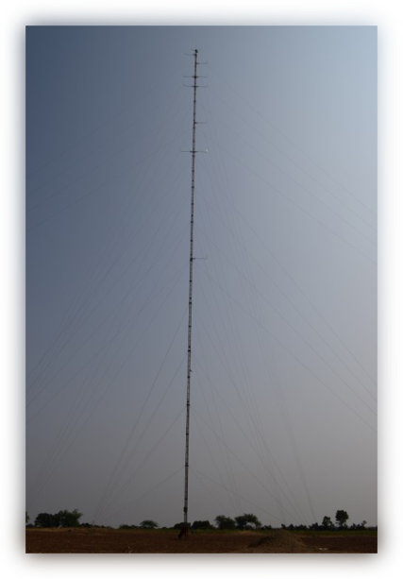

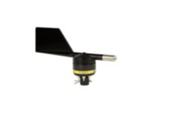
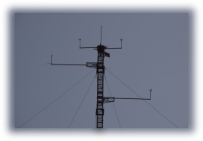
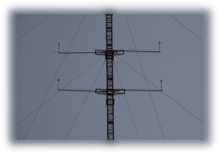
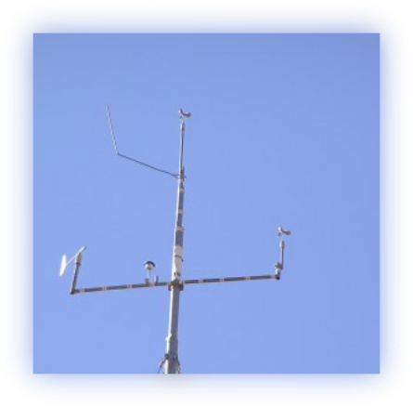

Understanding Wind Masts
A wind mast is a tall structure used to measure wind speed, direction, and other key atmospheric conditions at different heights. It provides essential data that helps in determining the viability of wind farm locations and optimizing turbine placement.
Key components
Anemometers: Measure wind speed at multiple heights.
Wind Vanes: Track the wind’s direction.
Other Sensors: Sometimes include temperature and air pressure sensors, adding context to wind data.
In this project, we focus on the strategic placement and efficiency optimization of wind turbines, based on wind mast data and power curve analysis, to maximize energy output
Notes:
A certain set of measurements needed for wind calculation ..

Slide 4
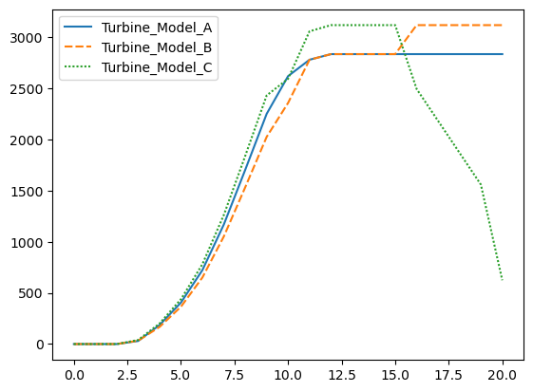
Understanding the Power Data Curve
A power curve illustrates the relationship between wind speed and the electrical output of a wind turbine. It is crucial for predicting energy production and optimizing windmill placement.
Vendor-Provided Power Curves:
Our project includes power curves for three windmill models provided by the vendor.
These curves help assess the performance of each model under varying wind conditions, ensuring better decision-making for installation.
Importance of Power Data Analysis:
Power curves enable us to estimate energy production efficiency
By analyzing these curves, we can determine which model performs best based on the wind data collected.
Notes:
A certain set of measurements needed for wind calculation ..

Slide 5
Loading ‘Mast1_ zone42_wgs84_ 473066 _ 2600838.csv’

Slide 6

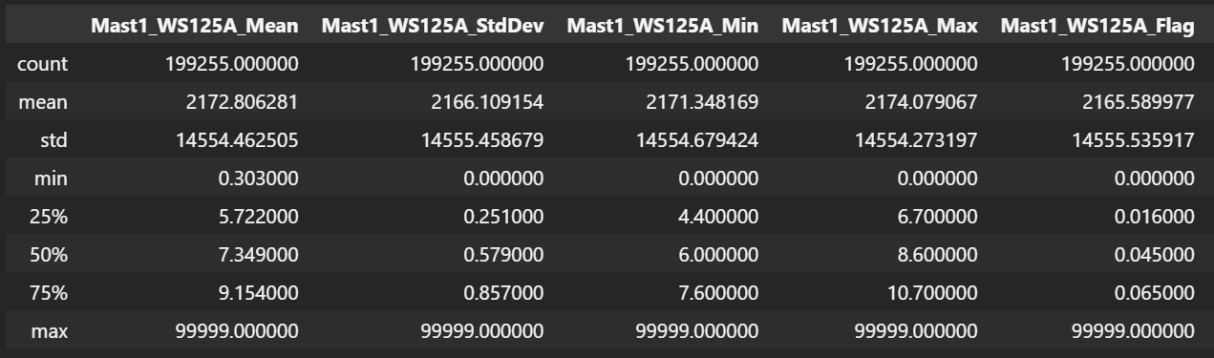

Slide 7
