Slide 1
Cardiovascular Risk Prediction
Manoj Kumar

Slide 2
Topics for discussion
Problem Statement
Treating Missing Values
Outlier Treatment
EDA
Feature Selection
Predictive Modeling
Hyper parameter tuning for best classifier
Model Evaluation
Ensembling

Slide 3
Problem Statement:
The dataset is from an ongoing cardiovascular study on residents of the town of Framingham, Massachusetts. The classification goal is to predict whether the patient has a 10-year risk of future coronary heart disease (CHD). The dataset provides the patients’ information. It includes over 3,000 records and 15 attributes.

Slide 4
Treating Missing Values
After loading the data set we look what is the data and variables in the data set and after we will use isnull function to see weather missing values present or not and we will treat the missing values with fullna function.
We fill the missing values of glucose variable with Mode values and we will drop the remaining column values having missing values

Slide 5
Outlier Treatment
plt.figure(figsize=(20,10), facecolor='w')
sns.boxplot(data=data)
plt.show()
We will see the box plot of the variables to look at any outliers present or not

Slide 6
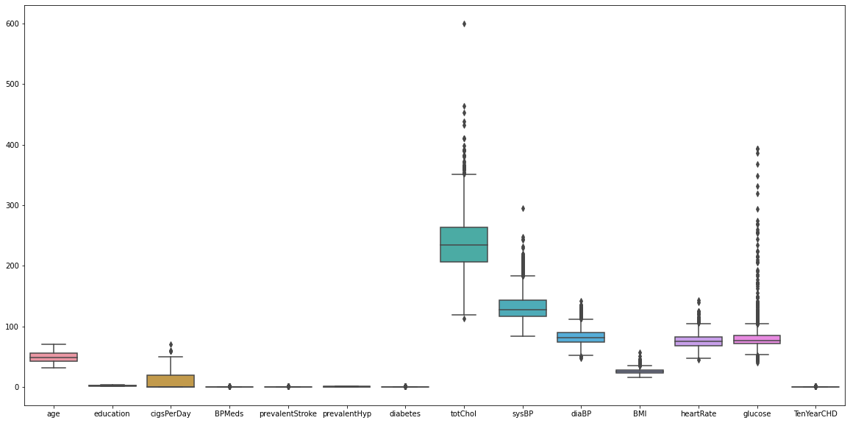

Slide 7
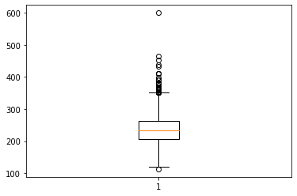
Removable Outliers are detected in totChol and sysBP columns of our dataset. Outliers in all other numerical columns are important and thus cannot be removed.

Slide 8
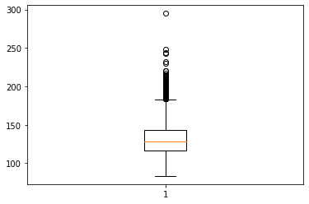
Removable Outliers are detected in totChol and sysBP columns of our dataset. Outliers in all other numerical columns are important and thus cannot be removed.

Slide 9
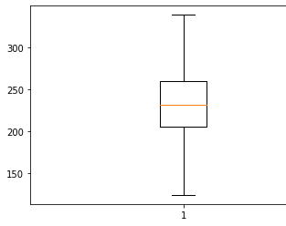
After removing Outliers

Slide 10
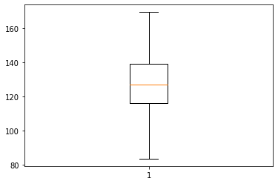
After removing Outliers

Slide 11
Exploratory Data Analysis
In Exploratory Data Analysis we have three step process
1. Univariative Analysis
2. Bivariative Analysis
3. Multivariate Analysis

Slide 12
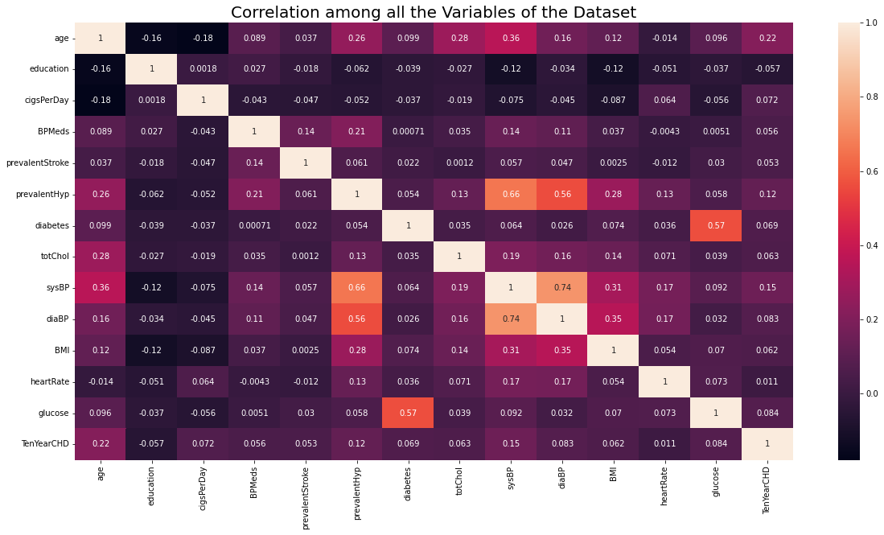
Checking relationship between variables

Slide 13
Univariate Analysis
Univariative Analysis is a two step process
1.Univariate Analysis on numerical
variables
2.Univariate Analysis on categorical
variables

Slide 14
Univariate Analysis on categorical variables

Slide 15
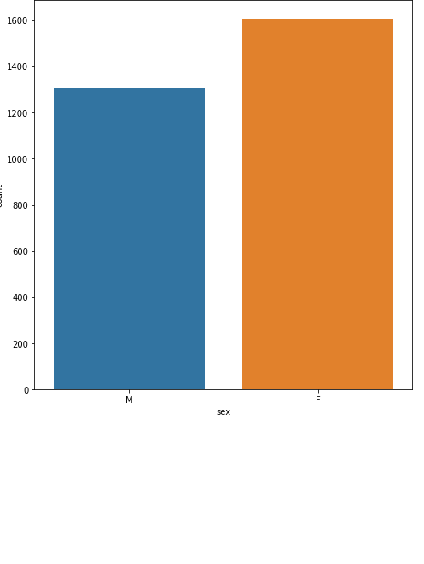
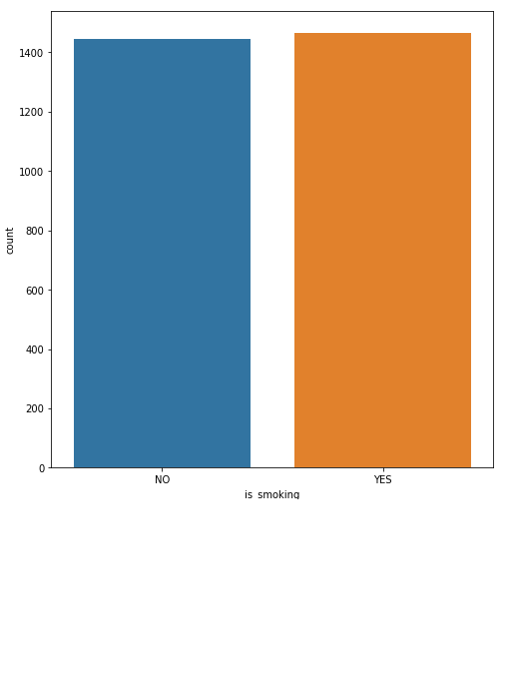
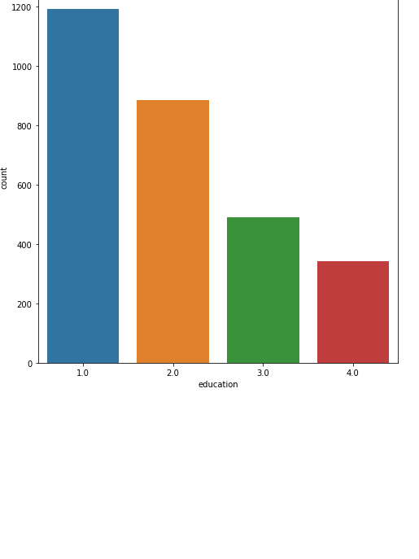

Slide 16
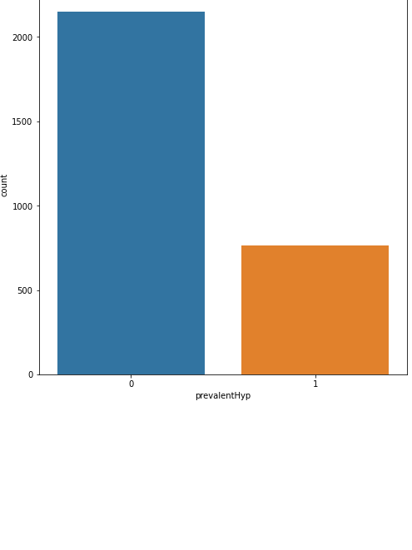
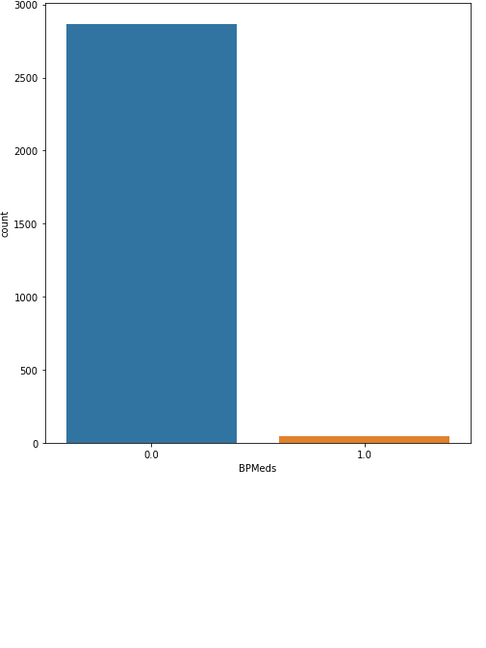
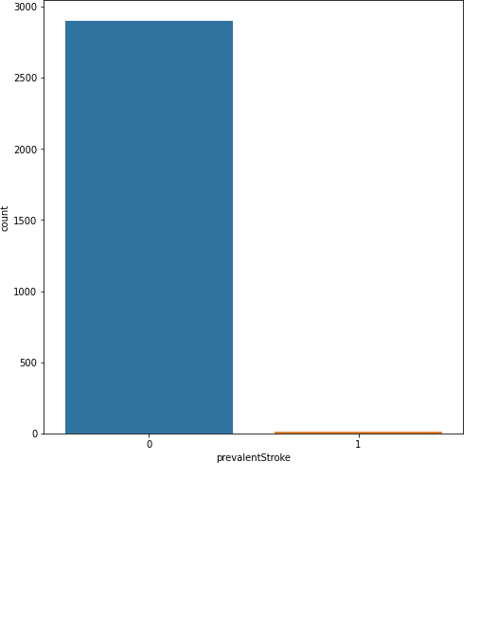
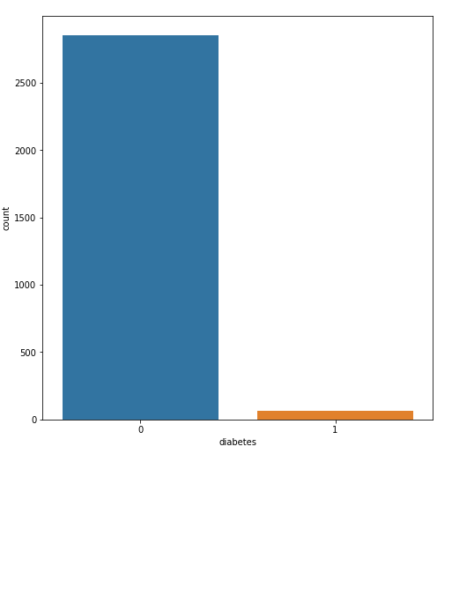
BPMeds,prevelentstroke,HYp,diabetes

Slide 17
Univariate Analysis on Numerical variables

Slide 18
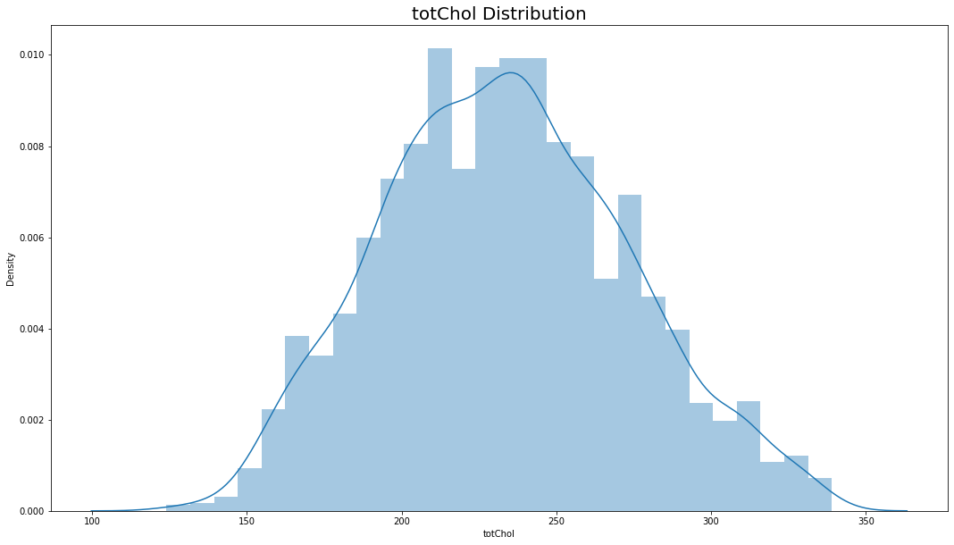
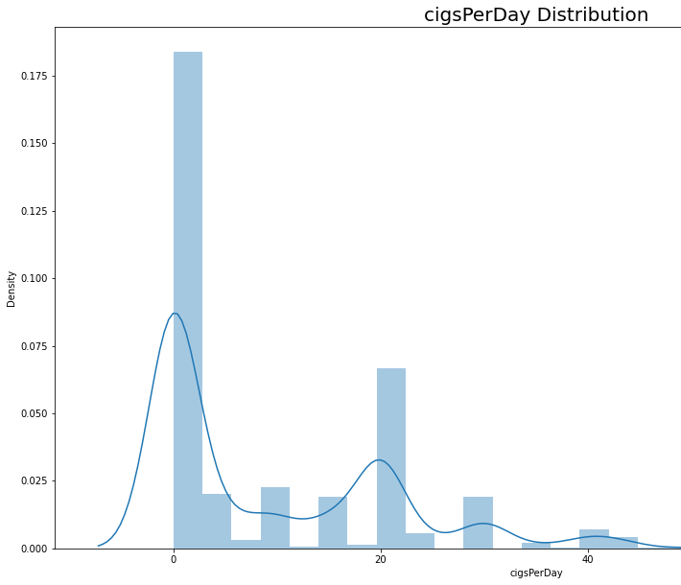
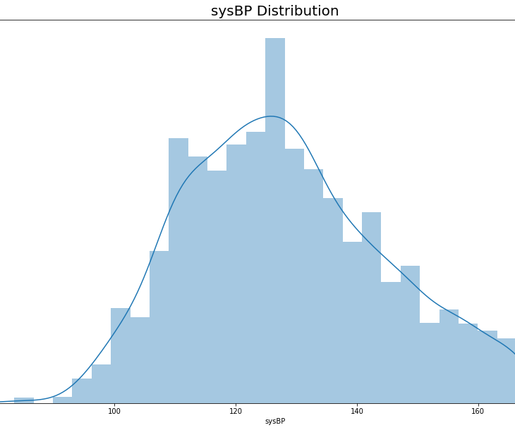

Slide 19
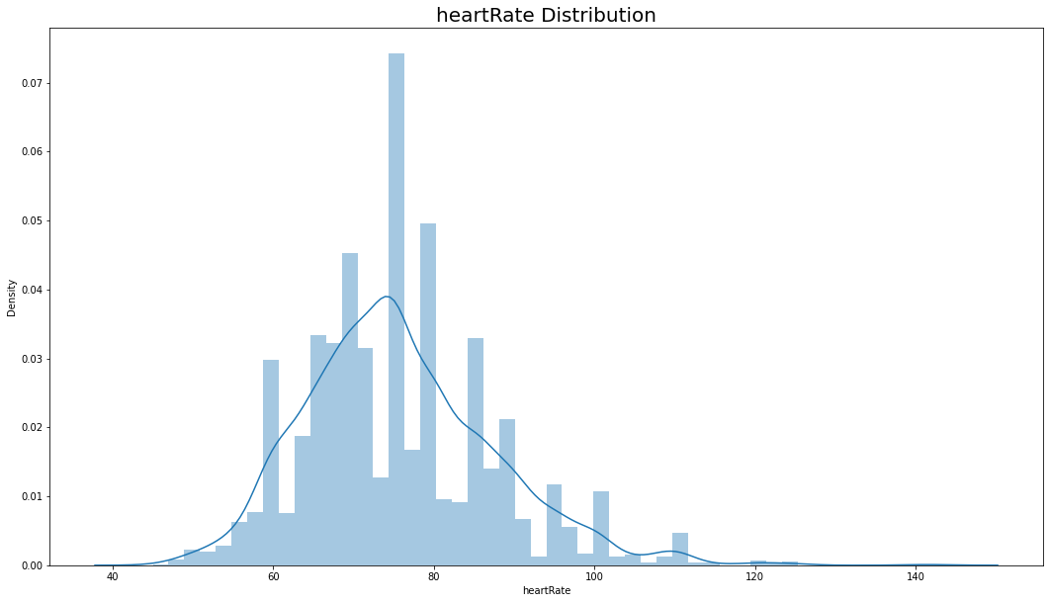
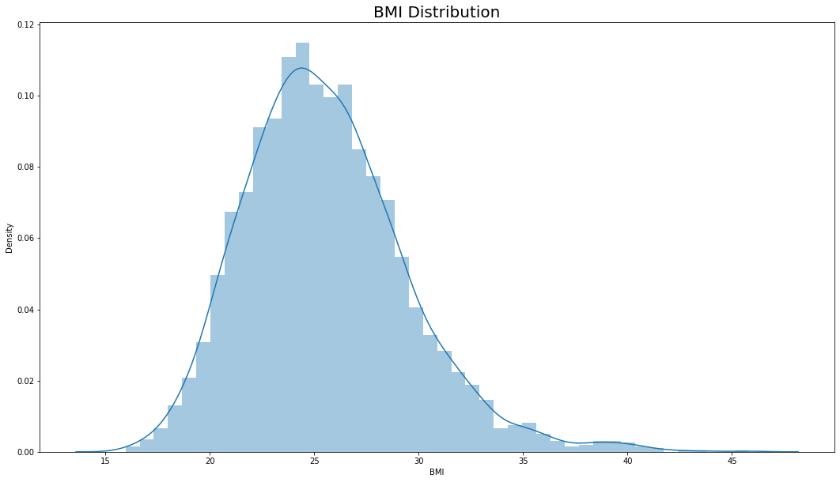
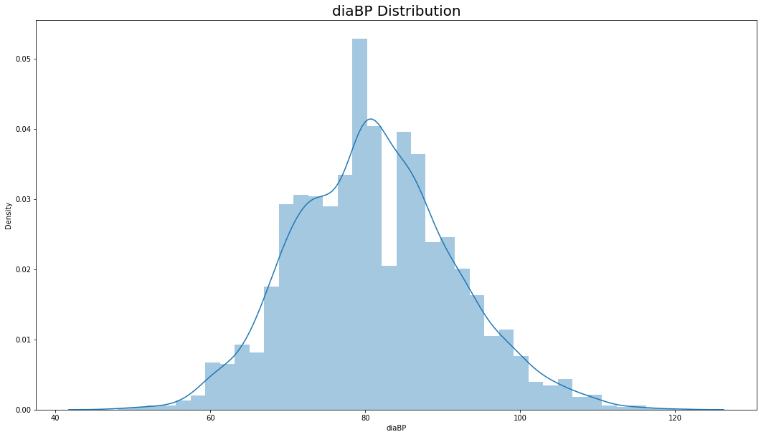
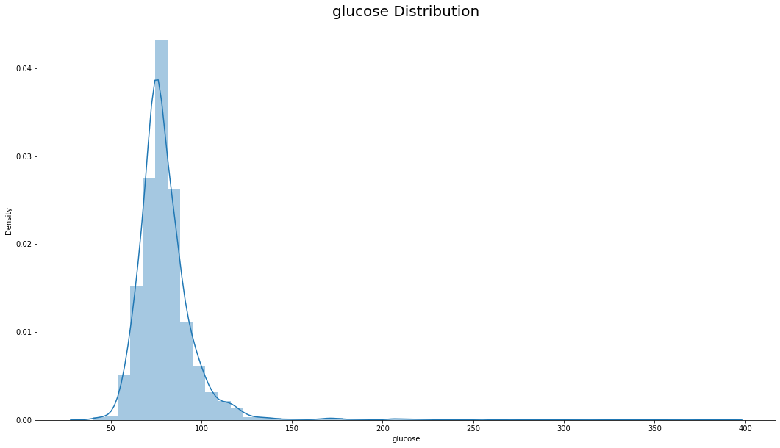

Slide 20
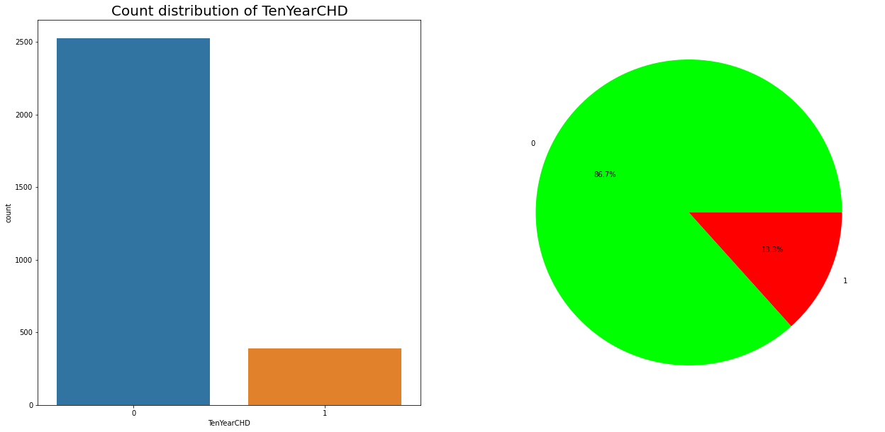
Target variable

Slide 21
Bivariative Analysis

Slide 22
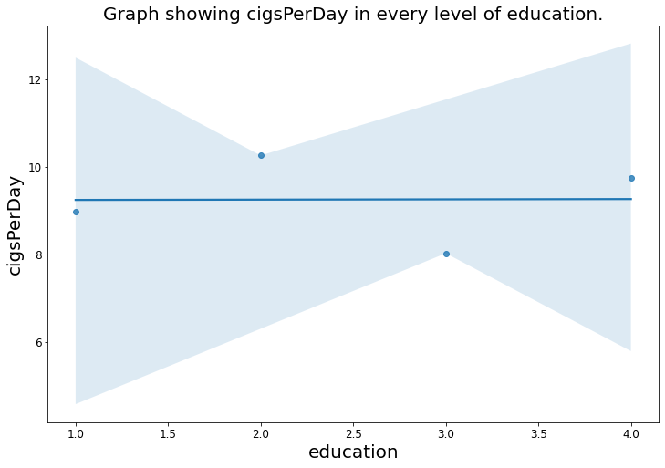

Slide 23
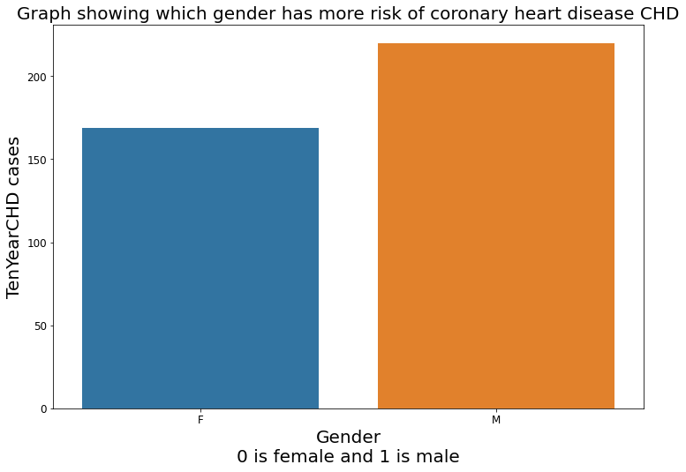

Slide 24
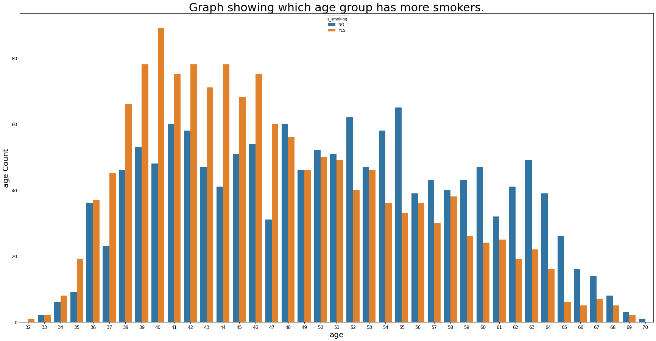

Slide 25
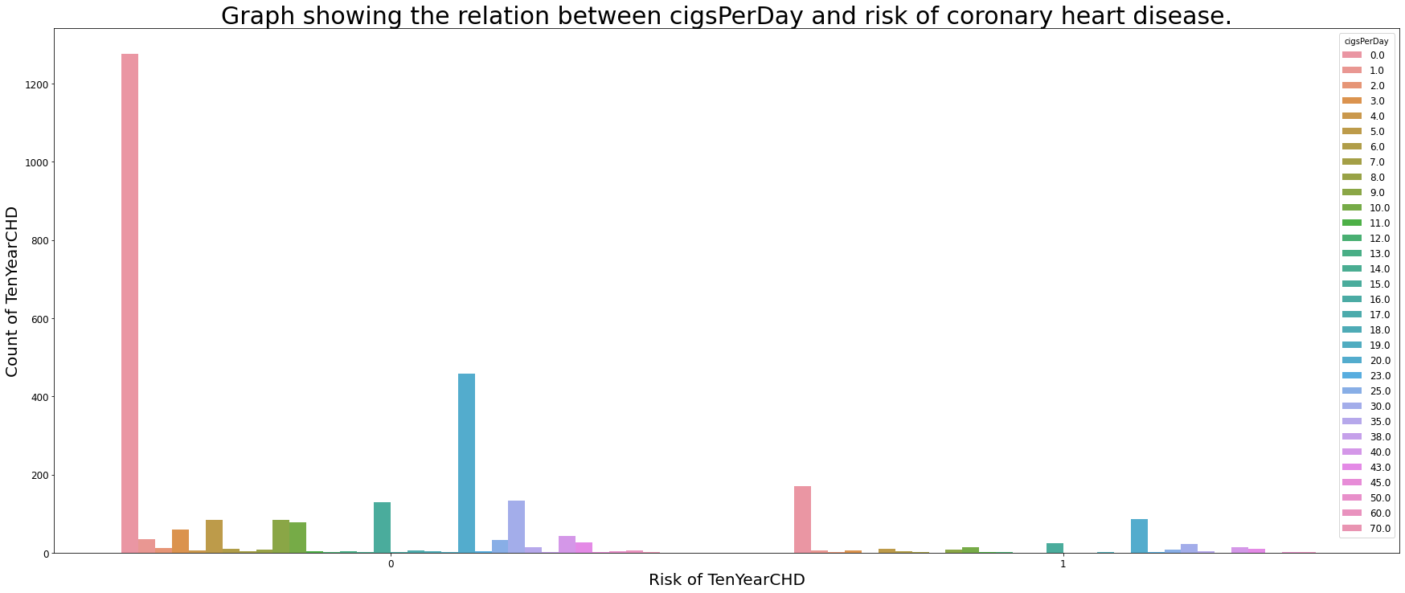

Slide 26
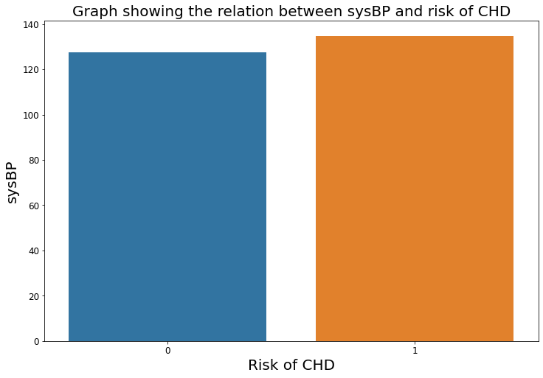

Slide 27
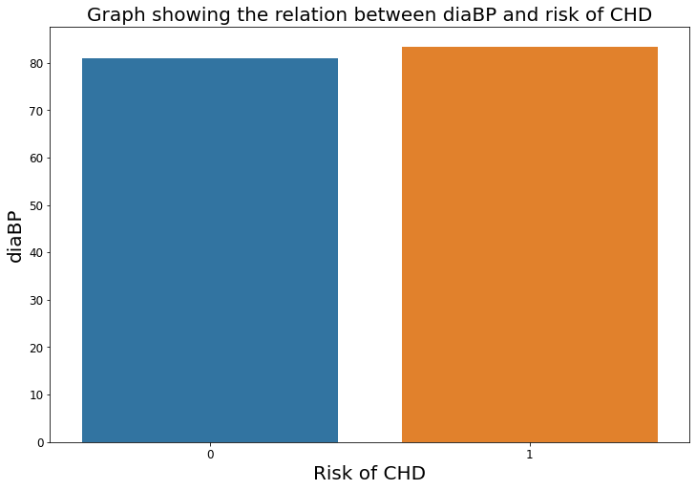

Slide 28
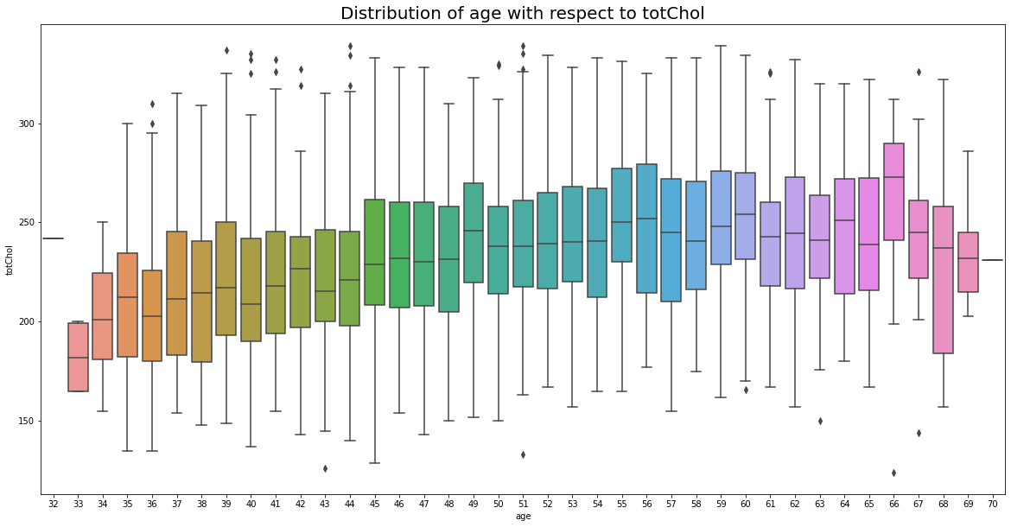

Slide 29
MULTIVARIATE ANALYSIS

Slide 30
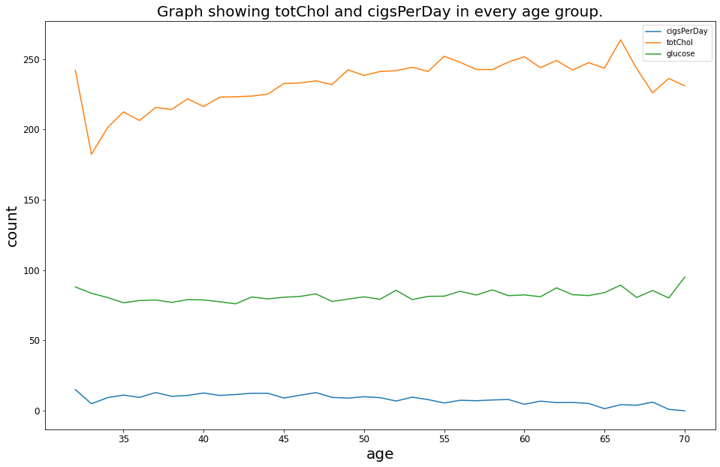

Slide 31
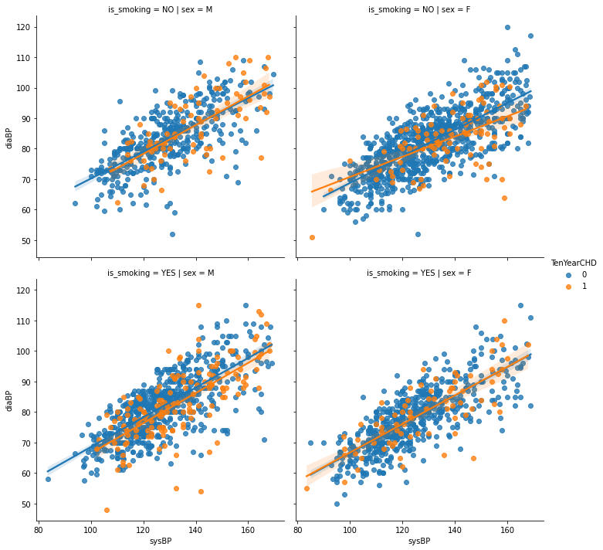

Slide 32
Feature Selection

Slide 33
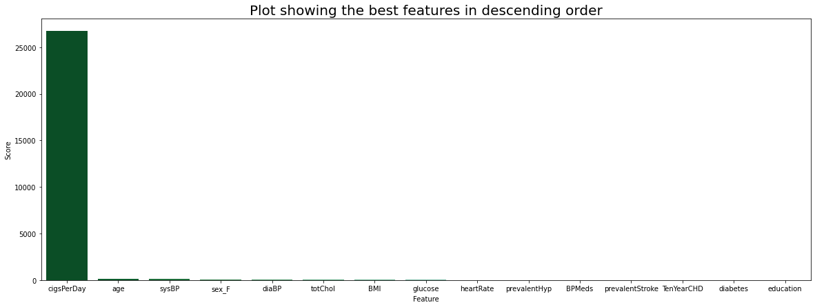

Slide 34
#Select 8 features
features=scores["Feature"].tolist()[:8]
Features:
['cigsPerDay', 'age', 'sysBP', 'sex_F', 'diaBP', 'totChol', 'BMI', 'glucose']
 | cigsPerDay | age | sysBP | sex_F | diaBP | totChol | BMI | glucose | TenYearCHD
1 | 0.0 | 36 | 168.0 | 0 | 98.0 | 212.0 | 29.77 | 75.0 | 0
2 | 10.0 | 46 | 116.0 | 1 | 71.0 | 250.0 | 20.35 | 94.0 | 0
3 | 20.0 | 50 | 158.0 | 0 | 88.0 | 233.0 | 28.26 | 94.0 | 1
4 | 30.0 | 64 | 136.5 | 1 | 85.0 | 241.0 | 26.42 | 77.0 | 0
7 | 35.0 | 36 | 102.0 | 0 | 68.0 | 295.0 | 28.15 | 63.0 | 0

Slide 35
Predictive Modeling

Slide 36
LogisticRegression
Accuracy of Logistic Regression: 86.44939965694682

Slide 37
KNeighborsClassifier
Accuracy of k-NN Classification: 78.04459691252144

Slide 38
Random Forest Classfier
Accuracy of Random Forest: 86.19210977701543

Slide 39
DecisionTreeClassifier
Accuracy of DecisionTreeClassifier: 79.15951972555746

Slide 40
Gradient Boosting Classifier
Accuracy of Gradient Boosting Classifier: 85.76329331046311

Slide 41
Hyperparameter Tuning for best Classifier
Using Randomized Search Cross Validation
Random Forest Classifier
Accuracy on training set is : 0.8964530892448512
Accuracy on validation set is : 0.8636363636363636
Accuracy of Hyper-tuned Random Forest Classifier: 86.36363636363636
Gradient Boosting Classifier
Accuracy on training set is : 1.0
Accuracy on validation set is : 0.7958833619210978
Accuracy of Hyper-tuned Gradient Boosting Classifier: 79.58833619210978

Slide 42
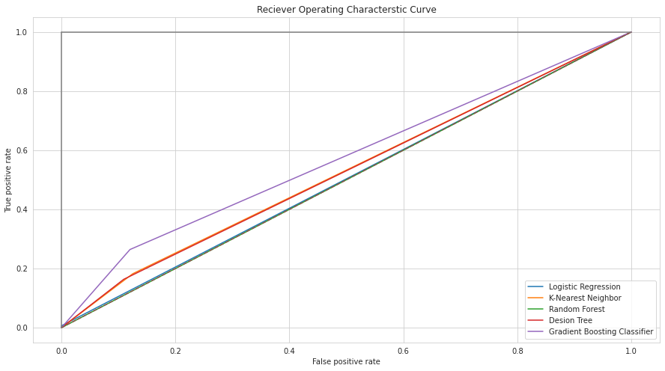

Slide 43
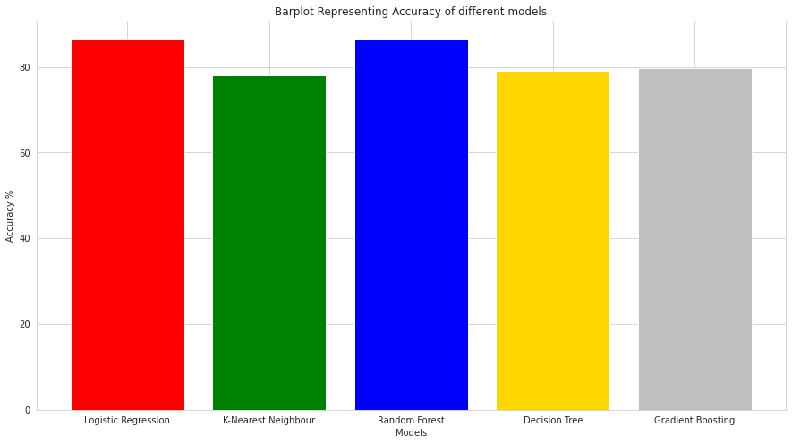

Slide 44
# Ensembling
scv=StackingCVClassifier(classifiers=[rf_hyper, gb_hyper, knn,lr], meta_classifier= rf)
Accuracy of StackingCVClassifier: 86.44939965694682

Slide 45
Conclusion
⦁ Read the file and displayed its columns.
⦁ Handled missing values, Outliers and Duplicate Data.
⦁ Calculated basic statistics of the data (count, mean, std, etc), did exploratory analysis and described my observations.
⦁ Selected columns that will probably be important to predict heart disease.
⦁ Created training and testing sets (using 60% of the data for the training and reminder for testing) and scaled the data using MinMaxScaler.
⦁ Built 5 different machine learning models to predict TenYearCHD:
⦁ Logistic Regression - 86.44% Accuracy
⦁ kNN Classification - 78.04% Accuracy
⦁ Random Forest Classification - 86.19% Accuracy
⦁ Decision Tree Classification - 79.15% Accuracy
⦁ Gradient Boosting Classification - 85.76% Accuracy
⦁ Hyperparameter tuned the RandomForestClassification - 86.36% and GradientBoostingClassification - 79.58%.
⦁ Evaluated each model (f1 score, Accuracy, Precision ,Recall and Confusion Matrix) and plotted a graph for the false positive rate and true positive rate for each model.
⦁ Ensembled the four best models using Stacking technique to further increase the accuracy of the model and achieved an accuracy score of 86%
⦁ Concluded that Ensembling all the four most important models, with Random Forest Classification & logistic regression leading the way, has resulted in a very high accuracy score.

