Slide 1
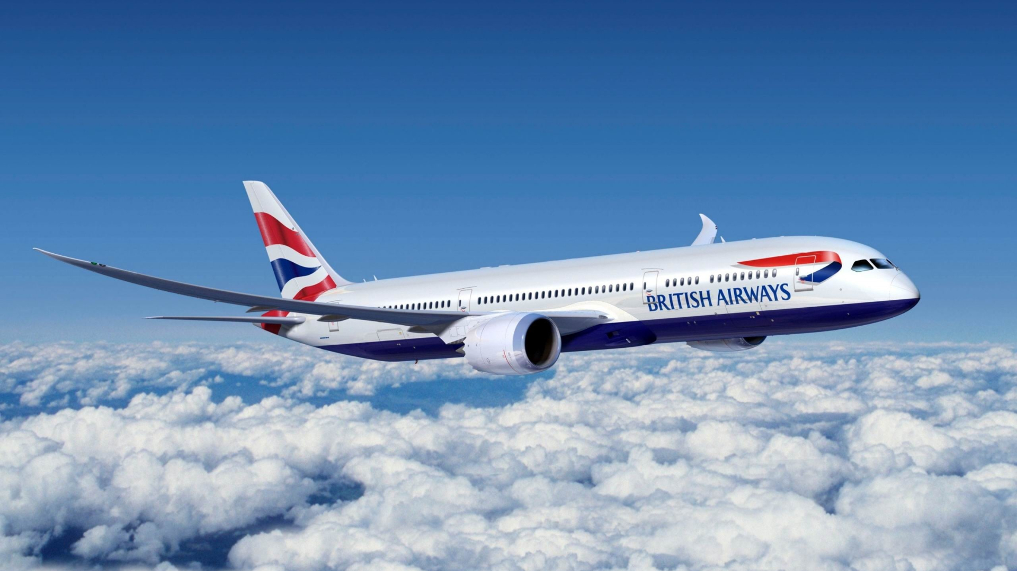


Slide 2
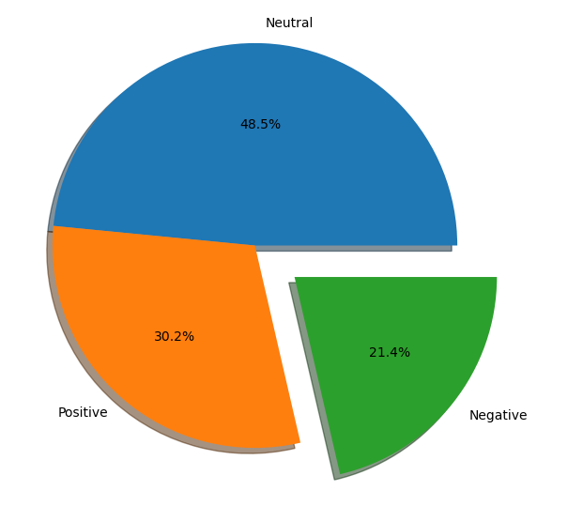
Sentiment Analysis
Positive Sentiment: 30.2%
Customers expressed satisfaction with services, amenities, and staff interactions.
Commendation for comfortable and well-maintained cabins.
Positive feedback regarding efficient booking and check-in processes.
Negative Sentiment: 21.4%
Criticisms about flight delays and disruptions affecting travel plans.
Complaints about customer service response time and issue resolution.
Negative comments about in-flight entertainment and food quality.
Neutral Sentiment: 48.4%
Neutral sentiments encompass general observations and factual statements.
Examples include flight information updates, basic service descriptions, etc.

Slide 3

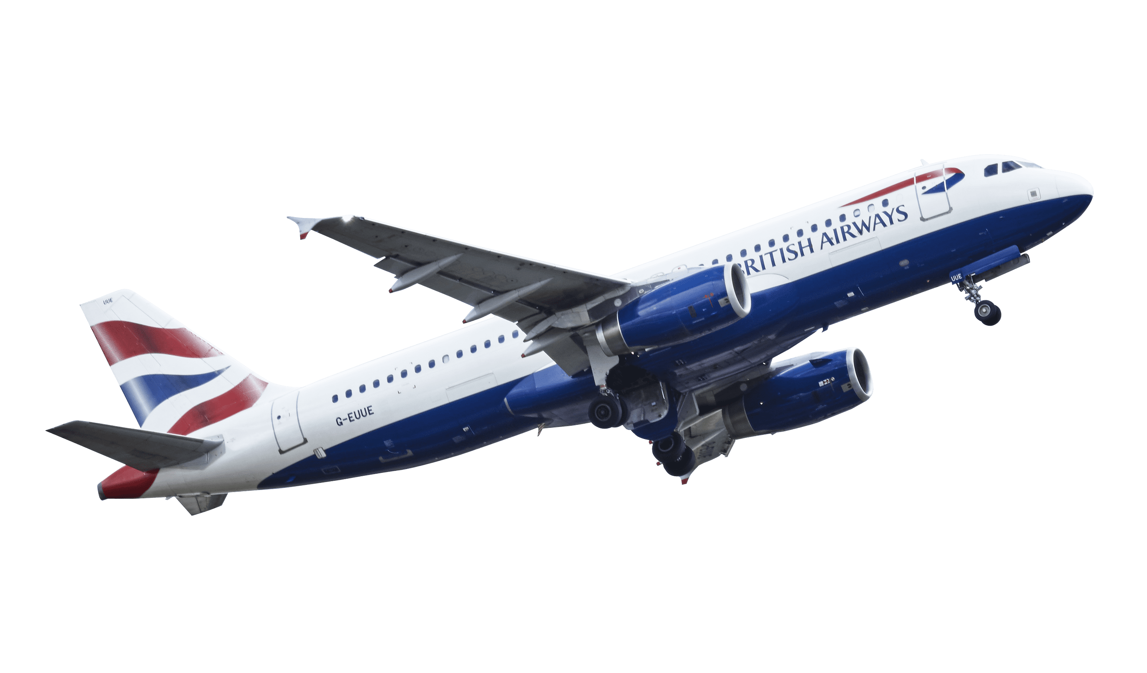
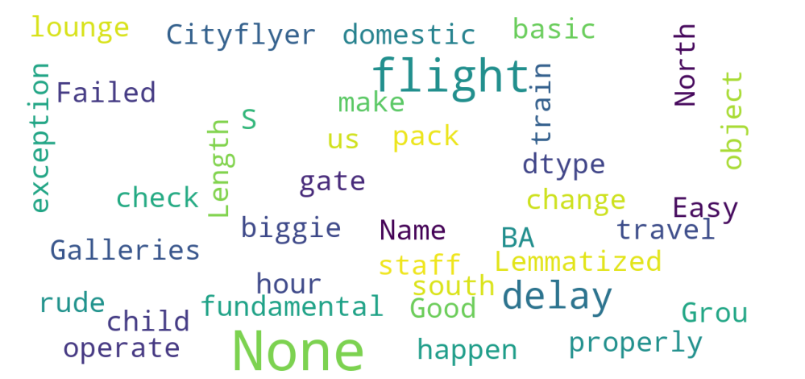

Slide 4

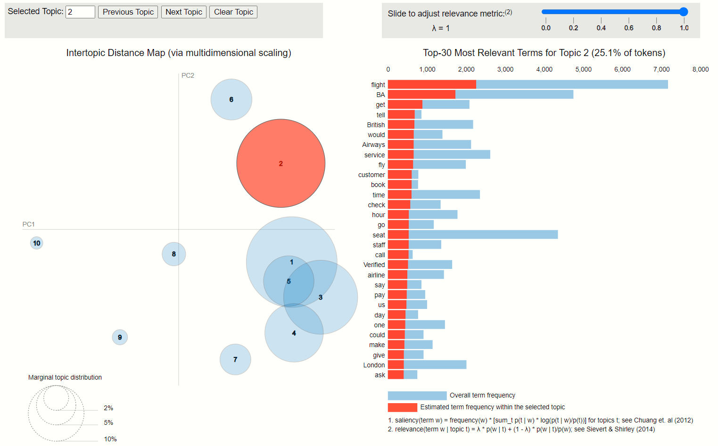
Visualization on the topics

