Slide 1

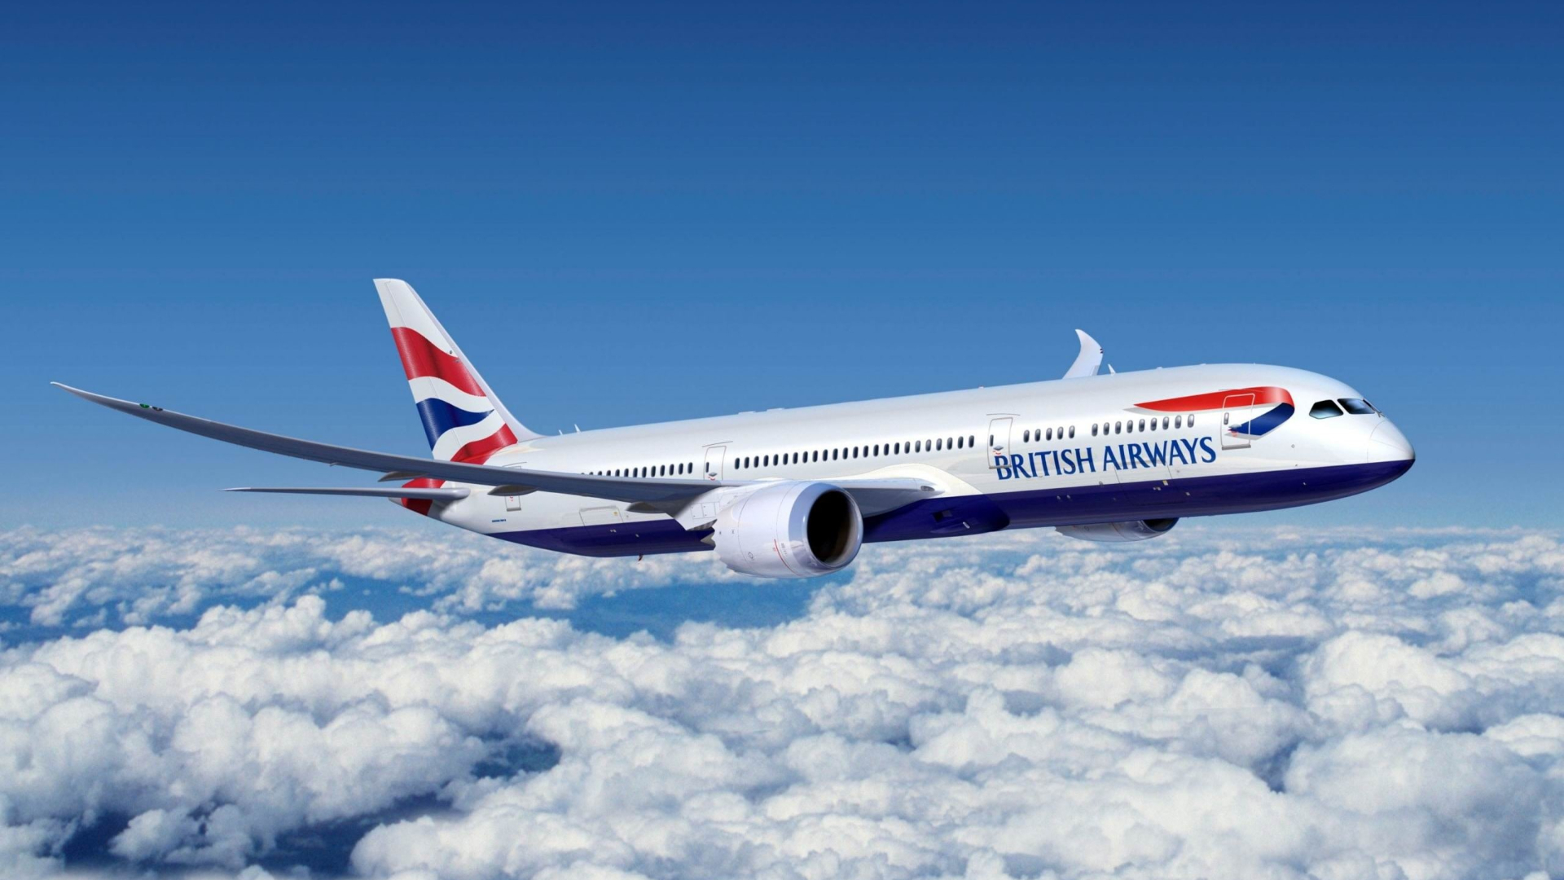
predictive model to understand factors that influence buying behaviour

Slide 2
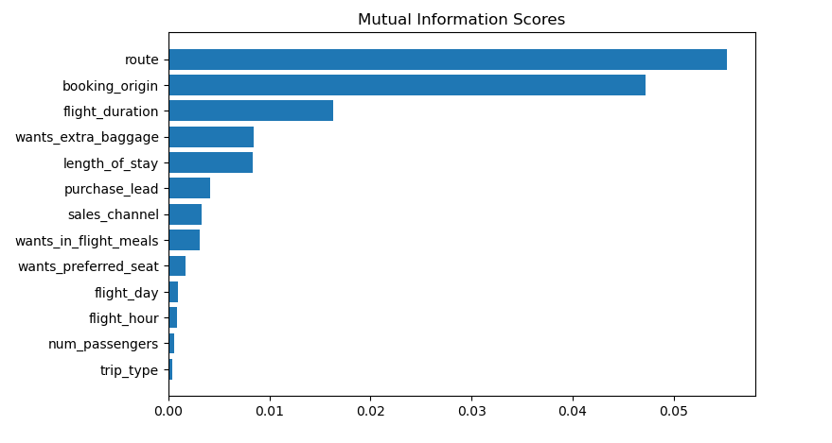
Predictive model to understand factors that influence buying behaviour
We have trained the data set with various model and received
ACCURACY: 85.02
route
booking_origin
flight_duration
wants_extra_baggage
length_of_stay
These are the top 5 features which influence
Customer buying behavior

Slide 3
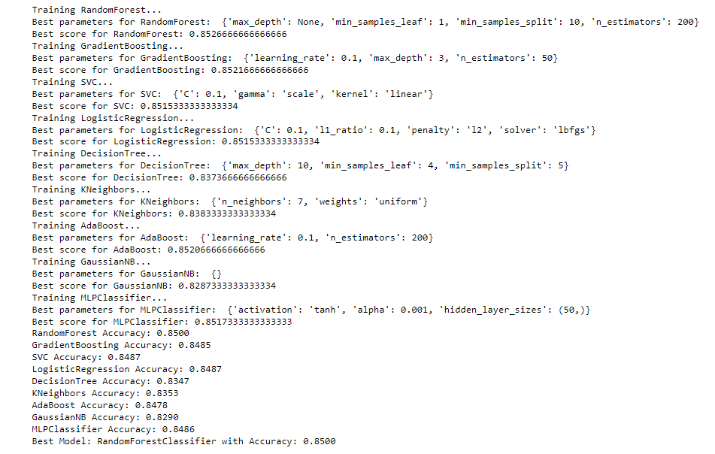
Result of Various Model

