Slide 1

Heart Failure Prediction
Saving Lives
Manoj Kumar Nallamala

Slide 2
Project Charter
Project Name : Heart Failure Prediction | Champion:
Business Owner Or Process Owner : NA | Project Leader : Manoj Kumar Nallamala
Problem Statement : Predicting the chances of heart failure based on various factors such as Blood Pressure, Platelets count, Ejection Fraction. | Project Goal : The goal of this project is to predict any and all heart failure in doing so we will use Machine Learning algorithms in achieving an accuracy of 95% for heart failure prediction.
Business Case : Every year, about 805k people in the United States have a heart attack. Of these, 605k had first heart attack and,200k happen to people who have already had a heart attack. About 1 in 5 heart attacks are silent—the damage is done, but the person is not aware of it. We can make this model available to doctors for first line of diagnosis | Project Scope : Collecting and preprocessing data of people on various factors indicating their health condition. With Our model we will be identifying potential factors for heart failure by machine learning algorithms. We will be using Regression techniques on the data collected and predicting the heart failure rate of a person.
Team Members : | Benefits : Early prediction of heart failure Doctors can suggest the proper diet to people on analysing the potential factors for heart failure Timeline : Proposal - Sept 18th Model Development Oct 10th Analysis – Nov 10th Final Report – Dec 5th

Slide 3
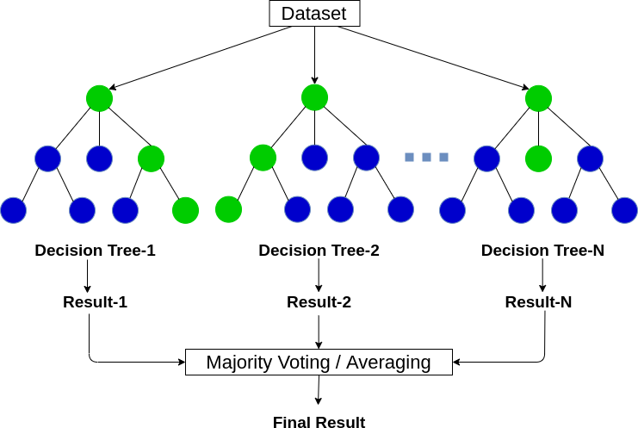
Model Selection
Random Forest:
A random forest is a machine learning technique that’s used to solve regression and classification problems.
As we have discussed before, multiple decision trees can be constructed on the same dataset. Random forest aggregates all possible trees than can be constructed and decides the final outcome based on the majority vote of the individual trees.

Slide 4
Model Analysis
We have used RandomForestClassifier function from sklearn open source package.
A decision tree is a popular classification structure used in machine learning. It is
a map of the possible outcomes of a series of related choices.
A decision tree typically starts with a single node, which branches into possible outcomes. Each of those outcomes leads to additional nodes, which branch off into other possibilities. This gives it a treelike shape.
Multiple decision trees can be constructed on same dataset.
Picking the best tree from the constructed trees will lead us to a even better model for predicting heart failure. We have constructed 10 different decision trees, which can be passed as value for argument “ n_estimators”.
We have used criterion as “entropy” which is a measure of chaos within the node. And chaos, in the context of decision trees, is having a node where all classes are equally present in the data

Slide 5
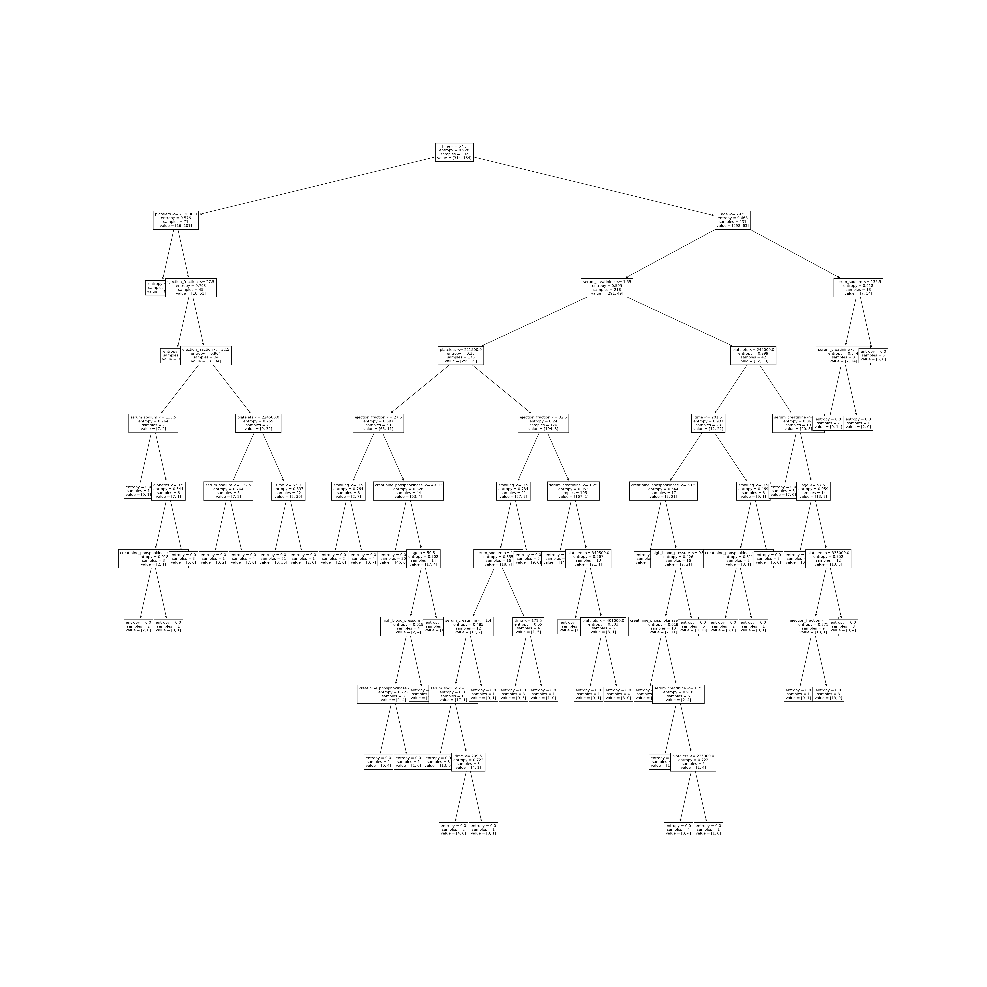

Slide 6
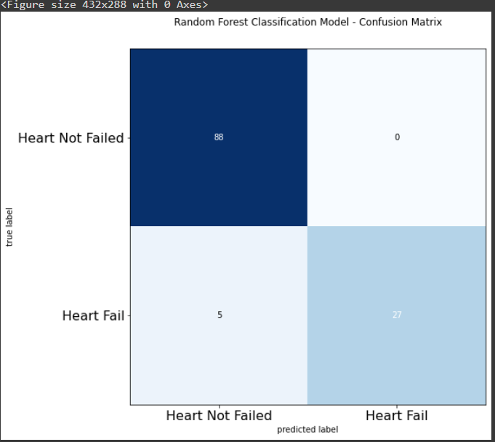
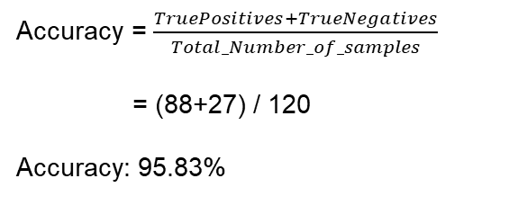
Confusion matrix evaluation for Random Forest
Confusion matrices are used to visualize important predictive analytics like recall, specificity, accuracy, and precision.
Confusion matrices are useful because they give direct comparisons of values like True Positives, False Positives, True Negatives and False Negatives
Accuracy = $\frac{TruePositives+TrueNegatives}{Total_Number_of_samples}$
= (88+27) / 120
Accuracy: 95.83%

Slide 7
Conclusion
As observed from the results of various models that we used, Random Forest algorithm gave the best accuracy (95.8%) for the predictions.
Decision tree models have second best performance among the remaining models with an accuracy of 93.3%.
It is quite obvious as to why Random Forest performed better than Decision Tree model because it builds on decision trees and overcomes the shortcomings of individual trees.
Random Forest also performs better on large datasets compared to many other algorithms in machine learning.

