Slide 1

Sentiment Analysis of IMDB Movie Reviews Using Deep Learning
Jashwanth Desaboina (1002086684)
Manoj Kumar Nallamala (1002075929)
Sai Srinivasa Karthik Stanam (1002064923)

Slide 2

Data Preprocessing
HTML tag removal is the process of removing markup tags from an HTML document in order to extract or display its plain text content.
Lowercase conversion is the process of transforming all of the letters in a text to their lowercase (small letter) form, usually for consistency or formatting.
Tokenization is the process of separating a text into distinct units, usually words or symbols, in order to aid analysis or natural language processing tasks.
Stopword removal entails removing common and inconsequential terms (e.g., "and," "the," "in") from a text in order to focus on more meaningful material when processing or analyzing text data.
The steps described above are necessary to guarantee that the text data is clean, homogeneous, and ready for further analysis with natural language processing algorithms.

Slide 3
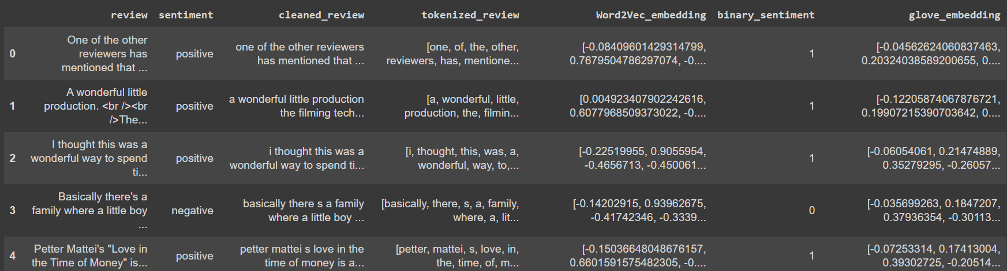
Preprocessed Dataset sample after Data preprocessing & Embedding

Slide 4

LSTM
Long Short-Term Memory (LSTM) is a sort of recurrent neural network architecture that is capable of learning and retaining long-term dependencies and patterns.
There are Four types of LSTM we used
Basic LSTM Model with Word2Vec Embedding
LSTM with Dropout and Early Stopping
LSTM with Glove embedding
Bidirectional LSTM

Slide 5
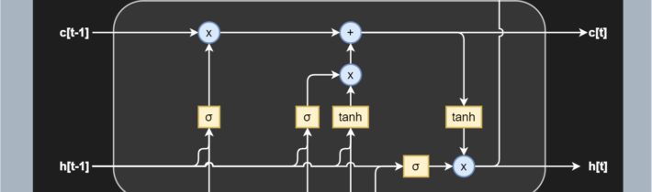
Basic LSTM Model with Word2Vec Embedding
A basic LSTM model with Word2Vec embedding is a recurrent neural network design that analyzes and predicts data sequences using Word2Vec word embeddings, making it particularly ideal for natural language processing tasks.

Slide 6
Basic LSTM Model with Word2Vec Embedding
Parameter | Value
Model Type | Sequential Model with LSTM Layer
Embedding Dimension | 128
Input Shape | (1, Embedding Dimension)
Number of LSTM Units | 64
Number of Dense Units | 1
Activation Function | Sigmoid
Training Data | Tokenized and Embedded Word2Vec Vectors
Parameter | Value
Model Type | Sequential Model with LSTM Layer
Embedding Dimension | 128
Input Shape | (1, Embedding Dimension)
Number of LSTM Units | 64
Number of Dense Units | 1
Activation Function | Sigmoid
Training Data | Tokenized and Embedded Word2Vec Vectors

Slide 7
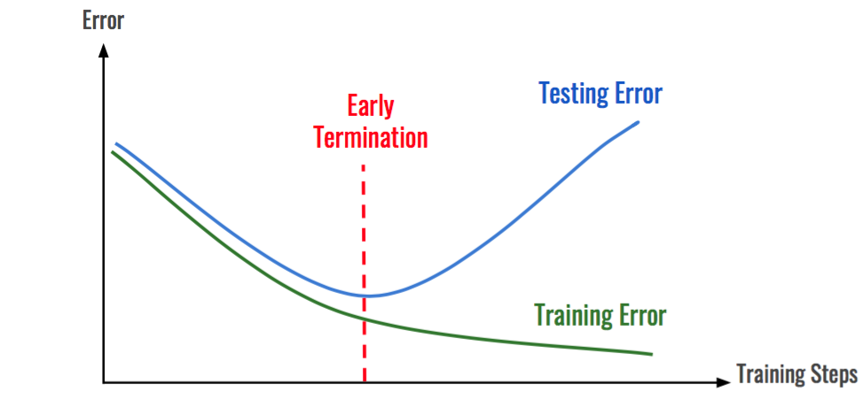
LSTM with Dropout and Early Stopping
A recurrent neural network design known as an LSTM model with dropout and early stopping contains dropout layers to minimize overfitting and early stopping to cease training when performance reaches a plateau, improving generalization and training effectiveness.

Slide 8
LSTM with Dropout and Early Stopping
Parameter | Value
Model Type | Sequential Model with LSTM Layers and Dropout
Embedding Dimension | 128
Input Shape | (1, Embedding Dimension)
Number of LSTM Units | 128, 64
Dropout Rate | 0.5
Number of Dense Units | 1
Activation Function | Sigmoid
Parameter | Value
Validation Data | Tokenized and Embedded Word2Vec Vectors
Test Data | Tokenized and Embedded Word2Vec Vectors
Loss Function | Binary Cross-Entropy
Optimizer | Adam
Learning Rate | 0.0001
Early Stopping Patience | 3
Evaluation Metric | Accuracy

Slide 9
LSTM with Glove embedding
Parameter | Value
Model Type | Sequential Model with LSTM Layer and Embedding Layer
Embedding Dimension | len(next(iter(glove_embeddings.values())))
Input Shape | (max_length_glove, Embedding Dimension)
Number of LSTM Units | 64
Dropout Rate | 0.2
Number of Dense Units | 1
Activation Function | Sigmoid
Training Data | Padded GloVe Embedding Vectors
Parameter | Value
Validation Data | Padded GloVe Embedding Vectors
Test Data | Padded GloVe Embedding Vectors
Loss Function | Binary Cross-Entropy
Optimizer | Adam
Early Stopping Patience | 3
Restore Best Weights | TRUE
Evaluation Metric | Accuracy

Slide 10
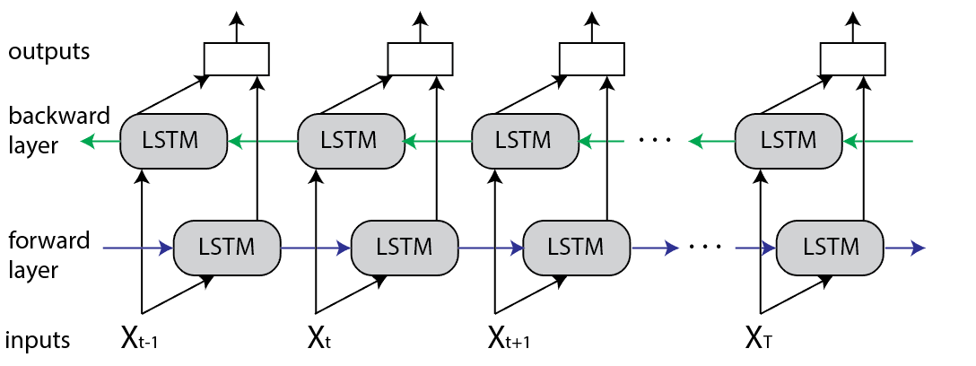
Bidirectional LSTM
A Bidirectional LSTM is a sort of recurrent neural network that processes sequences by taking into account information from both previous and subsequent time steps, allowing it to capture more thorough context and relationships in the data.

Slide 11
Bidirectional LSTM
Parameter | Value
Model Type | Sequential Model with Embedding Layer, BatchNormalization Layer, Dropout Layer, Conv1D Layer, MaxPooling1D Layer, Bidirectional LSTM Layer, LSTM Layer, Dropout Layer, and Dense Layer
Embedding Dimension | 64
Input Shape | (max_seq_len,)
Number of Conv1D Units | 32
Kernel Size of Conv1D Layer | 5
Activation Function of Conv1D Layer | relu
Number of MaxPooling1D Units | 2
Number of Bidirectional LSTM Units | 128
Parameter | Value
Number of LSTM Units | 64
Dropout Rate | 0.3, 0.5
Number of Dense Units | 1
Activation Function of Dense Layer | sigmoid
Training Data | Padded Sequence Data
Validation Data | Padded Sequence Data
Loss Function | Binary Cross-Entropy
Optimizer | Adam
Learning Rate | 0.0005
Number of Epochs | 5

Slide 12
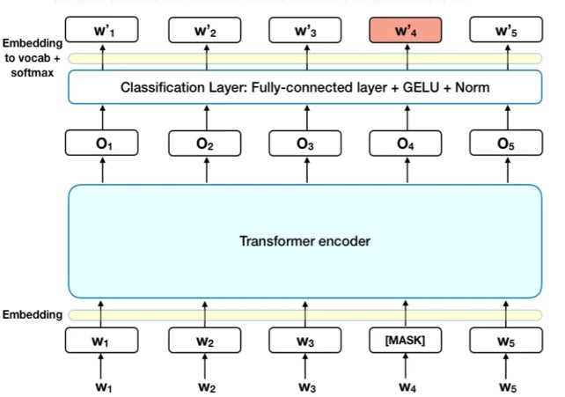
BERT
BERT (Bidirectional Encoder Representations from Transformers) is a cutting-edge natural language processing model developed by Google. It's pre-trained on a vast amount of text and can be fine-tuned for specific tasks, capturing context from both directions (left-to-right and right-to-left) in text.

Slide 13
BERT
Parameter | Value
Model Type | BERT For Sequence Classification
Embedding Dimension | 768
Input Shape | (max_seq_len, 768)
Number of Encoder Layers | 12
Number of Attention Heads | 12
Number of Dense Units | 768
Activation Function | GELU
Loss Function | Cross-Entropy Loss
Parameter | Value
Optimizer | AdamW
Model Type | BERT For Sequence Classification
Embedding Dimension | 768
Input Shape | (max_seq_len, 768)
Number of Encoder Layers | 12
Number of Attention Heads | 12
Number of Dense Units | 768

Slide 14
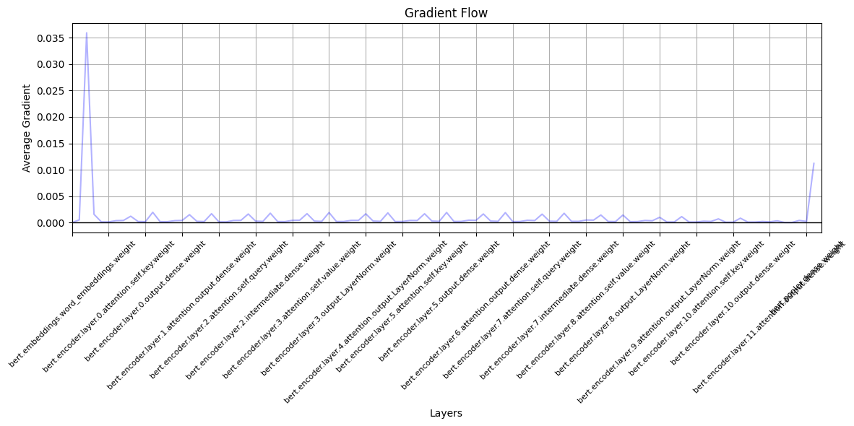

Slide 15
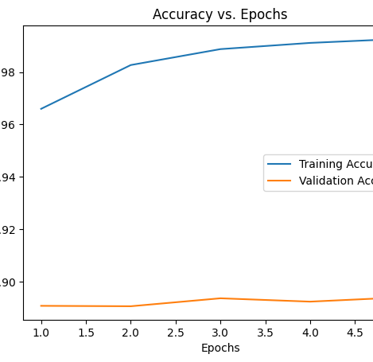
BERT Results without Regularization.
Training Accuracy: By the 5th epoch, the model achieved a training accuracy of 99.264%, indicating strong performance on the training data.
Validation Accuracy: Despite high training accuracy, the model's validation accuracy at the 5th epoch is 89.392%, highlighting a gap between training and validation performance.

Slide 16
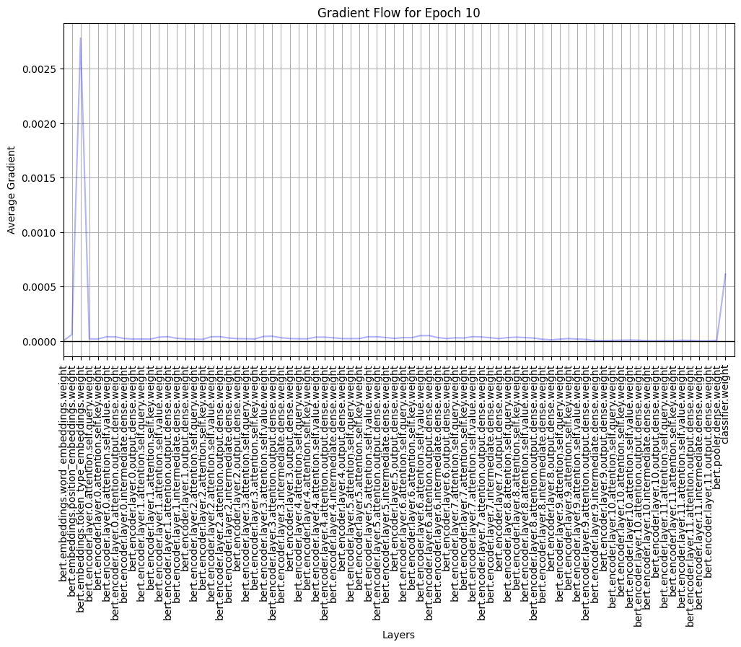
BERT With Regularization (2e-5)
Spike in the gradient change due to initial layer embeddings on input.

Slide 17
Summary on BERT model usage
BERT for Sentiment Analysis: The model utilizes the BERT (Bidirectional Encoder Representations from Transformers) architecture, a state-of-the-art transformer-based neural network pre-trained on a massive amount of text. This allows the model to understand context better and achieve significant performance in tasks like sentiment analysis on the IMDb dataset.
Gradient Visualization: After each training epoch, the gradient flow across various layers is visualized to ensure no gradient vanishing or exploding issues. This is essential for diagnosing training issues and ensuring stable model convergence.
Performance Metrics: By the end of 10 epochs, the model achieved a Validation Loss of 0.5435 and a Validation Accuracy of 90.001%. This high accuracy on the validation set demonstrates the model's capability to generalize well on unseen data and underscores the power of BERT in understanding and predicting sentiment from movie reviews.

Slide 18
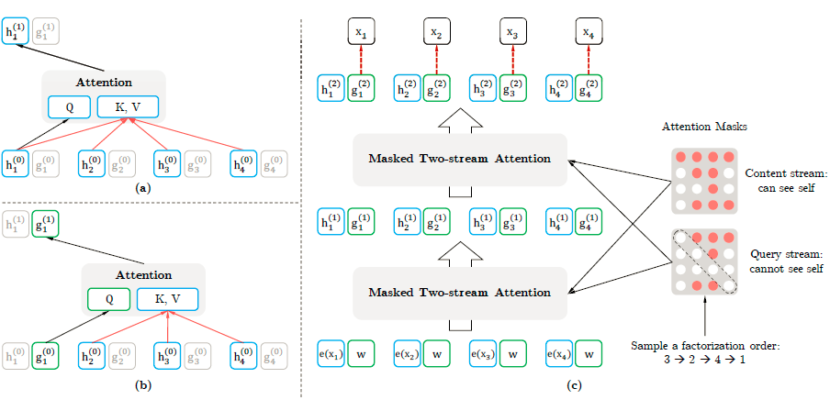
XLNet: A Generalized Autoregressive Pretraining
Evolution from BERT: XLNet improves upon BERT by maximizing the expected likelihood over permutations of the factorization order, overcoming the limitations of traditional autoregressive methods.
Permutation-based Training: Instead of predicting masked tokens, XLNet predicts each token by considering all possible permutations of tokens in a sentence, offering a more comprehensive understanding of context.
Two-stream Self-attention: Introduces a novel mechanism allowing each position to attend to all positions, including future ones, ensuring better contextual representation.

Slide 19
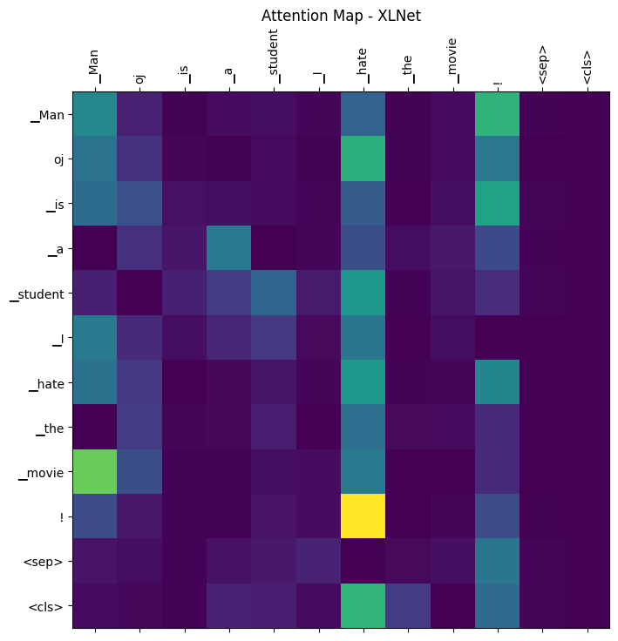
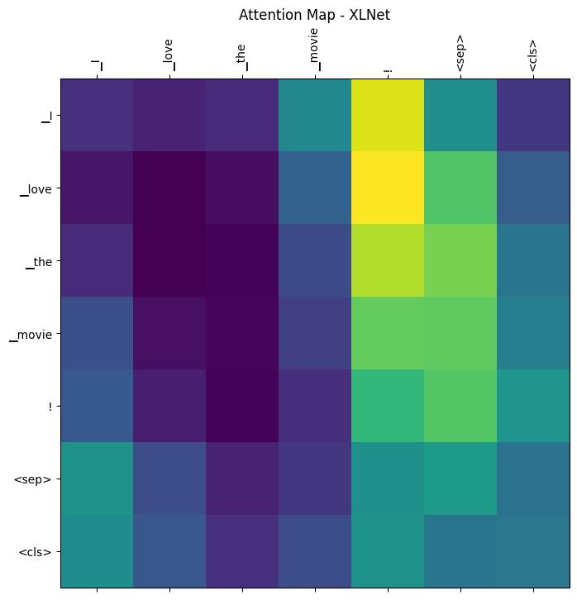

Slide 20
XLNet for IMDB Sentiment Classification: Results & Analysis
High Performance: After just 2 epochs, the model demonstrates impressive accuracy, reaching a validation accuracy of 93.32%. This indicates that XLNet, being a sophisticated transformer model, can effectively grasp sentiment nuances in movie reviews.
Training Dynamics: The model's validation loss remained relatively consistent across the provided epochs, moving from 0.2323 to 0.2336. The slight increase in loss from the first to the second epoch, despite the rise in accuracy, suggests a nuanced relationship between the model's confidence and its actual predictions. Regular monitoring can prevent overfitting in further epochs.
Attention Visualization: The provided attention plotting function allows for a deep dive into how XLNet focuses on different words when making predictions. By visualizing attention maps, it becomes evident how the model prioritizes certain tokens, offering insights into the model's decision-making process and ensuring it's capturing the right context.

Slide 21
DistilBERT Model
DistilBERT: A streamlined version of BERT, optimized for speed and efficiency.
Ideal for NLP tasks, maintaining high accuracy with reduced model size.
High-Performance Model:
Leveraged DistilBERT, achieving an impressive accuracy of 93.9% in classifying IMDb movie reviews.
Efficient Model Architecture:
DistilBERT retains most of BERT's performance by distilling 40% of its size, utilizing a lighter architecture with fewer layers, making it faster and more resource-efficient while maintaining high accuracy.
Model Architecture Insight:
DistilBERT simplifies BERT's architecture, removing certain layers (like the token-type embeddings and pooler) and retaining the transformer blocks, which makes it well-suited for NLP tasks requiring lower computational resources.

Slide 22



Slide 23

Computational Resources and Environmental Impact
High-End GPU Usage:
Utilized NVIDIA Tesla V100 GPU pods with 182 compute units in Google Colab, equipped with high RAM, for training XLNet and DistilBERT models.
250 watts GPU power consumption.
For 1.8 hours, the energy consumption would be 250 watts×1.8 hours = 450 watt-hours
250 watts×1.8 hours=450 watt-hours or 0.45 kilowatt-hours (kWh).
Environmental Consideration – Estimated Carbon Emissions:
The carbon intensity of electricity varies greatly depending on the region and its energy mix. As a general global average, we might use about 475 grams of CO2 emitted per kWh (source: International Energy Agency, 2020 data).
Therefore, the estimated emissions would be 0.45 kWh×475 g/kWh=213.75 grams of CO2
0.45 kWh×475 g/kWh = 213.75 grams of CO2.
Balancing Performance and Sustainability:
Strived for a balance between computational performance and environmental sustainability.
Emphasis on efficient model architectures and mindful usage of computational resources to reduce environmental footprint.

Slide 24
Model | Result
Basic LSTM Model with Word2Vec Embe | Training Accuracy: 85.36% (at 10 epochs) Validation Accuracy: 85.62% (at 10 epochs) Test Accuracy: 85.62%
LSTM with Dropout and Early Stopping | The model achieved 85.43% test accuracy. Effective sentiment classification on IMDB dataset. Potential for further optimization.
LSTM with Glove embedding | Test Accuracy (GloVe): 50.39% Test Loss (GloVe): 0.6931
Bidirectional LSTM | The model shows significant improvement in accuracy during training. Validation accuracy reached 88.80% after 5 epochs. The model seems to be performing well on the sentiment analysis task for movie reviews.
Basic LSTM Model with Word2Vec Embeded | Training Accuracy: 85.36% (at 10 epochs) Validation Accuracy: 85.62% (at 10 epochs) Test Accuracy: 85.62%
BERT Results without Regularization. | Training Accuracy: By the 5th epoch, the model achieved a training accuracy of 99.264%, indicating strong performance on the training data. Validation Accuracy: Despite high training accuracy, the model's validation accuracy at the 5th epoch is 89.392%, highlighting a gap between training and validation performance.
BERT With Regularization (2e-5) | By the end of 10 epochs, the model achieved a Validation Loss of 0.5435 and a Validation Accuracy of 90.001%.
DistilBERT Model | Leveraged DistilBERT, achieving an impressive test accuracy of 93.9% in classifying IMDb movie reviews.

Slide 25

Thank You

