Slide 1
SKIN ALLERGY MANAGEMENT SYSTEM
A Web-Based Project
Presented by:
M. Manoj
Register Number:12427122
B.Sc. Information Technology
Yadava college
Guided by:
A. Venkatesan, M.Sc., M.Phil.
Academic Year:2024-2027

Slide 2
INTRODUCTION
Skin allergies are common skin conditions that may cause itching, redness, rashes, and irritation.
Managing skin allergy information properly helps users understand their symptoms and take appropriate action.
The Skin Allergy Management System is a web-based application developed to manage patient details and provide preliminary skin allergy information
The system also provides doctor suggestions, hospital location information, and skin allergy reports.

Slide 3
PROBLEM STATEMENT
Skin allergy symptoms can be difficult to manage and track.
Patient details may not be maintained in an organized way.
Users may find it difficult to understand their skin allergy symptoms.
Finding suitable doctors and nearby hospitals can take time.
A simple web-based system is needed to manage allergy-related information in one place.

Slide 4
OBJECTIVES
To manage patient details in an organized manner.
To record skin allergy symptoms and allergy history.
To provide preliminary skin allergy analysis.
To provide suitable doctor suggestions.
To provide nearby hospital location information.
To generate and view patient report.

Slide 5
EXISTING SYSTEM
Skin allergy information is often managed manually.
Patient details may be stored in separated records.
Users may not have easy access to preliminary allergy information.
Finding suitable doctors and nearby hospitals may take more time.
Generating and maintaining reports manually can be difficult.

Slide 6
PROPOSED SYSTEM
A web-based system is developed to manage skin allergy-related information.
Users can register and securely login to the system.
Patient details, symptoms, and allergy history can be recorded.
The system provides preliminary skin allergy analysis.
Doctor suggestion and nearby hospital information are provided.
Patient reports can be generated and viewed easily.

Slide 7
ADVANTAGES OF PROPOSED SYSTEM
Easy and user-friendly web-based system.
Patient information can be maintained in one place.
Provides quick preliminary skin allergy analysis.
Helps users find suitable doctor suggestions.
Provides hospital location information.
Makes report generation and viewing easier.
Saves time and reduces manual work.

Slide 8
SYSTEM REQUIREMENTS
Hardware Requirements
Computer / Laptop
Minimum 4 GB RAM
Internet Connection
Software Requirements
Windows Operating System
Python
Flask
HTML, CSS, JavaScript
SQLite Database
Visual Studio Code
Web Browser

Slide 9
TECHNOLOGIES USED
Frontend
HTML
CSS
JavaScript
Backend
Python
Flask
Database
SQLite
AI / Analysis
Python-based symptom analysis
Development Tool
Visual Studio Code

Slide 10
SYSTEM WORKFLOW
HOME
REGISTRATION/LOGIN
DASHBOARD
PATIENT DETAILS
SKIN ALLERGY ANALYSIS
RESULT
DOCTOR SUGGESTION
HOSPITAL LOCATION
REPORT

Slide 11
MODULE DESCRIPTION-PART 1
1. Home Page Provides the main interface of the system.
2. User Registration Allows new users to create an account.
3. User Login Allows registered users to access the system.
4. User Dashboard Provides access to the main modules from one place.
5. Patient Details Allows users to manage patient information, symptoms, and allergy history.

Slide 12
MODULE DESCRIPTION- PART 2
6. Skin Allergy Detection Analyzes the symptoms entered by the user for preliminary allergy screening.
7. Allergy Result / Prediction Displays the possible skin allergy condition and basic guidance.
8. Doctor Suggestion Provides suitable doctor information for further consultation.
9. Hospital Location Helps users find nearby hospitals and their location information.
10. Reports Displays the patient's details and allergy analysis in a report format.

Slide 13
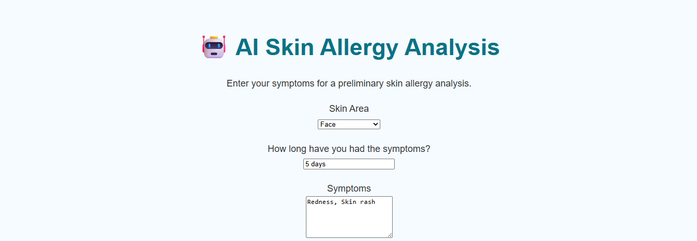
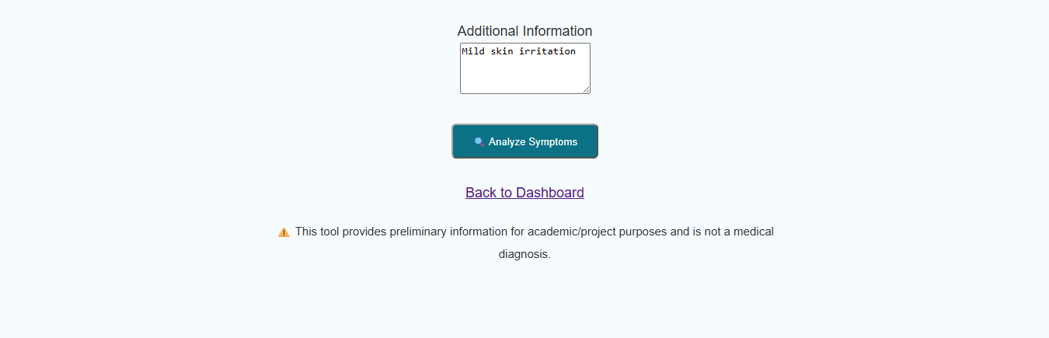
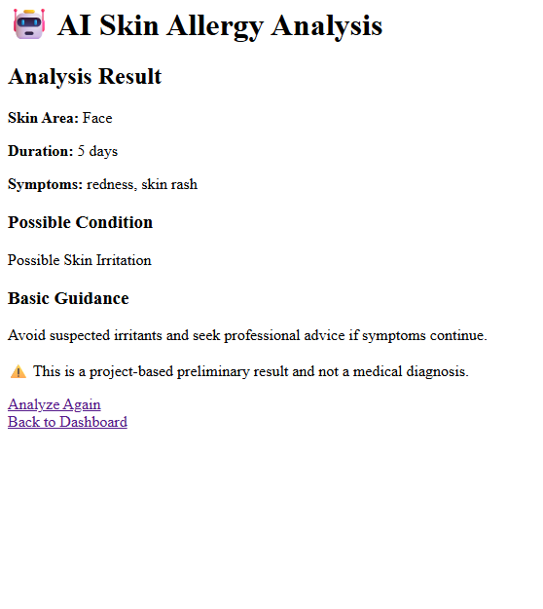
AI SKIN ALLERGY ANALYSIS
Input
Skin Area
Duration
Symptoms
Additional Information
Analysis
Symptom-based preliminary screening
Output
Possible skin condition
Basic guidance
Note
This is not a medical diagnosis.
Consult a qualified healthcare professional.

Slide 14
DOCTOR SUGGESTION
Provides suitable doctor information for further consultation.
Helps users understand the need for professional medical advice.
Guides users to seek appropriate healthcare support.
Users are advised to consult a qualified healthcare professional.

Slide 15
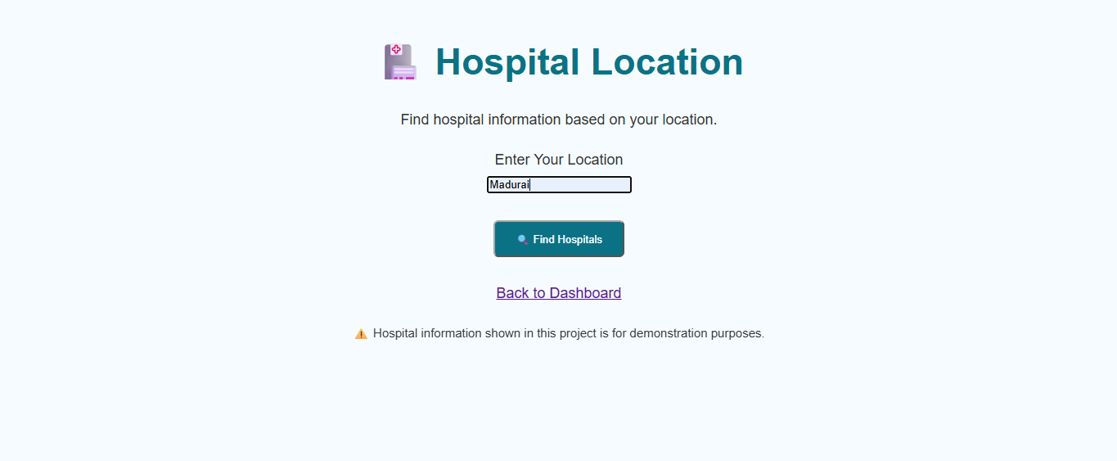
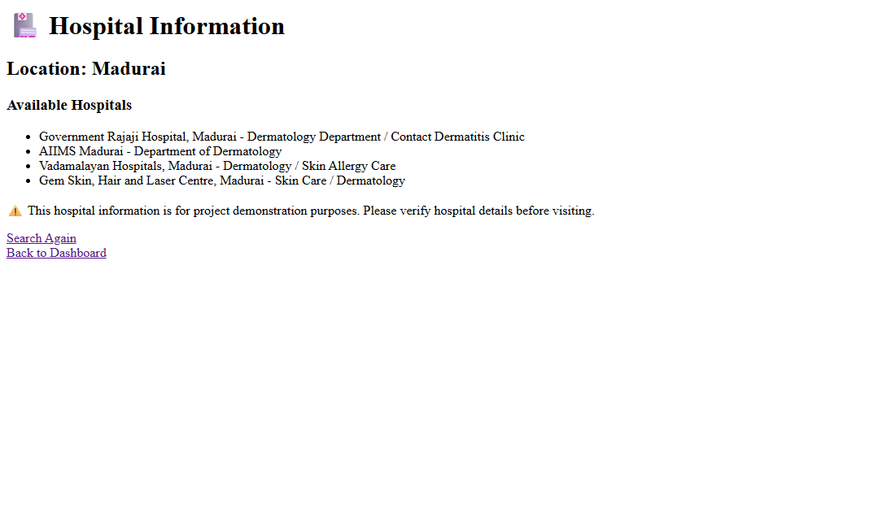
HOSPITAL LOCATION
• Allows users to enter or view location details.
• Helps users identify nearby hospitals for further consultation.

Slide 16
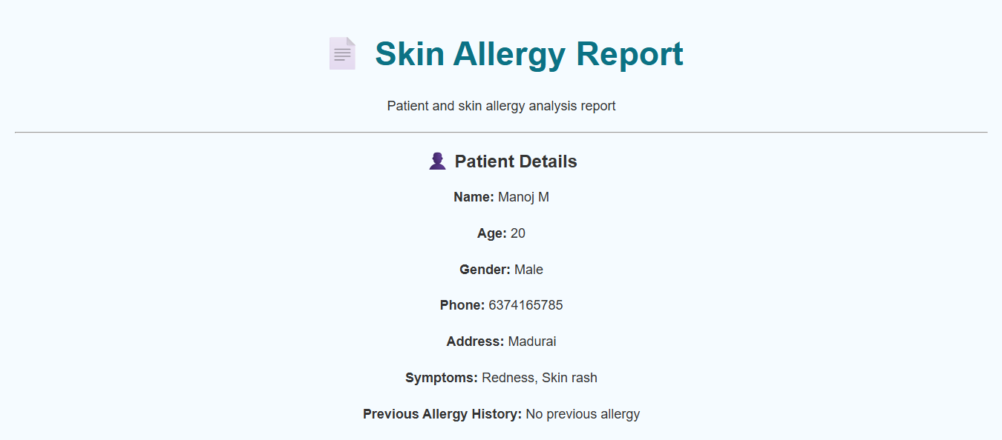
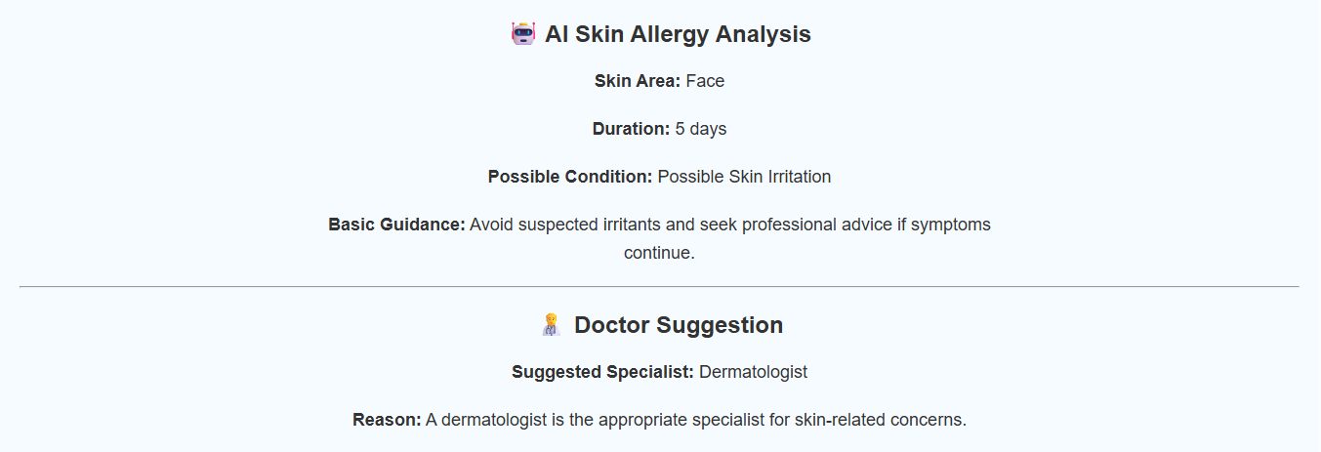
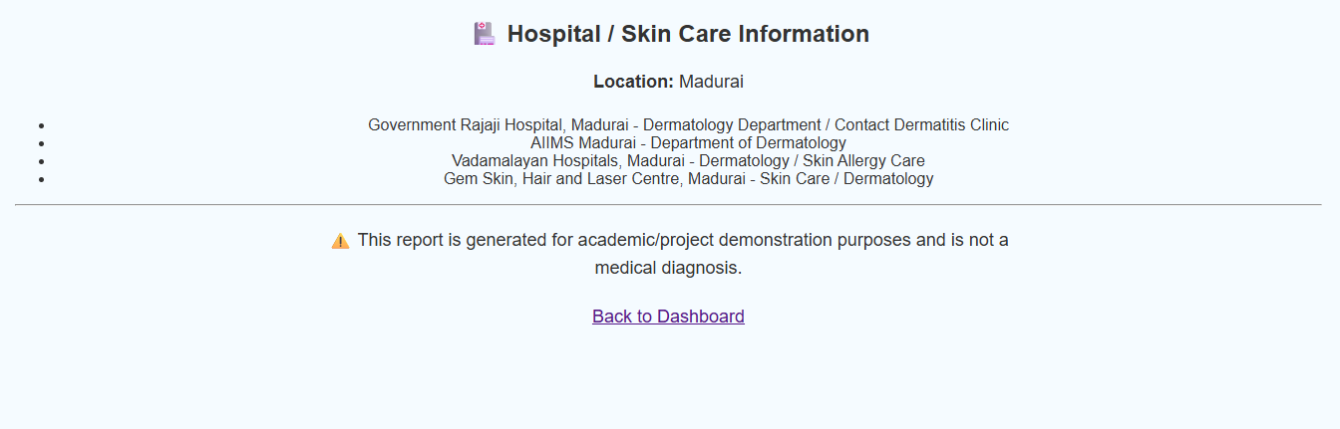
REPORTS
• Displays patient details in a structured format. • Includes symptoms, allergy history, and preliminary analysis. • Helps users view and maintain patient reports.

Slide 17
DATABASE/ DATAFLOW
• User registration and login details are stored in the database. • Patient details, symptoms, and allergy history are recorded. • AI analysis results are stored for report generation. • The system retrieves stored information when required. • Reports are generated using the stored patient information.

Slide 18
FUTURE ENHANCEMENT
• AI model can be improved using a larger skin image dataset. • Image-based skin condition detection can be added. • The system can support online doctor consultation. • Mobile application support can be developed. • More hospitals and healthcare services can be added. • The system can be enhanced with multilingual support.

Slide 19
CONCLUSION
• The AI Skin Allergy Management System provides a simple and user-friendly web-based platform. • It helps manage patient details, symptoms, and allergy history efficiently. • The system provides preliminary skin allergy analysis and basic guidance. • Doctor suggestions, hospital locations, and reports support better healthcare access. • The system can be further improved with advanced AI and image-based analysis.
THANK YOU

