Slide 1
VLSI MINI PROJECT
Design and Synthesis of an 8-bit Ripple Carry Adder
Using Verilog HDL and Yosys
RTL Design • Functional Simulation • Logic Synthesis
Tools: EDA Playground, Icarus Verilog, EPWave, Yosys
1

Slide 2
Project Description
• An 8-bit Ripple Carry Adder adds two 8-bit binary numbers with an input carry.
• The design is constructed from eight 1-bit Full Adders connected in cascade.
• The carry output of each stage becomes the carry input of the next stage.
• The project demonstrates a basic RTL-to-gate-level VLSI design flow.
• Functional verification was performed using Icarus Verilog and EPWave.
• RTL synthesis was performed using Yosys 0.37.
A[7:0], B[7:0], Cin → 8 Full Adders → Sum[7:0], Cout
2

Slide 3
Design Flow and Synthesis Output
RTL
Verilog design
Simulation
Icarus + EPWave
Synthesis
Yosys 0.37
Gate Level
Netlist + statistics
Synthesis Results
Full Adders: 8
AND cells: 24
OR cells: 16
XOR cells: 16
Total logic cells: 56
Verification
• 6 input combinations tested
• Sum and Cout matched expected results
• EPWave waveform generated successfully
• Synthesized gate-level Verilog generated successfully
3

Slide 4
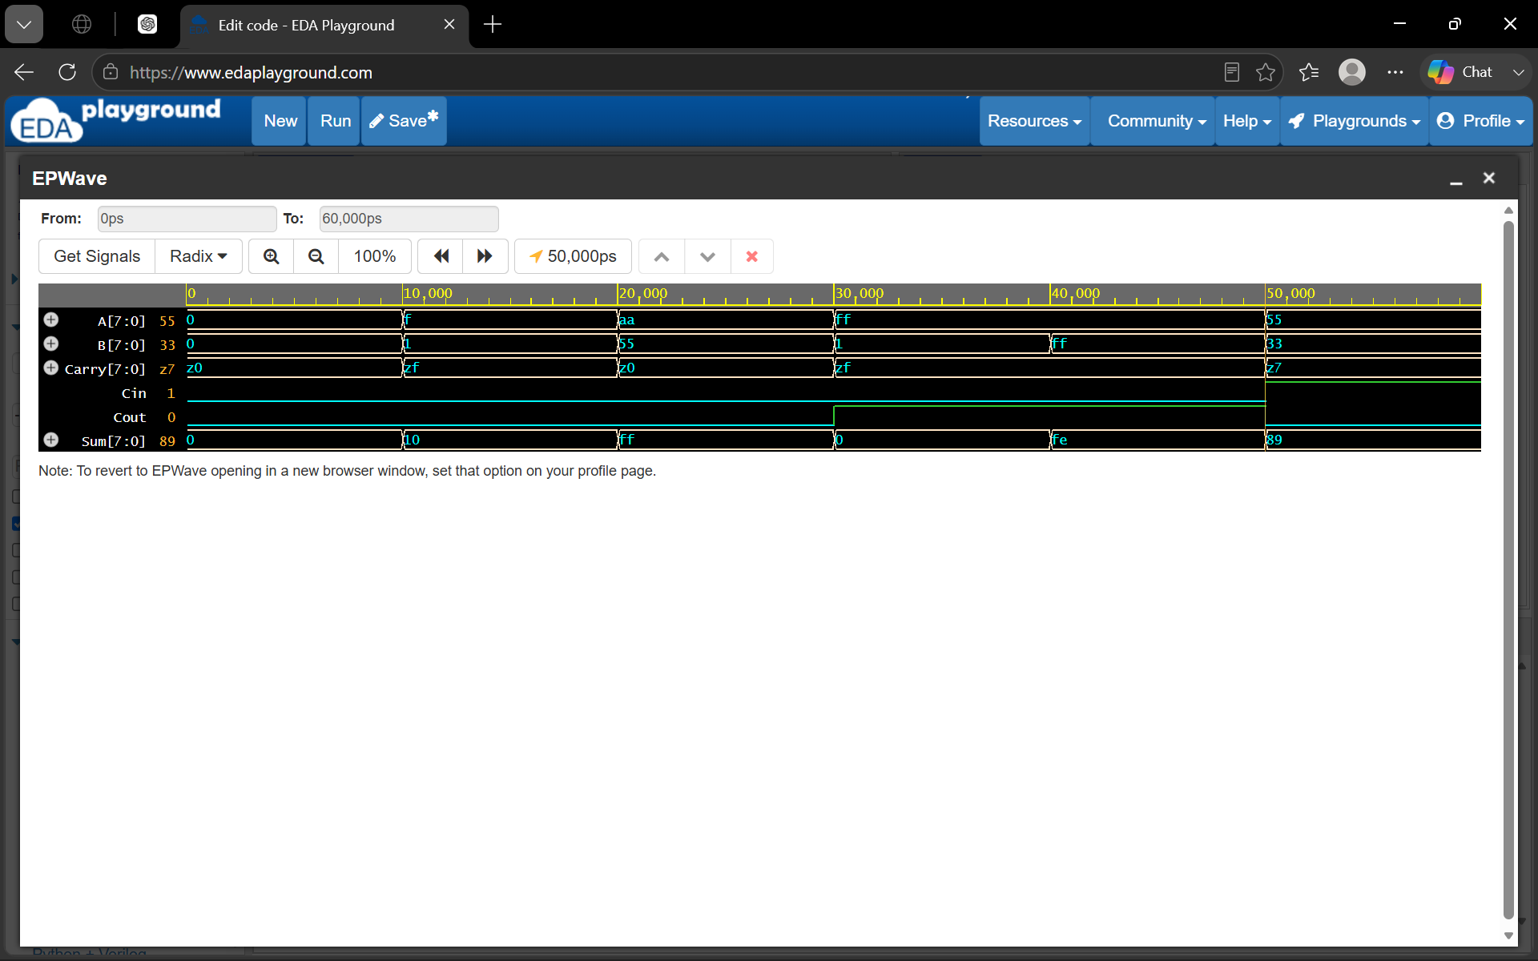
Simulation Output – EPWave
Simulation waveform showing A, B, Cin, Carry, Sum and Cout.
4

Slide 5
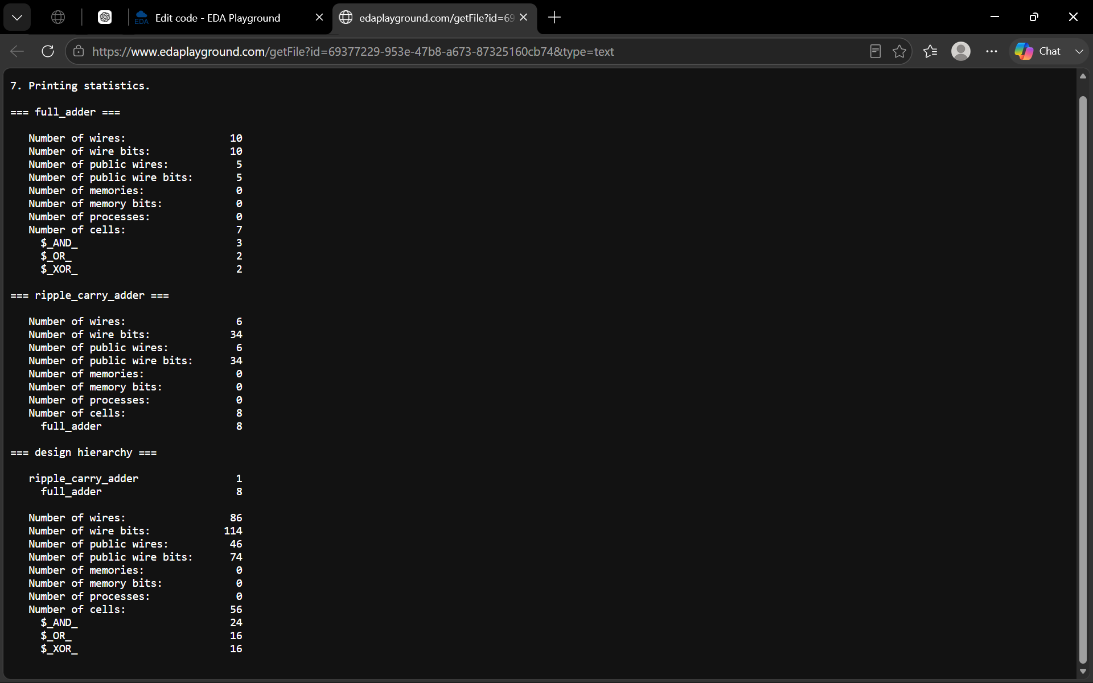
Synthesis Output – Yosys
Yosys synthesis statistics: 24 AND + 16 OR + 16 XOR = 56 logic cells.
5

Slide 6
References
• Yosys Open Synthesis Suite – https://yosyshq.net/yosys/
• EDA Playground – https://www.edaplayground.com/
• Icarus Verilog – https://steveicarus.github.io/iverilog/
• EPWave – waveform viewer available through EDA Playground
• Digital Logic Design references for Full Adders and Ripple Carry Adders
6

Slide 7
Conclusion
• The 8-bit Ripple Carry Adder was successfully designed using Verilog HDL.
• Functional simulation verified the correctness of Sum and Cout for multiple test cases.
• EPWave was used to analyze the simulation waveform.
• Yosys successfully synthesized the RTL and generated a gate-level representation.
• The final synthesized design contains 56 basic logic cells: 24 AND, 16 OR and 16 XOR.
• The project demonstrates a complete introductory RTL-to-gate-level VLSI flow using free tools.
Thank You
7

