Slide 1
Review Intelligence Engine
Turning thousands of unstructured product reviews into structured, decision-ready intelligence with a large language model.
28K+
LLM
Live
reviews mined
schema-locked extraction
hosted dashboard
Manoj · github.com/Manoj070213/Review-Intelligence-Engine

Slide 2
The problem: honest feedback, buried in text
Retailers collect tens of thousands of product reviews every month. Inside that text is their most honest product feedback — what breaks, what customers want, where quality is slipping. But it is unstructured, so almost none of it gets used at scale.
THE QUESTION
Can unstructured reviews be automatically turned into structured, decision-ready intelligence — early enough to act on?
Scale
A single analyst can read a few hundred reviews — nobody can read 30,000.
Latency
Defect trends surface in returns weeks after the reviews already warned of them.
Lost signal
That question drives every stage of the pipeline.
Feature requests stay scattered and never reach the product team in aggregate.

Slide 3
What it delivers — and why it matters
IN SCOPE
OUT OF SCOPE (V1)
Automated sentiment, theme & defect-risk extraction
Per-product quality scorecards and monthly trends
Feature-request capture from free text
Interactive, shareable dashboard
Real-time streaming ingestion
Multi-language review handling
Automated ticket creation / routing
Production deployment & auth
THE BUSINESS CASE
Catch defects early
Feed the roadmap
Scale the analyst
A trend caught a month late can mean thousands of extra returns and a damaged rating.
Aggregated feature requests turn scattered comments into product decisions.
Every review read the day it posts — consistently, not sampled.

Slide 4
Requirements and data needs
FUNCTIONAL
NON-FUNCTIONAL
Parse each review into a fixed structured record
Classify sentiment, themes, defect & return signals
Aggregate into product- and time-level views
Visualize results in a dashboard
Measure extraction accuracy against a labeled set
Runs end-to-end on a laptop, no infra required
Graceful offline fallback when no API key is set
Output structured enough to aggregate reliably
Reproducible: same inputs → same tables
Quality is a tracked metric, not an assumption
DATA NEEDS
Source
Fields
Coverage
Datafiniti “Consumer Reviews of Amazon Products” — ~28,000 real reviews
Review text, star rating, date, product name, helpful votes
Fire tablets, Kindle e-readers, AmazonBasics batteries (6 products)

Slide 5
Solution architecture: a five-stage pipeline
1
2
3
4
5
Ingest
Clean
Extract
Aggregate
Visualize
Load raw reviews
(CSV / API)
Drop dupes, nulls,
junk; fix dates
LLM → structured
JSON per review
Scorecards, trends,
complaint ranks
Interactive
dashboard
Python · pandas
pandas
Anthropic API
SQLite · SQL
HTML · Chart.js
The heart is Stage 3. A schema-locked prompt forces every review into the same JSON shape with a closed list of theme labels — the single design choice that makes thousands of free-text reviews countable and trendable.

Slide 6
Building it for real
From proposed concept to a working pipeline running on real data, a real LLM, and a live dashboard.
Python · pandas
Anthropic API
data pipeline & cleaning
LLM extraction
SQLite · SQL
HTML · Chart.js
aggregation & queries
interactive dashboard

Slide 7
How the LLM extraction works
Each review is sent to the model with a schema-locked prompt that returns one structured record — no free-text analysis.
OUTPUT SCHEMA (per review)
WHY THE SCHEMA MATTERS
{
"sentiment": "positive | negative | mixed",
"sentiment_score": -1.0 … 1.0,
"themes": [ closed enum list ],
"defect_risk": true | false,
"return_signal": true | false,
"feature_request": string | null
}
v1 let the model name themes freely → dozens of near-duplicate labels (“battery,” “battery life,” “charge issues”). Impossible to aggregate.
v2 locked the output to a fixed schema + enum. Results became countable and trendable.
The model never changed — the structure of its input did.

Slide 8
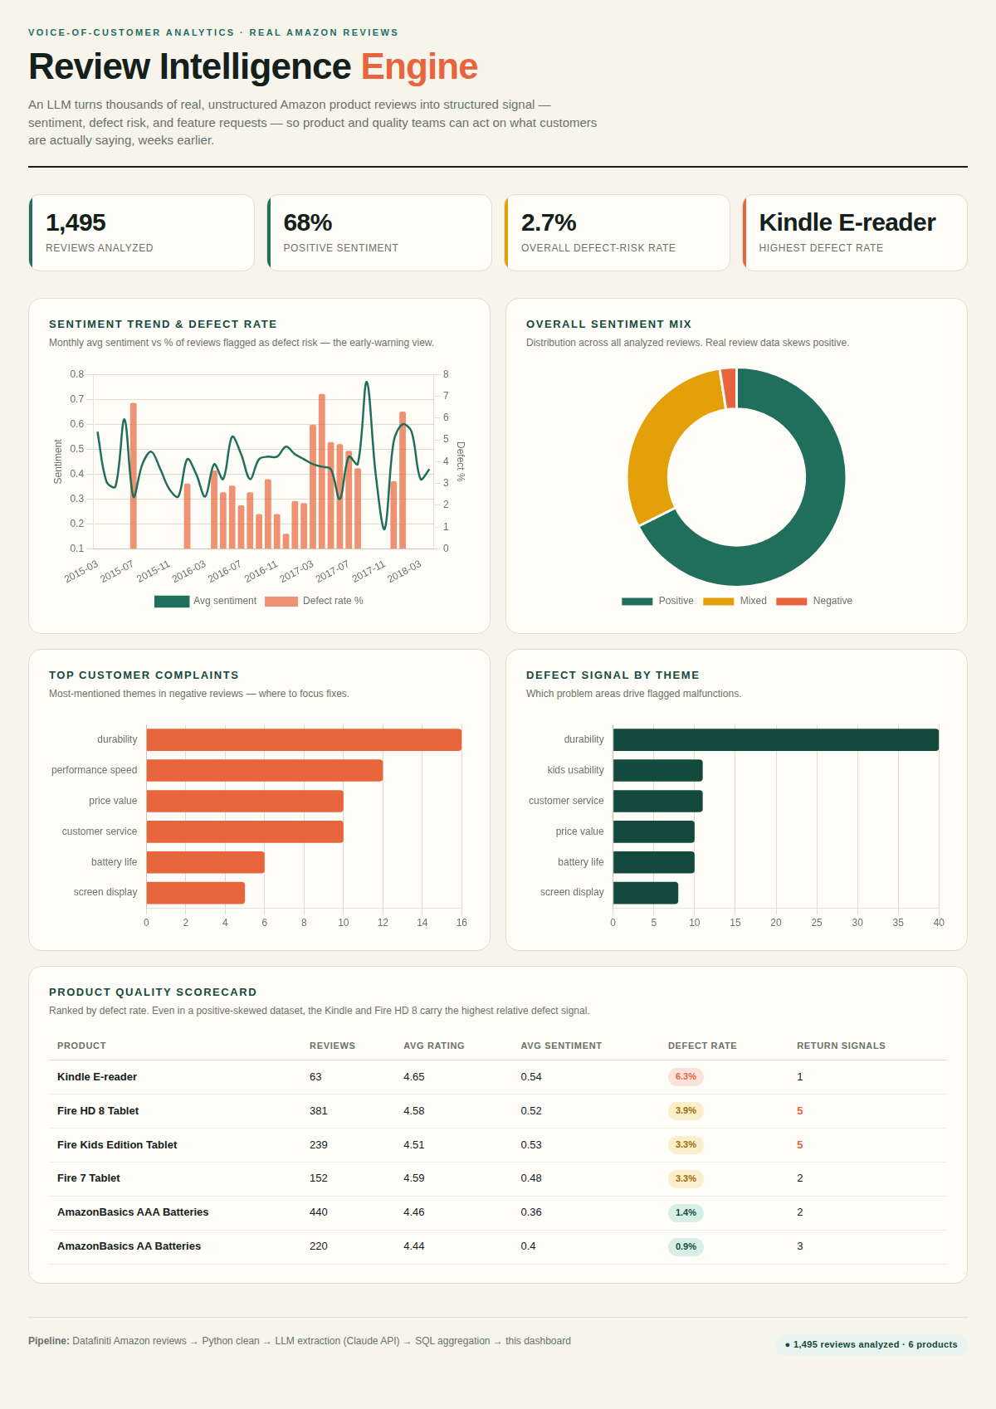
Demo: the live intelligence dashboard
WHAT A USER SEES
KPI band — reviews analyzed, positive %, defect-risk rate, highest-risk product.
Trend + sentiment — monthly sentiment vs defect-rate, and the overall sentiment mix.
Complaint & defect themes — where to focus fixes first.
Product scorecard — every product ranked by defect rate.
Live: manoj070213.github.io/Review-Intelligence-Engine/dashboard.html

Slide 9
What the data revealed
68%
6.3%
~7%
positive sentiment
Kindle defect rate
defect spike, 2017
reviews skew positive — the value is the small, concentrated negative signal
risk concentrates in specific products, though all average 4.4+ stars
an early-warning blip against an otherwise calm baseline
THE HEADLINE INSIGHT
Durability is the #1 complaint theme and the leading driver of defect signals. “Kids usability” surfaces as a defect theme tied specifically to the kids’ tablets — a product-line insight that is invisible when reading reviews one at a time.

Slide 10
PHASE 2 · QUALITY
Quality is measured, not assumed
A hand-labeled validation set scores extraction accuracy on every run, so output quality is a number that can be defended.
83%
THE QUALITY LOOP
1
Build
run the extraction prompt
sentiment accuracy of the offline keyword fallback on the labeled set
2
Measure
score against the labeled gold set
The two misses were both mixed-sentiment cases (“love the display, hate the storage”) — exactly where a keyword approach breaks and the LLM earns its place.
3
Fix the input
tighten the prompt / schema
4
Re-measure
confirm the number moved

Slide 11
PHASE 2 · REFLECTION
Lessons learned
Input structure > model choice
Real data is messy by default
The biggest accuracy gain came from constraining the prompt's output schema, not from a bigger model.
Dupes, nulls, mixed date formats and junk rows are the norm — cleaning is a real stage, not an afterthought.
Positive-skewed data hides signal
Measure quality, don't assume it
68% positive means the average looks fine; the insight lives in the concentrated negative minority.
A small labeled set turned “it seems to work” into a defensible accuracy number.
Engineer for the environment
Ship it end-to-end
Network limits forced batching and a sane offline fallback — design for where it actually runs.
A hosted dashboard beats a notebook: anyone can click a link and see the result.

Slide 12
FROM CONCEPT TO SHIPPED
A working AI app, end to end
Real Amazon reviews → cleaned in Python → structured by an LLM → aggregated in SQL → served as a live dashboard.
CODE
github.com/Manoj070213/Review-Intelligence-Engine
LIVE DASHBOARD
manoj070213.github.io/Review-Intelligence-Engine/dashboard.html
Thank you

