Slide 1

CUSTOMER SHOPPING
BEHAVIOR ANALYSIS
An end-to-end retail analytics solution — from raw data to business insight
Python • PostgreSQL • Power BI

Slide 2



Context & Scope
Why this project, and where its boundaries sit
The Context
In Scope
Retailers collect rich transaction data but rarely turn it into clear decisions.
This project analyzes a customer shopping dataset to understand who buys, what they spend, how discounts and subscriptions affect behavior, and which products and segments drive revenue — packaged as an interactive dashboard a business user can explore.
Data cleaning & feature engineering
Loading data into a SQL database
Business questions answered in SQL
Interactive BI dashboard
Out of Scope
Real-time streaming data
Predictive ML models (future work)
Production deployment & scaling

Slide 3




Business Case
What value the analysis unlocks for the business
Grow Revenue
Smarter Discounts
Identify the products, age groups, and segments that contribute most so marketing spend targets what works.
Measure where discounts are applied and whether discounted buyers still spend above average.
Retain Customers
Improve Experience
Segment New, Returning, and Loyal buyers and see whether repeat buyers are likely to subscribe.
Surface top-rated products and shipping preferences to guide inventory and service decisions.

Slide 4


Requirements
Functional and technical needs the solution must meet
Functional
Technical
Clean raw CSV data and handle missing values
Engineer new fields (age group, purchase frequency in days)
Store data in a queryable SQL database
Answer 10 defined business questions with SQL
Present KPIs and charts in an interactive dashboard
Allow filtering by segment, category, and status
Python + pandas for data preparation
PostgreSQL relational database
SQLAlchemy + psycopg2 to connect Python to SQL
Power BI for visualization & DAX measures
Jupyter Notebook for reproducible workflow
GitHub for version control & sharing

Slide 5

Data Needs
The dataset and the fields that power the analysis
3,900
18
2
1
Customer records
Original columns
Engineered features
Cleaned SQL table
Key Fields Used
gender
age → age_group
category
item_purchased
purchase_amount
review_rating
subscription_status
discount_applied
shipping_type
previous_purchases
frequency_of_purchases → days
location

Slide 6


Solution Architecture
How data flows from source to insight
›
›
›
›
CSV Source
Python + pandas
PostgreSQL
SQL Analysis
Power BI
Raw shopping behavior dataset (3,900 rows)
Clean, handle nulls, engineer features
Load into customer table via SQLAlchemy
10 business questions answered
KPIs, DAX measures & dashboard
A reproducible pipeline: each stage hands clean, structured data to the next.

Slide 7


Tech Stack
The tools behind each layer of the solution
Python & pandas
PostgreSQL
SQLAlchemy + psycopg2
Data loading, cleaning, and feature engineering in Jupyter Notebook
Relational database storing the cleaned customer table
Bridge that moves the pandas DataFrame into PostgreSQL
SQL
Power BI + DAX
GitHub
Aggregations, CASE logic, CTEs, and window functions for analysis
Interactive dashboard with KPI cards and charts
Version control and project sharing

Slide 8

Demo Scenarios
Business questions the solution answers live
Revenue by gender & age group
Top-rated & top-selling products
Discount behavior
Total spend split across demographics
Best products by rating and by category
Who used discounts yet still spent above average
Customer segmentation
Shipping comparison
Subscriber value
New, Returning, and Loyal buyer counts
Average spend: Standard vs Express
Do subscribers and repeat buyers spend more?

Slide 9
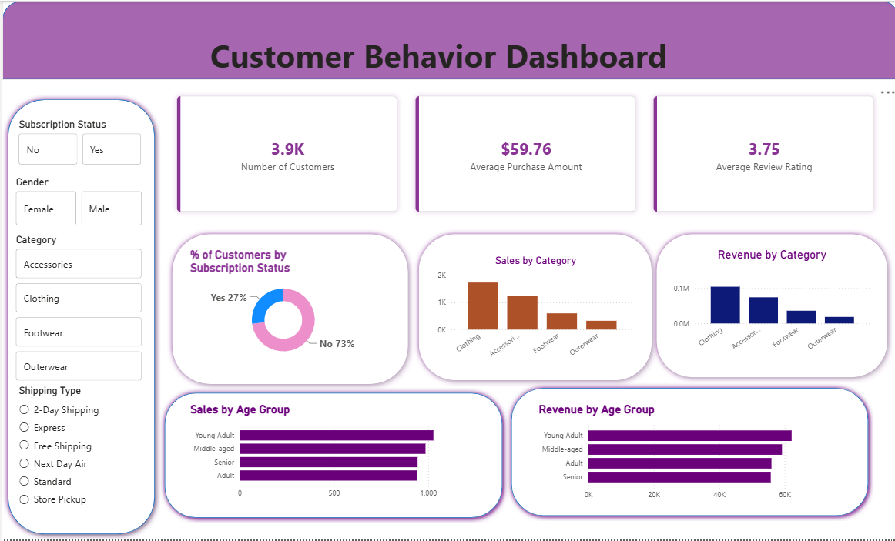
Dashboard

Slide 10
Link to Code & Prototype
Everything is version-controlled and reproducible
GitHub Repository
github.com/Manoj070213/customer-shopping-behavior-analysis
Notebook
SQL Queries
CUSTOMER_BEHAVIOR_ANALYSIS.ipynb — data prep & feature engineering
SQL_QUERIES_CUSTOMER_BEHAVIOR_PROJECT.sql — 10 business questions
Power BI Report
Dataset
REPORT_POWERBI.pbix — interactive dashboard
customer_shopping_behavior.csv — source data

Slide 11

Lessons Learned
What the build taught me
Clean data is everything
Small details break connections
Consistent column names and handling nulls early prevented errors downstream in SQL and Power BI.
A single trailing space in a database name caused repeated connection failures — precision matters.
Tools work best together
Start from the question
Python, SQL, and Power BI each did one job well; the value came from chaining them into one pipeline.
Defining the business questions first kept the SQL and dashboard focused on real insight, not just charts.

Slide 12
From Raw Data to Real Insight
A complete analytics pipeline — Python, PostgreSQL, and Power BI — turning a shopping dataset into decisions a business can act on.
Thank you

