Slide 1


PANIMALAR ENGINEERING COLLEGE
DEPARTMENT OF COMPUTER SCIENCE AND ENGINEERING
CS8811 PROJECT WORK
Automation of Daily Stock Movements with Selenium
Guide Name: Dr.S.Balaji (Associate Professor)
Team: Manoj G ,Mahendra Babu R ,Karthik Guptha K V
BATCH NO: D-12
1

Slide 2
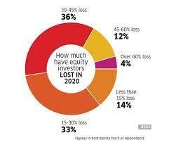
INTRODUCTION:
The financial market is a volatile, composite system and is influenced in an unknown number of ways and is always in a constant state of flux and this makes it highly unpredictable to know the value of stocks or to invest in a particular stock or to keep track of those already invested in.
These changes depend on various social, geographical, and political factors which in turn affect the stocks value drastically, and having to keep tabs on these various changes might not be an easy process as it involves checking each stock individually.
To make this time-consuming process into a simple, processed, and understandable source of information, we introduce the concept of selenium and web-drivers and this process would be even more steadfast when automated which the proposed program would do.
2

Slide 3
LITERATURE SURVEY
S.NO
TITLE
AUTHORS
INFERENCE
1.
Stock markets and economic growth of India
M. Madhuri Devi and Anjali Hinduja Dept. of Commerce, Bhilai Mahila Mahavidyalaya, Bhilai, CG, India Pt. Ravishankar Shukla University.
The two fold policies of Indian economic system i.e. fiscal and monetary policy has been resulted into the efficient survival of economy of India after the inheritance of almost NEP later on.
2.
Automation Of Stock Management Process
KATENDE KENNETH
KIDONGE B.COM (DR.B.R
Ambedkar University, Agra, India) Department of Computer Science, Faculty of Computing and Information Technology.
Stock management is one aspect of business that enhances a company is business performance so as to reap big from the business venture being undertaken.
3

Slide 4
Problem Statement:
The stock market is influenced in many ways and there are various weak areas that are easily manipulated and this led to fluctuation in the stock movements which the investor may not be aware of or the investor may not take into consideration of small changes that may be crucial in future.
Thus, to resolve this manual, time consuming process a system is developed to automate, scrape and mail the important stock information to the client or the said individual.
This helps not only to reduce the time to go through the tedious process of opening a web-browser, visit the website on which stocks are monitored and search for the stock information on those the user is invested on.
4

Slide 5


Development Environment:
Hardware:
RAM :: 4 GB
Storage :: 256GB
CPU :: 1.7 GHz or Faster
Architecture :: 32-bit or64-bit
Software:
Programming Language::Python 3.5&Above,PIP3,HTML
Operating System : Windows 10 or Higher, Linux and MacOS
5

Slide 6
System Architecture Overview (Development Environment)
Data Formatting
Using HTML
Data
Pushing
PYTHON
Data Scrapping
Selenium
Webdrives
Reading Mail IDS from Database
Mails sent
Sending Mails
6

Slide 7
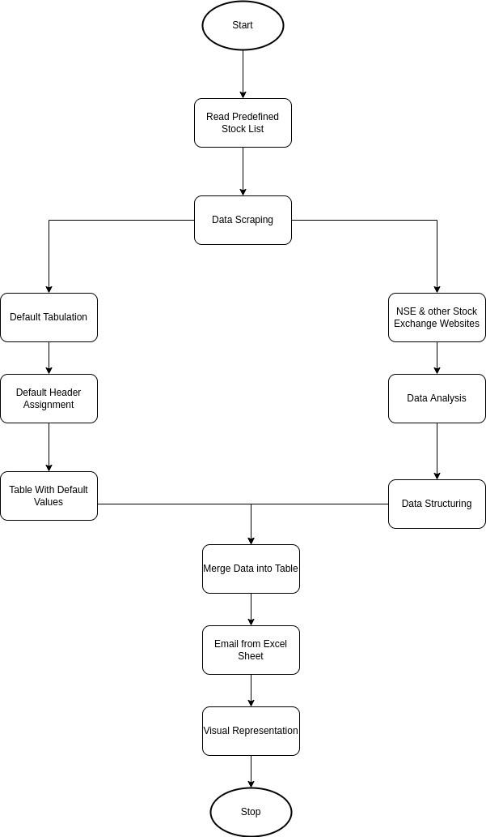
Flow Chart:
This above flowchart represents the flow of the process that is going on in the project.

Slide 8
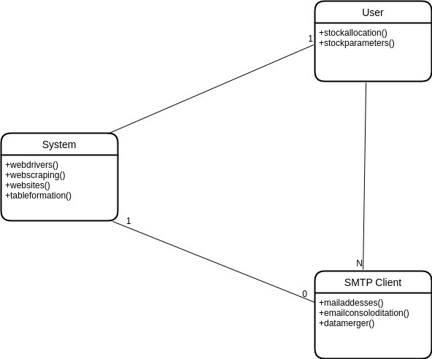
ER Diagram:

Slide 9
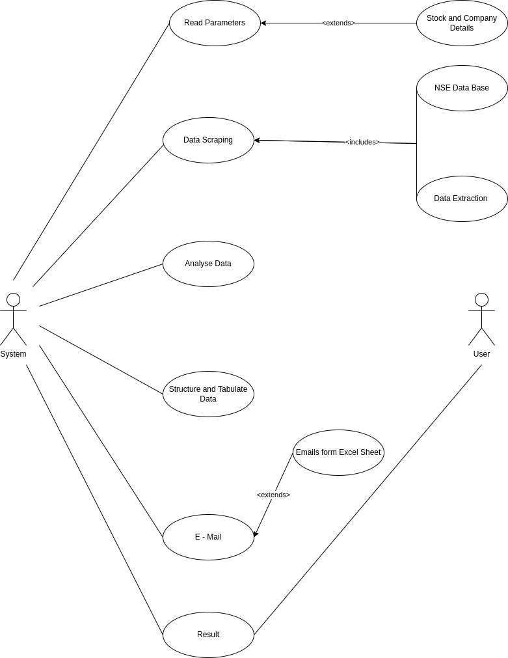
Use Case Diagram:

Slide 10
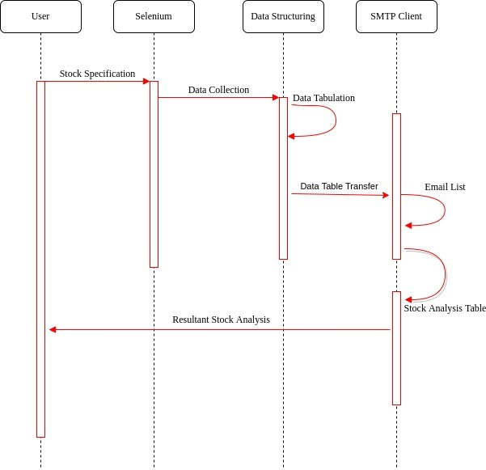
Sequence Diagram:

Slide 11
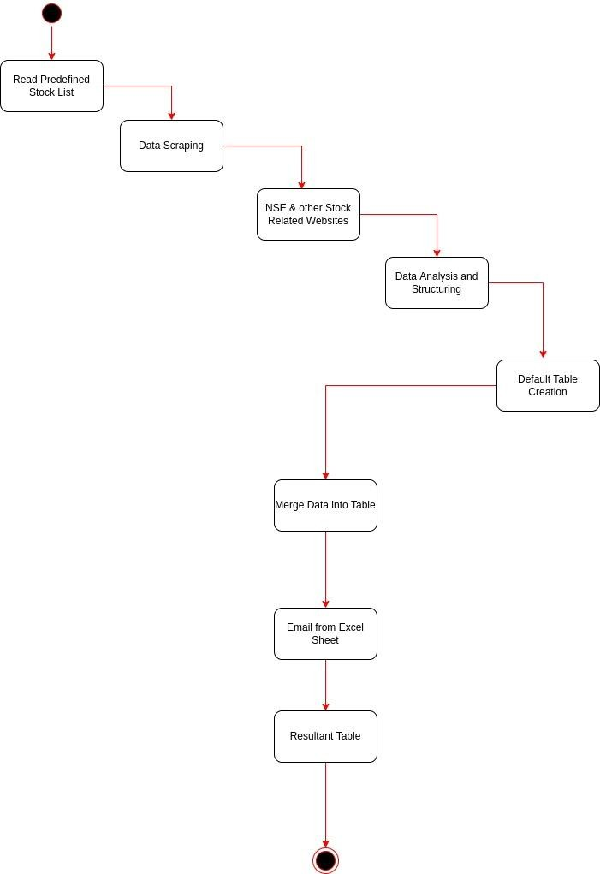
Activity Diagram:

Slide 12

Module Description:
Selenium:
Selenium is a browser automation framework. It provides several tools and APIs for automating user interaction on pure HTML and JavaScript applications in browsers such as Internet Explorer, Mozilla Firefox, Google Chrome, Safari, etc.
However, Selenium does not support rich internet application (RIA) technologies such as Silverlight, Flex or Flash, and JavaFX. This blog will help you learn about Selenium, one of the best automation testing tools.
12

Slide 13
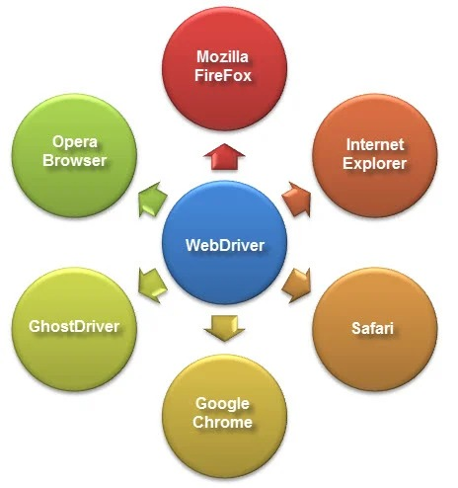
Web-drivers:
WebDriver is a collection of open source APIs which are used to automate the testing of a web application. Description: Selenium WebDriver tool is used to automate web application testing to verify that it works as expected. It supports many browsers such as Firefox, Chrome, IE, and Safari.
The webdriver module provides all the WebDriver implementations. Currently supported WebDriver implementations are Firefox, Chrome, IE and Remote.
13

Slide 14

Pandas:
Pandas is a powerful and flexible Python package that allows you to work with labeld and time series data. It also provides statistics methods, enables plotting, and more. One crucial feature of Pandas is its ability to write and read Excel, CSV, and many other types of files.
Functions like the Pandas read_csv() method enable you to work with files effectively. You can use them to save the data and labels from Pandas objects to a file and load them later as Pandas Series or Data Frame instances
14

Slide 15
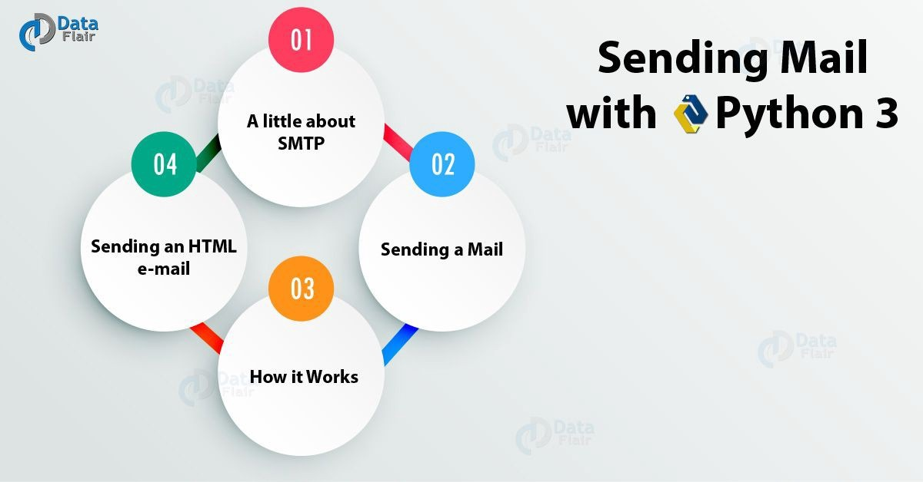
SMTP(simple mail transfer protocol):
The smtplib is a Python library for sending emails using the Simple Mail Transfer Protocol (SMTP). The smtplib is a built-in module; we do not need to install it. It abstracts away all the complexities of SMTP.
15

Slide 16
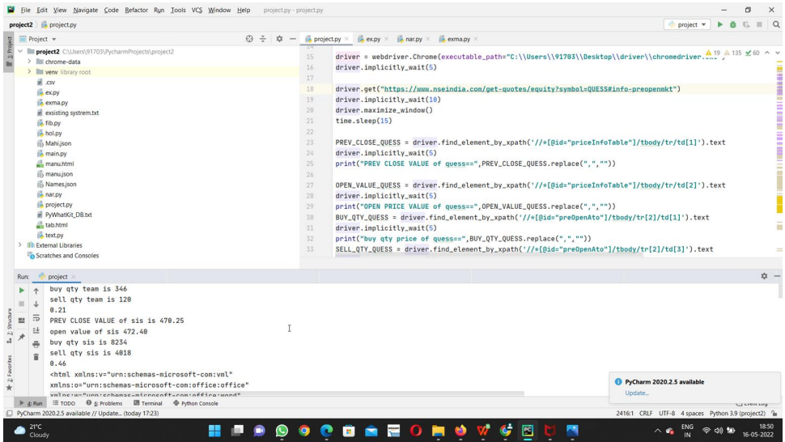
Testing:
This testing module focuses on single entity to work for the specific format provided in the HTML.
16

Slide 17
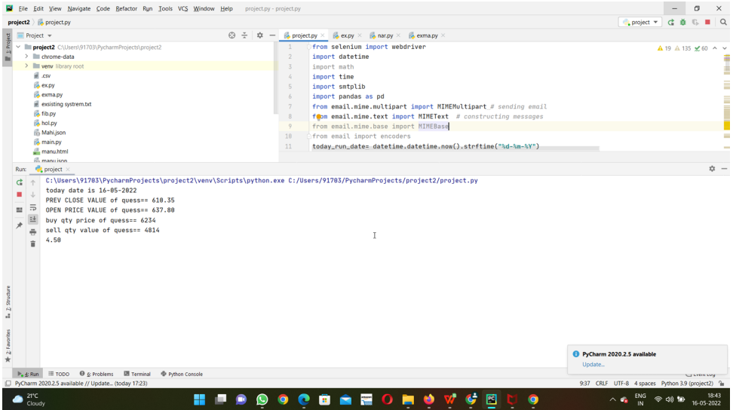
Output:
17

Slide 18
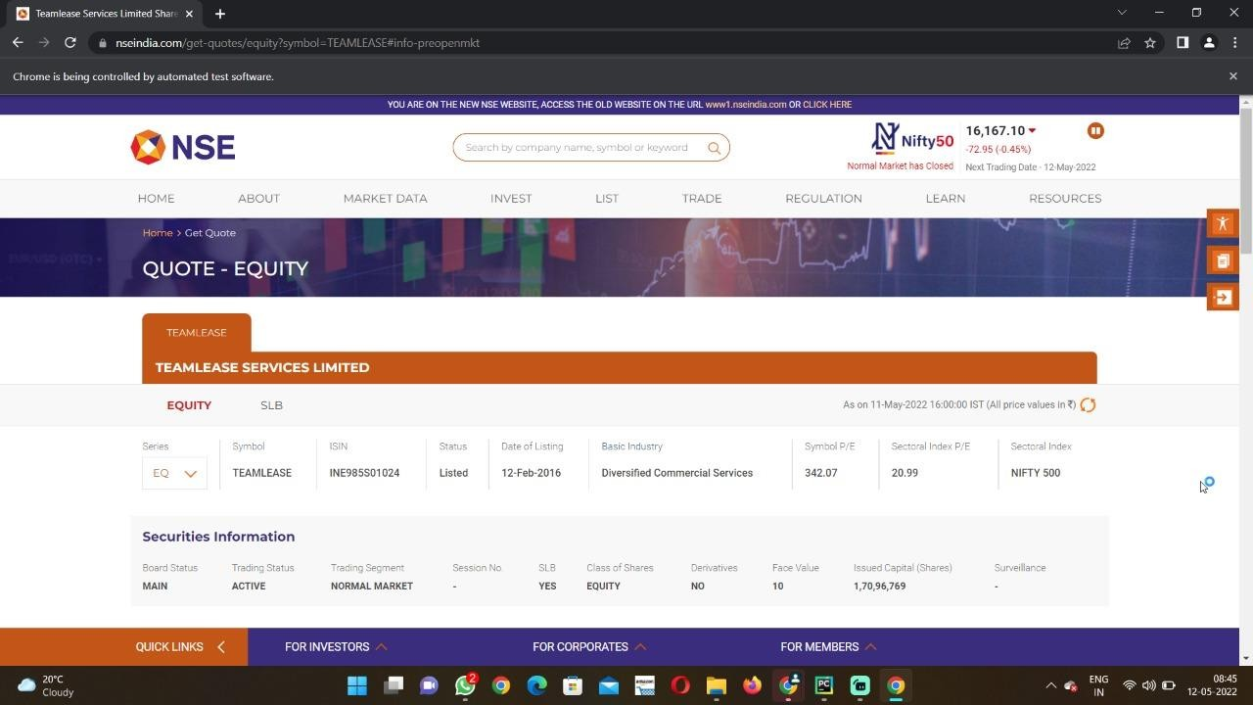

Slide 19
19

Slide 20
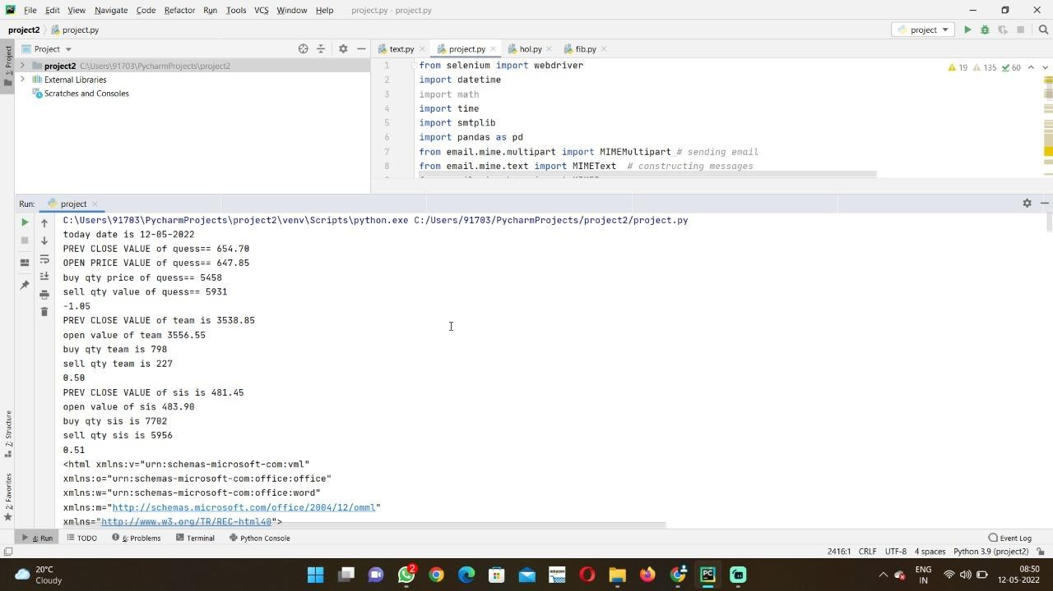

Slide 21
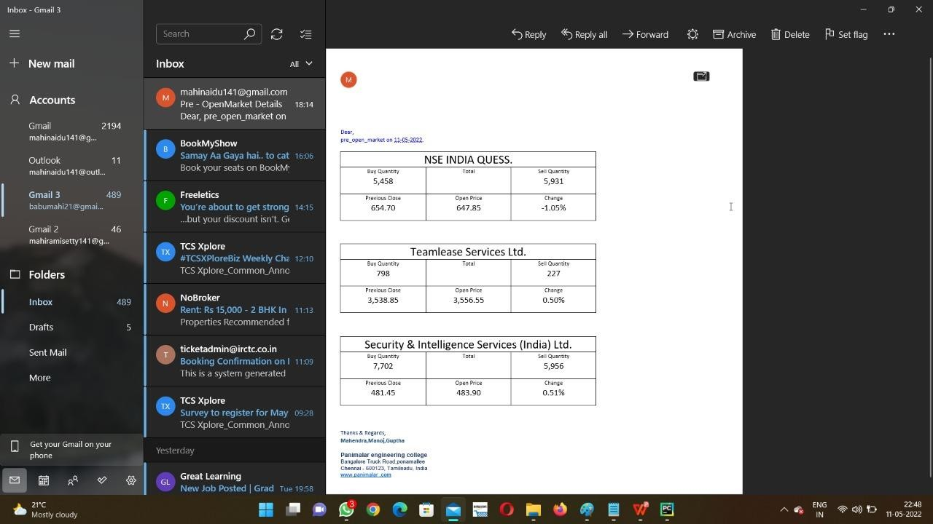

Slide 22
Conclusion:
In this project, we are getting the Previous value , stock starting value, closing value , Average Trade Spacing Value of any given organization and structure this data into a simple tabulo . This tabulo will be send to provided Email using STMP and selenium.
Future Work:
We plan to extend this application for sending Data to WhatsApp automatically. This inturn saves time and man power.
22

Slide 23
REFERENCES Reference for facts on on introduction:
[1] Manh Ha Duong Boriss Siliverstovs June 2006 - The Stock Market and Investment.
[2] Antoniou, A.P Holmes and R Priestley (1998): “The Effects of Stock Index Futures Trading on stock index volatility: An Analysis of the Asymmetric Response of Volatility to News?” The Journal of Futures Markets, 18 (2), 151-166.
[3] Stock Market Volatility – Conceptual Perspective through Literature Survey D. Mamtha, Research Scholar, VIT Business School, VIT University, Vellore, Tamil Nadu, India
[4] A Study on Stock Market Volatility Pattern of BSE and NSE in India Goutham Tanty and Dr. P K Patjoshi, Assistant Professsor, RIMS, Rourkela, Centurian University, Bhubanashwar
[5] Thenmozhi M (2002): “Futures Trading, Information and Spot Price Volatility of NSE-50 Index Futures Contract” NSE Research Initiative, Paper no. 18.
[6] What Triggers National Stock Market Jumps? Baker, Scott, Nicholas Bloom, Steve Davis, and Marco Sammon.
23

Slide 24
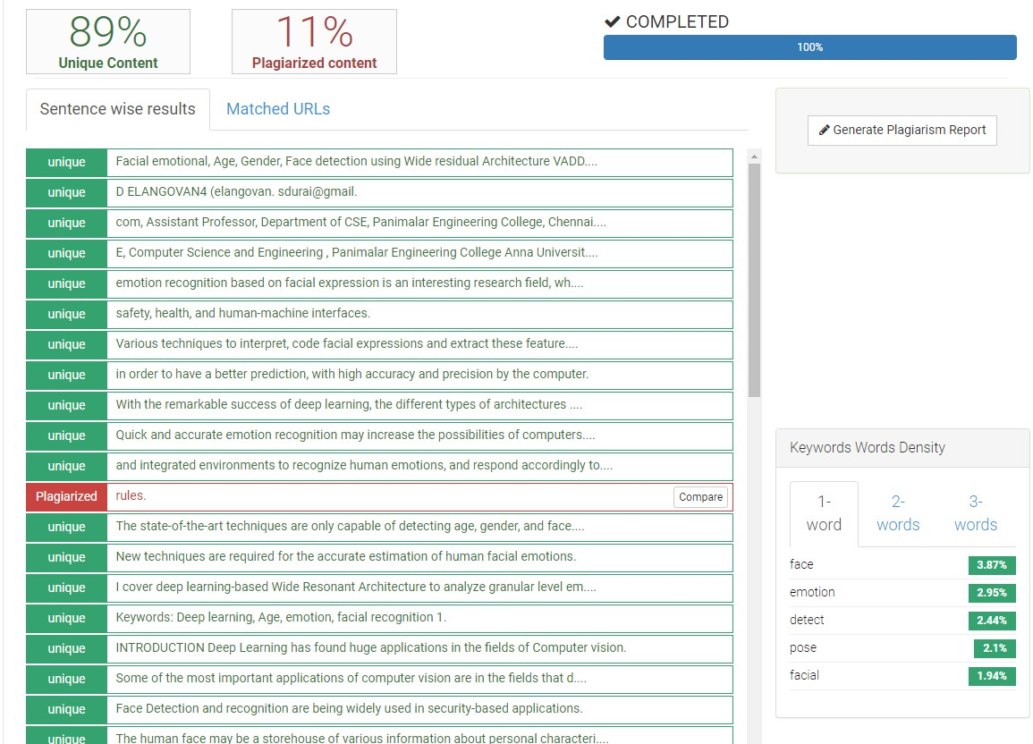
Plagiarism Report:
24

