Slide 1
PROJECT: Smart Health Monitoring
TEAM : BEGINNERs
Members :
MANOJ
MEGHANA
KAVITHA
SRUTHI

Slide 2
PURPOSE OF USING THIS DEVICE
AFFORDABLE
NO NEED OF CARETAKERS
EASE OF APPLICATION
ACCURATE
DETAILS CAN BE RETRIEVED AT ANY TIME
GIVE ALERT BEFORE CRITICAL SITUATION

Slide 3
REQUIREMENTS
HARDWARE:
Node MCU
Pulse sensor
Temperature sensor (LM 35)
Arduino UNO
Basic shield
SOFTWARE:
Arduino IDE
IBM Watson Cloud platform
MIT App Inventor

Slide 4
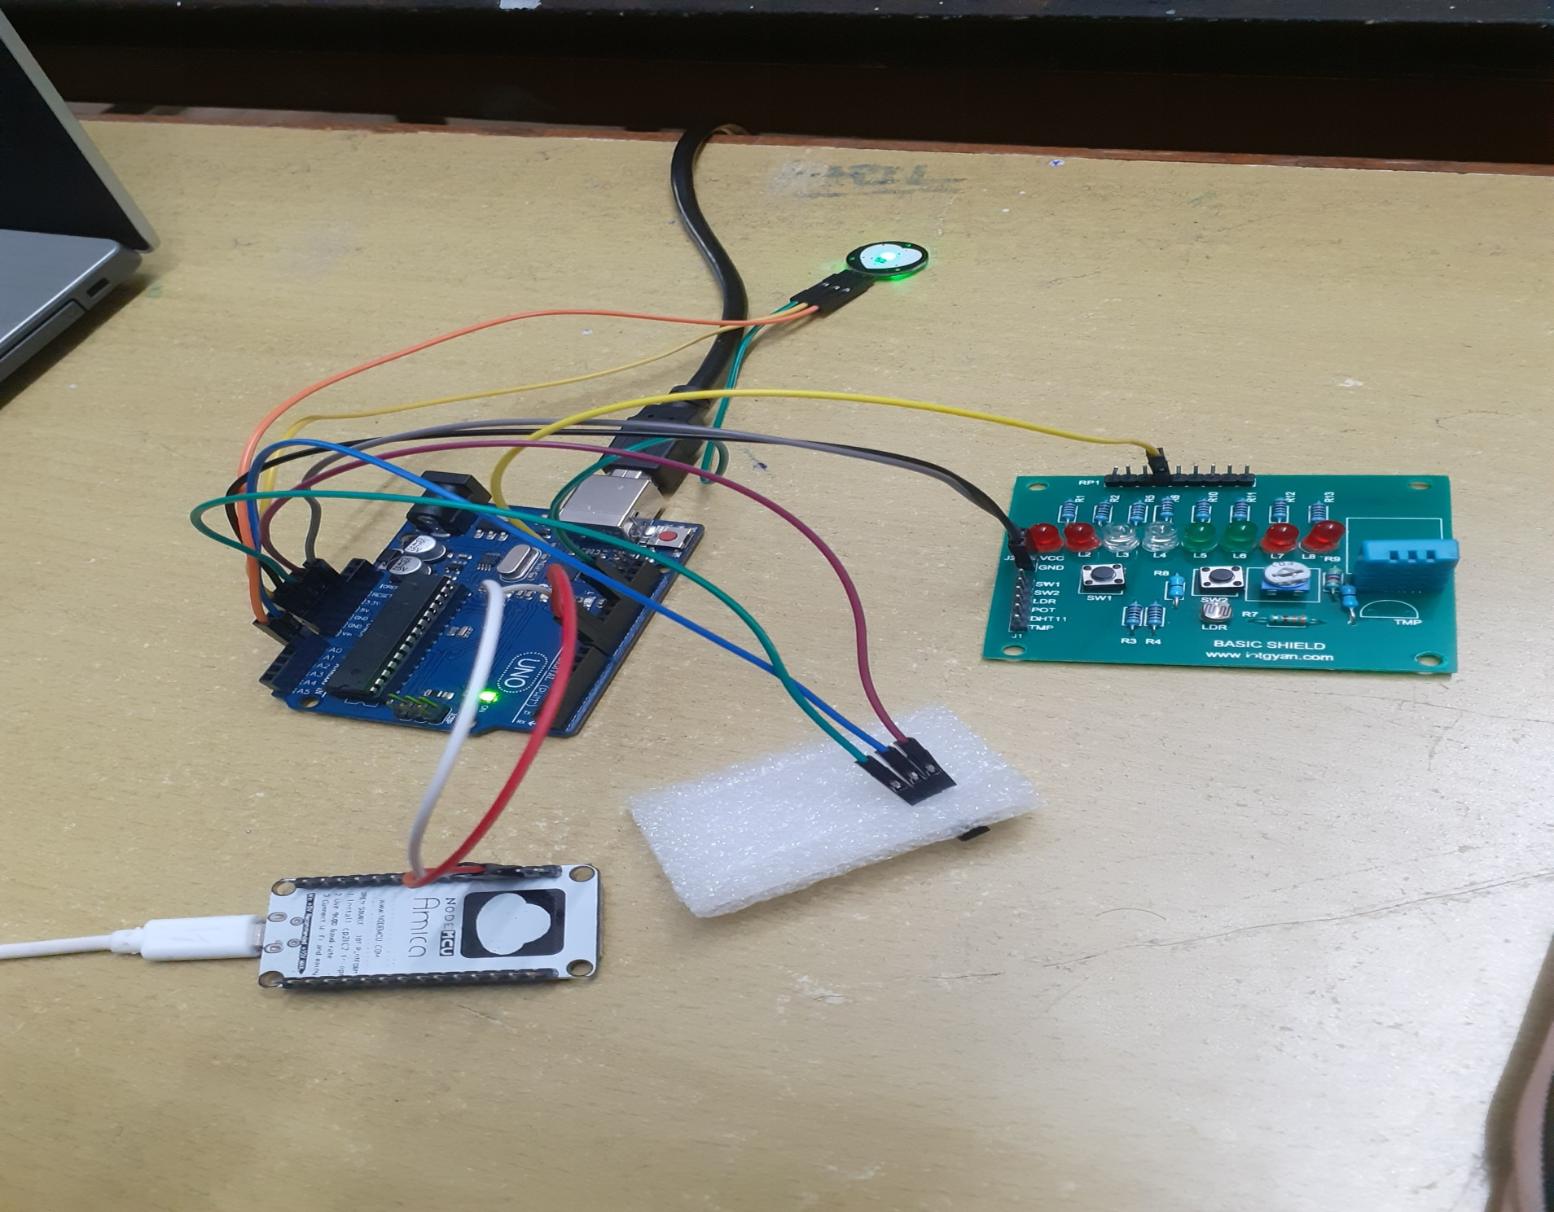

Slide 5
Principle of Heartbeat Sensor:
The basic heartbeat sensor consists of a light emitting diode and a detector like a light detecting resistor or a photodiode. The heart beat pulses causes a variation in the flow of blood to different regions of the body. When a tissue is illuminated with the light source, i.e. light emitted by the led, it either reflects (a finger tissue) or transmits the light (earlobe). Some of the light is absorbed by the blood and the transmitted or the reflected light is received by the light detector. The amount of light absorbed depends on the blood volume in that tissue. The detector output is in form of electrical signal and is proportional to the heart beat rate.
BPM(Beats per minute) = 60*f

Slide 6
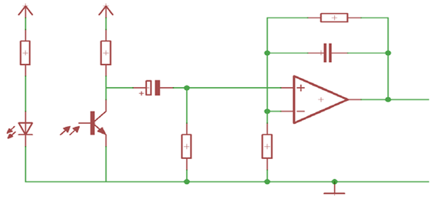
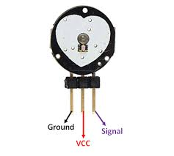
HEART RATE SENSOR

Slide 7
WORKING PRINCIPLE OF THERMAL SENSOR(LM35)
The power supply of the LM35 temperature sensor requires 5.5V and it consists of three terminals of a material which perform the operation according to the temperature to vary resistance. When the voltage increases, then the temperature also rises. We can see this operation by using a diode.
TEMPERATURE ∝ VOLTAGE

Slide 8
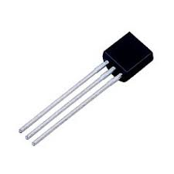
Features of LM35 Temperature Sensor
Calibrated directly in ˚ Celsius (Centigrade)
Rated for full l −55˚ to +150˚C range
Suitable for remote applications
Low cost due to wafer-level trimming
Operates from 4 to 30 volts
Low self-heating,
±1/4˚C of typical nonlinearity

Slide 9
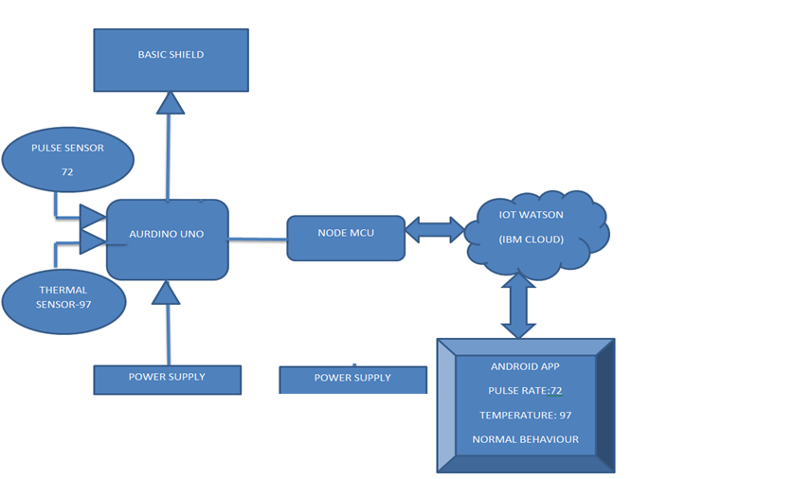
BLOCK DIAGRAM

Slide 10
Project Description :
Keeping track of the health status of the patient at home is a difficult. Especially old age patients should be periodically monitored and their loved ones need to be informed about their health status from time to time while at work. So we propose an innovative system that automated this task with ease. Our system puts forward a smart patient health tracking system that uses Sensors to track patient health and alerts the care takers in case of emergencies.
By using sensors we can check the health parameters of the elders and these sensor values are sent to IBM Watson cloud and those values are stored in the database. These values are then visualized on the user interface which is created using node red of IBM Watson services. These values are also sent to mobile application and whenever there is case of emergency notifications are sent to desired persons.

Slide 11
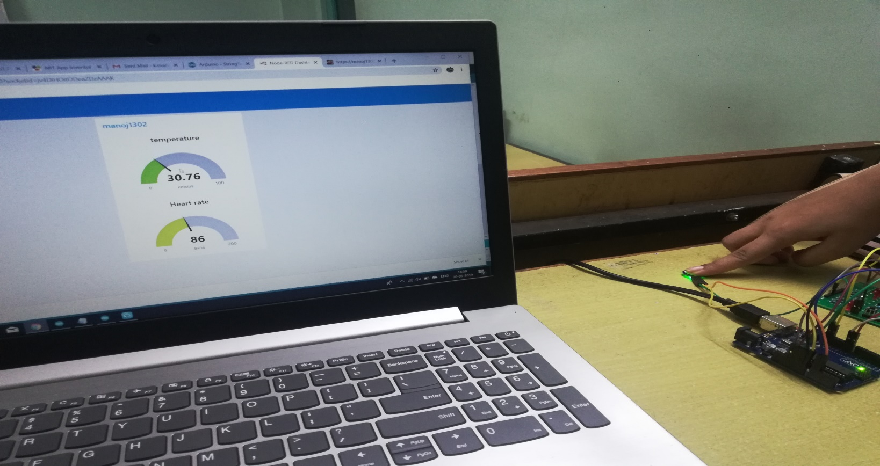
READING THE VALUES FROM THE DEVICE

Slide 12
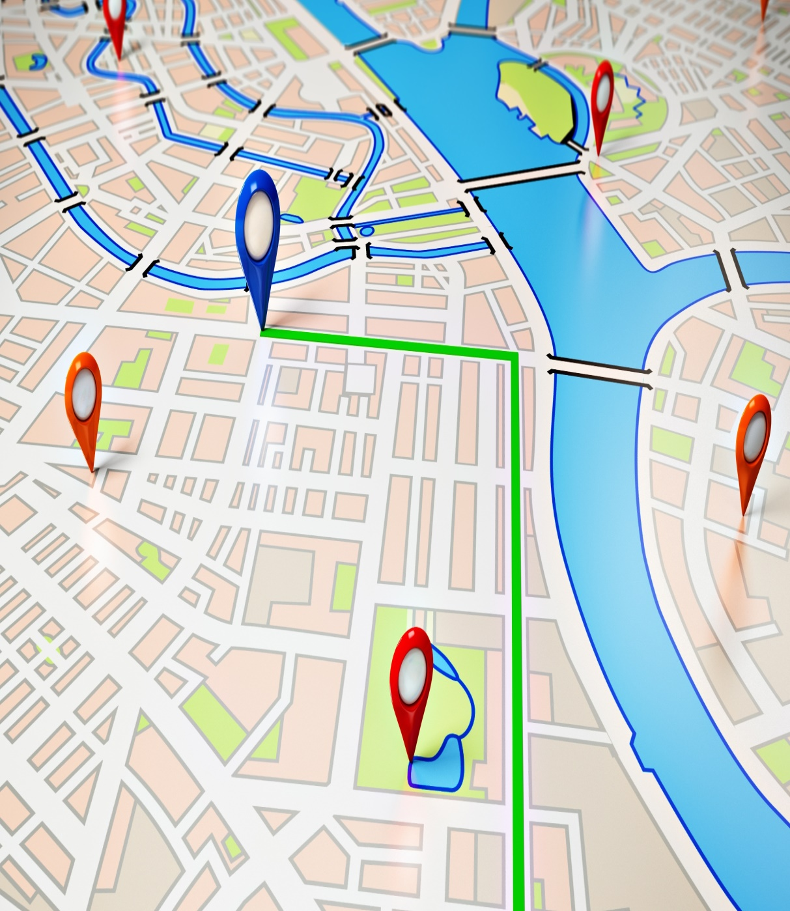
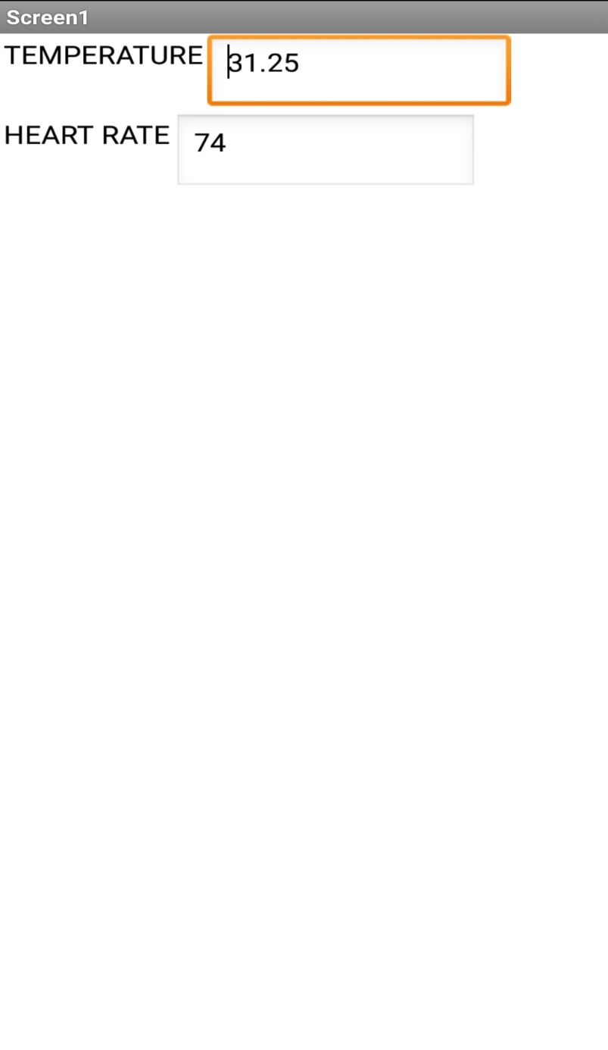

Slide 13
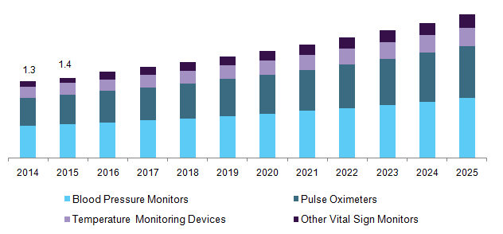
GRAPHICAL REPRESENTATION

Slide 14
THANK YOU

