Slide 1
Project Management Group – 4 Section-05

Slide 2
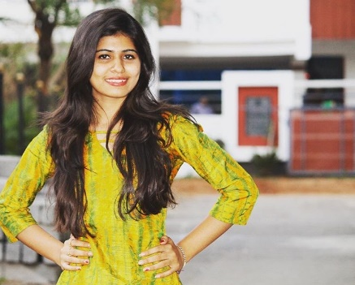
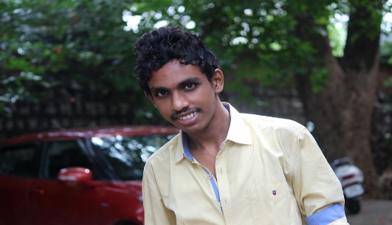
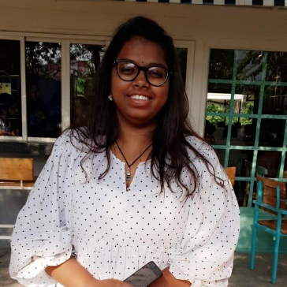
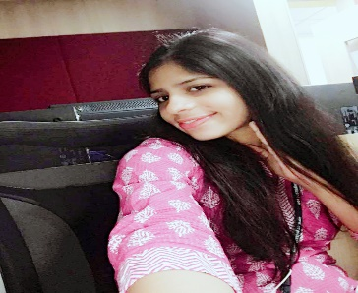
Team Members:-
Nithya Vudayamari - S534641
Naga Sai Manoj Goppisetty – S534885
Manasa Goripathi - S534782
Farheen Mohammad – S534800

Slide 3
TABLE OF CONTENTS
Title of the Slide | Presenter | Slide number
Lessons learned | Farheen
Difficult components | Manasa
Jelled team and techniques | Manoj
Interesting components | Manoj
Likes and dislikes | Nithya
Conclusion | Nithya

Slide 4
Lessons learned on this project!!!!!!

Slide 5
most difficult component of this project!!!!

Slide 6
Jell Teams and Techniques

Slide 7
most interesting component of this project

Slide 8
like or dislike about this project!!

Slide 9
THANK YOU

