Slide 1
DIGITAL IMAGE PROCESSING
SWE1010
REVIEW-2
.

Slide 2
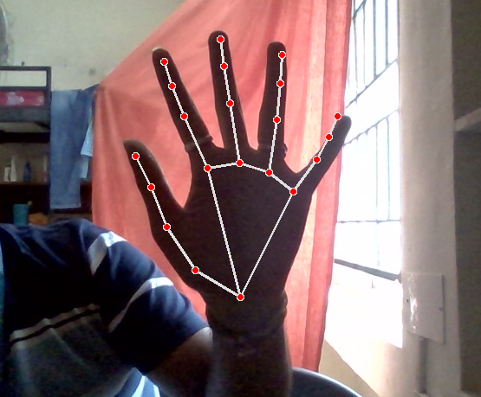
TITLE
SIGN RECOGNITION FROM VIDEO SEQUENCES

Slide 3
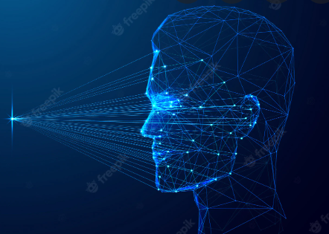
ABSTRACT
Our project aims to bridge the communication gap between normal people, deaf and dumb individuals by utilizing sign.
The study of automatic sign recognition combines machine learning, computer vision, and human-computer interactions.
The translation process, hearing people's integration, and the teaching of hand sign to the hearing community might all benefit from robust automatic identification of hand sign .
The rationale behind opting for a vision-based system is that it offers an easier and more natural means of communication between a person and a computer.
The inability to communicate is considered a real illness. People with this condition communicate in a variety of ways, with sign being one of the most popular.
Creating sign applications for deaf individuals is critical because they will be able to communicate easily with those who do not understand signs.

Slide 4
Introduction
A gesture is any movement made by a bodily part, such as the hand or the face. Using image processing and computer vision, we can recognise gestures in this case.
In addition to helping computers comprehend human gestures, gesture recognition also serves as a translator between computers and people.Like some other oral languages, hand sign is a naturally evolving language. It is used on a regular basis for communication by those who are deaf.
Any movement of the body, including the hand is a gesture. Here, we are utilising image processing and computer vision for gesture identification. Gesture recognition makes it possible for computers to comprehend human behaviour and serves as a translator between computers and people.
Since there aren't many people who use hand sign in general, finding knowledgeable individuals to record signs is more difficult.Because of these factors, the prevailing consensus is that we are still far from being resilient systems that recognise sign language.
The development of sign detection is similar to that of oral languages. People who are deaf use it to communicate every day

Slide 5
Motivation
.
.
.
,
The main objective of this research is to create a system based on vision that can recognise sign gestures in video clips.
A vision-based approach was chosen because it provides a simpler and more natural way for people and computers to communicate.
The identification of hand gestures is a difficult challenge when developing practical applications for the deaf mute community.
As a result, we can get a successful result. We will specifically use image processing concepts on the gathered photographs. For those who are Deaf and Mute, or those who lack the ability to hear and communicate, sign language is crucial.
It becomes crucial for people to comprehend their language because it is the sole means of communication for these individuals.

Slide 6
Timeline
Objectives’ of the project
Step-1
Step-2
Step-3
Step-4
Step-5
Step-6
Image acquisition from camera
Hand region segmentation
Hand detection and tracking
Hand posture recognization
Image processing
comparision between recognized image with processed image

Slide 7
workflow
Hand recognizer
hand detection from live Video
import the requried packages
.
recognising the Hand
consider the captured image
download the captured image
comparision between the processed image with captured image
suitable filter for clear vision of the captured image
image processing

Slide 8
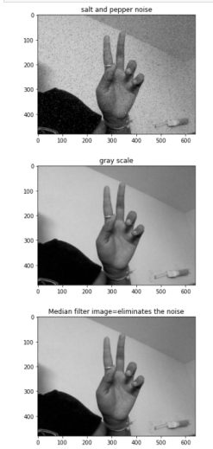
outputs
image processing
hand detection

Slide 9
conclusion
In this proposed work, we can able to know that it is very difficult to communicate for the deaf and dumb people. so,by using hand gesture recognition we are going to detect the image from live video from that we can get original image. Image processing and computer vision are used here to identify gestures. Gesture recognition allows computers to understand human behaviour and acts as a translator between computers and humans.We employed image processing here since we don't know the environmental situation that led to the usage of the project, so we applied some image processing based on the situation and image type to communicate the message appropriately by utilising a computer.

Slide 10
Thank You!
.
.
.
.
.

Slide 11
References
https://ieeexplore.ieee.org/document/8663054
https://www.researchgate.net/publication/284626785_Hand_Gesture_Recognition_A_Literature_Review
https://www.hindawi.com/journals/tswj/2014/267872/

