Slide 1

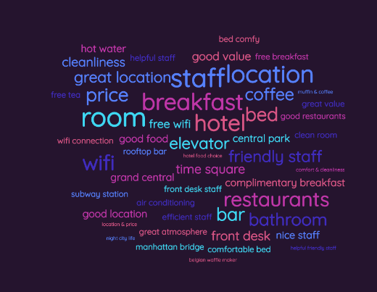
SWE1017-NATURAL LANGUAGE PROCESSING Disaster Tweets NLP: EDA & BERT With Transformers
THE NAME OF THE COMPANY
kaggle compitition
Team Members
20MIA1117 - PILLARAM MANOJ
20MIA1031 - SANJAY.M
20MIA1162 - GUNA SHANKAR.S

Slide 2
Dataset
Description
Application
THE NAME OF THE COMPANY
METHOD
Algorithm

Slide 3
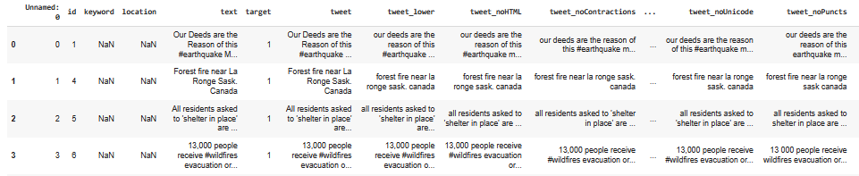
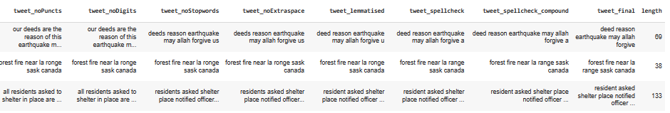
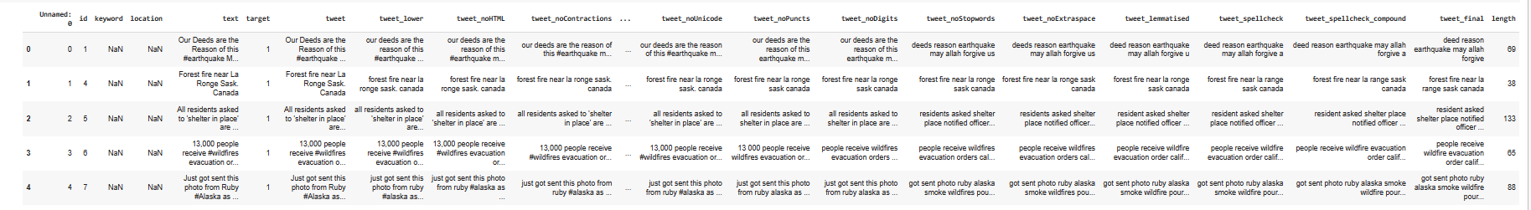
Dataset Description
THE NAME OF THE COMPANY

Slide 4
Dataset Description
The text of a tweet
A keyword from that tweet (although this may be blank!)
The location the tweet was sent from (may also be blank
80%
train
20%
train-test
30%
testing
THE NAME OF THE COMPANY

Slide 5
Application
Emergency Alerts
Disaster Response
Political Action
Early Warning Systems
THE NAME OF THE COMPANY
Public Safety Alerts
Disaster Research
Media Coverage
Crisis Communication
Fundraising

Slide 6
METHOD
https://arxiv.org/pdf/2202.00795.pdf
https://www.warse.org/IJATCSE/static/pdf/file/ijatcse06911sl2020.pdf
S.no | Authors | Title | Abstract | Journal Name, Year | Data set | Methodology | performance measure
1 | Hamada M. Zahera | Fine-tuned BERT Model for Multi-Label Tweets Classification | They has conveyed that describe method for categorising disaster-related tweets into multiple label information types (i.e, labels). During disasters, they aim to filter the most relevant tweets first. Then we assign relevant information types to tweets. SearchAndRescue, MovePeople, and Volunteer are examples of information types. We use a refined BERT model with ten BERT layers. In addition, we submitted our approach to the TREC-IS 2019 challenge, and the evaluation results revealed that our approach outperforms the F1-score of median score in identifying actionable information. | 2019 | TREC-IS Dataset | Fine-tuning BERT | 0.85
2 | Gleen A. Dalaorao, Ariel M. Sison | Applying Modified TF-IDF with Collocation in Classifying Disaster-Related Tweets | They conveyed that Disaster-related tweets classification refers to posted tweets on twitter during time-critical events that are group together according to pre-defined categories. The Term Frequency – Inverse Document Frequency (TF-IDF) helps classifier extract useful features, but it can be ambiguous and can reduce classification efficacy. This paper aims to provide an analysis of the effectiveness of tweets classification by applying improved TF-IDF with collocation. The performance evaluation metrics considered are confusion matrix, precision, recall, and F1 score. | 2020 | Crisislex dataset | TF-IDF Collocation Weight Processing, RandomForest, Multinomial Naive Bayes and SVM | 0.87
THE NAME OF THE COMPANY

Slide 7
Algorithm
LR
SVC
KNN
SVM
The BERT (Bidirectional Encoder Representations from Transformers) model is a Google-developed pre-trained deep learning algorithm for natural language processing tasks. It is an effective text classification and language translation tool. The BERT model is used to categorise tweets as disaster or non-disaster tweets. To adapt to the specific classification task, the BERT model is fine-tuned on training data.
BERT
THE NAME OF THE COMPANY
The BERT model and the TF-IDF vectorizer are both effective text classification tools.The BERT model is more complex and requires more computational resources than the TF-IDF vectorizer, but it can be more accurate.
TF-IDF
The TF-IDF vectorizer (Term Frequency-Inverse Document Frequency) is a popular feature extraction tool in natural language processing. It is a statistical method for determining the significance of a word in a document based on its frequency and the number of documents in which it appears. The TF-IDF vectorizer is used to convert tweets into numerical feature vectors. The TF-IDF vectorizer assigns a score to each word in the corpus based on its frequency in a specific tweet and its overall frequency in the corpus.

Slide 8

THE NAME OF THE COMPANY
“Fake news travels quicker than actual news”

