Slide 1

BDAT 1007
Social Data Mining Techniques
Assignment 2
REAL TIME DATA COLLECTION ON
Social Media Applications
Prepared By
Manoj Gottumukkala

Slide 2

Agenda
1
About me
2
Data Collection- Twitter and Reddit
3
Data model
4
Storing of data
5
Web API
Notes:
On todays’ agenda we will be first outlining the tasks of the assignment.
Then we will introduce the team.
We will then provide the details of our project and then go to a live demonstration

Slide 3



About me
Link to the video presentation
https://www.youtube.com/watch?v=EshPJnyrlFA&feature=youtu.be
Manoj Gottumukkala
University of Western Ontario
Masters in Electrical and Computer Engineering
Notes:
Our data source comes directly from Monster.ca, compiling a list from searching the first 5 pages of job postings for the job posting “Python Developer”

Slide 4
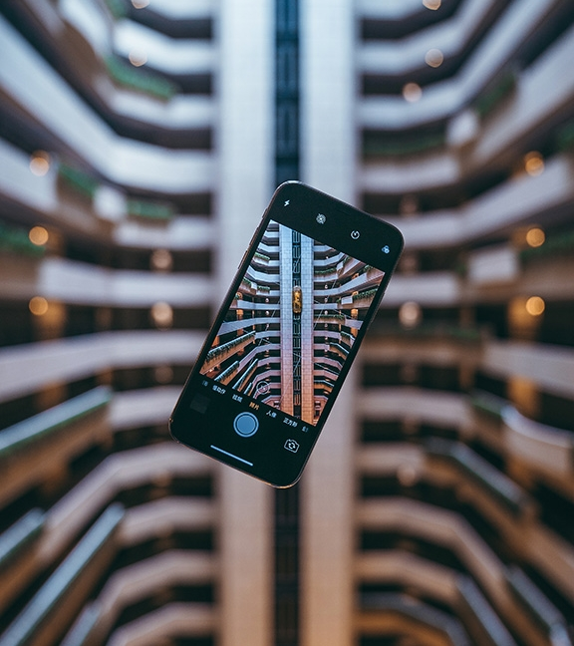
TOOLS AND TECHNIQUES FOR REAL TIME DATA COLLECTION ASSIGNMENT #2
Use a programming language (C# or Python) as a choice for project creation.
Your code should be well commented and easy to execute and demonstrate
Due date for Assignment #2 – Monday, 22nd of February 2021 @ 1pm.
Tasks
1. Build a Web Application that allows for:
Real-time acquisition of feeds
Display (media from the social media feed i.e. photos, videos, web links)
Store collected data in a remote data source(i.e Microsoft Azure, MS SQL Server)
Remember that each time you import this data you do not want duplicates
Check for previous entries before importing the record
2. Collect a minimum of 100 entries.
3. Build a data model (Object) that suits your data collection. For example:
Twitter-Social Media Object
UserId
Twitter handle
Likes/Dislikes
Description
Date
4. Demonstrate the use of One to Many Lists in your Data Model. For example:
Many businesses function out of multiple offices and usually have many contacts within the business.
Use a List collection to give yourself the ability to add multiple Address and Contact Objects to your Business Object
5. Store this data in a Cloud database (Azure MS SQL Server or MongoDB are good choices)
Remember to choose a free database
On Azure, setup a Web App + SQL, this option will allow you to setup a 32 Mb Database on a Free Tier Server
6. Add one more Social Media provider (i.e Twitter, Instagram) and duplicate the data collection techniques.
Note: Presentations will be a individual power point format with video included in submission on Blackboard link.

Slide 5


Social Media Platforms
TWITTER
Reddit

Slide 6








TOOLS
Notes:
In regards to the tools used in our assignment:
We used Python as the programming language for web scraping.
Beautiful Soup is the python package used for the HTML parsing and web scraping.
We used SQL Server as our database.

Slide 7


Data Model
ID
Unique identifier
id
Unique Identifier of the user
Name
Name of the user account.
Author Name
Name of the account user.
screen_name
Screen Name of the user.
Text
content posted by the user.
image_url
Profile picture url
Link
Link posted by the user.
text
Content of the post

Slide 8

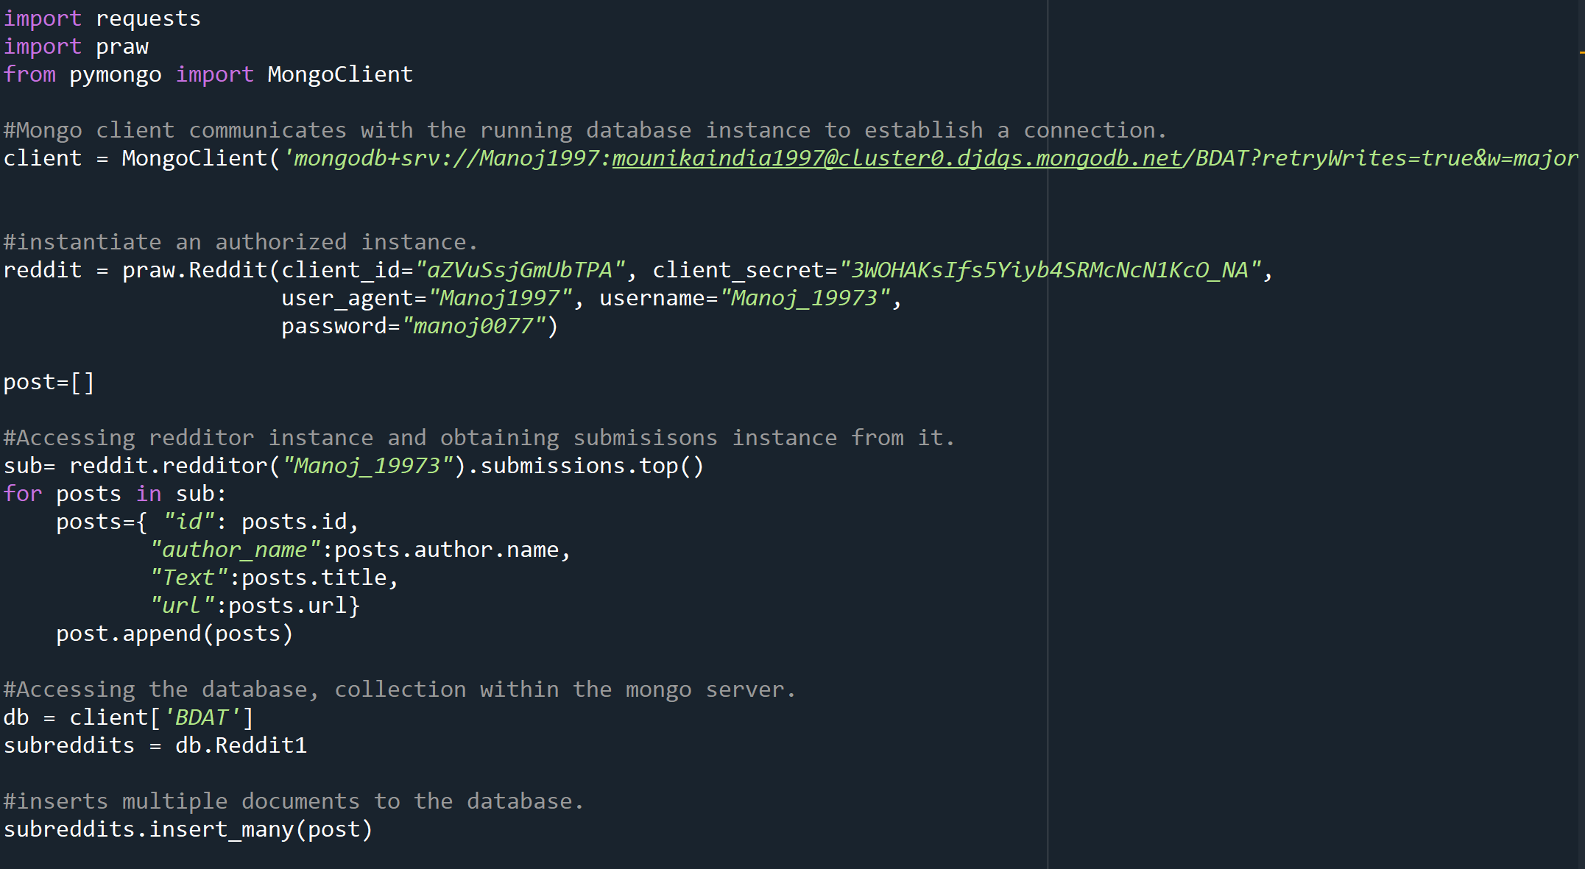

DATA
Collection
-Reddit
Notes:
Our data source comes directly from Monster.ca, compiling a list from searching the first 5 pages of job postings for the job posting “Python Developer”

Slide 9
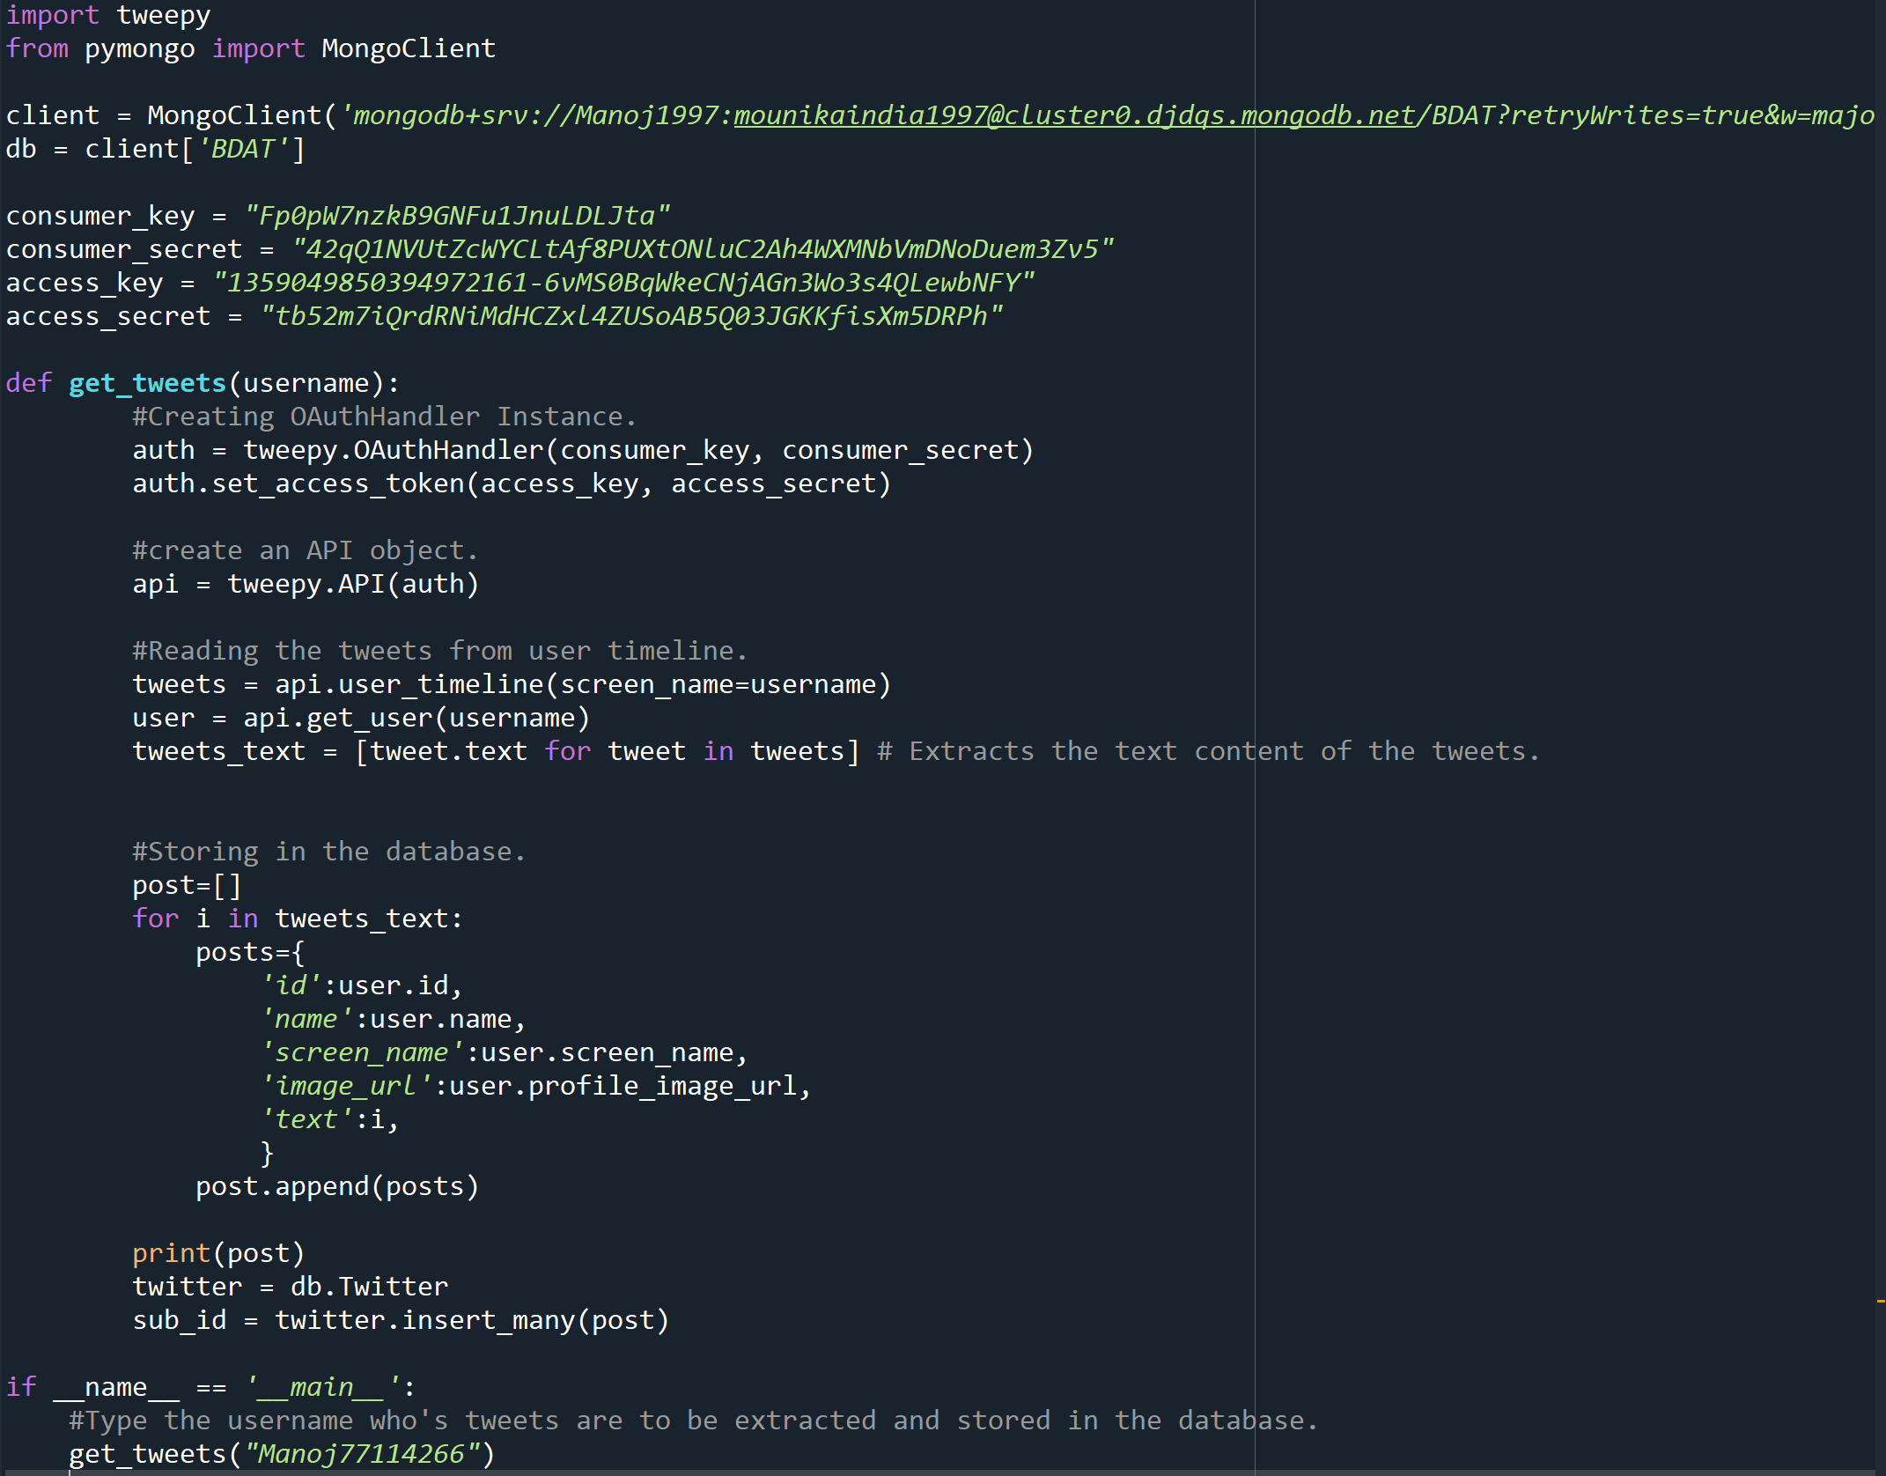
Project Details
DATA
Collection
-Twitter
Notes:
Our data source comes directly from Monster.ca, compiling a list from searching the first 5 pages of job postings for the job posting “Python Developer”

Slide 10


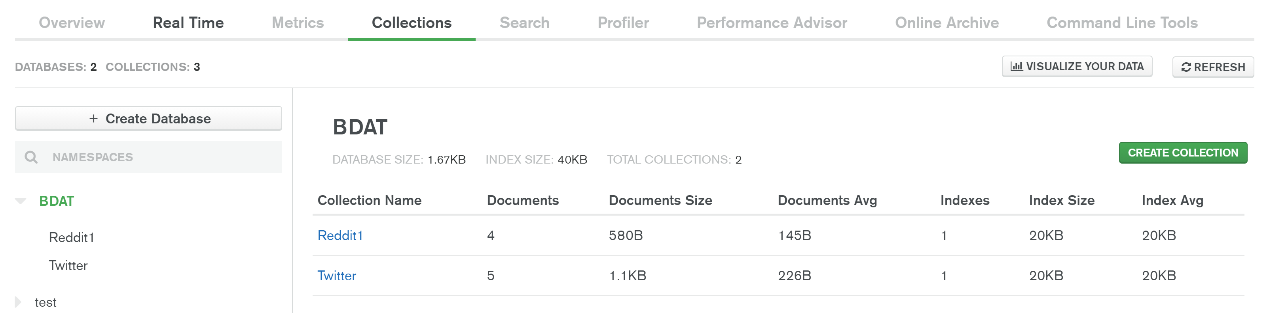
Storing the data.
DATABASE-Mongo Db

Slide 11
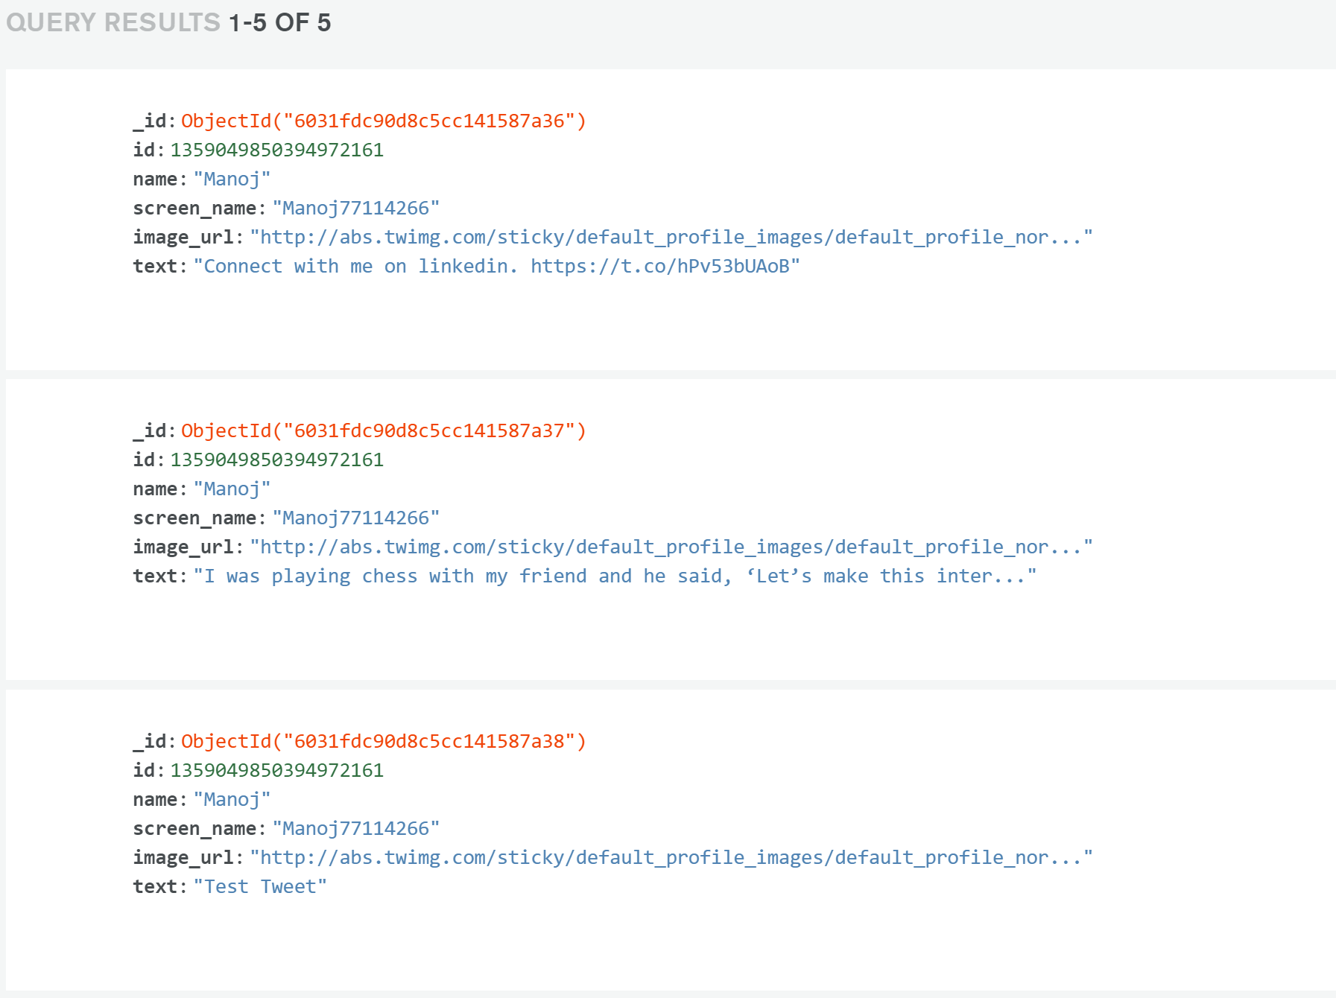
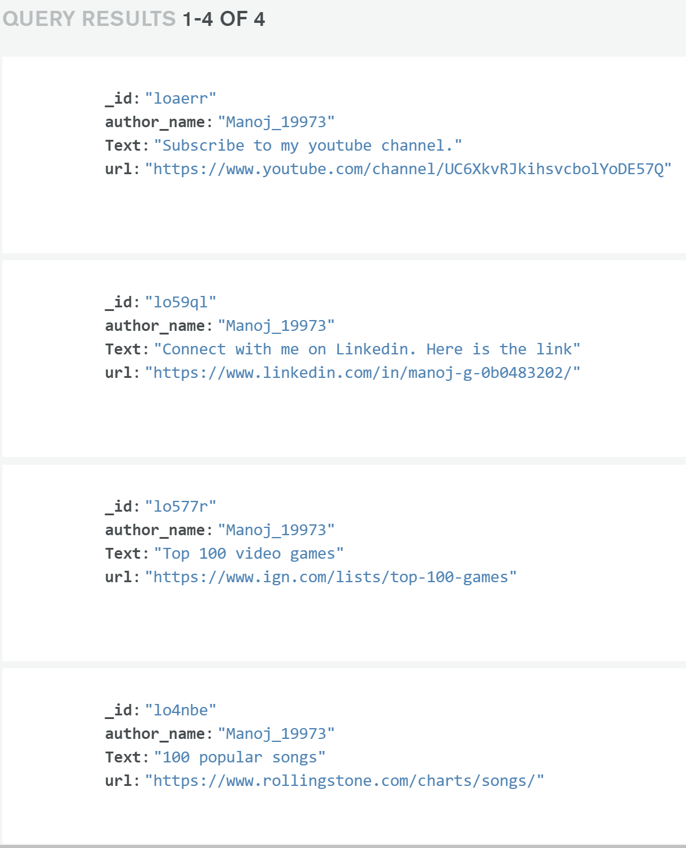
Documents in the collections.

Slide 12
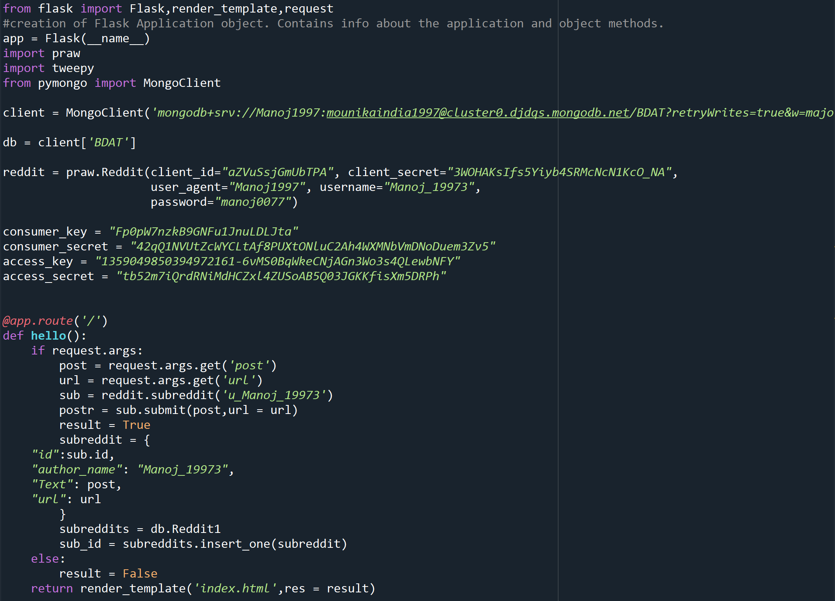
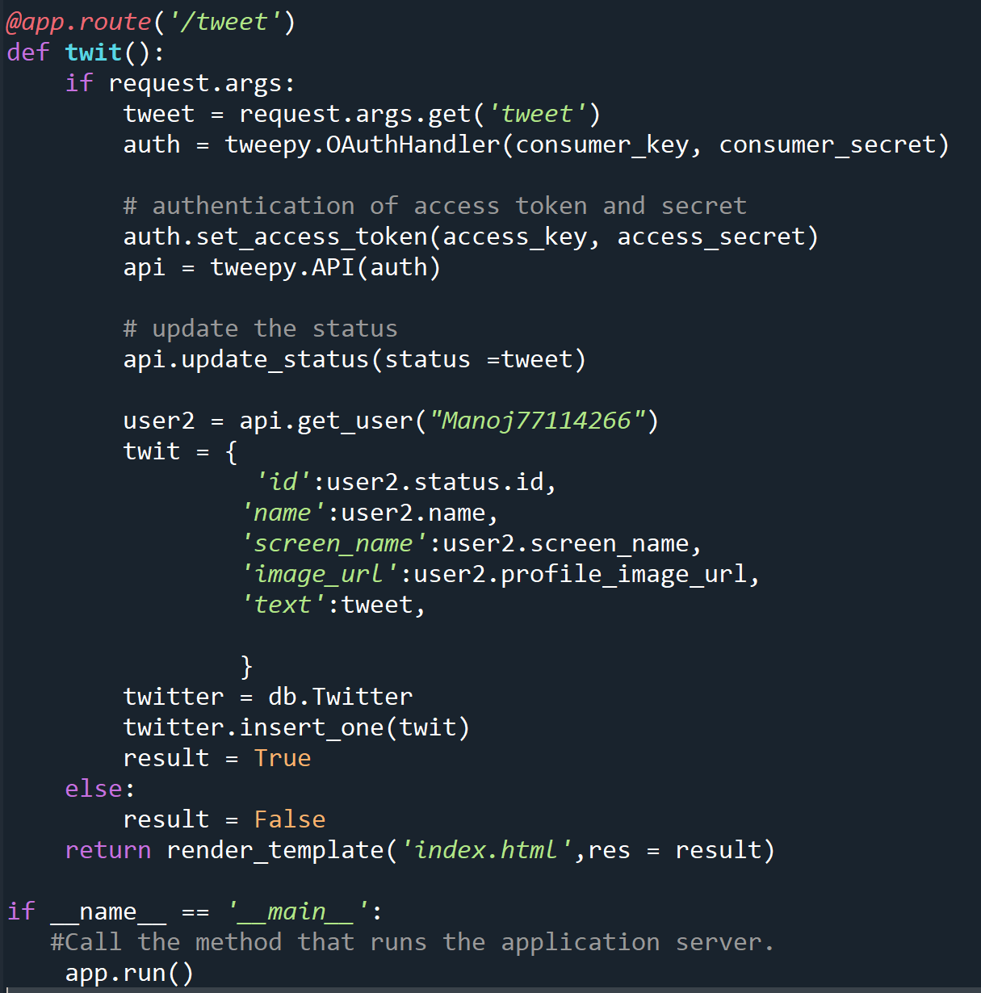
WEB APPLICATION USING FLASK

Slide 13

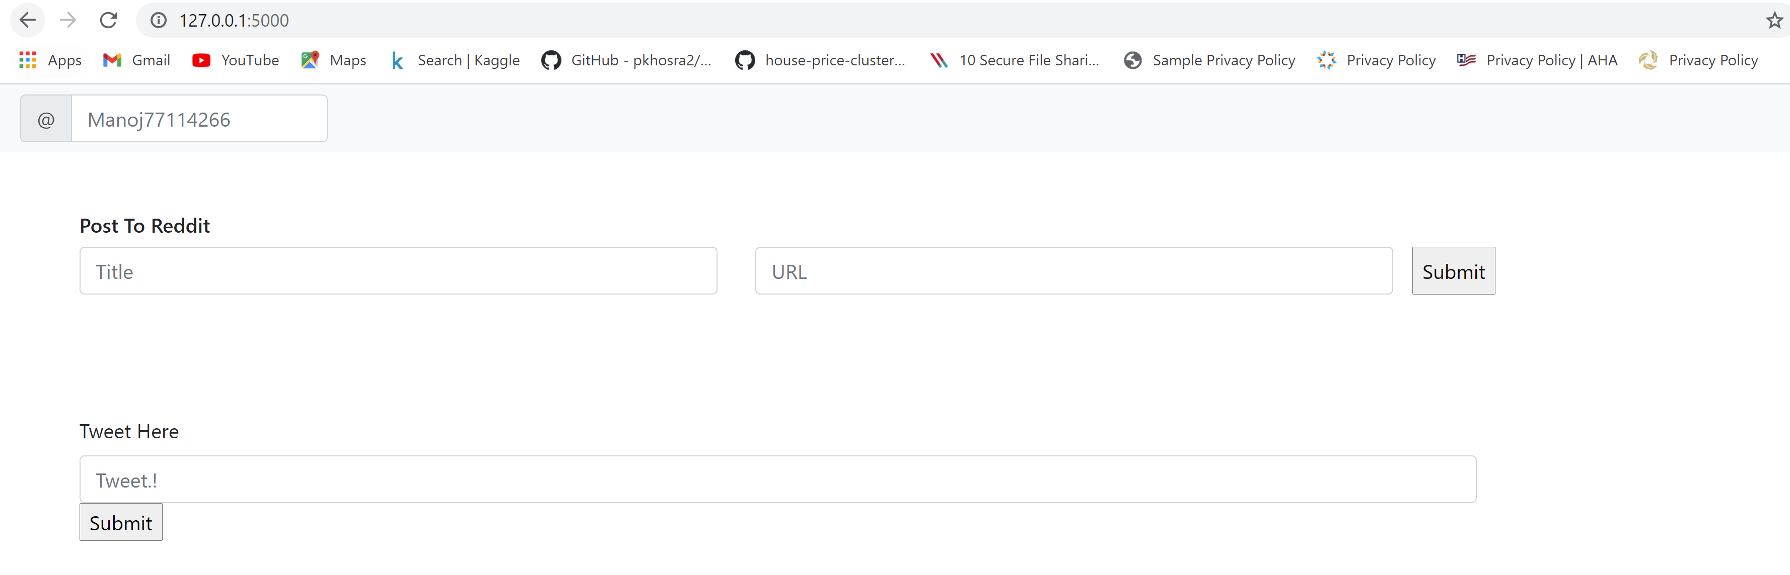
WEB API

Slide 14
THANK YOU

