Slide 1
DATA ANALYTICS · INFORMATION SECURITY
Cybersecurity Threat
Detection & Analysis
Using Python
Presented by [Your Name]
Analysis of 5,200 network security events · January – March 2025
5,200
42
830
15.96%
Events
Features
Threats
Threat Rate
Notes:
Introduce yourself and the project. This is an end-to-end Python data analysis of 5,200 network security events, finding that about 16% are real threats and building rules to prioritise them.

Slide 2
Project Overview
An end-to-end Python analysis of a network security event log
01
02
03
What the Project Is
The Security Problem
Overall Objective
An end-to-end analysis of a security event log containing 5,200 network events and 42 features, covering network traffic, login activity, security controls, threat labels and risk scores.
Security teams log far more events than they can investigate. Here only 830 of 5,200 events are real threats — roughly 84% of the alert queue is noise that still has to be reviewed.
Use Python to separate real threats from normal traffic, identify which indicators are genuinely reliable, and produce a rule that tells an analyst which events to open first.
Key outcome: a Risk Score above 70 isolates 625 events — and all 625 are confirmed threats.
Cybersecurity Threat Detection & Analysis | Project Overview
Notes:
Say: the project turns a noisy 5,200-event log into a prioritised queue. 84% of the log is noise; the goal is to find the 16% that matters.

Slide 3
Project Objectives
Six questions the analysis was designed to answer
1
Detect Cybersecurity Threats
2
Analyse Attack Patterns
3
Identify Suspicious Indicators
Measure how many events are genuine threats and how they differ from normal traffic.
Break threats down by threat type, attack type and attack vector to see where attacks come from.
Test malware flags, suspicious URLs, unusual ports and failed logins for reliability.
4
Analyse Risk & Anomaly Scores
5
Understand Threat Severity
6
Identify High-Risk Events
Use NumPy statistics to compare score behaviour across threat and non-threat events.
Examine how severity levels map to real threats and what should be escalated first.
Define a score threshold that isolates the events an analyst must review immediately.
Cybersecurity Threat Detection & Analysis | Project Objectives
Notes:
These six objectives map directly to the sections of the analysis. Each one is answered with a number later in the deck.

Slide 4
Dataset Overview
cybersecurity_threat_dataset.csv · network security event log
5,200
42
Dataset at a Glance
Attribute | Value
Raw rows loaded | 5,255
Duplicate events removed | 55
Final records analysed | 5,200
Total columns | 42
Numeric columns | 18
Categorical columns | 24
Columns with missing values | 11
Time period covered | 01 Jan – 31 Mar 2025
Target column | Is_Threat (1 / 0)
Threat events | 830
Non-threat events | 4,370
Final records after duplicate removal
Columns / features
Event & Network
Event_ID, Timestamp, Source_IP, Destination_IP, Protocol, Packet_Count, Bytes_Sent / Received, Connection_Duration
Login & Access
Login_Attempts, Failed_Login_Count, Successful_Login_Count, Session_Duration, Authentication_Method
Security Controls
Malware_Detected, Firewall_Status, Antivirus_Status, Encryption_Used, Suspicious_URL, Unusual_Port, Multiple_Failed_Logins
Threat Fields
Threat_Type, Attack_Type, Attack_Vector, Severity, Threat_Status, Detection_Method, Is_Threat, Is_Malicious, Incident_Status
Risk & Anomaly
Risk_Score (0–100), Anomaly_Score (0–100)
Cybersecurity Threat Detection & Analysis | Dataset Overview
Notes:
Mention that 55 duplicate events were removed, which is why the analysed total is 5,200 rather than 5,255.

Slide 5
Technologies Used
The Python data-analysis stack and the role each library played
Python
Core language for the entire workflow — loading, cleaning, analysing and visualising the security log in one environment.
Pandas
Table operations: read_csv, isnull().sum(), drop_duplicates(), groupby().transform(), value_counts() and crosstab() for every distribution.
NumPy
Numerical work: np.mean, np.median, np.std, np.percentile and np.corrcoef, plus boolean array filtering to isolate high-risk events.
Matplotlib
Base plotting engine — figure sizing, titles, axis labels and layout for all charts in the project.
Seaborn
Statistical charts in one line each: count plots, box plots, histograms, scatter plots and the correlation heatmap.
Cybersecurity Threat Detection & Analysis | Technologies Used
Notes:
One-liner for interviews: Pandas is for anything shaped like a table; NumPy is for the numbers underneath it; Seaborn and Matplotlib turn the result into a picture.

Slide 6
Data Cleaning Process
Five sequential steps from raw file to analysis-ready dataset
1
2
3
4
5
Data
Inspection
>
Missing Value
Analysis
>
Missing Value
Handling
>
Duplicate
Removal
>
Type & Consistency
Checks
shape, info(), dtypes,
describe()
11 columns with
missing values found
Categorical fills +
group-wise median
55 duplicate events
removed
Timestamp parsed,
Protocol standardised
Result of cleaning
5,255
55
5,200
16
8
0
Raw rows
Duplicates removed
Clean records
Protocol spellings found
After standardising
Remaining nulls
Cybersecurity Threat Detection & Analysis | Data Cleaning Process
Notes:
Good detail to mention: the Protocol column had 16 spellings such as HTTP, http and Http. Standardising case reduced it to the correct 8 protocols.

Slide 7
Missing Value Handling
Different types of missingness required different treatments
Categorical Missing Values
Why threat fields were not dropped
Filled with "None" — Threat_Type, Attack_Type, Attack_Vector, Threat_Status. The event genuinely had no threat, so "None" is the correct value.
Filled with "Unknown" —
Authentication_Method, Antivirus_Status, Browser, Country. The data was simply not captured.
4,370
0
Rows with blank Threat_Type
Threat events with blanks
Four columns were blank in 84.04% of rows. Cross-checking against Is_Threat showed every one of those 4,370 rows is a non-threat event, and no threat event has a blank Threat_Type.
Numerical Missing Values — Group-Wise Median
Filled using the median of each column within its own Is_Threat group, because threat and non-threat traffic behave very differently:
The values are missing because there was no threat to describe — not because of a data quality problem. Dropping these rows would have deleted the entire non-threat population.
Column | Non-Threat | Threat
Bytes_Received | 5,993.00 | 20,823.00
Response_Time | 0.82 | 3.41
Session_Duration | 25.20 | 12.45
Cybersecurity Threat Detection & Analysis | Missing Value Handling
Notes:
This is the strongest "data judgement" story in the project: 84% missing looked alarming but was structural. Explain why you checked it against Is_Threat before touching it.

Slide 8
Exploratory Data Analysis
What the first pass through the cleaned data revealed
Class imbalance
Threats are evenly spread
Only 830 of 5,200 events are threats (15.96%). The dataset is heavily weighted toward normal traffic.
Nine threat types range from 101 down to 87 events — no single dominant attack campaign.
Severity is decisive
Scores are right-skewed
All 4,370 non-threat events are Low severity. Every Medium, High and Critical event is a real threat.
Risk Score mean 27.67 vs median 20.07. Most events sit low, with a separate high-risk cluster.
Indicators are rare but sharp
Redundant column found
Each indicator fires on under 11% of events, yet fires far more often on threats.
Attack_Type is an exact copy of Threat_Type across all 5,200 rows.
Cybersecurity Threat Detection & Analysis | Exploratory Data Analysis
Notes:
Each of these six observations is expanded on a later slide. Use this as the map of the findings section.

Slide 9
Threat Distribution
Threat vs Non-Threat across all 5,200 analysed events
4,370
Non-Threat Events
84.04% of the log
830
Threat Events
15.96% of the log
5,200
Total Events Analysed
after removing 55 duplicates
Roughly 1 in every 6 logged events is a genuine threat — the remaining 5 are noise an analyst still has to triage.
Cybersecurity Threat Detection & Analysis | Threat Distribution
Notes:
Headline number of the whole project: 830 threats out of 5,200 events, about 15.96%.

Slide 10
Attack & Threat Patterns
Threat type, attack type and attack vector across the 830 threat events
Threat Type / Attack Type
Attack Vector
Attack_Type is an exact duplicate of Threat_Type in all 5,200 rows
How threats entered the environment
Web Application
134 (16.1%)
Remote Desktop
126 (15.2%)
Email
126 (15.2%)
Network
112 (13.5%)
USB Device
112 (13.5%)
API
112 (13.5%)
Social Engineering
108 (13.0%)
Web Application, Remote Desktop and Email together account for 386 threats — 46.5% of all threat events.
Cybersecurity Threat Detection & Analysis | Attack & Threat Patterns
Notes:
Port Scanning is the most common threat type at 101 events, but the spread from 101 down to 87 is narrow — attack activity is broad rather than one campaign.

Slide 11
Severity Analysis
Severity distribution and what it reveals about detection quality
Critical
97
All threats
High
317
All threats
Medium
302
All threats
Low
4,484
4,370 non-threat + 114 threat
Every Medium, High and Critical event — all 716 of them — is a confirmed threat. Non-threat events are always Low severity. However, 114 real threats are also rated Low, so severity alone would miss 13.7% of them.
Cybersecurity Threat Detection & Analysis | Severity Analysis
Notes:
Severity is a high-precision but incomplete filter: perfect when it fires above Low, but it misses 114 threats rated Low.

Slide 12
Security Indicators
How often each indicator fires on threat vs non-threat events (%)
Precision when flagged
Indicator | Flags | Precision
Unusual Port | 466 | 100%
Failed Logins | 443 | 96.8%
Malware | 541 | 86.3%
Suspicious URL | 538 | 76.4%
Unusual Port is a perfect indicator here: all 466 flagged events are threats and no non-threat event used one. It still catches only 56% of threats.
Encryption works in reverse: 80.66% of non-threat events are encrypted, against only 34.22% of threat events — absence of encryption is itself a warning sign.
Cybersecurity Threat Detection & Analysis | Security Indicators
Notes:
Key nuance for interviews: precision and coverage are different. Unusual Port is 100% precise but only catches 56% of threats, so rules must be layered.

Slide 13
Risk & Anomaly Analysis
NumPy statistics on the two scoring columns, and the high-risk threshold
Threat vs Non-Threat Comparison
High-Risk Events
Statistic | Non-Threat | Threat
Risk Score — mean | 17.95 | 78.87
Risk Score — maximum | 54.64 | 100.00
Anomaly Score — mean | 20.18 | 75.19
Anomaly Score — maximum | 65.33 | 100.00
Filtering the cleaned dataset with NumPy boolean conditions:
Filter | Events | Threats
Risk Score > 70 | 625 | 625 (100%)
Risk Score > 80 | 388 | 388 (100%)
Anomaly Score > 70 | 531 | 531 (100%)
Risk > 70 AND Anomaly > 70 | 411 | 411 (100%)
Overall Risk Score: mean 27.67 · median 20.07 · std 24.61 · range 0 – 100
Correlation with Is_Threat (np.corrcoef)
A Risk Score above 70 isolates 625 events and every one is a genuine threat. That cuts the review queue by 88% while still covering 75.3% of all 830 threats.
0.907
0.863
0.786
Risk Score
Anomaly Score
Risk ↔ Anomaly
Cybersecurity Threat Detection & Analysis | Risk & Anomaly Analysis
Notes:
This is the most actionable slide. Risk Score correlates with threat status at 0.907 and a simple threshold of 70 gives a perfectly precise, high-coverage alert queue.

Slide 14
Login Behaviour Analysis
Average login activity compared across threat and non-threat events
Attack Signature
Many attempts
5.51 vs 1.73 — 3.2× higher
Many failures
5.02 vs 0.98 — 5.1× higher
Few successes
0.49 vs 0.75 — lower despite trying more
Short sessions
14.63 vs 25.78 — attackers do not stay
Median failed logins: 5 for threats, 1 for non-threats (maximum observed: 18).
Supporting traffic behaviour: threat events send 10.6× more bytes, make 7.6× more requests and transmit 5.5× more packets than normal events.
Cybersecurity Threat Detection & Analysis | Login Behaviour Analysis
Notes:
Simple way to explain it: many attempts, many failures, few successes, short sessions. That is the opposite of a legitimate user.

Slide 15
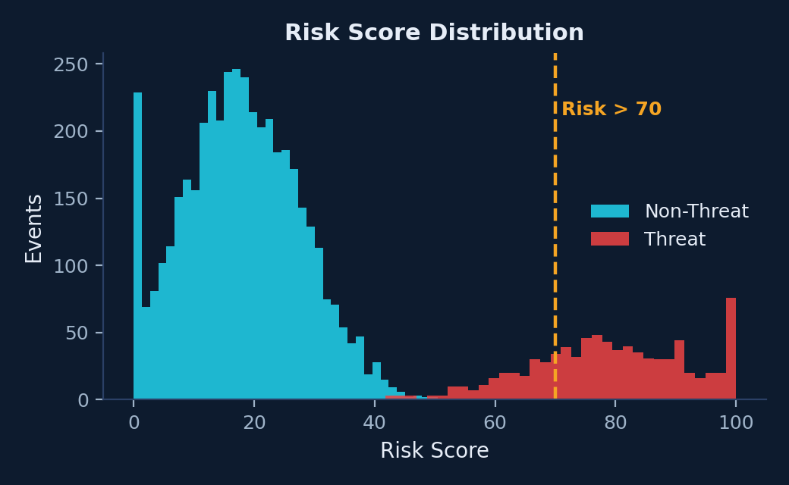
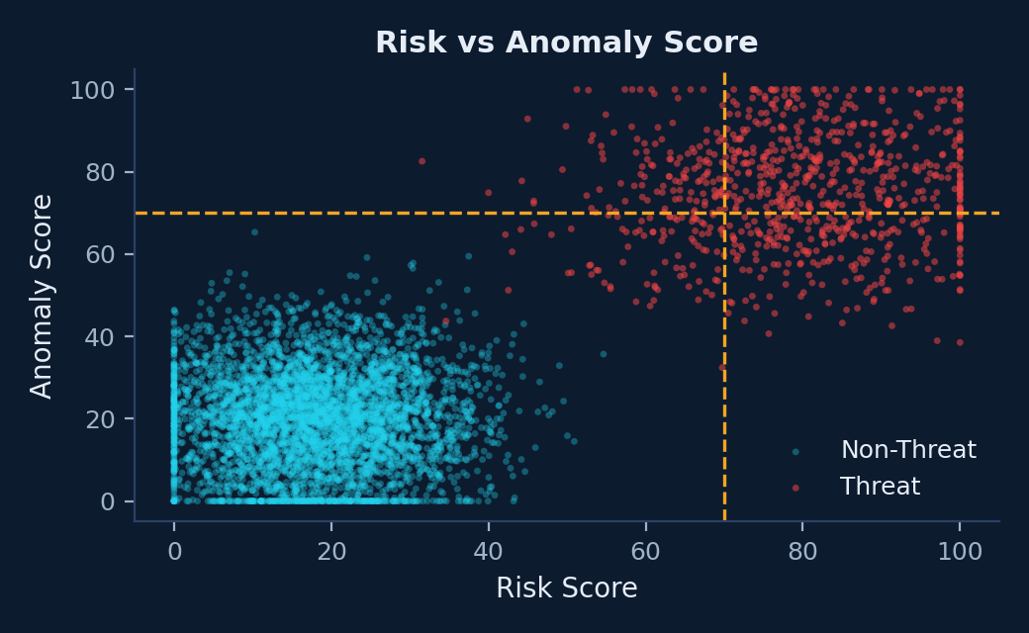
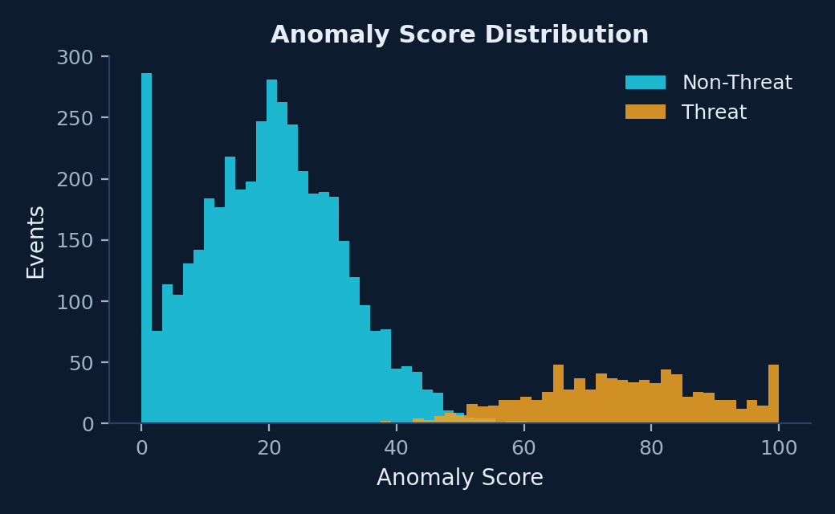
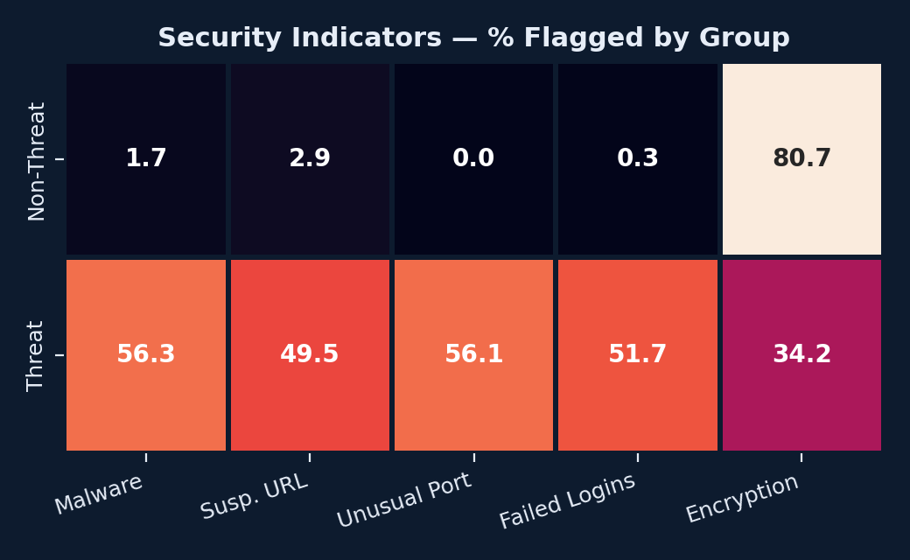
Data Visualizations
Four charts that carried the most analytical weight
Risk Score Distribution
Risk vs Anomaly Score
Two clearly separated clusters, split at the 70 threshold
Threat events cluster in the top-right quadrant
Anomaly Score Distribution
Security Indicator Heatmap
Same right-skewed shape, confirming the pattern
Indicator firing rates by group, in percent
Cybersecurity Threat Detection & Analysis | Data Visualizations
Notes:
The project also produced count plots for threat type, attack type, attack vector and severity — these four were selected because they drove the conclusions.

Slide 16
Key Cybersecurity Insights
The findings that matter to a security team
15.96%
625
466
of logged events are genuine threats — 830 out of 5,200.
events score above 70 on risk, and 100% of them are real threats.
unusual-port events, all threats. Zero false positives on this indicator.
716
134
237
Medium, High and Critical events — every one is a confirmed threat.
threats entered through Web Application, the largest single attack vector.
threats are still Active, and 104 real threats were closed as False Positive.
Threat events average a Risk Score of 78.87 against 17.95 for normal events — a 4.4× gap that makes prioritisation straightforward.
Cybersecurity Threat Detection & Analysis | Key Cybersecurity Insights
Notes:
If you only remember six numbers from this project, remember these. Each one is defensible and computed directly from the dataset.

Slide 17
Project Conclusion
What the analysis delivered
1
What Was Achieved
2
How It Helps Monitoring
A raw 5,255-row log was cleaned to 5,200 analysis-ready records, fully profiled across 42 features, with every finding computed from the data rather than assumed.
The analysis quantifies the threat landscape — 15.96% threat rate, nine threat types, seven attack vectors — and shows which indicators a detection rule can actually trust.
3
Prioritising High-Risk Events
4
Practical Python Skills
A Risk Score > 70 rule returns 625 events, all genuine threats, cutting the analyst queue by 88% while covering 75.3% of threats. Severity gives a second lane: 97 Critical events first.
Demonstrates the full workflow — Pandas cleaning and aggregation, NumPy statistics, Seaborn and Matplotlib visualisation, and translating results into an operational recommendation.
The analysis is descriptive, not predictive — it profiles this three-month dataset and does not build a classifier.
Cybersecurity Threat Detection & Analysis | Project Conclusion
Notes:
Be honest about scope: this is descriptive analysis. Saying so shows you understand the limits of your own work, which interviewers value.

Slide 18
Learnings & Future Scope
What the project taught me, and where it could go next
What I Learned
FUTURE SCOPE
Not completed in this project
Missing data needs a reason, not a default. The 4,370 blanks were structural, not errors.
Group-wise imputation beats a global median
when the groups genuinely differ.
Consistency checks catch what counts miss.
Protocol had 16 spellings instead of 8.
Precision and coverage are different.
Unusual Port is 100% precise but finds only 56% of threats.
Check for redundant columns.
Attack_Type duplicated Threat_Type entirely.
Value is in the prioritisation, not the statistics.
"Review these 625 events" is actionable; a mean of 27.67 is not.
Machine-learning threat prediction
Train a classifier on these features and validate the Risk > 70 threshold on unseen data.
Real-time monitoring
Apply the cleaning and scoring logic to a live event stream instead of a static CSV.
Automated alerting
Trigger alerts when Risk > 70 or an unusual port is used, routed by severity.
Dashboard integration
A Power BI or Streamlit dashboard for threat rate, severity mix and open incidents.
Triage quality review
Investigate the 104 real threats that were closed as False Positive.
Cybersecurity Threat Detection & Analysis | Learnings & Future Scope
Notes:
Clearly label the right column as future work you have not done. Claiming unbuilt features is the fastest way to lose credibility in an interview.

