Slide 1
Smart Waste Management System
"Smarter Bins. Cleaner Cities. Greener Future."

Slide 2
Problem Statement
Every day, bins overflow due to irregular collection.
Existing smart bins fail to detect mixed waste and optimize routes.
This leads to inefficiency, higher costs, and unhygienic conditions.

Slide 3
Our Solution
An IoT + AI powered waste management system:
Detects waste type (Wet/Dry)
Measures fill level and weight
Optimizes collection routes with real-time traffic

Slide 4
System Architecture
Hardware: ESP32, Ultrasonic Sensor, Load Cell, Servo Motor, Camera
AI/ML: trained model made for classification
Web Dashboard: Live bin status, AI detection, Route optimization

Slide 5
Machine learning trained in roboflow
Collected and created our own dataset with labeled images (Dry/Wet waste).
Used Roboflow platform for dataset preparation (annotation, augmentation, preprocessing).
Trained the dataset using the YOLOv8 object detection algorithm.
Model learns to classify and detect waste types (Dry / Wet).
Exported the trained model and connected it to our application via Roboflow API.
Achieved real-time detection using ESP32 and mobile camera integration.

Slide 6
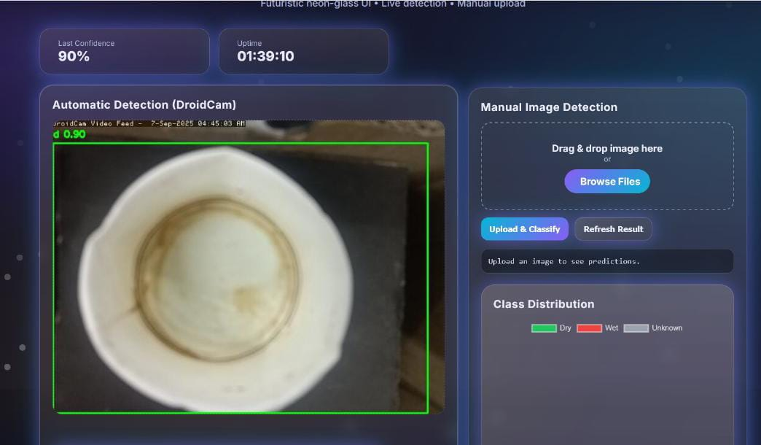
WeB page for dry wet classification

Slide 7
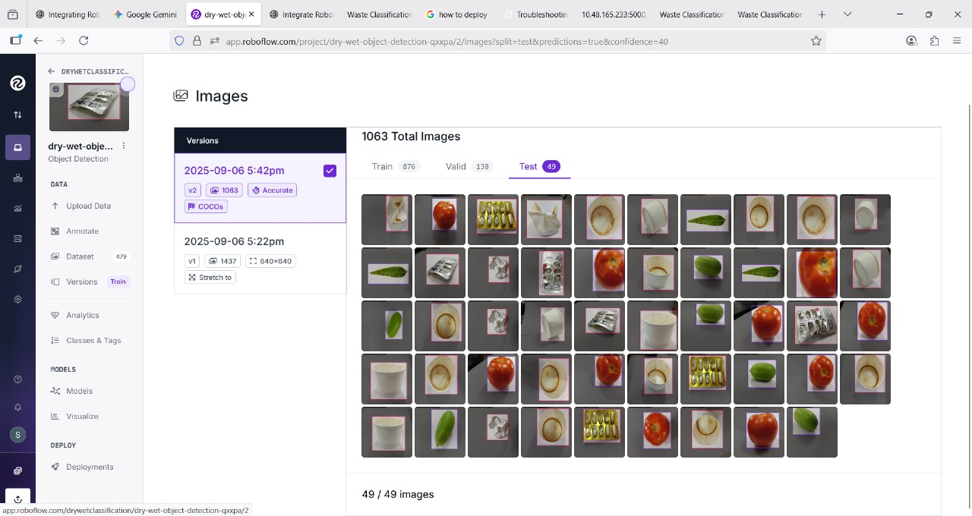
Machine learning model trained for single objects

Slide 8
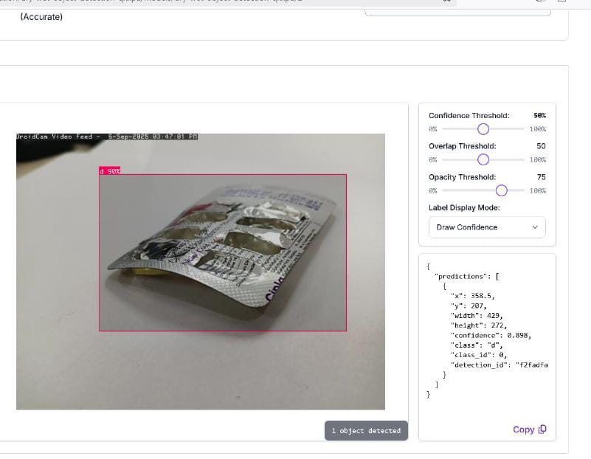
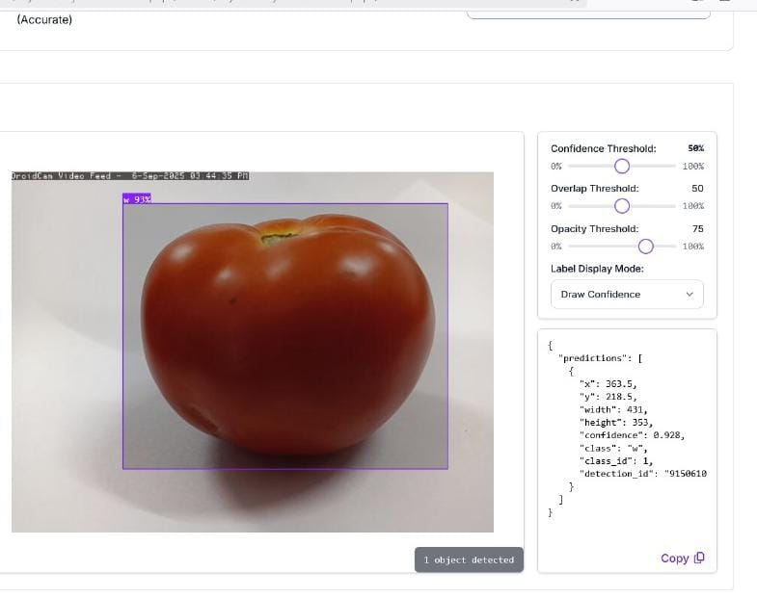
Machine learning model trained for single objects

Slide 9
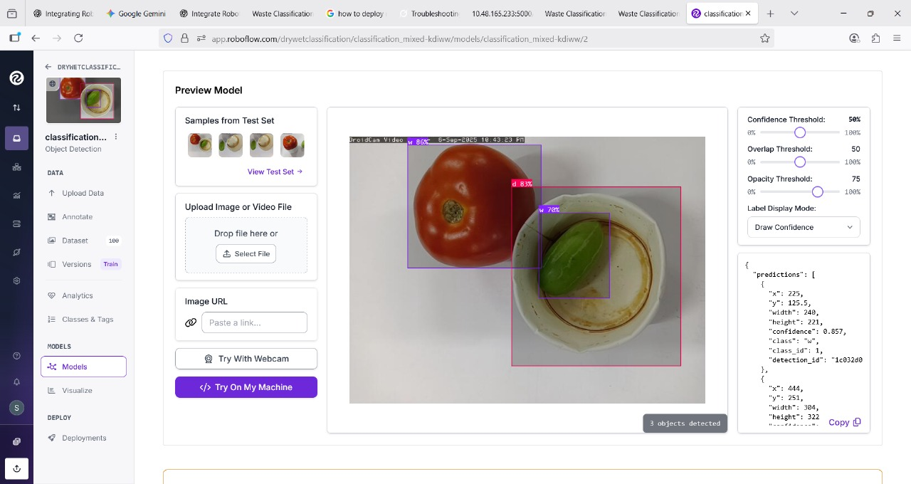
Machine learning model trained for multiple objects

Slide 10
Mapping Integration with Firebase
ESP32 sends sensor data (waste type, fill level, weight) along with latitude & longitude.
Data is stored in Firebase Realtime Database / Firestore.
Web app fetches this data using Firebase SDK.
Google Maps API displays bin locations as markers on the map.
Marker colors indicate bin status (dry/wet, full/not full).
Real-time updates ensure changes reflect instantly on the map.

Slide 11
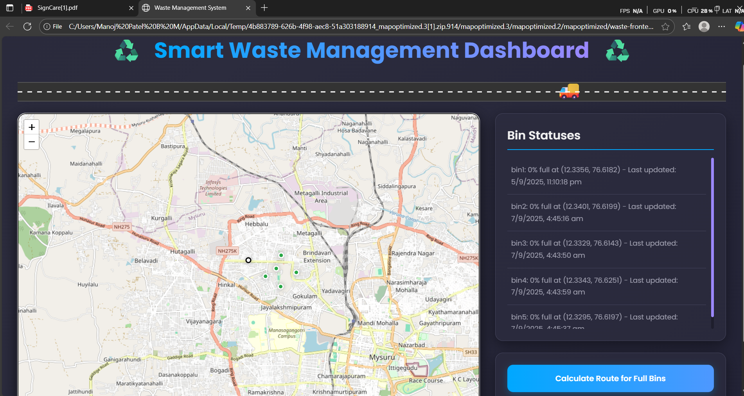
WEB page for maping

Slide 12
Impact & Real-World Value
Reduces waste collection costs by optimizing routes
Prevents overflow → cleaner city
Helps municipalities with real-time data
Engages citizens for better accountability

Slide 13
Future Improvements
Detect mixed waste inside plastic bags (IR/thermal sensors)
Predictive waste collection using ML
Solar-powered IoT bins for remote areas
Integration with municipal apps

Slide 14
Demo
Live webpage: Bin fill level & weight
Waste detection (Dry/Wet classification)
Servo motor action (lid open/close)
Route optimization map
Citizen feedback form

Slide 15
Closing
Our project makes waste management smarter, cheaper, and citizen-friendly.
Together, we can build cleaner, smarter cities!

