Slide 1
Single Image Super Resolution
Manoj Maddineni
(B20CS034)
Mentor -
Dr. Angshuman Paul

Slide 2
Deliverables-A software for super resolution of histopathological images
Single image super-resolution (SISR) aims at reconstructing a high resolution image from its low-resolution counterpart.
High resolution images offer a higher pixel density thereby giving more details about the original content.
In this project, we do SISR using Machine Learning techniques.
Especially in case of Histopathology, super resolution images would help to better study the tissue and predict any possible disease

Slide 3
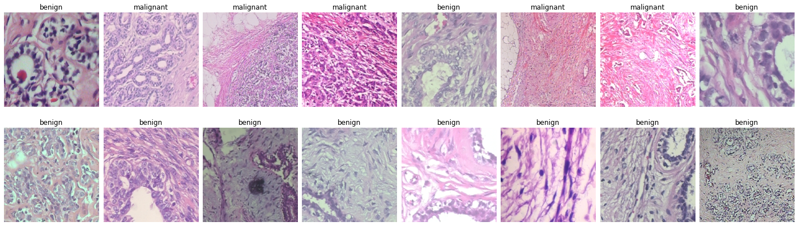
Dataset –BreakHis Dataset Kaggle
Figure 1.1 [2]

Slide 4
Earlier approaches
Bicubic Interpolation
SRCNN
SRGAN
ESRGAN….
Drawbacks
Despite SRGAN and ESRGAN being good models they don’t work so well in real world cases where the degradations are far too complex and unknown in nature.

Slide 5
Real-ESRGAN
Real-ESRGAN is an extension of the powerful ESRGAN to restore real-world LR images by synthesizing training pairs with a more practical degradation process.
Hence, here the classical “first-order” degradation model is extended to the “second-order” degradation model for real world degradations
Brief overview of the methodology in next slides...
Degradation process
Network Architecture
Training pipeline

Slide 6
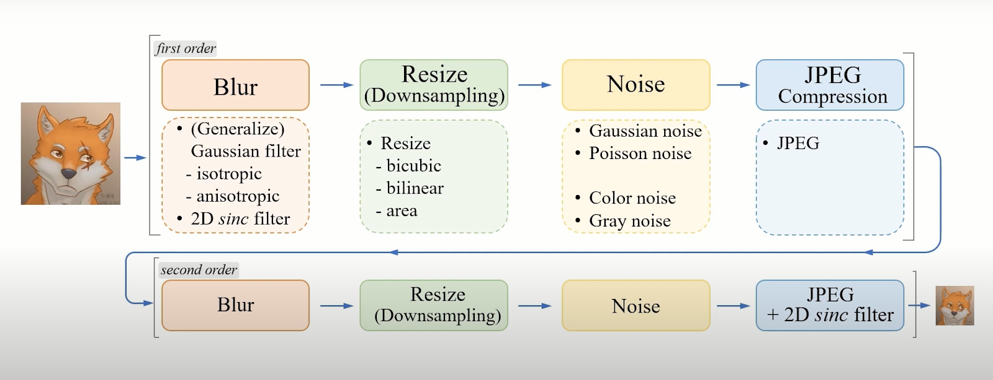
Degradation process
Figure 1.1 [2]

Slide 7
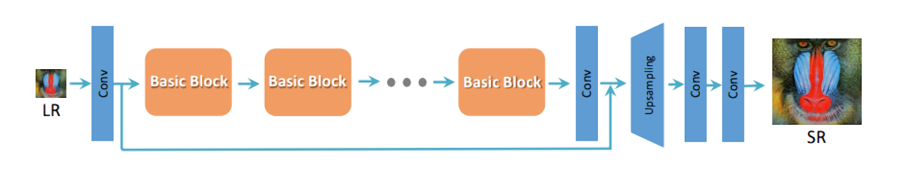
Network Architecture a. Generator
Figure 1.2[2]

Slide 8
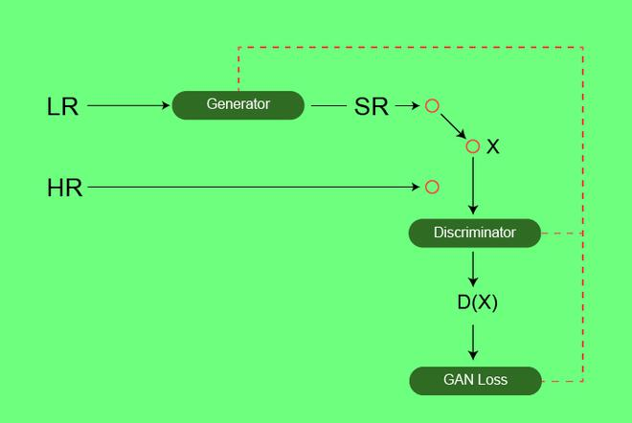
Network Architecture – b. GAN
Figure 1.3 [3]

Slide 9
Training pipeline
The training process is divided into two stages. First, we train a PSNR-oriented model with the L1 loss. The obtained model is named by Real-ESRNet. We then use the trained PSNR-oriented model as an initialization of the generator, and train the Real-ESRGAN with a combination of L1 loss, perceptual loss and GAN loss .

Slide 10
Evaluation Metrics -
Mean Squared Error(MSE)
- The average MSE calculated over 1000 images = 47.78
2. Peak Signal to Noise Ratio(PSNR)
- The average PSNR calculated over 1000 images = 31.68

Slide 11
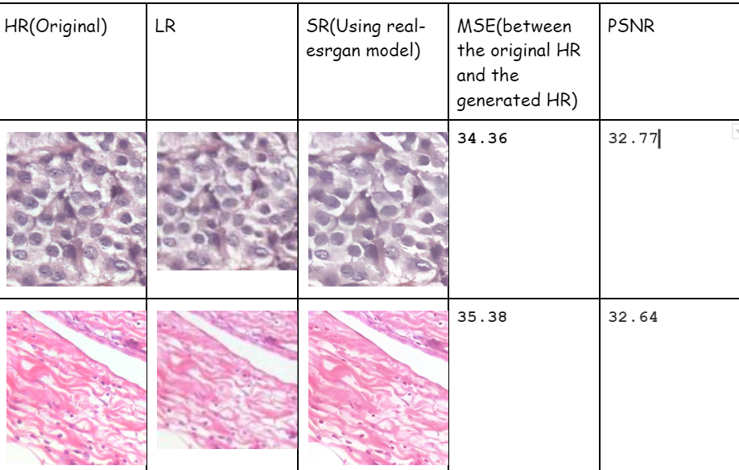
Results -

Slide 12
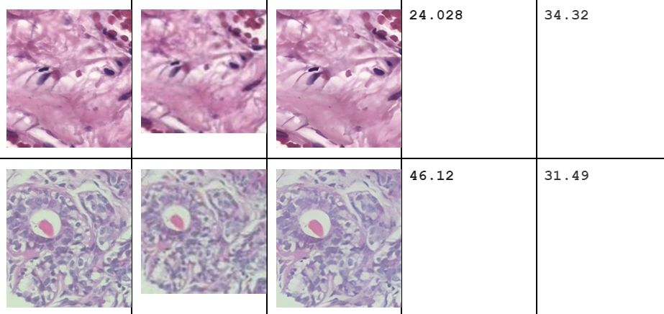

Slide 13
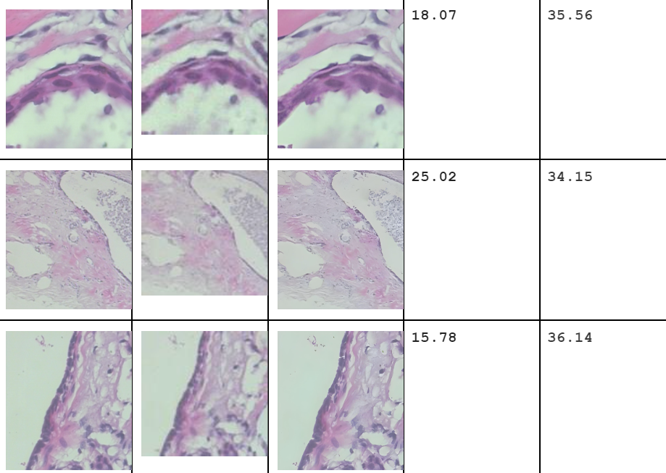

Slide 14
References-
[1] https://github.com/xinntao/Real-ESRGAN
[2] https://arxiv.org/pdf/2107.10833v2.pdf
[3] https://media.geeksforgeeks.org/wp-content/uploads/20200619230513/SRGAN.jpg
[4] https://www.kaggle.com/datasets/ambarish/breakhis

Slide 15
Thank You!

