Slide 1
An Introduction to Software Engineering

Slide 2
Objectives
To introduce software engineering and to explain its importance
To set out the answers to key questions about software engineering
To introduce ethical and professional issues and to explain why they are of concern to software engineers

Slide 3
Topics covered
FAQs about software engineering
Professional and ethical responsibility

Slide 4
Software engineering
The economies of ALL developed nations are dependent on software.
More and more systems are software controlled
Software engineering is concerned with theories, methods and tools for professional software development.
Expenditure on software represents a significant fraction of GNP in all developed countries.

Slide 5
Software costs
Software costs often dominate computer system costs. The costs of software on a PC are often greater than the hardware cost.
Software costs more to maintain than it does to develop. For systems with a long life, maintenance costs may be several times development costs.
Software engineering is concerned with cost-effective software development.

Slide 6
FAQs about software engineering
What is software?
What is software engineering?
What is the difference between software engineering and computer science?
What is the difference between software engineering and system engineering?
What is a software process?
What is a software process model?

Slide 7
FAQs about software engineering
What are the costs of software engineering?
What are software engineering methods?
What is CASE (Computer-Aided Software Engineering)
What are the attributes of good software?
What are the key challenges facing software engineering?

Slide 8
What is software?
Computer programs and associated documentation such as requirements, design models and user manuals.
Software products may be developed for a particular customer or may be developed for a general market.
Software products may be
Generic - developed to be sold to a range of different customers e.g. PC software such as Excel or Word.
Bespoke (custom) - developed for a single customer according to their specification.
New software can be created by developing new programs, configuring generic software systems or reusing existing software.

Slide 9
What is software engineering?
Software engineering is an engineering discipline that is concerned with all aspects of software production.
Software engineers should adopt a systematic and organised approach to their work and use appropriate tools and techniques depending on the problem to be solved, the development constraints and the resources available.

Slide 10
What is the difference between software engineering and computer science?
Computer science is concerned with theory and fundamentals; software engineering is concerned with the practicalities of developing and delivering useful software.
Computer science theories are still insufficient to act as a complete underpinning for software engineering (unlike e.g. physics and electrical engineering).

Slide 11
What is the difference between software engineering and system engineering?
System engineering is concerned with all aspects of computer-based systems development including hardware, software and process engineering. Software engineering is part of this process concerned with developing the software infrastructure, control, applications and databases in the system.
System engineers are involved in system specification, architectural design, integration and deployment.

Slide 12
What is a software process?
A set of activities whose goal is the development or evolution of software.
Generic activities in all software processes are:
Specification - what the system should do and its development constraints
Development - production of the software system
Validation - checking that the software is what the customer wants
Evolution - changing the software in response to changing demands.

Slide 13
What is a software process model?
A simplified representation of a software process, presented from a specific perspective.
Examples of process perspectives are
Workflow perspective - sequence of activities;
Data-flow perspective - information flow;
Role/action perspective - who does what.
Generic process models
Waterfall;
Iterative development;
Component-based software engineering.

Slide 14
What are the costs of software engineering?
Roughly 60% of costs are development costs, 40% are testing costs. For custom software, evolution costs often exceed development costs.
Costs vary depending on the type of system being developed and the requirements of system attributes such as performance and system reliability.
Distribution of costs depends on the development model that is used.

Slide 15
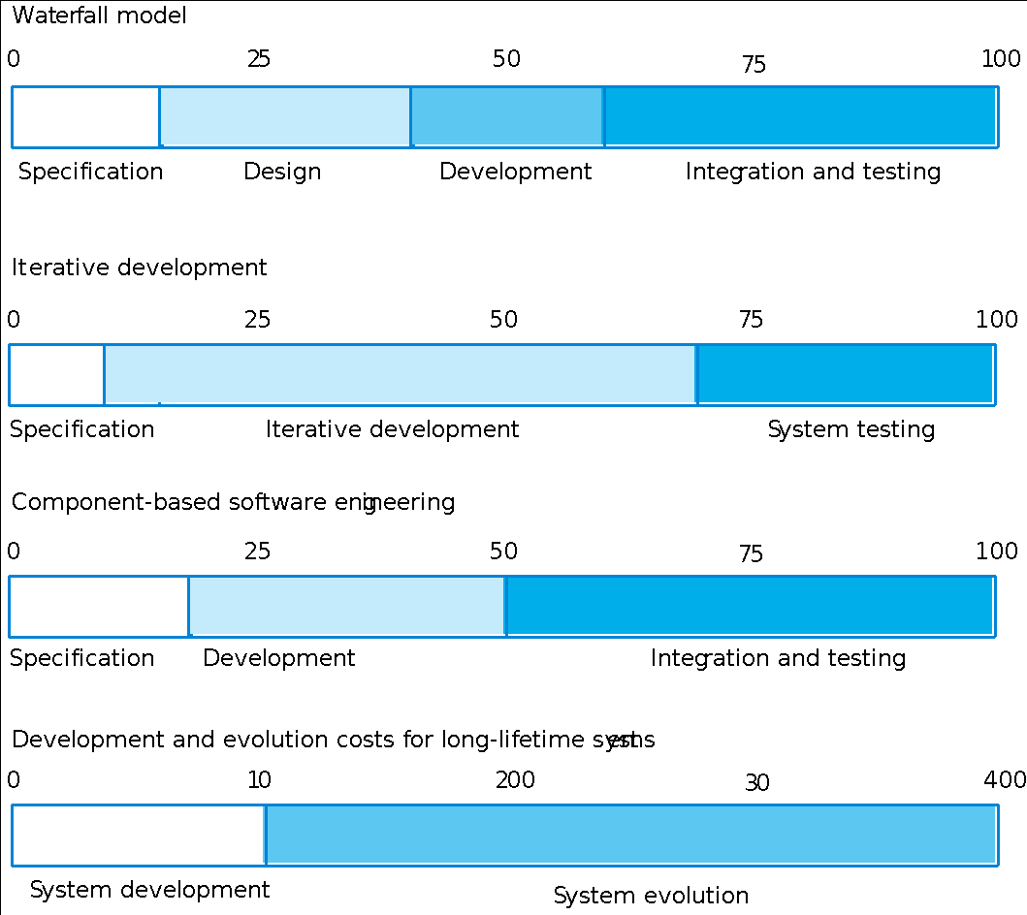
Activity cost distribution

Slide 16
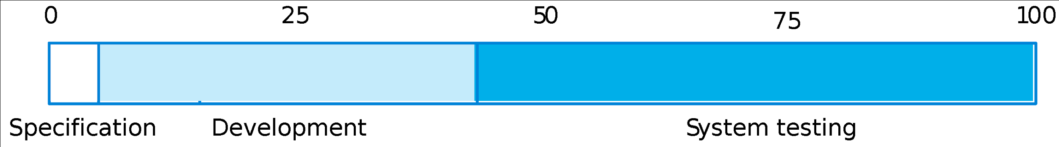
Product development costs

Slide 17
What are software engineering methods?
Is a structured approach to s/w development whose aim is to facilitate production of high quality software in a cost effective way
Methods like
(i)Structured Analysis (function oriented method)
(ii)Object oriented methods (by booch & Rambaugh)
Integrated into single unified approach built around unified modelling language (UML)
No ideal method, method depends on areas

Slide 18
Methods include components
All methods are based on developing models of a system that can be represented graphically and include different components like.
Model descriptions
Descriptions of graphical models(notations) which should be produced;
Rules
Constraints applied to system models;
Recommendations
Advice on good design practice;
Process guidance
What activities to follow.

Slide 19
What is CASE (Computer-Aided Software Engineering)
Software systems that are intended to provide automated support for software process activities such as Requirement analysis, System modelling, Debugging and Testing
CASE systems are often used for method support.
Upper-CASE
Tools to support the early process activities of requirements and design;
Lower-CASE
Tools to support later activities such as programming, debugging and testing.

Slide 20
CASE to support methods
All methods come with CASE like
Editors – For notations used
Analysis – modules that check system model
according to method rules
Report Generators –to create s/m documentation
Code Generators – Automatically generates source code from s/m model
Process Guidance tools for S/W Engineers.

Slide 21
What are the attributes of good software?
Service v/s Quality
The software should deliver the required functionality and performance to the user and should be maintainable, dependable and acceptable.
Maintainability
Software must evolve to meet changing needs;
Dependability
Software must be trustworthy; characteristics include reliability, security and safety; Dependable s/w should not cause physical or economic damage in the event of system failure;

Slide 22
Attributes of good software
Efficiency
Software should not make wasteful use of system resources like memory and processor cycles; includes responsiveness, processing time, memory utilisation etc
Acceptability
Software must accepted by the users for which it was designed. This means it must be understandable, usable and compatible with other systems. ( eg: appropriate user interface and adequate documentation)

Slide 23
What are the key challenges facing software engineering?
Heterogeneity, delivery and trust.
Heterogeneity
Developing techniques for building software that can cope with heterogeneous platforms and execution environments;
It is a challenge of developing techniques for building dependable software that is flexible enough to cope this heterogenity
Delivery
Developing techniques that lead to faster delivery of software;
Challenge to shorten delivery times for large and complex sytems without compromising system quality

Slide 24
key challenges facing software engineering
Trust
Developing techniques that demonstrate that software can be trusted by its users.

Slide 25
Professional and ethical responsibility
Software engineering involves wider responsibilities than simply the application of technical skills.
Software engineers must behave in an honest and ethically responsible way if they are to be respected as professionals.
Ethical behaviour is more than simply upholding the law.

Slide 26
Issues of professional responsibility
Confidentiality
Engineers should normally respect the confidentiality of their employers or clients irrespective of whether or not a formal confidentiality agreement has been signed.
Competence
Engineers should not misrepresent their level of competence. They should not knowingly accept work which is outwith their competence.

Slide 27
Issues of professional responsibility
Intellectual property rights
Engineers should be aware of local laws governing the use of intellectual property such as patents, copyright, etc. They should be careful to ensure that the intellectual property of employers and clients is protected.
Computer misuse
Software engineers should not use their technical skills to misuse other people’s computers. Computer misuse ranges from relatively trivial (game playing on an employer’s machine, say) to extremely serious (dissemination of viruses).

Slide 28
ACM/IEEE Code of Ethics
The professional societies in the US like ACM,IEEE and British Computer society have cooperated to produce a code of ethical practice.
Members of these organisations sign up to the code of practice when they join.
The Code contains eight Principles related to the behaviour of and decisions made by professional software engineers, including practitioners, educators, managers, supervisors and policy makers, as well as trainees and students of the profession.

Slide 29
Code of ethics - preamble
Preamble
The short version of the code summarizes aspirations at a high level of the abstraction; the clauses that are included in the full version give examples and details of how these aspirations change the way we act as software engineering professionals. Without the aspirations, the details can become legalistic and tedious; without the details, the aspirations can become high sounding but empty; together, the aspirations and the details form a cohesive code.
Software engineers shall commit themselves to making the analysis, specification, design, development, testing and maintenance of software a beneficial and respected profession. In accordance with their commitment to the health, safety and welfare of the public, software engineers shall adhere to the following Eight Principles:

Slide 30
Code of ethics - principles
PUBLIC
Software engineers shall act consistently with the public interest.
CLIENT AND EMPLOYER
Software engineers shall act in a manner that is in the best interests of their client and employer consistent with the public interest.
PRODUCT
Software engineers shall ensure that their products and related modifications meet the highest professional standards possible.

Slide 31
Code of ethics - principles
JUDGMENT
Software engineers shall maintain integrity and independence in their professional judgment.
MANAGEMENT
Software engineering managers and leaders shall subscribe to and promote an ethical approach to the management of software development and maintenance.
PROFESSION
Software engineers shall advance the integrity and reputation of the profession consistent with the public interest.

Slide 32
Code of ethics - principles
COLLEAGUES
Software engineers shall be fair to and supportive of their colleagues.
SELF
Software engineers shall participate in lifelong learning regarding the practice of their profession and shall promote an ethical approach to the practice of the profession.

Slide 33
Ethical dilemmas
In situations where different people have different views & objectives are likely to be faced with ethical dilemmas for Ex:
Disagreement in principle with the policies of senior management.
Your employer acts in an unethical way and releases a safety-critical system without finishing the testing of the system.
Participation in the development of military weapons systems or nuclear systems.

Slide 34
Key points
Software engineering is an engineering discipline that is concerned with all aspects of software production.
Software products consist of developed programs and associated documentation. Essential product attributes are maintainability, dependability, efficiency and usability.
The software process consists of activities that are involved in developing software products. Basic activities are software specification, development, validation and evolution.
Methods are organised ways of producing software. They include suggestions for the process to be followed, the notations to be used, rules governing the system descriptions which are produced and design guidelines.

Slide 35
Key points
CASE tools are software systems which are designed to support routine activities in the software process such as editing design diagrams, checking diagram consistency and keeping track of program tests which have been run.
Software engineers have responsibilities to the engineering profession and society. They should not simply be concerned with technical issues.
Professional societies publish codes of conduct which set out the standards of behaviour expected of their members.

