Slide 1
Software Processes

Slide 2
Objectives
To introduce software process models
To describe three generic process models and when they may be used
To describe outline process models for requirements engineering, software development, testing and evolution
To explain the Rational Unified Process model
To introduce CASE technology to support software process activities

Slide 3
Topics covered
Software process models
Process iteration
Process activities
The Rational Unified Process
Computer-aided software engineering

Slide 4
The software process
A structured set of activities required to develop a
software system
  Specification;
  Design;
  Validation;
  Evolution.
A software process model is an abstract representation of a process. It presents a description of a process from some particular perspective.

Slide 5
Generic software process models
The waterfall model
  Separate and distinct phases of specification and development.
Evolutionary development
  Specification, development and validation are interleaved.
Component-based software engineering
  The system is assembled from existing components.
There are many variants of these models e.g. formal development where a waterfall-like process is used but the specification is a formal specification that is refined through several stages to an implementable design.

Slide 6
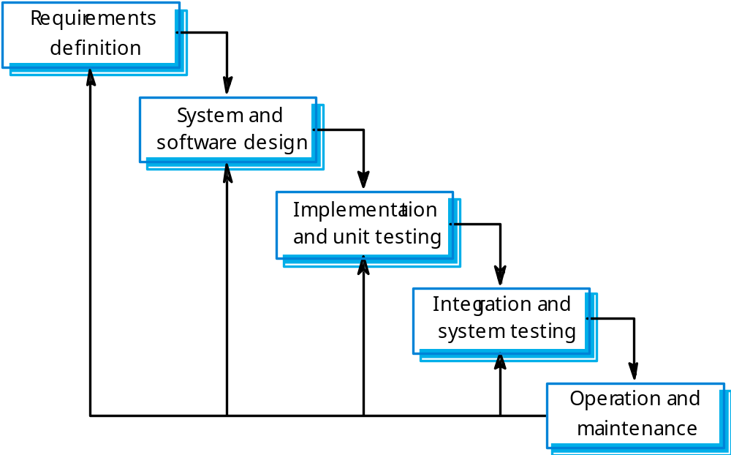
Waterfall model

Slide 7
Waterfall model phases
Requirements analysis and definition
System and software design
Implementation and unit testing
Integration and system testing
Operation and maintenance
The main drawback of the waterfall model is the difficulty of accommodating change after the process is underway. One phase has to be complete before moving onto the next phase.

Slide 8
Waterfall model problems
Inflexible partitioning of the project into distinct stages makes it difficult to respond to changing customer requirements.
Therefore, this model is only appropriate when the requirements are well-understood and changes will be fairly limited during the design process.
Few business systems have stable requirements.
The waterfall model is mostly used for large systems engineering projects where a system is developed at several sites.

Slide 9
Evolutionary development
Exploratory development
  Objective is to work with customers and to evolve a final system from an initial outline specification. Should start with well-understood requirements and add new features as proposed by the customer.
Throw-away prototyping
  Objective is to understand the system requirements. Should start with poorly understood requirements to clarify what is really needed.

Slide 10
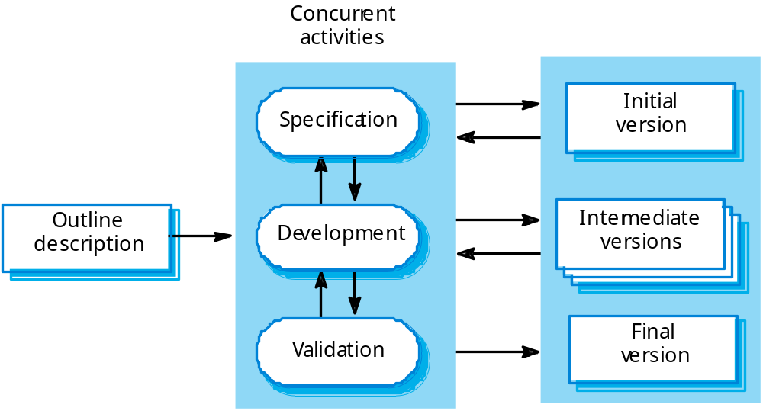
Evolutionary development

Slide 11
Evolutionary development
Problems
  Lack of process visibility;
  Systems are often poorly structured;
  Special skills (e.g. in languages for rapid prototyping) may be required.
Applicability
  For small or medium-size interactive systems;
  For parts of large systems (e.g. the user interface);
  For short-lifetime systems.

Slide 12
Component-based software engineering
Based on systematic reuse where systems are integrated from existing components or COTS (Commercial-off-the-shelf) systems.
Process stages
  Component analysis;
  Requirements modification;
  System design with reuse;
  Development and integration.
This approach is becoming increasingly used as component standards have emerged.

Slide 13
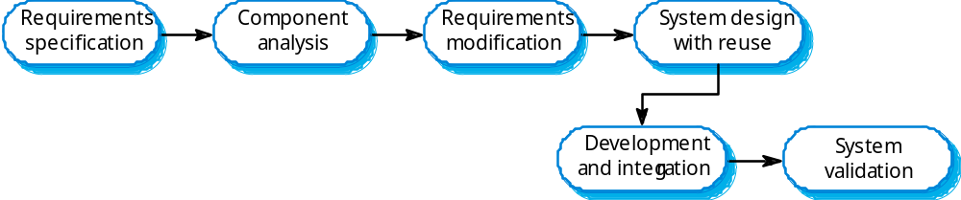
Reuse-oriented development

Slide 14
Process iteration
System requirements ALWAYS evolve in the course of a project so process iteration where earlier stages are reworked is always part of the process for large systems.
Iteration can be applied to any of the generic process models.
Two (related) approaches
  Incremental delivery;
  Spiral development.

Slide 15
Incremental delivery
Rather than deliver the system as a single delivery, the development and delivery is broken down into increments with each increment delivering part of the required functionality.
User requirements are prioritised and the highest priority requirements are included in early increments.
Once the development of an increment is started, the requirements are frozen though requirements for later increments can continue to evolve.

Slide 16
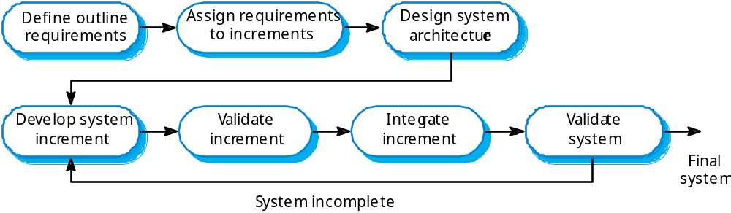
Incremental development

Slide 17
Incremental development advantages
Customer value can be delivered with each increment so system functionality is available earlier.
Early increments act as a prototype to help elicit requirements for later increments.
Lower risk of overall project failure.
The highest priority system services tend to receive the most testing.

Slide 18
Extreme programming
An approach to development based on the development and delivery of very small increments of functionality.
Relies on constant code improvement, user involvement in the development team and pairwise programming.
Covered in Chapter 17

Slide 19
Spiral development
Process is represented as a spiral rather than as a sequence of activities with backtracking.
Each loop in the spiral represents a phase in the process.
No fixed phases such as specification or design - loops in the spiral are chosen depending on what is required.
Risks are explicitly assessed and resolved throughout the process.

Slide 20
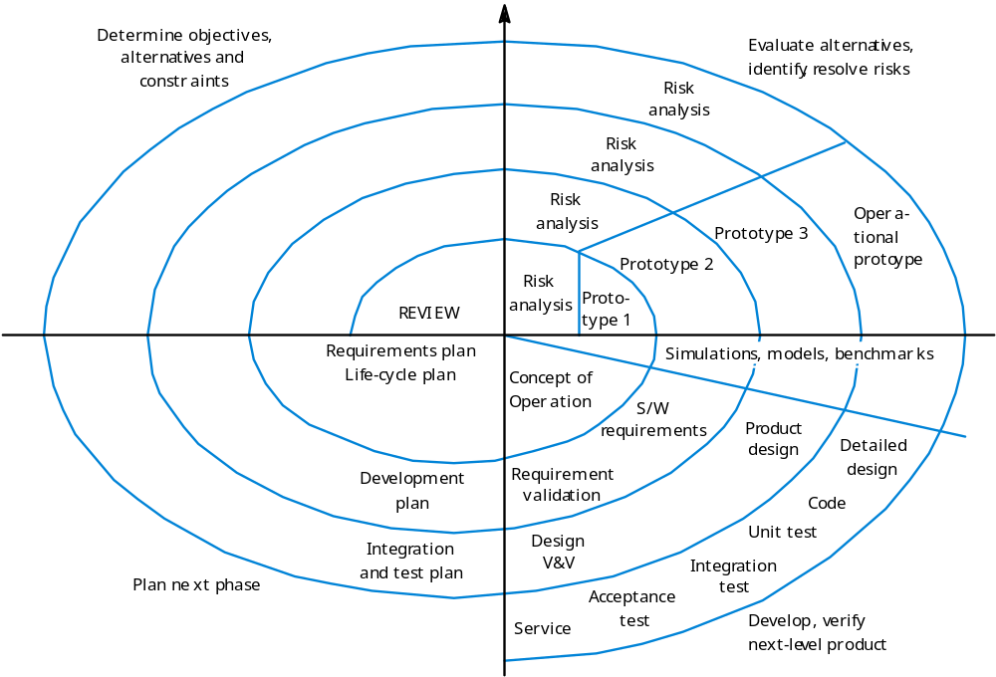
Spiral model of the software process

Slide 21
Spiral model sectors
Objective setting
  Specific objectives for the phase are identified.
Risk assessment and reduction
  Risks are assessed and activities put in place to reduce the key risks.
Development and validation
  A development model for the system is chosen which can be any of the generic models.
Planning
  The project is reviewed and the next phase of the spiral is planned.

Slide 22
Process activities
Software specification
Software design and implementation
Software validation
Software evolution

Slide 23
Software specification
The process of establishing what services are required and the constraints on the system’s operation and development.
Requirements engineering process
  Feasibility study;
  Requirements elicitation and analysis;
  Requirements specification;
  Requirements validation.

Slide 24
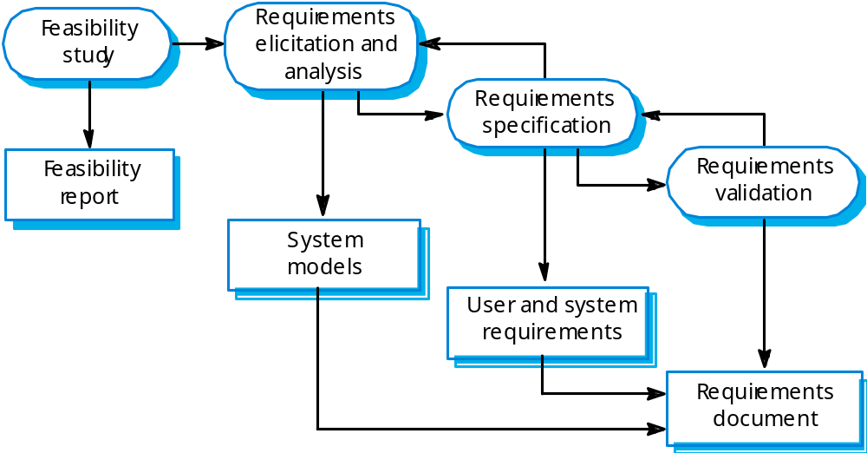
The requirements engineering process

Slide 25
Software design and implementation
The process of converting the system specification into an executable system.
Software design
  Design a software structure that realises the specification;
Implementation
  Translate this structure into an executable program;
The activities of design and implementation are closely related and may be inter-leaved.

Slide 26
Design process activities
Architectural design
Abstract specification
Interface design
Component design
Data structure design
Algorithm design

Slide 27
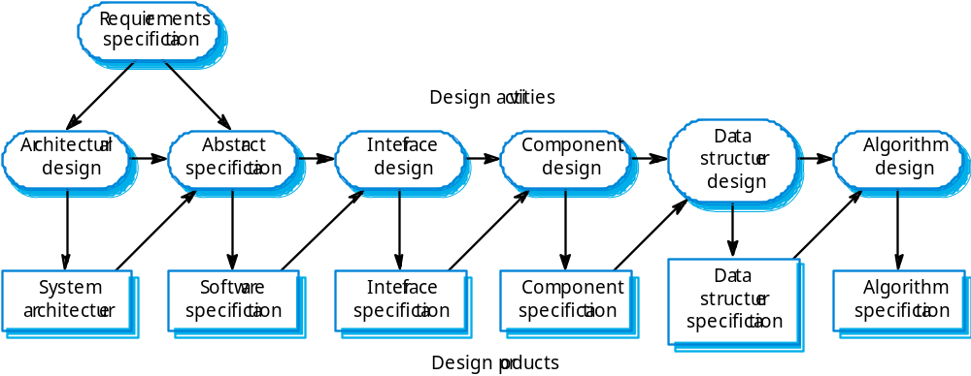
The software design process

Slide 28
Structured methods
Systematic approaches to developing a software design.
The design is usually documented as a set of graphical models.
Possible models
  Object model;
  Sequence model;
  State transition model;
  Structural model;
  Data-flow model.

Slide 29
Programming and debugging
Translating a design into a program and removing errors from that program.
Programming is a personal activity - there is no generic programming process.
Programmers carry out some program testing to discover faults in the program and remove these faults in the debugging process.

Slide 30
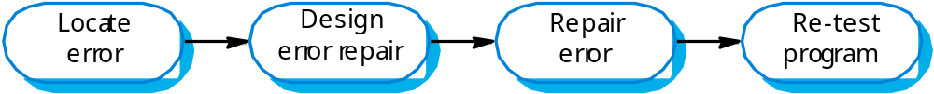
The debugging process

Slide 31
Software validation
Verification and validation (V & V) is intended to show that a system conforms to its specification and meets the requirements of the system customer.
Involves checking and review processes and system testing.
System testing involves executing the system with test cases that are derived from the specification of the real data to be processed by the system.

Slide 32
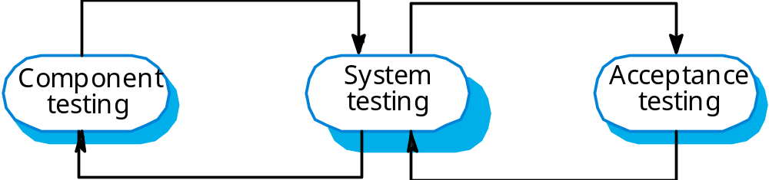
The testing process

Slide 33
Testing stages
Component or unit testing
  Individual components are tested independently;
  Components may be functions or objects or coherent groupings of these entities.
System testing
  Testing of the system as a whole. Testing of emergent properties is particularly important.
Acceptance testing
  Testing with customer data to check that the system meets the customer’s needs.

Slide 34
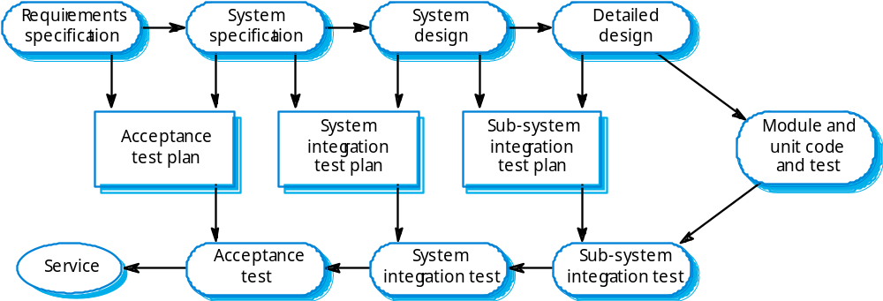
Testing phases

Slide 35
Software evolution
Software is inherently flexible and can change.
As requirements change through changing business circumstances, the software that supports the business must also evolve and change.
Although there has been a demarcation between development and evolution (maintenance) this is increasingly irrelevant as fewer and fewer systems are completely new.

Slide 36
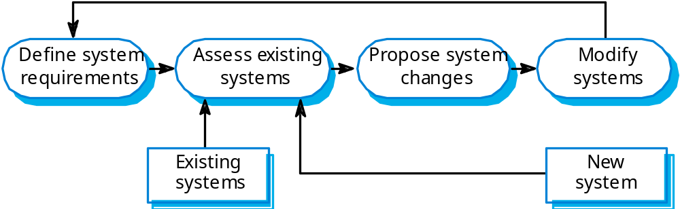
System evolution

Slide 37
The Rational Unified Process
A modern process model derived from the work on the UML and associated process.
Normally described from 3 perspectives
  A dynamic perspective that shows phases over time;
  A static perspective that shows process activities;
  A practive perspective that suggests good practice.

Slide 38
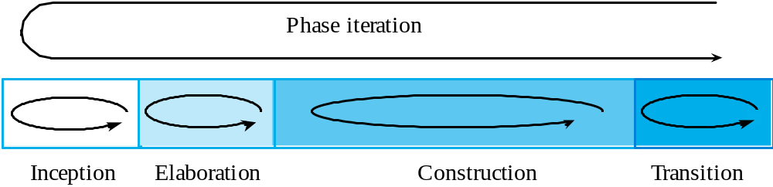
RUP phase model

Slide 39
RUP phases
Inception
  Establish the business case for the system.
Elaboration
  Develop an understanding of the problem domain and the system architecture.
Construction
  System design, programming and testing.
Transition
  Deploy the system in its operating environment.

Slide 40
RUP good practice
Develop software iteratively
Manage requirements
Use component-based architectures
Visually model software
Verify software quality
Control changes to software

Slide 41
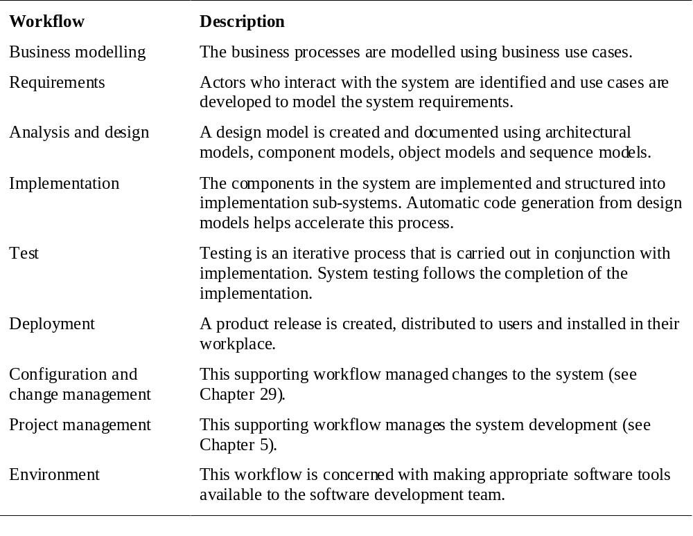
Static workflows

Slide 42
Computer-aided software engineering
Computer-aided software engineering (CASE) is software to support software development and evolution processes.
Activity automation
  Graphical editors for system model development;
  Data dictionary to manage design entities;
  Graphical UI builder for user interface construction;
  Debuggers to support program fault finding;
  Automated translators to generate new versions of a program.

Slide 43
Case technology
Case technology has led to significant improvements in the software process. However, these are not the order of magnitude improvements that were once predicted
  Software engineering requires creative thought - this is not readily automated;
  Software engineering is a team activity and, for large projects, much time is spent in team interactions. CASE technology does not really support these.

Slide 44
CASE classification
Classification helps us understand the different types of CASE tools and their support for process activities.
Functional perspective
  Tools are classified according to their specific function.
Process perspective
  Tools are classified according to process activities that are supported.
Integration perspective
  Tools are classified according to their organisation into integrated units.

Slide 45
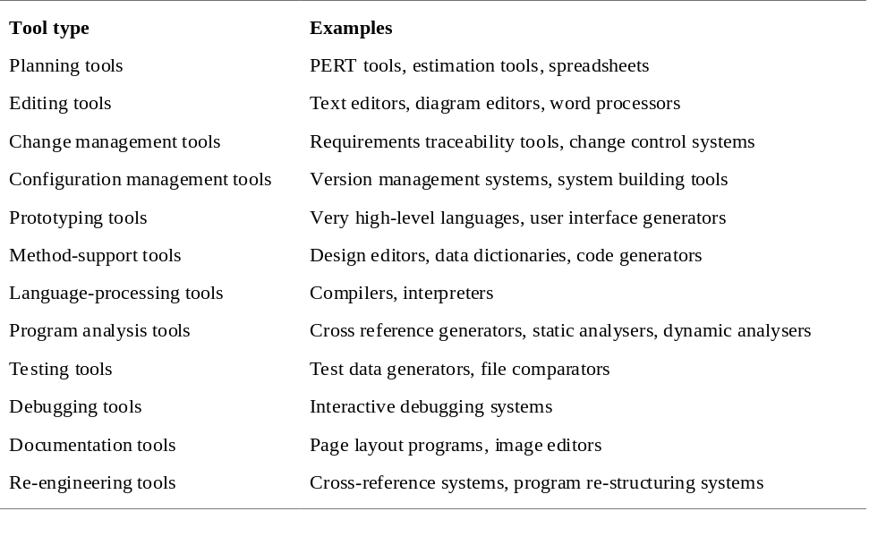
Functional tool classification

Slide 46
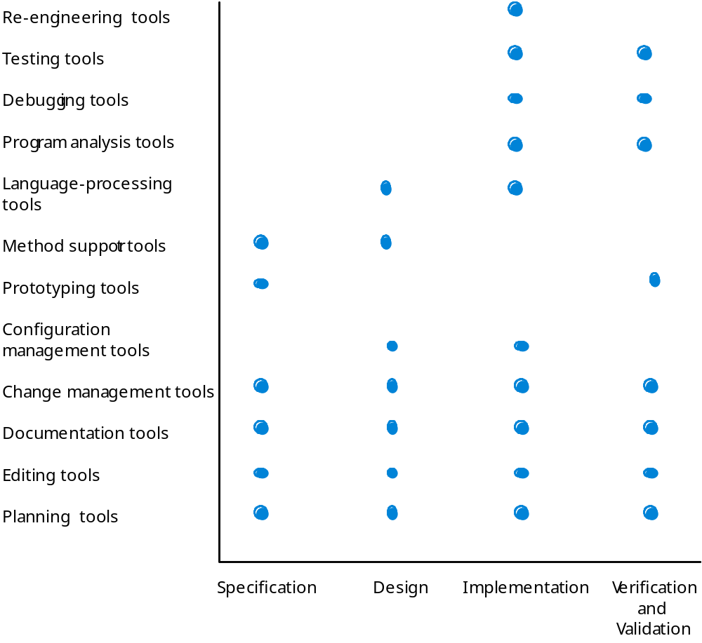
Activity-based tool classification

Slide 47
CASE integration
Tools
  Support individual process tasks such as design consistency checking, text editing, etc.
Workbenches
  Support a process phase such as specification or design, Normally include a number of integrated tools.
Environments
  Support all or a substantial part of an entire software process. Normally include several integrated workbenches.

Slide 48
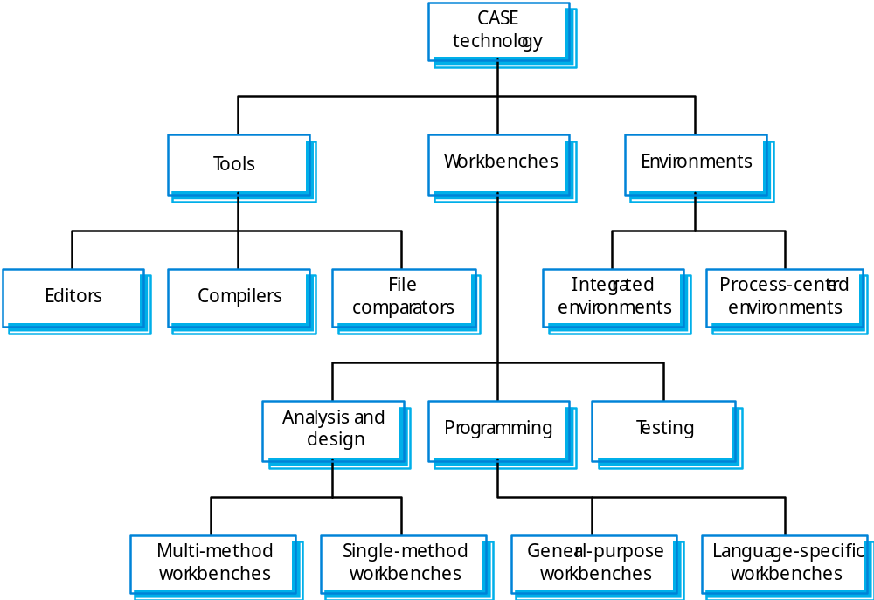
Tools, workbenches, environments

Slide 49
Key points
Software processes are the activities involved in producing and evolving a software system.
Software process models are abstract representations of these processes.
General activities are specification, design and implementation, validation and evolution.
Generic process models describe the organisation of software processes. Examples include the waterfall model, evolutionary development and component-based software engineering.
Iterative process models describe the software process as a cycle of activities.

Slide 50
Key points
Requirements engineering is the process of developing a software specification.
Design and implementation processes transform the specification to an executable program.
Validation involves checking that the system meets to its specification and user needs.
Evolution is concerned with modifying the system after it is in use.
The Rational Unified Process is a generic process model that separates activities from phases.
CASE technology supports software process activities.

