Slide 1
Software Requirements

Slide 2
Objectives
To introduce the concepts of user and system requirements
To describe functional and non-functional requirements
To explain how software requirements may be organised in a requirements document

Slide 3
Topics covered
Functional and non-functional requirements
User requirements
System requirements
Interface specification
The software requirements document

Slide 4
Requirements engineering
Requirements for a system are the descriptions of the services provided by the system and the constraints under which it operates and is developed.
The process of finding out, analysing, documenting and checking these services and constraints is called requirements engineering.

Slide 5
What is a requirement?
It may range from a high-level abstract statement of a service or of a system constraint to a detailed mathematical functional specification.
This is inevitable as requirements may serve a dual function
May be the basis for a bid for a contract - therefore must be open to interpretation;
May be the basis for the contract itself - therefore must be defined in detail;
Both these statements may be called requirements.

Slide 6
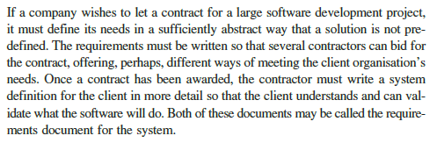
Requirements abstraction (Davis)

Slide 7
Types of requirement
User requirements
Are Statements in natural language plus diagrams of the services the system provides and its operational constraints. Written for customers.
System requirements
A structured document setting out detailed descriptions of the system’s functions, services and operational constraints. Defines exactly what should be implemented and therefore may be part of a contract between client and contractor.
Different levels of s/m specification are useful as different types of readers exist.

Slide 8
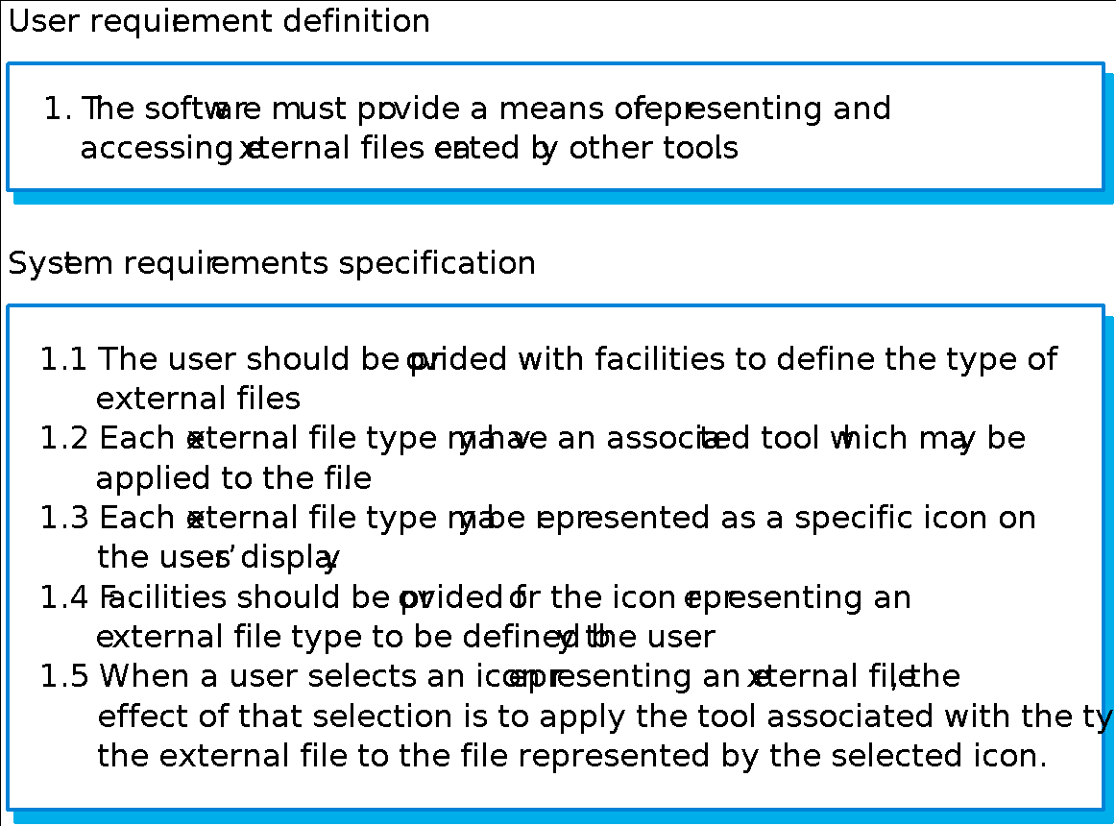
Definitions and specifications

Slide 9
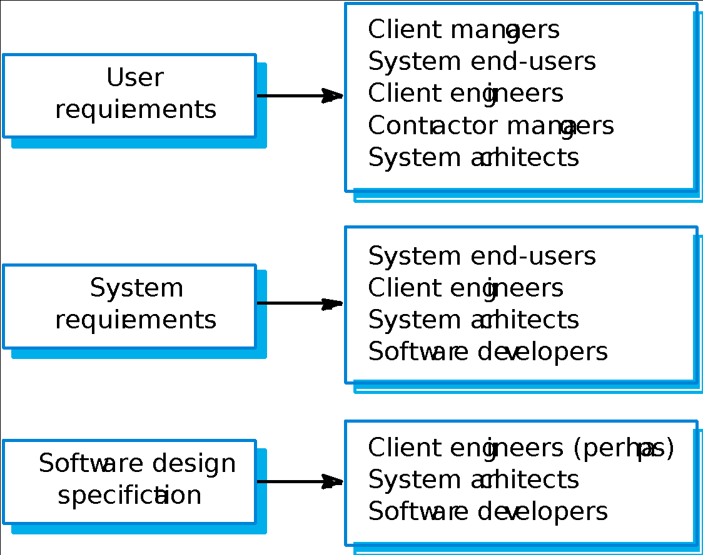
Requirements readers

Slide 10
Functional and non-functional requirements
Functional requirements
Statements of services the system should provide, how the system should react to particular inputs and how the system should behave in particular situations.
Non-functional requirements
constraints on the services or functions offered by the system such as timing constraints, constraints on the development process, standards, etc.
Domain requirements
Requirements that come from the application domain of the system and that reflect characteristics of that domain.

Slide 11
Functional requirements
Describe functionality or system services.
Depend on the type of software, expected users and the type of system where the software is used.
Functional user requirements may be high-level statements of what the system should do but functional system requirements should describe the system services in detail.

Slide 12
The LIBSYS system
A library system that provides a single interface to a number of databases of articles in different libraries.
Users can search for, download and print these articles for personal study.

Slide 13
Examples of functional requirements
The user shall be able to search either all of the initial set of databases or select a subset from it.
The system shall provide appropriate viewers for the user to read documents in the document store.
Every order shall be allocated a unique identifier (ORDER_ID) which the user shall be able to copy to the account’s permanent storage area.

Slide 14
Requirements imprecision
Problems arise when requirements are not precisely stated.
Ambiguous requirements may be interpreted in different ways by developers and users.
Consider the term ‘appropriate viewers’
User intention - special purpose viewer for each different document type;
Developer interpretation - Provide a text viewer that shows the contents of the document.

Slide 15
Requirements completeness and consistency
In principle, requirements should be both complete and consistent.
Complete
They should include descriptions of all facilities required.
Consistent
There should be no conflicts or contradictions in the descriptions of the system facilities.
In practice, it is impossible to produce a complete and consistent requirements document.

Slide 16
Non-functional requirements
These define system properties and constraints e.g. reliability, response time and storage requirements. Constraints are I/O device capability, system representations, etc.
Process requirements may also be specified mandating a particular CASE system, programming language or development method.
Non-functional requirements may be more critical than functional requirements. If these are not met, the system is useless.

Slide 17
Non-functional classifications
Product requirements
Requirements which specify that the delivered product must behave in a particular way e.g. execution speed, reliability, etc.
Organisational requirements
Requirements which are a consequence of organisational policies and procedures e.g. process standards used, implementation requirements, etc.
External requirements
Requirements which arise from factors which are external to the system and its development process e.g. interoperability requirements, legislative requirements, etc.

Slide 18
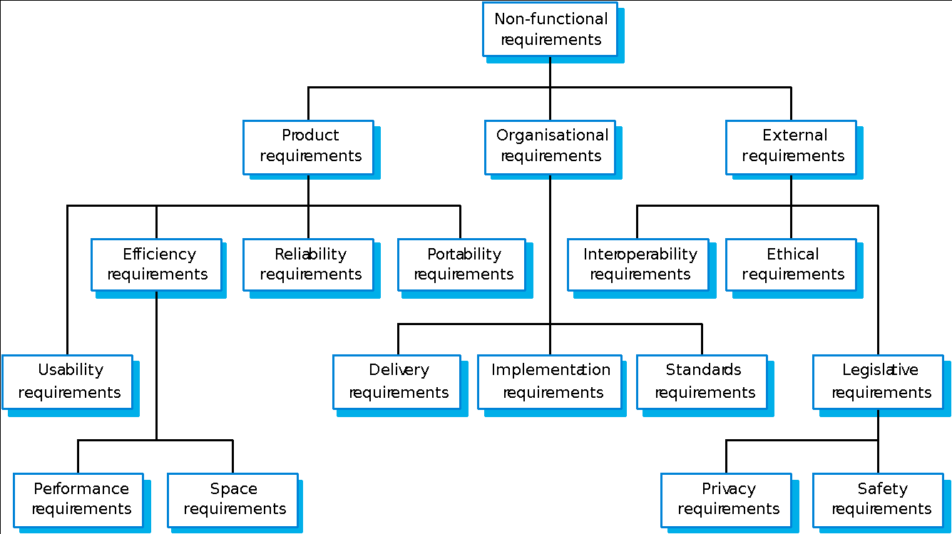
Non-functional requirement types

Slide 19
Non-functional requirements examples
Product requirement
8.1 The user interface for LIBSYS shall be implemented as simple HTML without frames or Java applets.
Organisational requirement
9.3.2 The system development process and deliverable documents shall conform to the process and deliverables defined in XYZCo-SP-STAN-95.
External requirement
7.6.5 The system shall not disclose any personal information about customers apart from their name and reference number to the operators of the system.

Slide 20
Goals and requirements
Non-functional requirements may be very difficult to state precisely and imprecise requirements may be difficult to verify.
Goal
A general intention of the user such as ease of use.
Verifiable non-functional requirement
A statement using some measure that can be objectively tested.
Goals are helpful to developers as they convey the intentions of the system users.

Slide 21
Examples
A system goal
The system should be easy to use by experienced controllers and should be organised in such a way that user errors are minimised.
A verifiable non-functional requirement
Experienced controllers shall be able to use all the system functions after a total of two hours training. After this training, the average number of errors made by experienced users shall not exceed two per day.

Slide 22
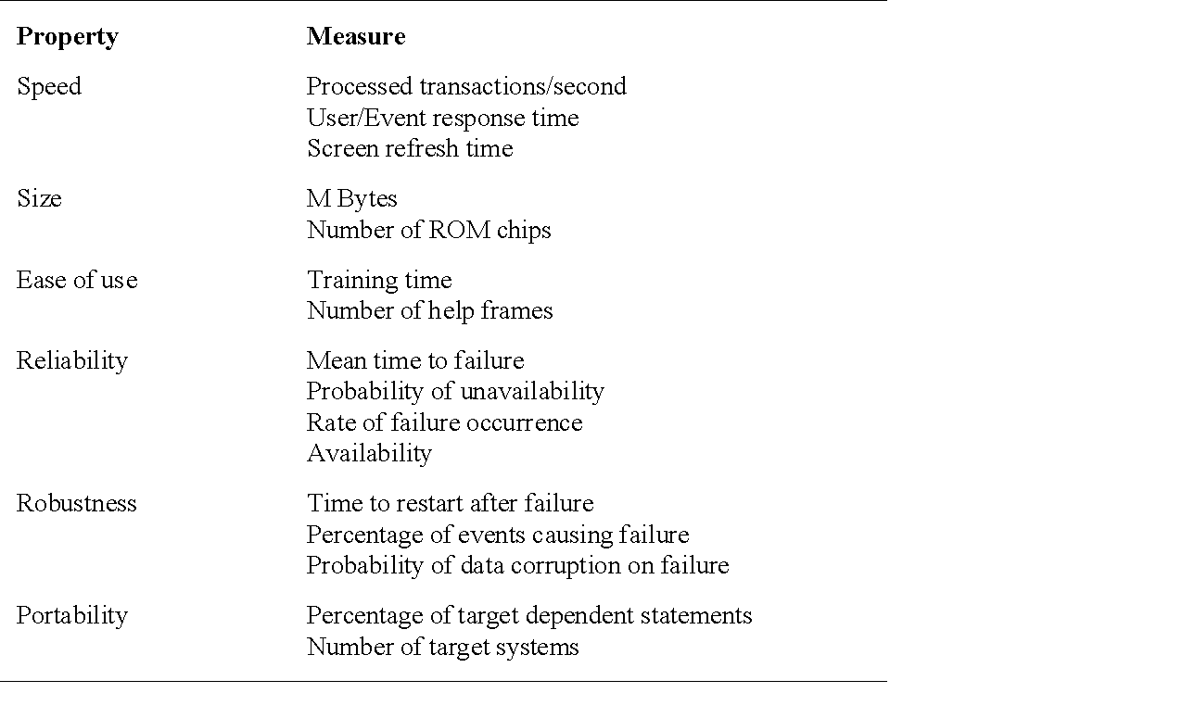
Requirements measures

Slide 23
Requirements interaction
Conflicts between different non-functional requirements are common in complex systems.
Spacecraft system
To minimise weight, the number of separate chips in the system should be minimised.
To minimise power consumption, lower power chips should be used.
However, using low power chips may mean that more chips have to be used. Which is the most critical requirement?

Slide 24
Domain requirements
Derived from the application domain and describe system characteristics and features that reflect the domain.
Domain requirements be new functional requirements, constraints on existing requirements or define specific computations.
If domain requirements are not satisfied, the system may be unworkable.

Slide 25
Library system domain requirements
There shall be a standard user interface to all databases which shall be based on the Z39.50 standard.
Because of copyright restrictions, some documents must be deleted immediately on arrival. Depending on the user’s requirements, these documents will either be printed locally on the system server for manually forwarding to the user or routed to a network printer.

Slide 26
Train protection system
The deceleration of the train shall be computed as:
D_{train} = D_{control} + D_{gradient}
where D_{gradient} is 9.81ms² * compensated gradient/alpha and where the values of 9.81ms² /alpha are known for different types of train.

Slide 27
Domain requirements problems
Understandability
Requirements are expressed in the language of the application domain;
This is often not understood by software engineers developing the system.
Implicitness
Domain specialists understand the area so well that they do not think of making the domain requirements explicit.

Slide 28
User requirements
Should describe functional and non-functional requirements in such a way that they are understandable by system users who don’t have detailed technical knowledge.
User requirements are defined using natural language, tables and diagrams as these can be understood by all users.

Slide 29
Problems with natural language
Lack of clarity
Precision is difficult without making the document difficult to read.
Requirements confusion
Functional and non-functional requirements tend to be mixed-up.
Requirements amalgamation
Several different requirements may be expressed together.

Slide 30
LIBSYS requirement
4..5 LIBSYS shall provide a financial accounting system that maintains records of all payments made by users of the system. System managers may configure this system so that regular users may receive discounted rates.

Slide 31
Editor grid requirement
2.6 Grid facilities To assist in the positioning of entities on a diagram,
the user may turn on a grid in either centimetres or inches, via an
option on the control panel. Initially, the grid is off. The grid may be
turned on and off at any time during an editing session and can be
toggled between inches and centimetres at any time. A grid option
will be provided on the reduce-to-fit view but the number of grid
lines shown will be reduced to avoid filling the smaller diagram
with grid lines.

Slide 32
Requirement problems
Database requirements includes both conceptual and detailed information
Describes the concept of a financial accounting system that is to be included in LIBSYS;
However, it also includes the detail that managers can configure this system - this is unnecessary at this level.
Grid requirement mixes three different kinds of requirement
Conceptual functional requirement (the need for a grid);
Non-functional requirement (grid units);
Non-functional UI requirement (grid switching).

Slide 33
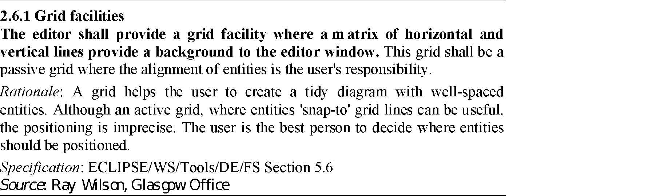
Structured presentation

Slide 34
Guidelines for writing requirements
Invent a standard format and use it for all requirements.
Use language in a consistent way. Use shall for mandatory requirements, should for desirable requirements.
Use text highlighting to identify key parts of the requirement.
Avoid the use of computer jargon.

Slide 35
System requirements
More detailed specifications of system functions, services and constraints than user requirements.
They are intended to be a basis for designing the system.
They may be incorporated into the system contract.
System requirements may be defined or illustrated using system models discussed in Chapter 8.

Slide 36
Requirements and design
In principle, requirements should state what the system should do and the design should describe how it does this.
In practice, requirements and design are inseparable
A system architecture may be designed to structure the requirements;
The system may inter-operate with other systems that generate design requirements;
The use of a specific design may be a domain requirement.

Slide 37
Problems with NL specification
Ambiguity
The readers and writers of the requirement must interpret the same words in the same way. NL is naturally ambiguous so this is very difficult.
Over-flexibility
The same thing may be said in a number of different ways in the specification.
Lack of modularisation
NL structures are inadequate to structure system requirements.

Slide 38
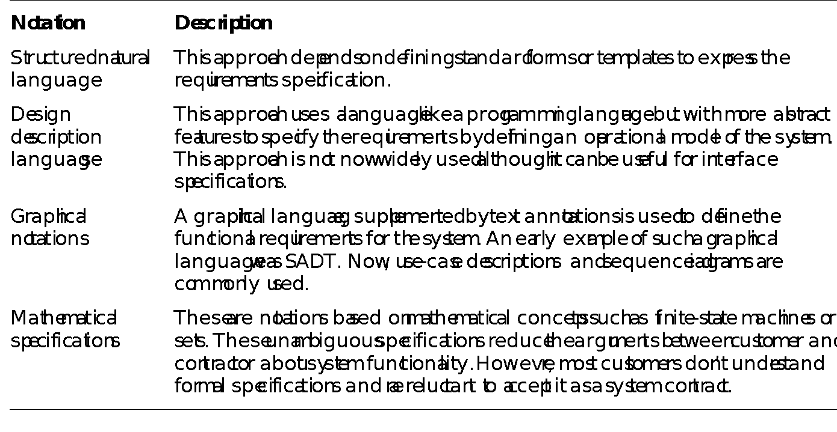
Alternatives to NL specification

Slide 39
Structured language specifications
The freedom of the requirements writer is limited by a predefined template for requirements.
All requirements are written in a standard way.
The terminology used in the description may be limited.
The advantage is that the most of the expressiveness of natural language is maintained but a degree of uniformity is imposed on the specification.

Slide 40
Form-based specifications
Definition of the function or entity.
Description of inputs and where they come from.
Description of outputs and where they go to.
Indication of other entities required.
Pre and post conditions (if appropriate).
The side effects (if any) of the function.

Slide 41
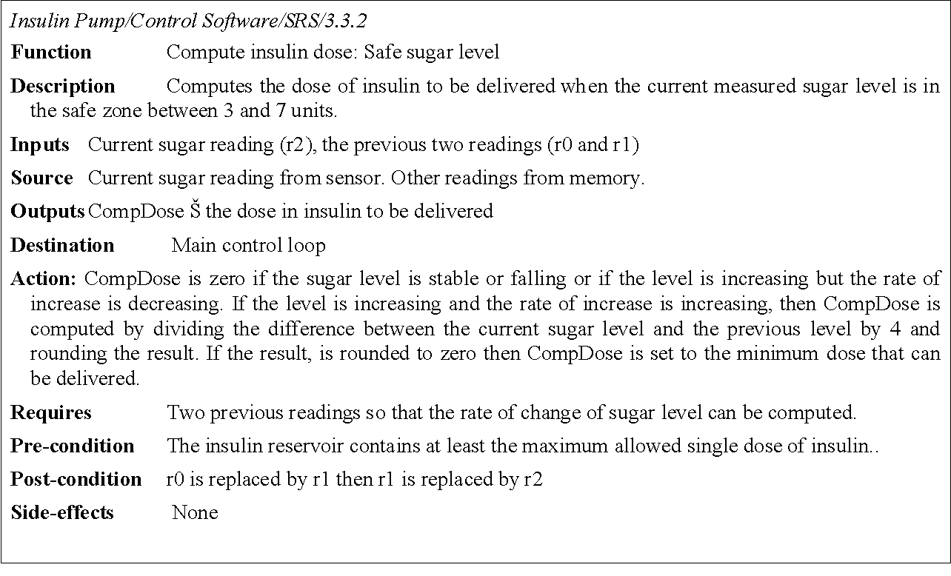
Form-based node specification

Slide 42
Tabular specification
Used to supplement natural language.
Particularly useful when you have to define a number of possible alternative courses of action.

Slide 43
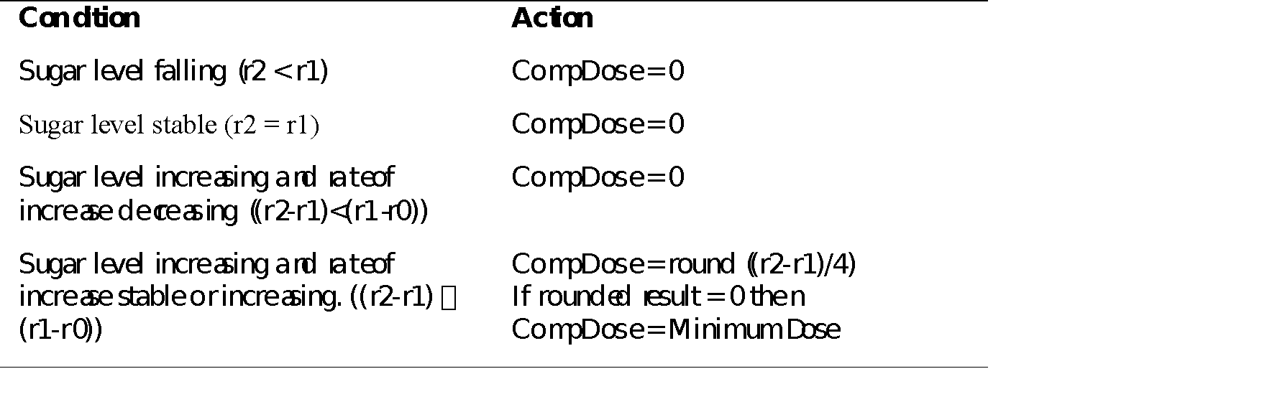
Tabular specification

Slide 44
Graphical models
Graphical models are most useful when you need to show how state changes or where you need to describe a sequence of actions.
Different graphical models are explained in Chapter 8.

Slide 45
Sequence diagrams
These show the sequence of events that take place during some user interaction with a system.
You read them from top to bottom to see the order of the actions that take place.
Cash withdrawal from an ATM
Validate card;
Handle request;
Complete transaction.

Slide 46
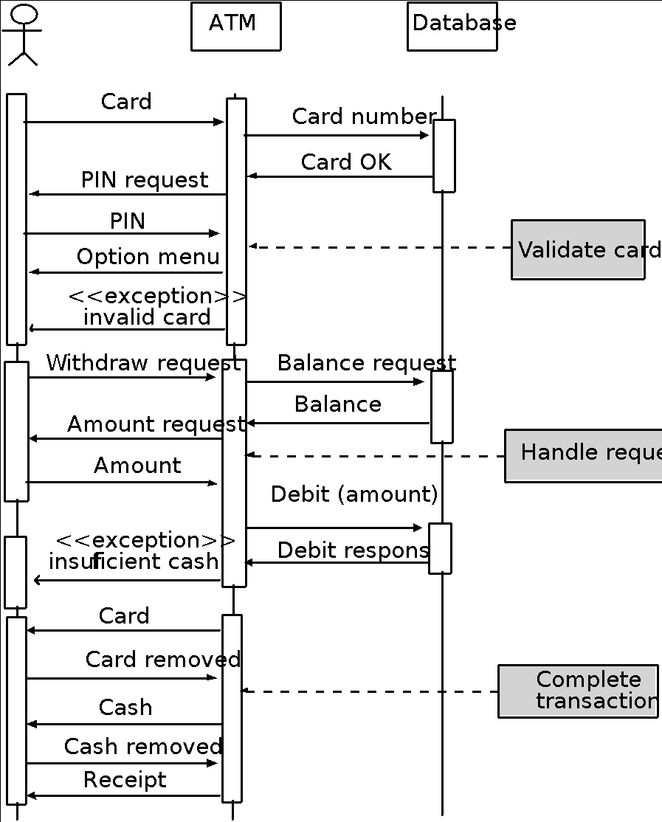
Sequence diagram of ATM withdrawal

Slide 47
Interface specification
Most systems must operate with other systems and the operating interfaces must be specified as part of the requirements.
Three types of interface may have to be defined
Procedural interfaces;
Data structures that are exchanged;
Data representations.
Formal notations are an effective technique for interface specification.

Slide 48
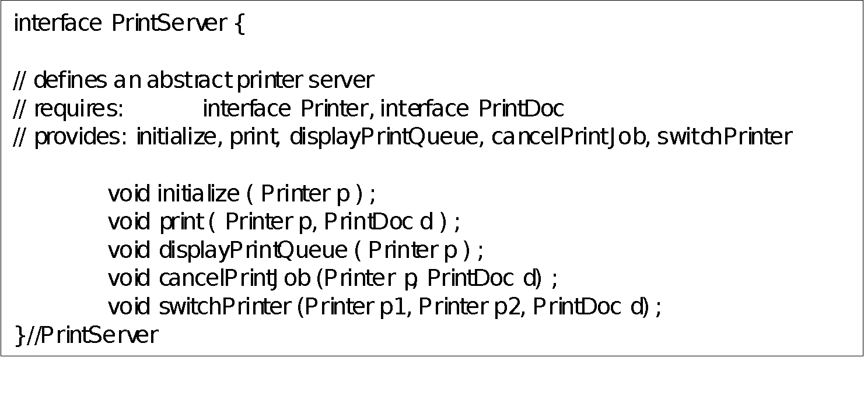
PDL interface description

Slide 49
The requirements document
The requirements document is the official statement of what is required of the system developers.
Should include both a definition of user requirements and a specification of the system requirements.
It is NOT a design document. As far as possible, it should set of WHAT the system should do rather than HOW it should do it

Slide 50
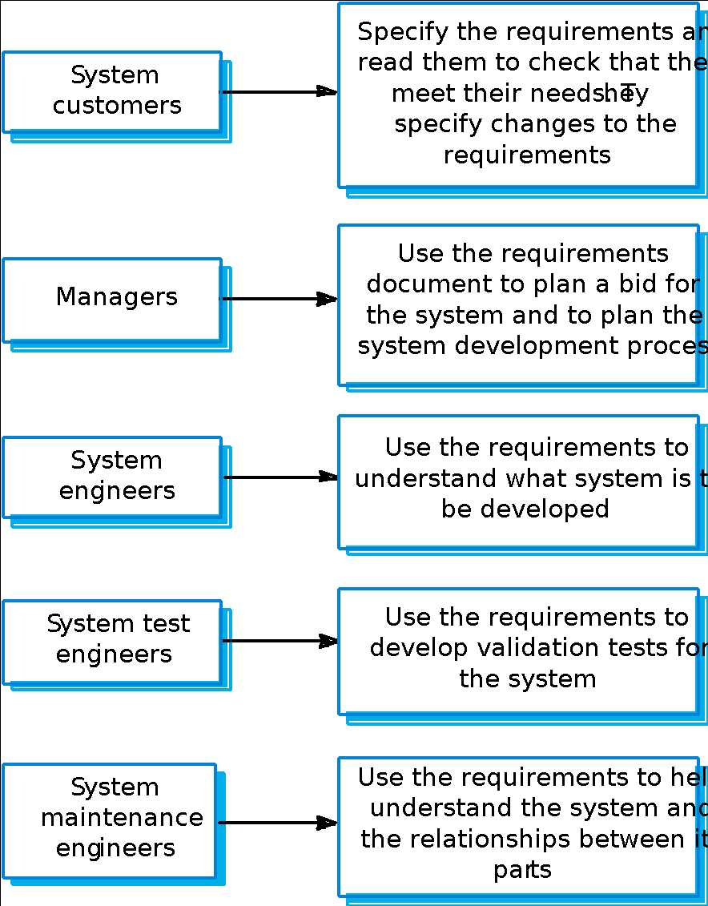
Users of a requirements document

Slide 51
IEEE requirements standard
Defines a generic structure for a requirements document that must be instantiated for each specific system.
Introduction.
General description.
Specific requirements.
Appendices.
Index.

Slide 52
Requirements document structure
Preface
Introduction
Glossary
User requirements definition
System architecture
System requirements specification
System models
System evolution
Appendices
Index

Slide 53
Key points
Requirements set out what the system should do and define constraints on its operation and implementation.
Functional requirements set out services the system should provide.
Non-functional requirements constrain the system being developed or the development process.
User requirements are high-level statements of what the system should do. User requirements should be written using natural language, tables and diagrams.

Slide 54
Key points
System requirements are intended to communicate the functions that the system should provide.
A software requirements document is an agreed statement of the system requirements.
The IEEE standard is a useful starting point for defining more detailed specific requirements standards.

