Slide 1
System models

Slide 2
Objectives
To explain why the context of a system should be modelled as part of the RE process
To describe behavioural modelling, data modelling and object modelling
To introduce some of the notations used in the Unified Modeling Language (UML)
To show how CASE workbenches support system modelling

Slide 3
Topics covered
Context models
Behavioural models
Data models
Object models
CASE workbenches

Slide 4
System modelling
System modelling helps the analyst to understand the functionality of the system and models are used to communicate with customers.
Different models present the system from different perspectives
  External perspective showing the system’s context or environment;
  Behavioural perspective showing the behaviour of the system;
  Structural perspective showing the system or data architecture.

Slide 5
Model types
Data processing model showing how the data is processed at different stages.
Composition model showing how entities are composed of other entities.
Architectural model showing principal sub-systems.
Classification model showing how entities have common characteristics.
Stimulus/response model showing the system’s reaction to events.

Slide 6
Context models
Context models are used to illustrate the operational context of a system - they show what lies outside the system boundaries.
Social and organisational concerns may affect the decision on where to position system boundaries.
Architectural models show the system and its relationship with other systems.

Slide 7
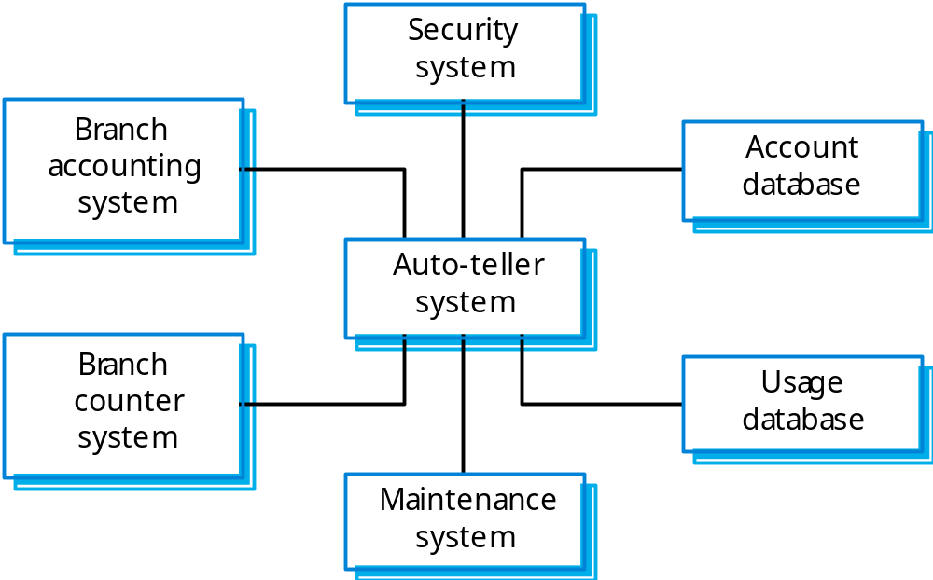
The context of an ATM system

Slide 8

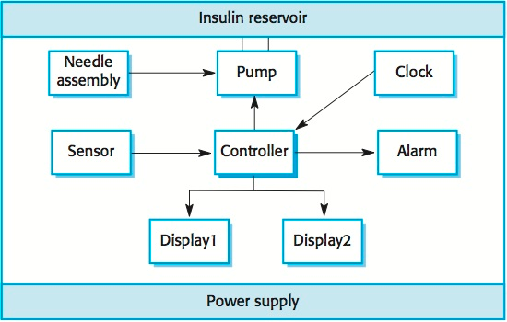

Slide 9
Process models
Process models show the overall process and the processes that are supported by the system.
Data flow models may be used to show the processes and the flow of information from one process to another.

Slide 10
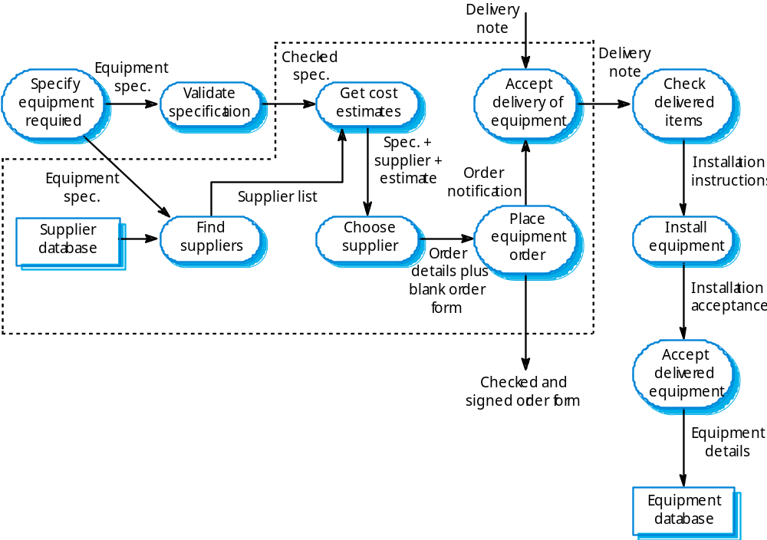
Equipment procurement process

Slide 11
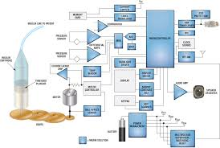

Slide 12
Behavioural models
Behavioural models are used to describe the overall behaviour of a system.
Two types of behavioural model are:
  Data processing models that show how data is processed as it moves through the system;
  State machine models that show the systems response to events.
These models show different perspectives so both of them are required to describe the system’s behaviour.

Slide 13
Data-processing models
Data flow diagrams (DFDs) may be used to model the system’s data processing.
These show the processing steps as data flows through a system.
DFDs are an intrinsic part of many analysis methods.
Simple and intuitive notation that customers can understand.
Show end-to-end processing of data.

Slide 14
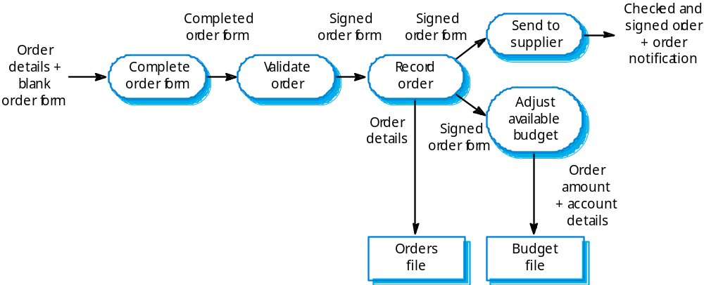
Order processing DFD

Slide 15
Data flow diagrams
DFDs model the system from a functional perspective.
Tracking and documenting how the data associated with a process is helpful to develop an overall understanding of the system.
Data flow diagrams may also be used in showing the data exchange between a system and other systems in its environment.

Slide 16
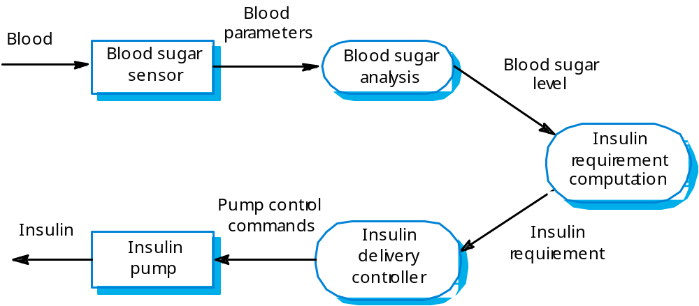
Insulin pump DFD

Slide 17
State machine models
These model the behaviour of the system in response to external and internal events.
They show the system’s responses to stimuli so are often used for modelling real-time systems.
State machine models show system states as nodes and events as arcs between these nodes. When an event occurs, the system moves from one state to another.
Statecharts are an integral part of the UML and are used to represent state machine models.

Slide 18
Statecharts
Allow the decomposition of a model into sub-models (see following slide).
A brief description of the actions is included following the ‘do’ in each state.
Can be complemented by tables describing the states and the stimuli.

Slide 19
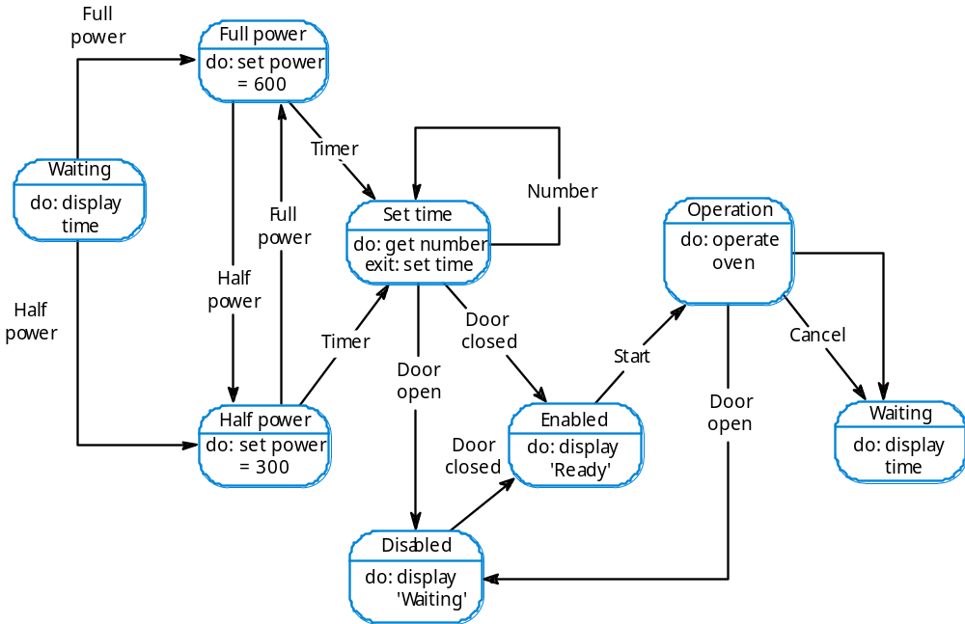
Microwave oven model

Slide 20
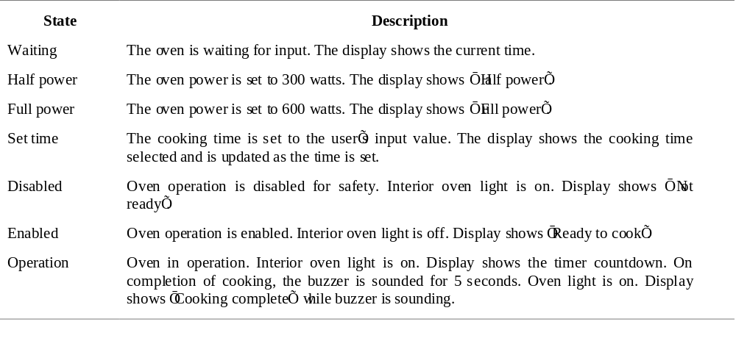
Microwave oven state description

Slide 21
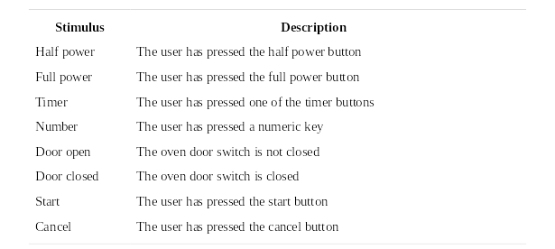
Microwave oven stimuli

Slide 22
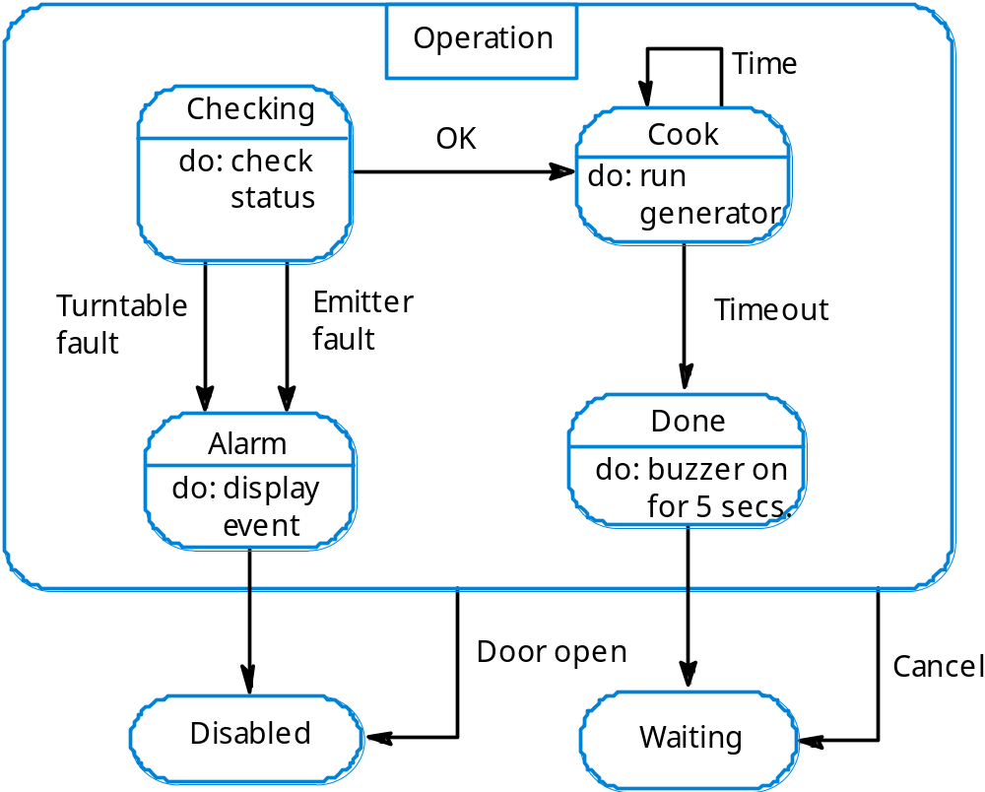
Microwave oven operation

Slide 23
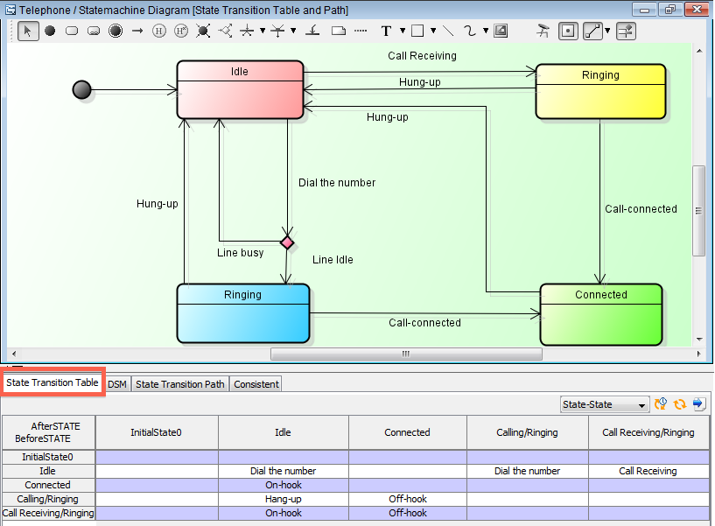

Slide 24
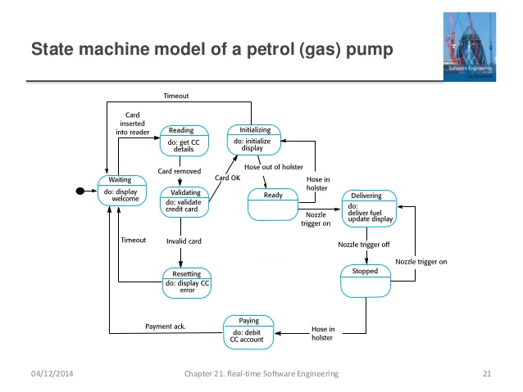

Slide 25
Semantic data models
Used to describe the logical structure of data processed by the system.
An entity-relation-attribute model sets out the entities in the system, the relationships between these entities and the entity attributes
Widely used in database design. Can readily be implemented using relational databases.
No specific notation provided in the UML but objects and associations can be used.

Slide 26
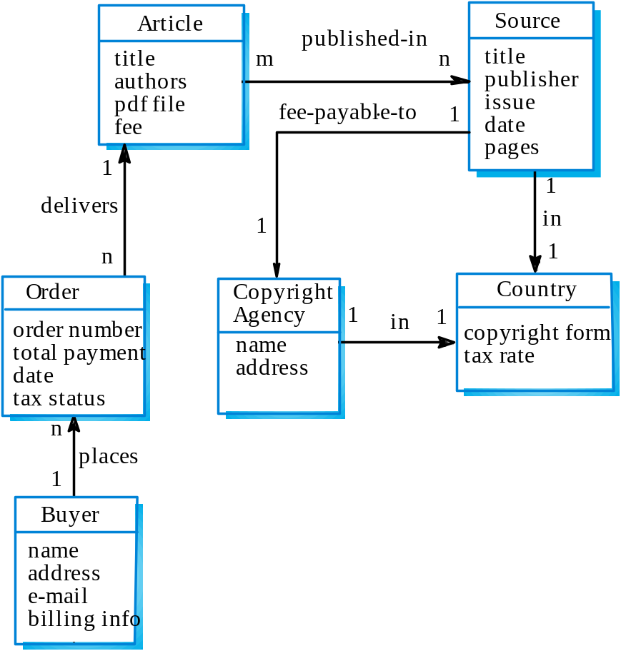
Library semantic model

Slide 27
Data dictionaries
Data dictionaries are lists of all of the names used in the system models. Descriptions of the entities, relationships and attributes are also included.
Advantages
  Support name management and avoid duplication;
  Store of organisational knowledge linking analysis, design and implementation;
Many CASE workbenches support data dictionaries.

Slide 28
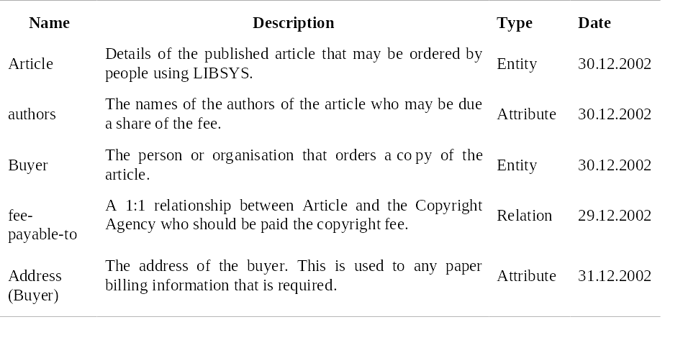
Data dictionary entries

Slide 29
Object models
Object models describe the system in terms of object classes and their associations.
An object class is an abstraction over a set of objects with common attributes and the services (operations) provided by each object.
Various object models may be produced
  Inheritance models;(how object classes are related to each other)
  Aggregation models;( how objects are aggregated to form other objects)
  Interaction models.(how objects interact with other objects)

Slide 30
Object models
OO requirement analysis involves modelling real-world entities using object classes
More abstract entities are more difficult to model using this approach
Process of identifying Objects and Object class is recognised as one of difficult areas in OOD as this requires a deep understanding of the application domain
Object classes reflecting domain entities are reusable across systems

Slide 31
Inheritance models
OOM involves identifying the classes of object that are important in the domain being studied
They are then organized into a taxonomy
Taxonomy is a classification scheme that shows how an object class is related to other classes through common attributes and services
To display this taxonomy the classes are organized into an inheritance hierarchy

Slide 32
Inheritance models
Object Classes at the top of the hierarchy reflect the common or general features of all classes.
Object classes inherit their attributes and services from one or more super-classes. these may then be specialised as necessary.
Class hierarchy design can be a difficult process if duplication in different branches is to be avoided.

Slide 33
Object models and the UML
The UML is a standard representation devised by the developers of widely used object-oriented analysis and design methods.
It has become an effective standard for object-oriented modelling.
Notation
  Object classes are rectangles with the name at the top, attributes in the middle section and operations in the bottom section;
  Relationships between object classes (known as associations) are shown as lines linking objects;
  Inheritance is referred to as generalisation and is shown ‘upwards’ rather than ‘downwards’ in a hierarchy.
  Next example shows inheritance where every object class inherits its attributes and operations from a single parent class.

Slide 34
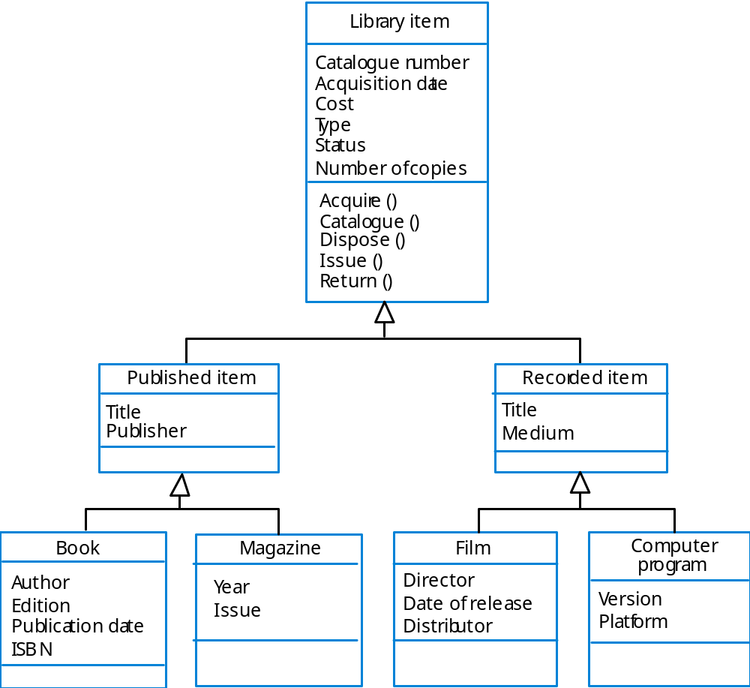
Library class hierarchy

Slide 35
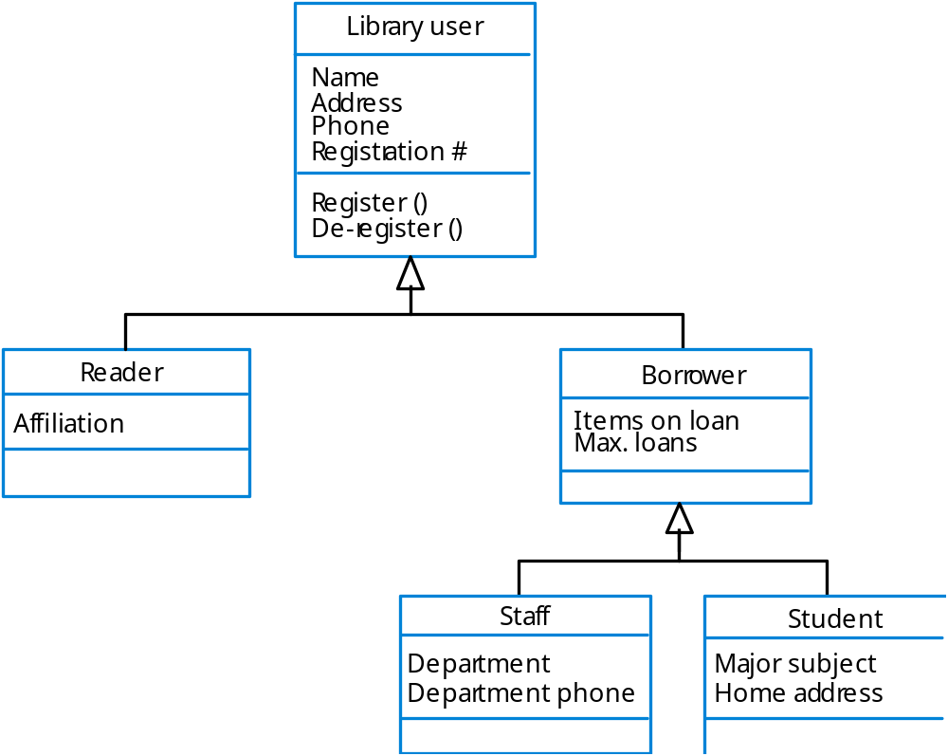
User class hierarchy

Slide 36
Multiple inheritance
Rather than inheriting the attributes and services from a single parent class, a system which supports multiple inheritance allows object classes to inherit from several super-classes.
This can lead to semantic conflicts where attributes/services with the same name in different super-classes have different semantics.
Multiple inheritance makes class hierarchy reorganisation more complex.

Slide 37
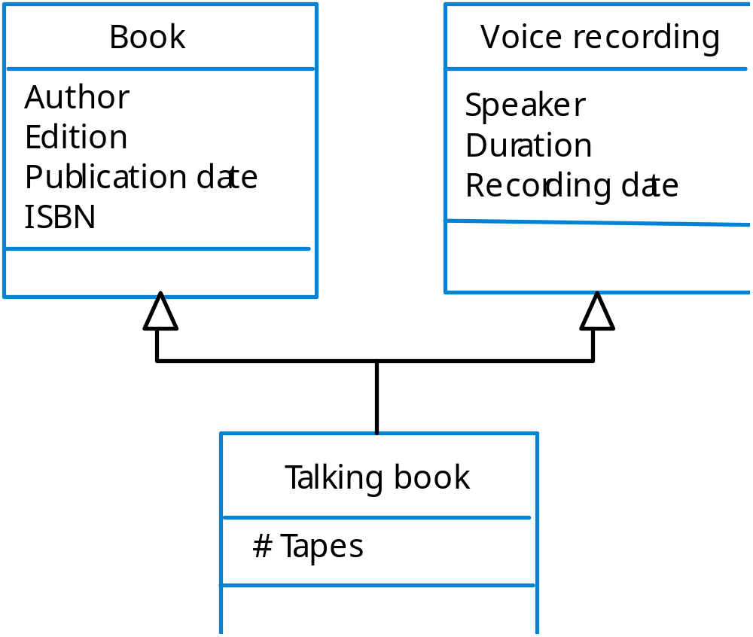
Multiple inheritance

Slide 38
Object aggregation
An aggregation model shows how classes that are collections are composed of other classes(i.e) an object is an aggregate of a set of other objects
Aggregation models are similar to the part-of relationship in semantic data models.
UML notation for aggregation is to represent the composition by including a diamond shape on the source of the link

Slide 39
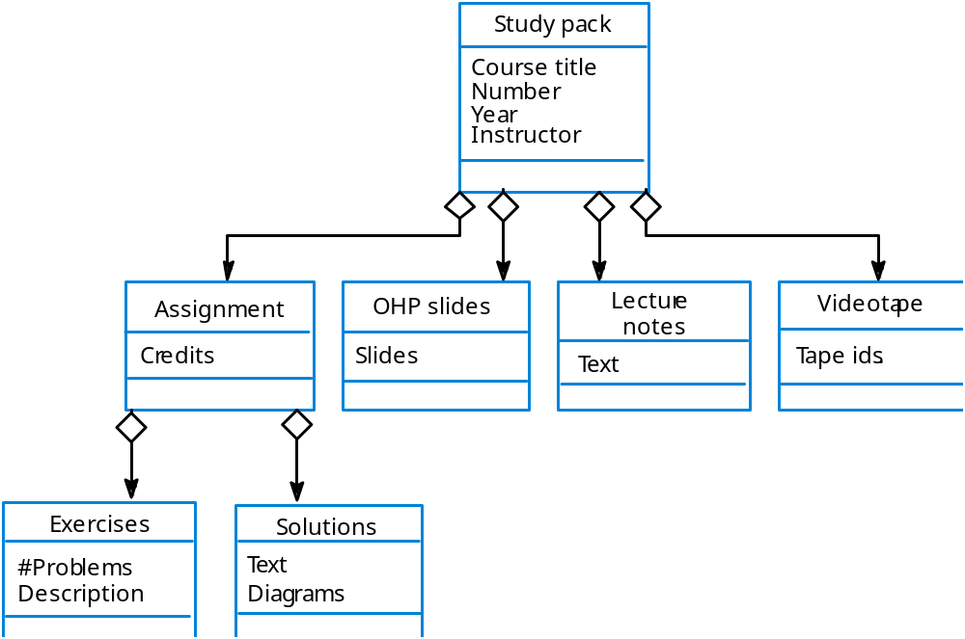
Object aggregation

Slide 40
Object behaviour modelling
A behavioural model shows the interactions between objects to produce some particular system behaviour that is specified as a use-case.
One way to model behaviour is to use UML sequence diagrams that show the sequence of actions involved in a use case.
Sequence diagrams in the UML are used to model interaction between objects.
UML also includes collaboration diagrams that show the sequence of messages exchanged by objects

Slide 41
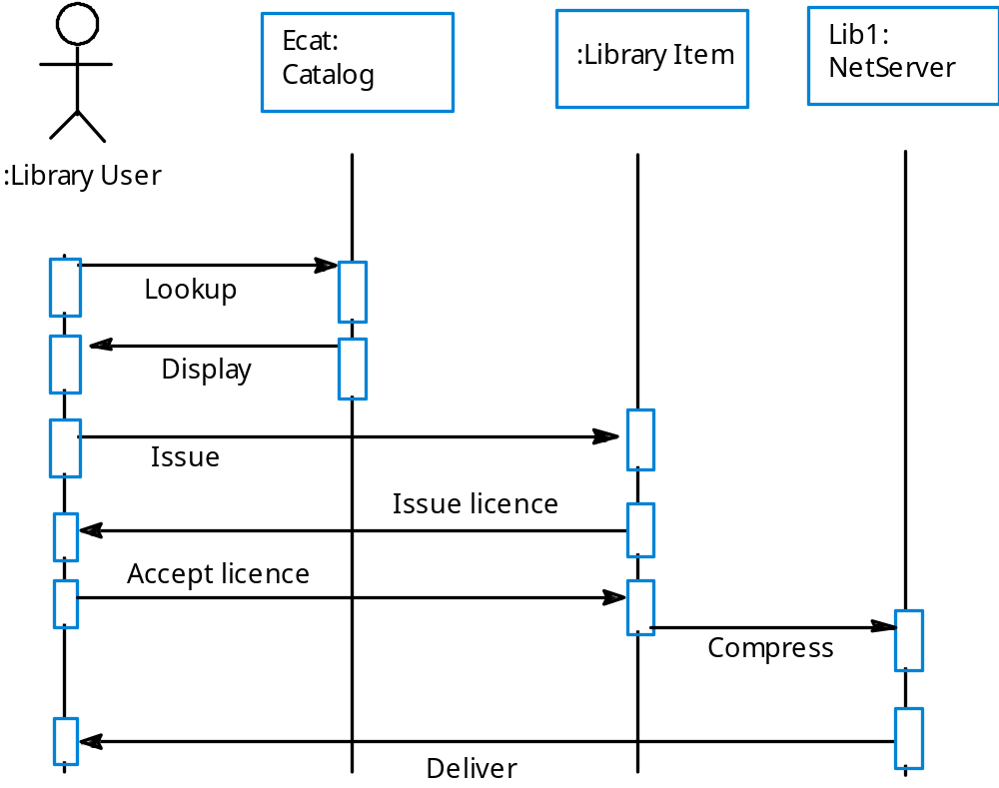
Issue of electronic items

Slide 42
Object behaviour modelling
Objects and actors are aligned along the top of the diagram
Labelled arrows indicate operations
Sequence of operations is from top to bottom

Slide 43
Structured methods
Structured methods incorporate system modelling as an inherent part of the method.
Methods define a set of models, a process for deriving these models and rules and guidelines that should apply to the models.
CASE tools support system modelling as part of a structured method.

Slide 44
Method weaknesses
They do not model non-functional system requirements.
They do not usually include information about whether a method is appropriate for a given problem.
The may produce too much documentation.
The system models are sometimes too detailed and difficult for users to understand.

Slide 45
CASE workbenches
A coherent set of tools that is designed to support related software process activities such as analysis, design or testing.
Analysis and design workbenches support system modelling during both requirements engineering and system design.
These workbenches may support a specific design method or may provide support for a creating several different types of system model.

Slide 46
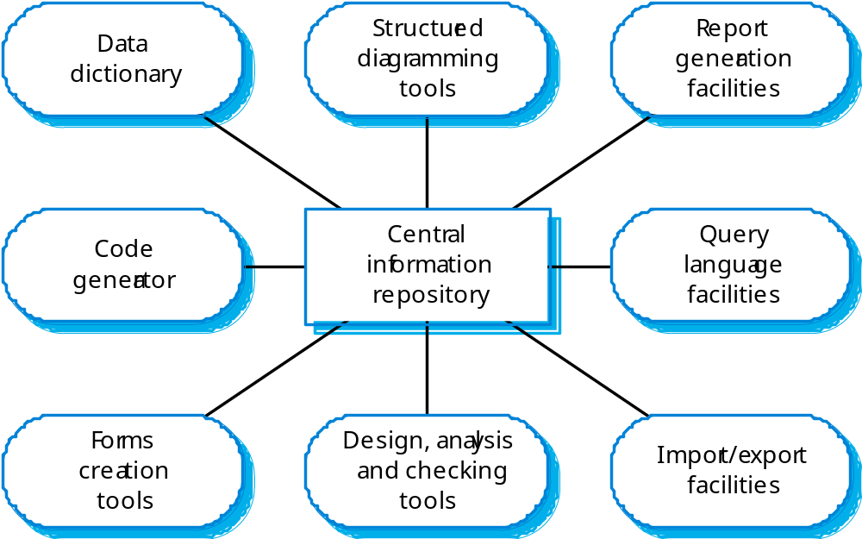
An analysis and design workbench

Slide 47
Analysis workbench components
Diagram editors
Model analysis and checking tools
Repository and associated query language
Data dictionary
Report definition and generation tools
Forms definition tools
Import/export translators
Code generation tools

Slide 48
Key points
A model is an abstract system view. Complementary types of model provide different system information.
Context models show the position of a system in its environment with other systems and processes.
Data flow models may be used to model the data processing in a system.
State machine models model the system’s behaviour in response to internal or external events

Slide 49
Key points
Semantic data models describe the logical structure of data which is imported to or exported by the systems.
Object models describe logical system entities, their classification and aggregation.
Sequence models show the interactions between actors and the system objects that they use.
Structured methods provide a framework for developing system models.

