Slide 1

FULL STACK DEVELOPER
MINI PROJECT IN PYTHON
NAME: MANOJ K V

Slide 2
PROJECT TITLE SHEET
PHARMACY MANAGMENT IN PYTHON
Project Report Submitted
In partial fulfillment of the requirement for the proficient certificate course
Done By
MANOJ K V
Under the guidance of
SOWMITHRA M
Approved by
CHINNAIYAN G

Slide 3
ABOUT PUMO TECHNOVATION
We are the India's Largest Design, Developer and Manufacture of Fracture CON ROD's also Owning Technical Campus Collaborated with world's leading companies like FANUC INDIA, MITSUBISHI CUTTING TOOLS, ACCURATE GAUGES, ADITYA MEASUREMENTS, RENISHAW & MITUTOYA (JAPAN).
Our total lab setup is focused for engineer’s and industries updating requirements. the tech campus is completely accelerating under the guidance of industrial experts having 27+ years’ experience and young aspirants, Pumo Technovation is the first tech campus to have all facilities & labs in India to offer training courses and job assurance all under one roof.
Pumo Technovation Training in IT, Electronics & Electricals creating experts for emerging technology industries and specialist technology jobs.
A part of CADD Centre, which is Asia's largest CAD/CAM/CAE training institute.

Slide 4
PROJECT OBJECTIVE
Inventory Management:
The system allows for the addition and viewing of medicines in the pharmacy's inventory, helping manage stock levels effectively.
Sales Processing:
Users can process sales for medicines, deducting the sold quantity from the inventory and calculating the total amount based on the price.
Prescription Management:
The system enables the addition and viewing of patient prescriptions, maintaining a record of what medications are prescribed to which patients.
User Interaction:
The program features a command-line interface that provides a menu for users to interact with, making it easy to navigate through the available functions.
Input Validation:
The system checks for sufficient quantities during sales, ensuring that the pharmacy does not sell more medicine than is available.
Clear Output:
The output messages clearly communicate the success or failure of operations, providing feedback to the user.

Slide 5
HARDWARE AND SOFTWARE REQUIREMENTS:
HARDWARE :
✓ Device name : DESKTOP-O9C1VQ2
✓ Processor :AMD PRO A4-4350B R4, 5 COMPUTE CORES 2C+3G 2.50 GHz
✓ Installed RAM : 4.00 GB (3.84 GB usable)
✓ Device ID :B9AF4930-6554-4448-ABD8- 5D97B0D0DB79-
✓ Product ID :00379-20000-00001-AAOEM
✓ System type :64-bit operating system, x64-based processor
✓ Pen and touch :No pen or touch input is available for this display
SOFTWARE:
✓PyCharm Community Edition 2024.1.4
✓Python

Slide 6
SOURCE CODE:
class Pharmacy:
def __init__(self):
self.inventory = {}
self.prescriptions = []
def add_medicine(self, name, quantity, price):
if name in self.inventory:
current_quantity, current_price = self.inventory[name]
self.inventory[name] = (current_quantity + quantity, price)
else:
self.inventory[name] = (quantity, price)
print(f"Medicine '{name}' added successfully.")
def view_inventory(self):
if not self.inventory:
print("Inventory is empty.")
else:
print("\nInventory:")
for name, (quantity, price) in self.inventory.items():
print(f"Name: {name}, Quantity: {quantity}, Price: {price}")

Slide 7
def sale(self, name, quantity):
if name in self.inventory:
current_quantity, price = self.inventory[name]
if quantity <= current_quantity:
total_amount = quantity * price
self.inventory[name] = (current_quantity - quantity, price)
print(f"Sale processed: {name}, Quantity: {quantity}, Total Amount: {total_amount}")
else:
print(f"Not enough quantity of '{name}' in inventory.")
else:
print(f"Medicine '{name}' not found in inventory.")
def add_prescription(self, patient_name, medicine_name, quantity):
self.prescriptions.append({
'patient_name': patient_name,
'medicine_name': medicine_name,
'quantity': quantity
})
print(f"Prescription added for patient '{patient_name}'.")

Slide 8
def view_prescriptions(self):
if not self.prescriptions:
print("No prescriptions found.")
else:
print("\nPrescriptions:")
for prescription in self.prescriptions:
print(f"Patient Name: {prescription['patient_name']}, Medicine: {prescription['medicine_name']}, Quantity: {prescription['quantity']}")
def menu(self):
print("\nPharmacy Management System")
print("1) Add Medicine")
print("2) View Inventory")
print("3) Process Sale")
print("4) Add Prescription")
print("5) View Prescriptions")
print("6) Exit")
def run(self):
while True:
self.menu()
choice = input("Enter your choice: ")
if choice == '1':
name = input("Enter medicine name: ")
quantity = int(input("Enter quantity: "))
price = float(input("Enter price: "))
self.add_medicine(name, quantity, price)

Slide 9
elif choice == '2':
self.view_inventory()
elif choice == '3':
name = input("Enter medicine name: ")
quantity = int(input("Enter quantity: "))
self.sale(name, quantity)
elif choice == '4':
patient_name = input("Enter patient name: ")
medicine_name = input("Enter medicine name: ")
quantity = int(input("Enter quantity: "))
self.add_prescription(patient_name, medicine_name, quantity)
elif choice == '5':
self.view_prescriptions()
elif choice == '6':
print("Exiting...")
break
else:
print("Invalid choice, please select again.")
phar = Pharmacy()
phar.run()
==============================================
COMPLETED THE PROGRAM ==============================================

Slide 10
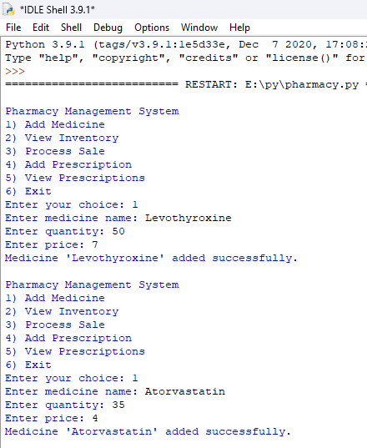
OUTPUT:
Add Medicine

Slide 11
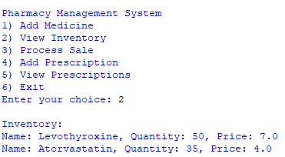
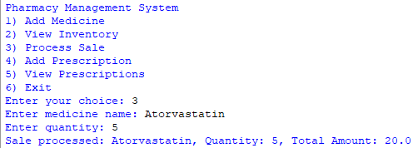
OUTPUT:
View inventory
Process sales

Slide 12
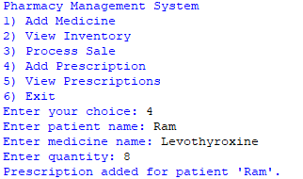
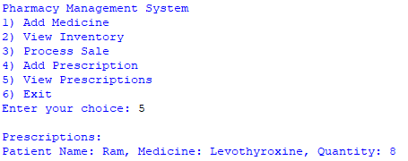
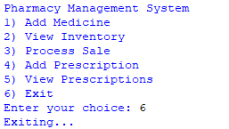
OUTPUT:
Add Prescriptions
View prescriptions
Exit

