Slide 1
Transport Demand Prediction (Power BI-style)
Mobiticket | Data Science Capstone
Major Project by LauncED Global
Manoj Choudhary

Slide 2
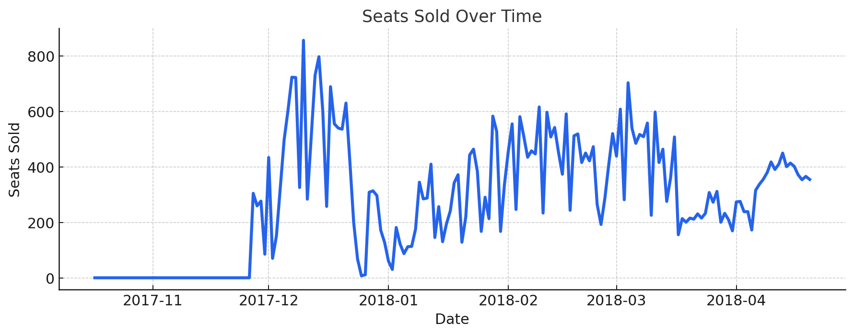
Seats Sold Over Time
Daily totals. Use to spot trends and seasonal patterns.

Slide 3
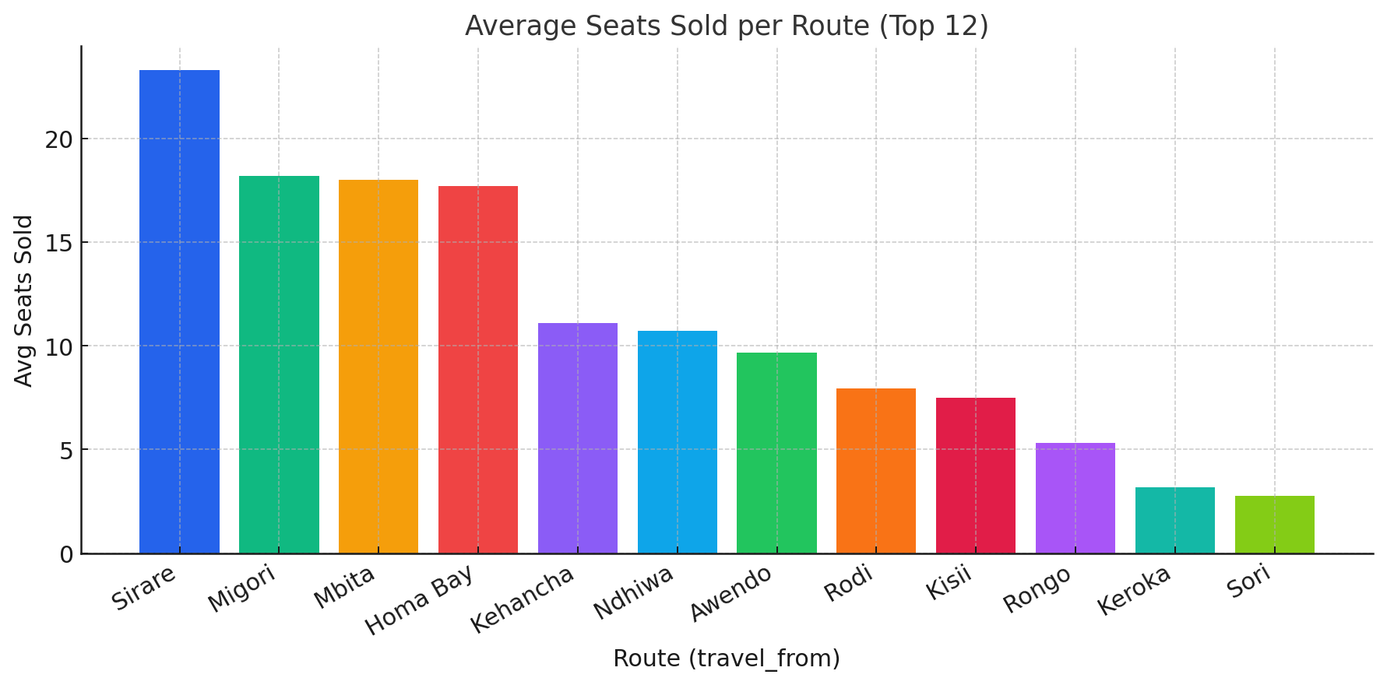
Average Seats Sold per Route (Top 12)
Identify consistently high-demand routes for scheduling.

Slide 4
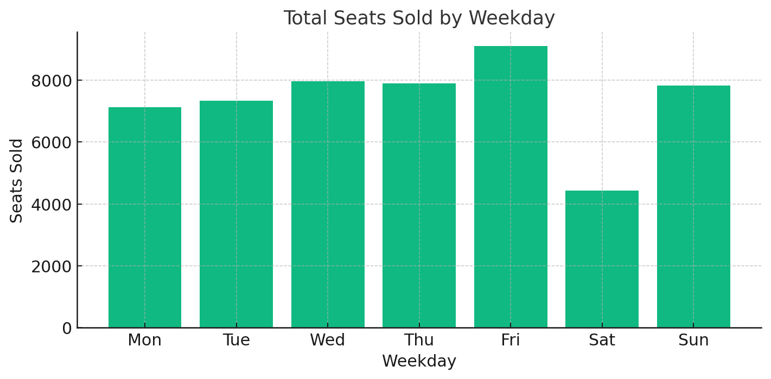
Total Seats Sold by Weekday
Plan staffing and fleet allocation for busy days.

Slide 5
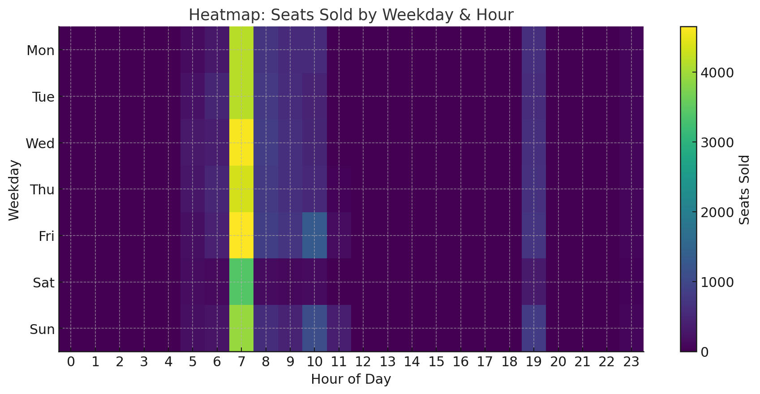
Heatmap: Seats Sold by Weekday & Hour
Peak demand times reveal optimal departure windows.

Slide 6
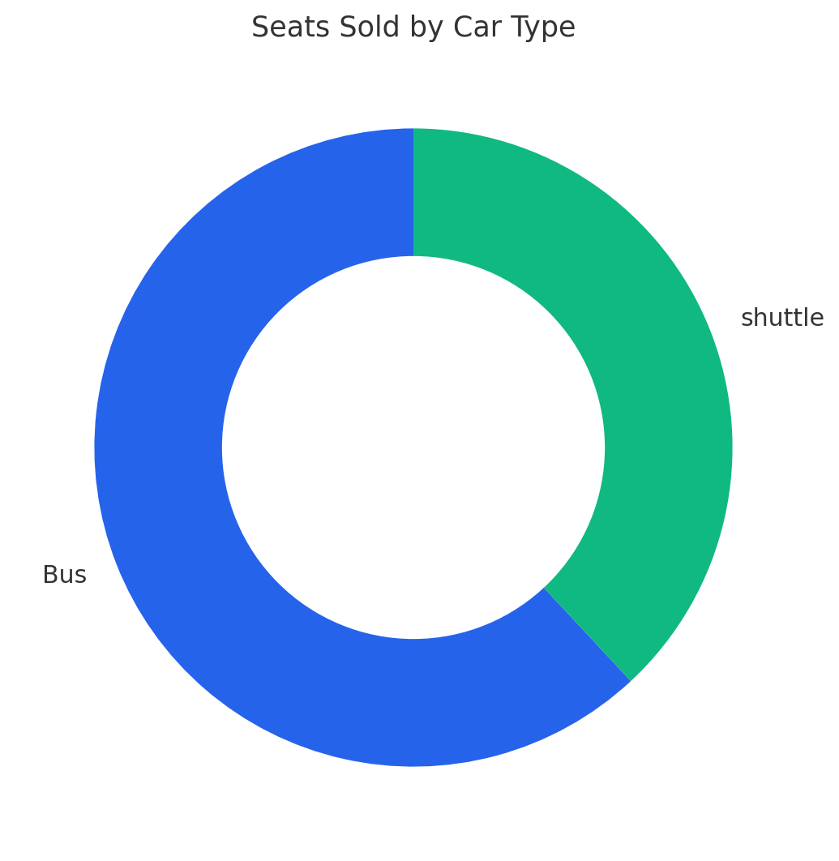
Seats Sold by Car Type
Vehicle mix by demand segment.

Slide 7
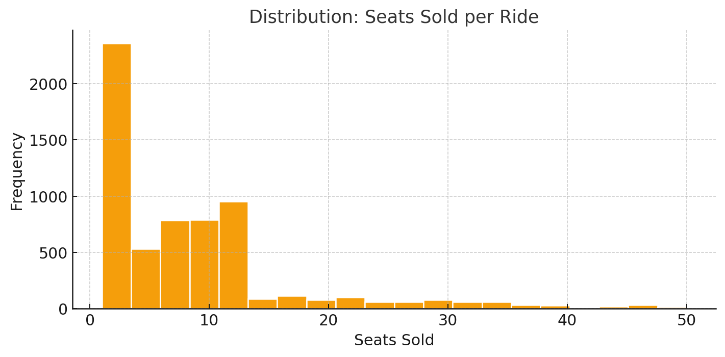
Distribution of Seats Sold per Ride
Typical occupancy profile per ride.

Slide 8
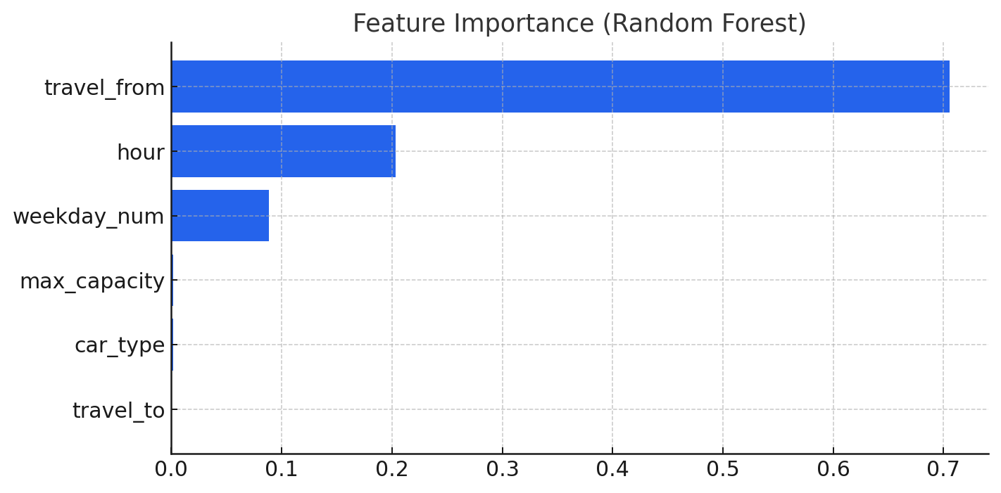
Feature Importance (Random Forest)
RMSE=7.01 | MAE=4.56 | R²=0.395

Slide 9
Key Insights & Recommendations
• Demand varies by weekday and hour; align departures with peak windows.
• Some routes drive higher average occupancy—prioritize capacity allocation.
• Vehicle type influences bookings; balance Bus vs. others based on route patterns.
• Model baseline: RMSE=7.01, R²=0.395; consider calendar/holiday features for
improvement.

