Slide 1
Problem 1:-

Slide 2
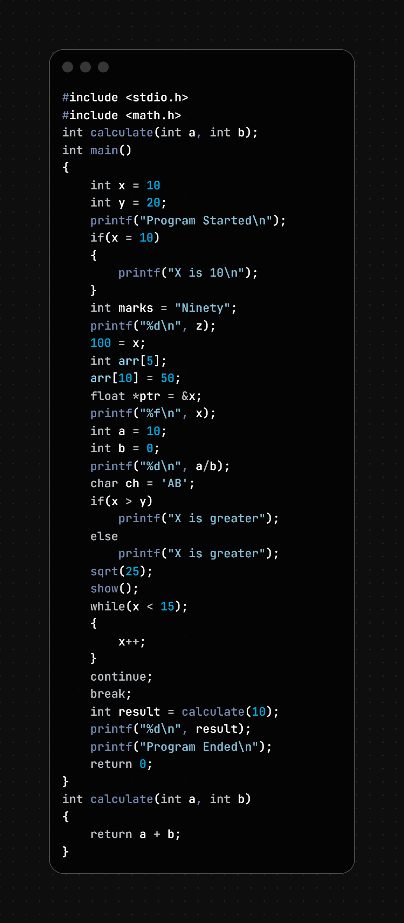
Line No. | Error | Type | Correction
8 | Missing ; after int x = 10 | Syntax Error | int x = 10;
13 | if(x = 10) uses assignment instead of comparison | Logical Error | if(x == 10)
18 | Assigning string to integer variable | Semantic Error | int marks = 90; or char marks[] = "Ninety";
20 | Variable z not declared | Semantic Error | Declare z before use, e.g., int z = 0;
22 | Cannot assign value to constant (100 = x) | Syntax/Semantic Error | x = 100;
26 | Array index out of bounds (arr[10]) | Logical Error | Use valid index 0 to 4, e.g., arr[4] = 50;
28 | float *ptr = &x; type mismatch | Semantic Error | int *ptr = &x;
30 | %f used for integer variable x | Format Specifier Error | printf("%d\n", x);
35 | Division by zero (a/b) | Runtime Error | Ensure b != 0 before division
37 | Multi-character constant 'AB' assigned to char | Semantic Error | char ch = 'A';
42 | Both if and else print same message | Logical Error | Change else message to printf("Y is greater");
45 | Return value of sqrt(25) ignored | Logical Warning | double r = sqrt(25);
47 | Function show() not declared/defined | Semantic Error | Define show() or remove call
49 | Extra semicolon after while(x < 15) | Logical Error | while(x < 15)
55 | continue used outside loop | Syntax Error | Place inside loop
57 | break used outside loop/switch | Syntax Error | Place inside loop/switch
59 | Function call has one argument but function needs two | Semantic Error | calculate(10, 20)
68 | Function prototype expects two arguments; call mismatch | Semantic Error | Pass two arguments
5 & 67 | Prototype and definition are correct, but call is incorrect | Semantic Error | int result = calculate(10,20);

Slide 3
Problem 2 :-

Slide 4
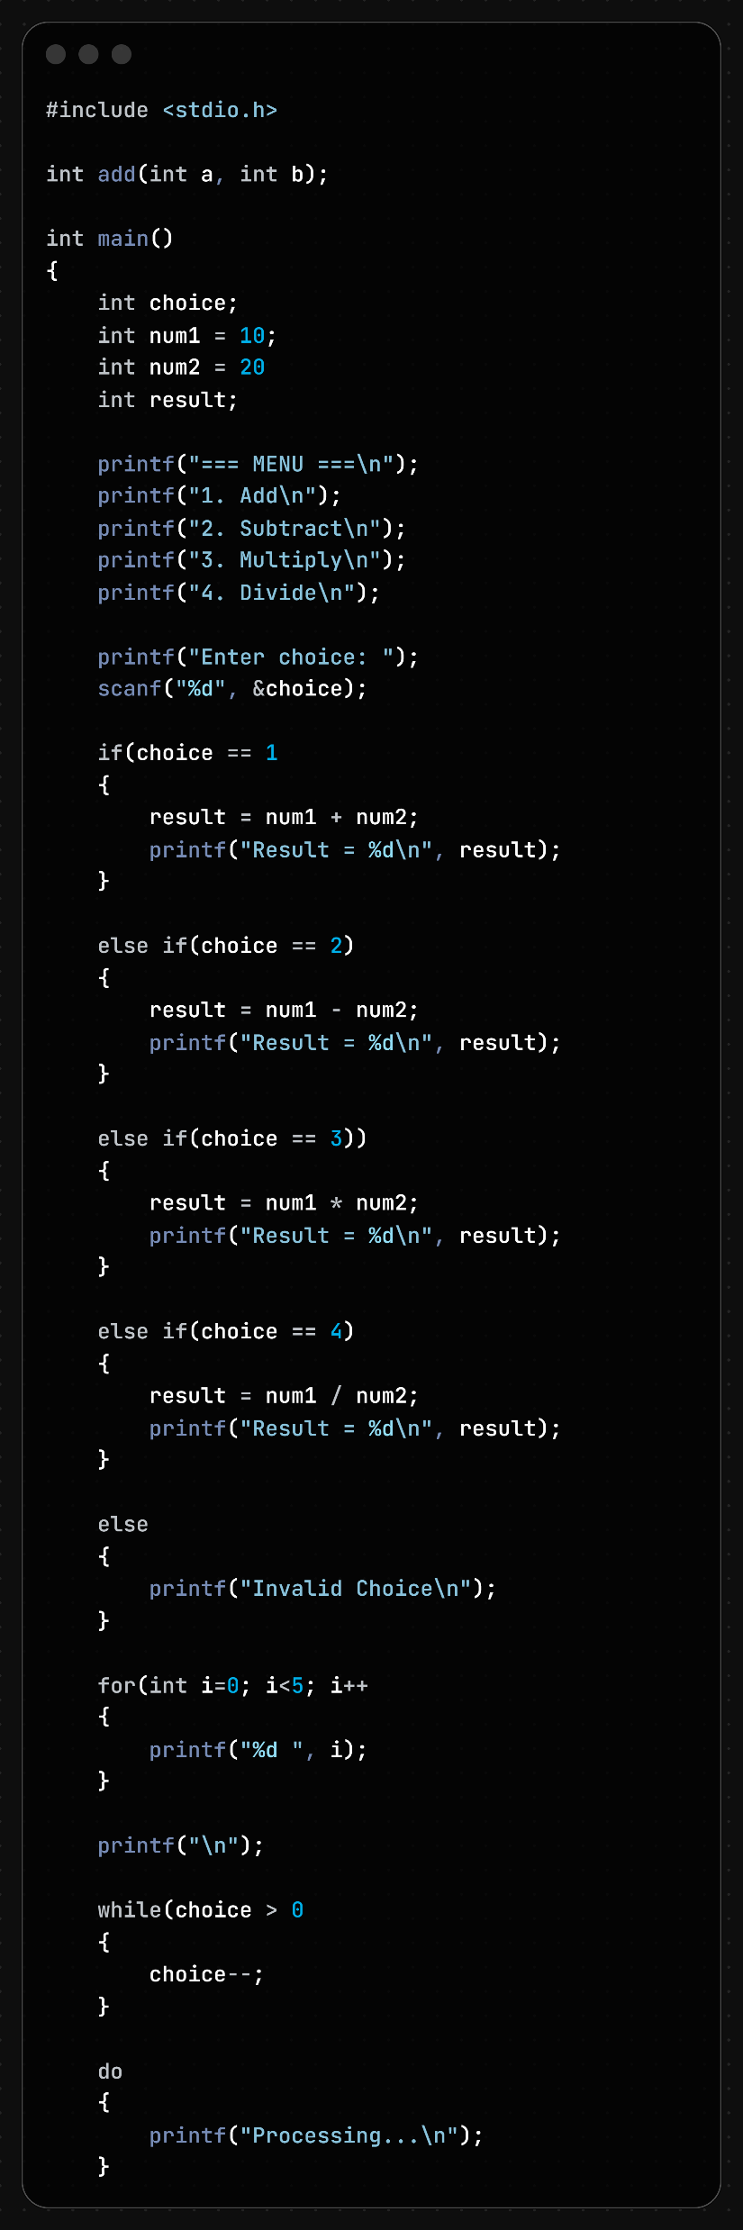
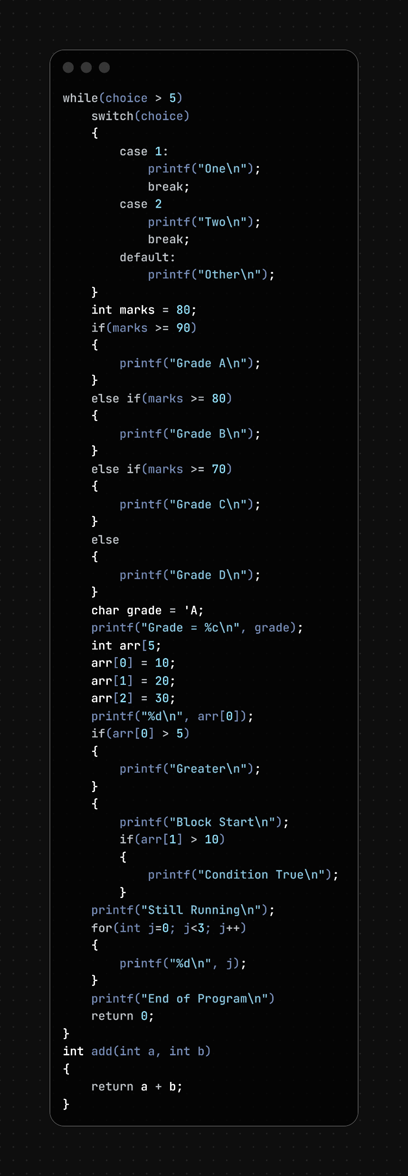

Slide 5
Line No. | Type of Error | Error in Code | Correction
8 | Syntax | int num2 = 20 | int num2 = 20;
18 | Syntax | if(choice == 1 | if(choice == 1)
29 | Syntax | else if(choice == 3)) | else if(choice == 3)
44 | Syntax | for(int i=0; i<5; i++ | for(int i=0; i<5; i++)
50 | Syntax | while(choice > 0 | while(choice > 0)
59 | Syntax | while(choice > 5) | while(choice > 5);
68 | Syntax | case 2 | case 2:
90 | Syntax | char grade = 'A; | char grade = 'A';
94 | Syntax | int arr[5; | int arr[5];
105 | Block/Brace | Opening { not closed | Add } before line 122
122 | Syntax | printf("End of Program\n") | printf("End of Program\n");
37 | Logical | result = num1 / num2; performs integer division | Use float and cast if decimal result is needed
1 & 126 | Semantic | add() function declared and defined but never used | Call add() or remove it

Slide 6
Problem 3:-

Slide 7
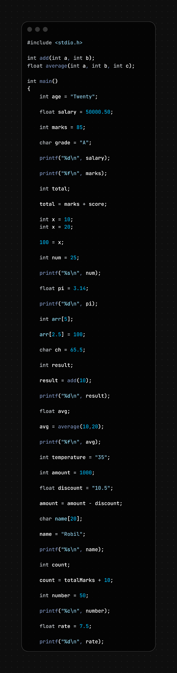
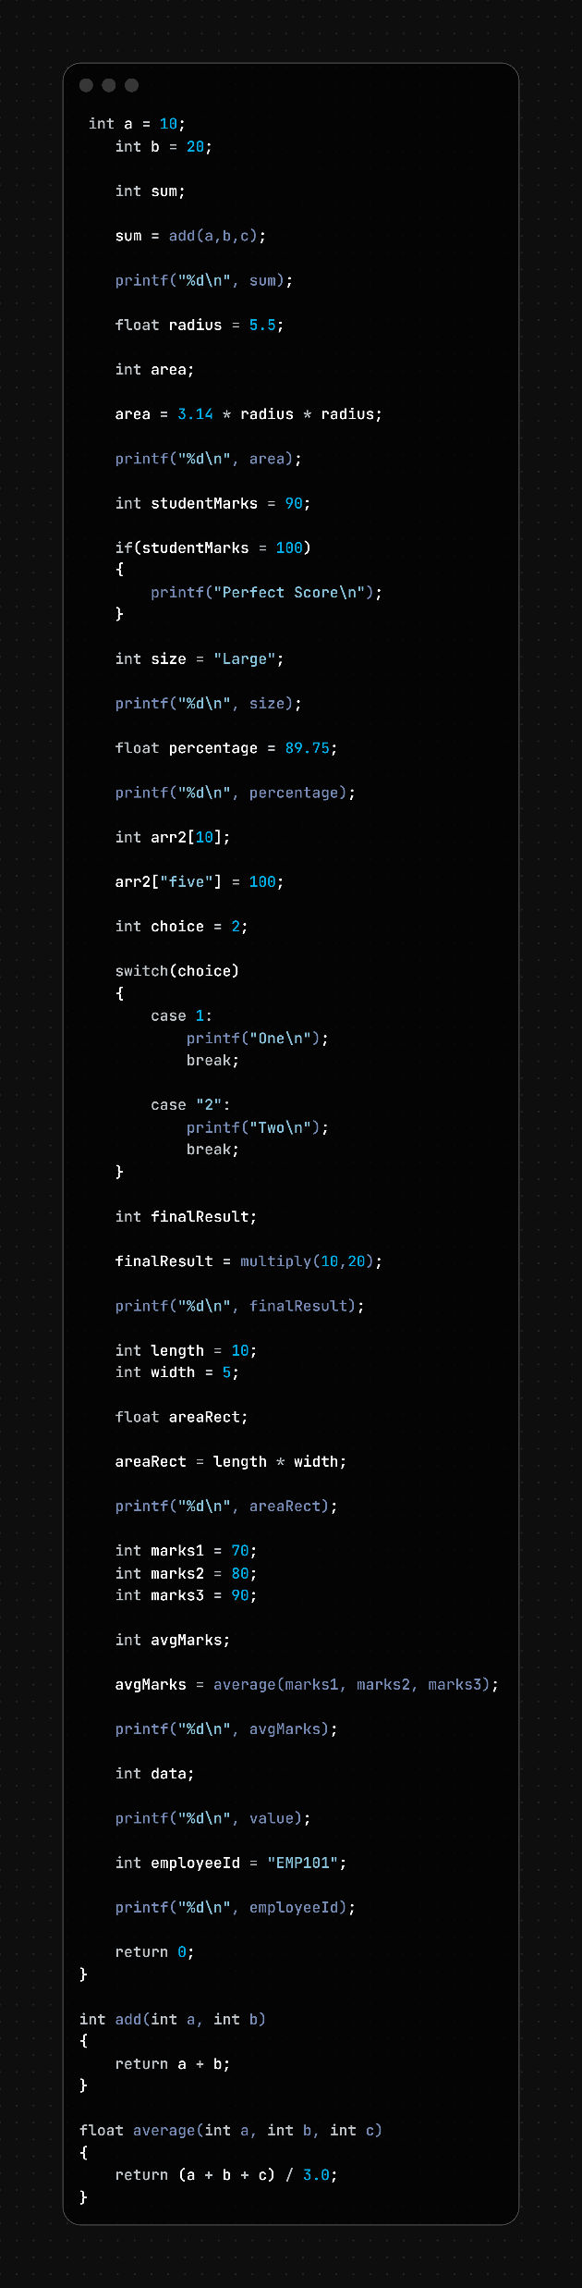

Slide 8
LINE NO. | ERROR TYPE | ERROR | CORRECTION
8 | Semantic | int age = "Twenty"; | int age = 20;
14 | Semantic | char grade = "A"; | char grade = 'A';
16 | Format Specifier | printf("%d\n", salary); | printf("%f\n", salary);
18 | Format Specifier | printf("%f\n", marks); | printf("%d\n", marks);
22 | Semantic | score not declared | Declare score or use an existing variable
25 | Syntax | Duplicate declaration of x | Rename variable or write x = 20;
27 | Syntax | 100 = x; | x = 100;
31 | Format Specifier | printf("%s\n", num); | printf("%d\n", num);
35 | Format Specifier | printf("%d\n", pi); | printf("%f\n", pi);
39 | Semantic | arr[2.5] uses float index | arr[2] = 100;
45 | Function Call | add(10) missing argument | add(10, 20);
51 | Function Call | average(10,20) missing argument | average(10,20,30);
55 | Semantic | int temperature = "35"; | int temperature = 35;
59 | Semantic | float discount = "10.5"; | float discount = 10.5;
65 | Syntax | name = "Robil"; for character array | strcpy(name,"Robil");
69 | Semantic | totalMarks not declared | Declare totalMarks before use
79 | Format Specifier | printf("%d\n", rate); | printf("%f\n", rate);
86 | Semantic | c not declared in add(a,b,c) | Use add(a,b)
100 | Logical | if(studentMarks = 100) uses assignment | if(studentMarks == 100)
106 | Semantic | int size = "Large"; | char size[] = "Large";
110 | Format Specifier | printf("%d\n", percentage); | printf("%f\n", percentage);
114 | Semantic | arr2["five"] = 100; invalid index | arr2[5] = 100;
122 | Syntax | case "2": uses string | case 2:
129 | Function Definition | multiply() not declared/defined | Create prototype and function definition
140 | Format Specifier | printf("%d\n", areaRect); | printf("%f\n", areaRect);
148 | Data Type | avgMarks declared as int | float avgMarks;
152 | Format Specifier | printf("%d\n", avgMarks); | printf("%f\n", avgMarks);
156 | Semantic | value not declared | Declare value before use
158 | Semantic | int employeeId = "EMP101"; | char employeeId[] = "EMP101";
160 | Format Specifier | printf("%d\n", employeeId); | printf("%s\n", employeeId);

Slide 9
Problem 4 :-

Slide 10
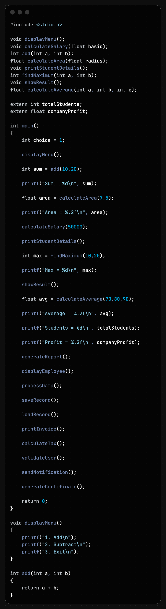
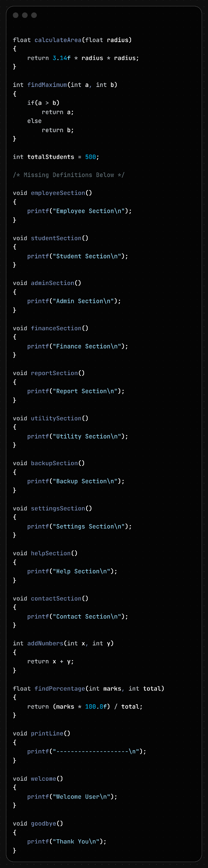

Slide 11
Line No. | Error Type | Error | Correction
7 | Semantic / Linker | Function showResult() declared but not defined. | Define showResult() or remove its call and declaration.
12 | Linker | extern float companyProfit; declared but no definition found. | Add float companyProfit = value; globally.
43 | Semantic / Linker | generateReport(); called without declaration and definition. | Add prototype void generateReport(); and define the function.
45 | Semantic / Linker | displayEmployee(); called without declaration and definition. | Add prototype and function definition.
47 | Semantic / Linker | processData(); called without declaration and definition. | Add prototype and function definition.
49 | Semantic / Linker | saveRecord(); called without declaration and definition. | Add prototype and function definition.
51 | Semantic / Linker | loadRecord(); called without declaration and definition. | Add prototype and function definition.
53 | Semantic / Linker | printInvoice(); called without declaration and definition. | Add prototype and function definition.
55 | Semantic / Linker | calculateTax(); called without declaration and definition. | Add prototype and function definition.
57 | Semantic / Linker | validateUser(); called without declaration and definition. | Add prototype and function definition.

Slide 12
Line No. | Error Type | Error Description | Correction
59 | Semantic / Linker | sendNotification(); called without declaration and definition. | Add function prototype and function definition.
61 | Semantic / Linker | generateCertificate(); called without declaration and definition. | Add function prototype and function definition.
25 | Linker | calculateSalary() declared and called but not defined. | Define void calculateSalary(float basic) function.
27 | Linker | printStudentDetails() declared and called but not defined. | Define void printStudentDetails() function.
31 | Linker | showResult() called but function body is missing. | Define void showResult() function.
35 | Linker | calculateAverage() declared and called but not defined. | Define float calculateAverage(int a, int b, int c) function.
10 | Warning | Variable choice declared but never used. | Use the variable in the program or remove it.
83–141 | Logical | Many functions (employeeSection(), studentSection(), adminSection(), etc.) are defined but never called. | Call these functions where required or remove unused code.
145 | Logical | addNumbers() duplicates the functionality of add(). | Reuse add() function or remove addNumbers().

Slide 13
Problem 5 :-

Slide 14
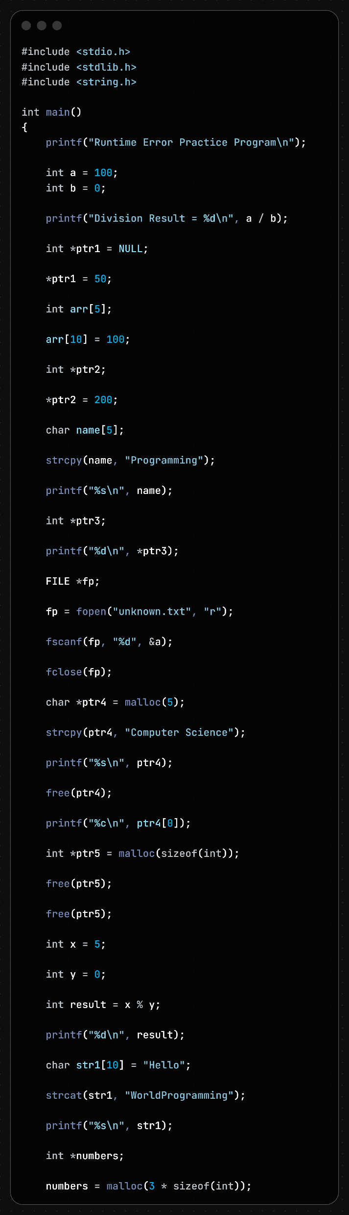
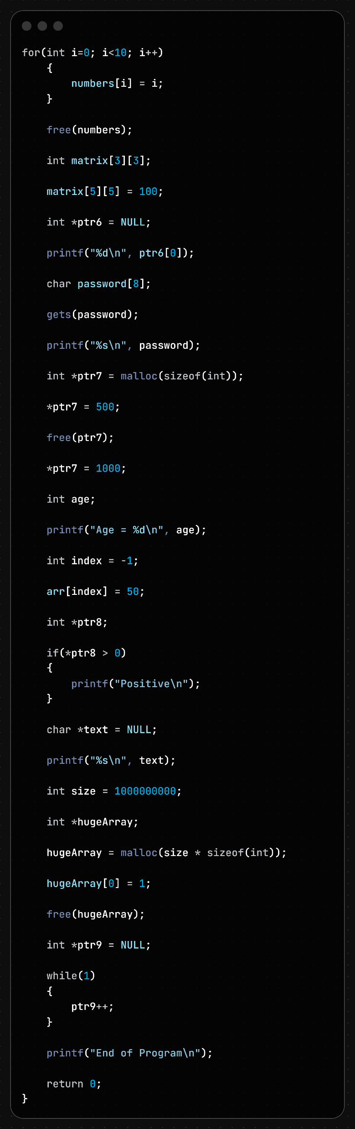

Slide 15
Line No. | Error Type | Error Description | Correction
10 | Runtime Error | Division by zero: a / b where b = 0 | Check b != 0 before division.
14 | Runtime Error | NULL pointer dereference: *ptr1 = 50; | Allocate memory or ensure pointer is valid before dereferencing.
18 | Runtime Error | Array index out of bounds: arr[10] for array size 5 | Use indices 0–4 only.
22 | Runtime Error | Uninitialized pointer dereference: *ptr2 = 200; | Initialize pointer using malloc() or point to a valid variable.
26 | Runtime Error | Buffer overflow: copying "Programming" into name[5] | Increase array size or use safe copy functions.
32 | Runtime Error | Reading uninitialized pointer: *ptr3 | Initialize pointer before use.
38 | Runtime Error | fscanf() on NULL file pointer if file doesn't exist | Check if(fp != NULL) before reading.
44 | Runtime Error | Buffer overflow: copying "Computer Science" into 5-byte allocation | Allocate sufficient memory using malloc(strlen("Computer Science")+1).
50 | Runtime Error | Use-after-free: accessing ptr4[0] after free(ptr4) | Do not access memory after freeing it.
56 | Runtime Error | Modulo by zero: x % y where y = 0 | Check y != 0 before modulus operation.
62 | Runtime Error | Buffer overflow: strcat() exceeds size of str1[10] | Ensure destination array is large enough.

Slide 16
Line No. | Error Type | Error Description | Correction
72 | Runtime Error | Heap buffer overflow: writing 10 elements into space for 3 | Allocate enough memory or limit the loop to 3 elements.
78 | Runtime Error | Array index out of bounds: matrix[5][5] in a 3×3 array | Use indices 0–2 only.
82 | Runtime Error | NULL pointer dereference: ptr6[0] | Allocate memory or check for NULL before access.
86 | Security / Runtime Error | gets() causes buffer overflow | Use fgets() instead.
96 | Runtime Error | Use-after-free: *ptr7 = 1000; after free(ptr7) | Do not access freed memory.
100 | Runtime Error | Uninitialized variable age printed | Initialize age before use.
104 | Runtime Error | Negative array index: arr[-1] | Use valid index range 0–4.
108 | Runtime Error | Dereferencing uninitialized pointer in condition | Initialize ptr8 before use.
116 | Runtime Error | Possible NULL pointer dereference if malloc() fails | Check if(hugeArray != NULL) before use.
128 | Logical / Runtime Error | Infinite loop: while(1) | Add a termination condition.
130 | Logical Error | Pointer continuously incremented, causing invalid memory access | Avoid incrementing a NULL pointer indefinitely.

Slide 17
Problem 6:-

Slide 18
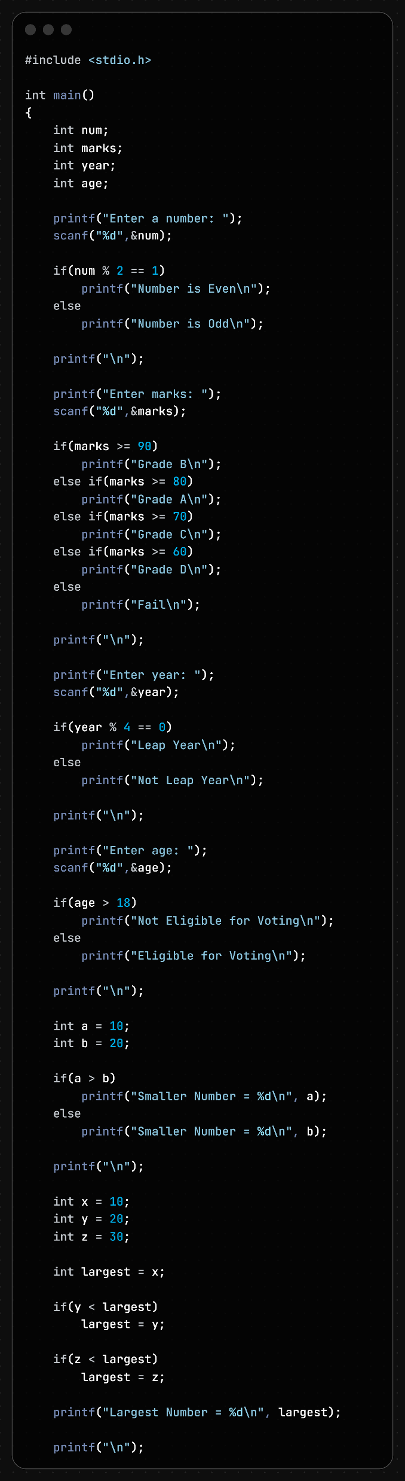
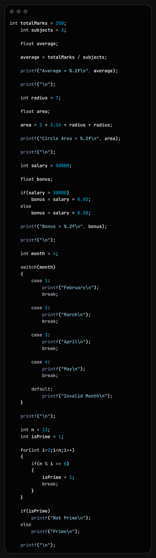
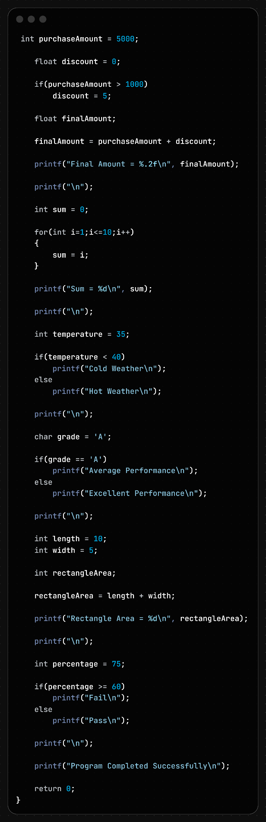

Slide 19
Line No. | Error Type | Error Description | Correction
12 | Logical Error | Condition num % 2 == 1 identifies odd numbers, but prints "Number is Even". | Change message to "Number is Odd" or use num % 2 == 0.
14 | Logical Error | Even numbers are printed as "Number is Odd". | Print "Number is Even" in the else block.
22 | Logical Error | Marks ≥ 90 should receive Grade A, not Grade B. | Change to printf("Grade A\n");.
24 | Logical Error | Marks between 80–89 should receive Grade B, not Grade A. | Change to printf("Grade B\n");.
36 | Logical Error | Leap year check is incomplete (year % 4 == 0). | Use `(year % 400 == 0)
45 | Logical Error | Age > 18 prints "Not Eligible for Voting". | Print "Eligible for Voting".
47 | Logical Error | Age ≤ 18 prints "Eligible for Voting". | Print "Not Eligible for Voting".
55 | Logical Error | Larger number is printed as "Smaller Number". | Print the actual smaller number.
57 | Logical Error | Larger number is printed as "Smaller Number". | Print a when a < b, otherwise print b.
67 | Logical Error | Logic finds the smallest number instead of the largest. | Use if(y > largest) and if(z > largest).
70 | Logical Error | Logic updates with smaller value instead of larger value. | Use if(z > largest) largest = z;.
80 | Logical Error | Integer division occurs before assignment to float. | Use average = (float)totalMarks / subjects;.

Slide 20
Line No. | Error Type | Error Description | Correction
90 | Logical Error | Formula used is 2πr² instead of area πr². | Use area = 3.14 * radius * radius;.
100 | Logical Error | Bonus for salary > 30000 is only 2%. | Use 0.20 (20%) if intended.
102 | Logical Error | Bonus for lower salary is 20%, which may be reversed. | Adjust logic as required.
112 | Logical Error | Month 1 prints February instead of January. | Change output to "January".
116 | Logical Error | Month 2 prints March instead of February. | Change output to "February".
120 | Logical Error | Month 3 prints April instead of March. | Change output to "March".
124 | Logical Error | Month 4 prints May instead of April. | Change output to "April".
139 | Logical Error | When a factor is found, isPrime remains 1. | Set isPrime = 0;.
145 | Logical Error | Prime number logic is reversed. | If isPrime == 1, print "Prime".
147 | Logical Error | Non-prime number logic is reversed. | Print "Not Prime" when isPrime == 0.

Slide 21
Line No. | Error Type | Error Description | Correction
158 | Logical Error | Discount amount is added instead of subtracted. | Use finalAmount = purchaseAmount - discount;.
170 | Logical Error | Sum is overwritten each iteration instead of accumulated. | Use sum += i;.
180 | Logical Error | Temperature 35°C is printed as "Cold Weather". | Reverse the messages or condition.
190 | Logical Error | Grade A prints "Average Performance". | Print "Excellent Performance".
192 | Logical Error | Other grades print "Excellent Performance". | Print "Average Performance" or another suitable message.
202 | Logical Error | Rectangle area calculated using addition. | Use rectangleArea = length * width;.
210 | Logical Error | Percentage ≥ 60 prints "Fail". | Print "Pass".
212 | Logical Error | Percentage < 60 prints "Pass". | Print "Fail".

Slide 22
Problem 7:-

Slide 23
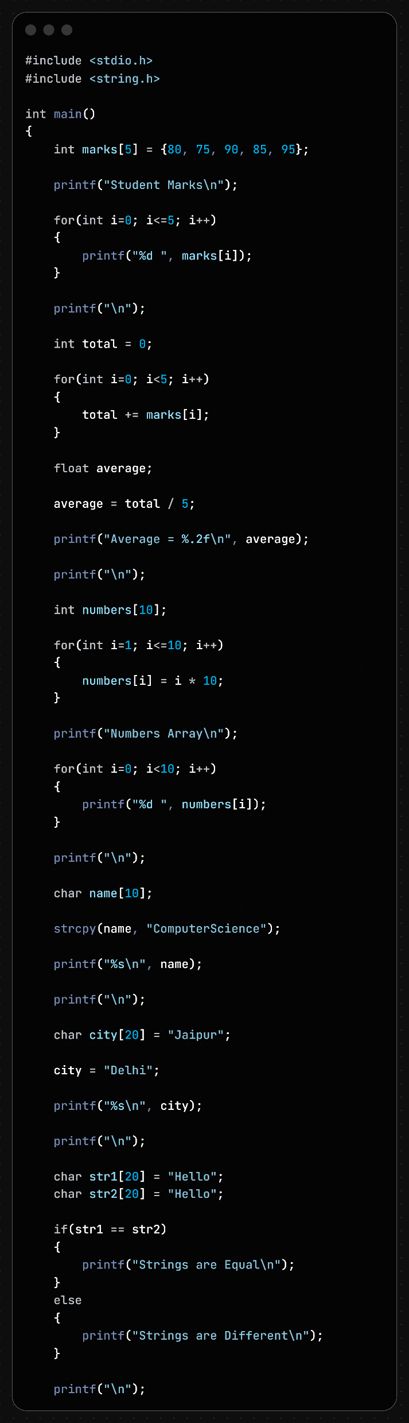
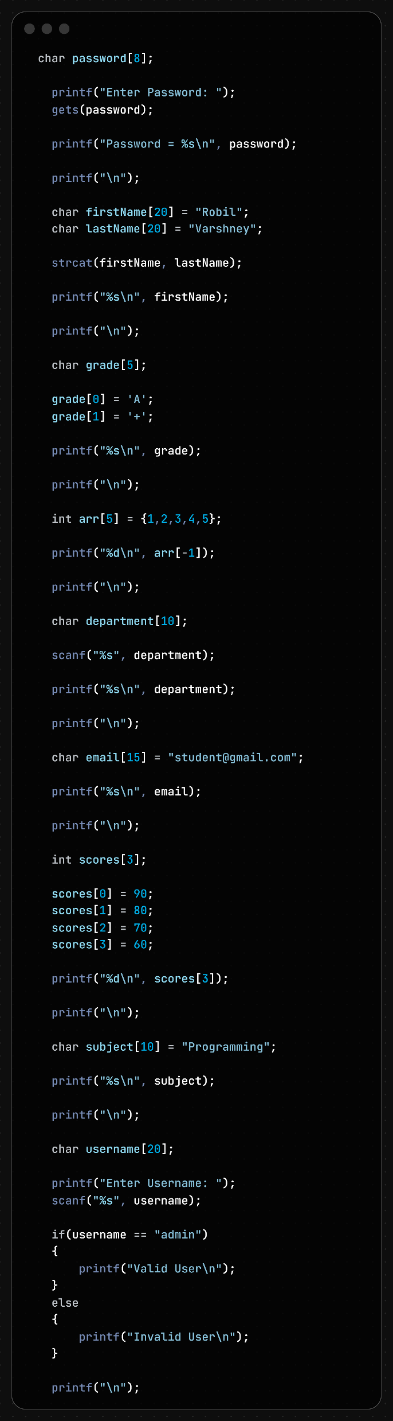

Slide 24
Line No. | Error Type | Error Description | Correction
9 | Runtime Error | Loop condition i <= 5 accesses marks[5], which is out of bounds. | Use i < 5.
24 | Logical Error | Integer division occurs before storing in float. | Use average = (float)total / 5;.
32 | Runtime Error | Loop writes to numbers[10], which is out of bounds. | Use for(i=0; i<10; i++).
46 | Runtime Error | Buffer overflow: "ComputerScience" exceeds name[10]. | Increase array size or use a shorter string.
54 | Syntax Error | Cannot assign a string directly to a character array: city = "Delhi"; | Use strcpy(city, "Delhi");.
62 | Logical Error | Strings compared using == instead of strcmp(). | Use strcmp(str1, str2) == 0.
75 | Security / Runtime Error | gets() is unsafe and may cause buffer overflow. | Use fgets().
84 | Runtime Error | Possible buffer overflow in strcat(firstName, lastName). | Ensure destination array is large enough.
94 | Runtime Error | Character array grade is not null-terminated before printing as string. | Add grade[2] = '\0';.
102 | Runtime Error | Negative array index: arr[-1]. | Use valid indices 0–4.

Slide 25
Line No. | Error Type | Error Description | Correction
110 | Runtime Error | scanf("%s", department) may overflow input buffer. | Use width specifier: scanf("%9s", department);.
116 | Runtime Error | "student@gmail.com" exceeds size of email[15]. | Increase array size.
128 | Runtime Error | scores[3] is out of bounds for array size 3. | Use indices 0–2 only.
138 | Runtime Error | "Programming" exceeds size of subject[10]. | Increase array size.
146 | Logical Error | String comparison using == instead of strcmp(). | Use strcmp(username, "admin") == 0.
158 | Runtime Error | "987654321012" exceeds size of mobile[10]. | Increase array size.
168 | Runtime Error | Loop condition i <= 5 accesses attendance[5]. | Use i < 5.
178 | Runtime Error | course[20] accesses memory beyond valid range. | Use index 0–19 only.
190 | Runtime Error | college string is not null-terminated. | Add college[5] = '\0';.
210 | Runtime Error | "IT-A" requires 5 bytes including '\0', but section[3] is too small. | Use char section[5] = "IT-A";.

Slide 26
Problem 8:-

Slide 27
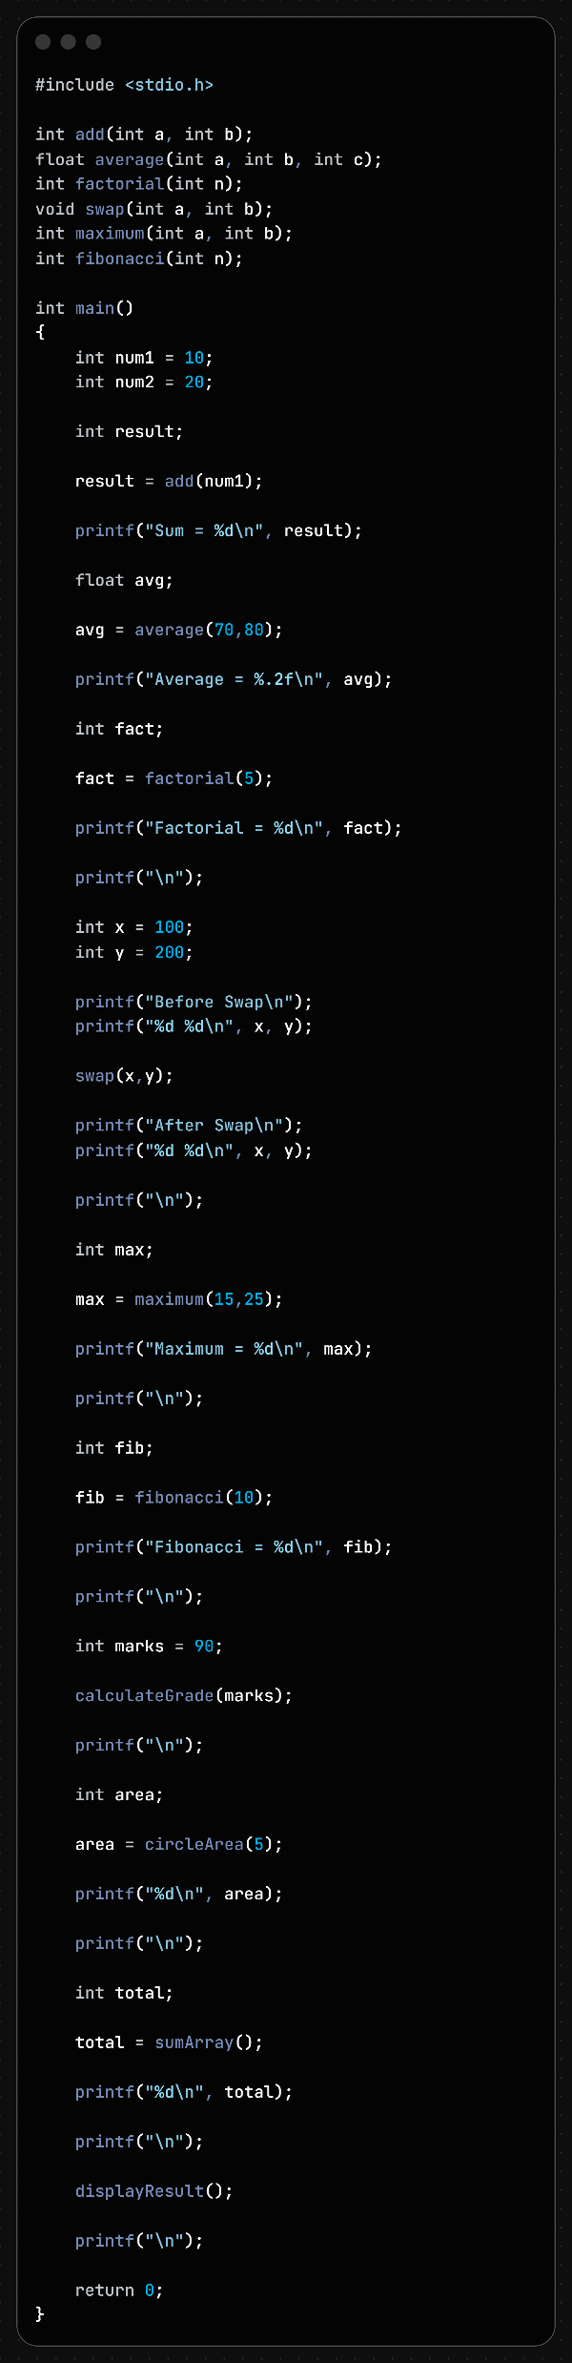
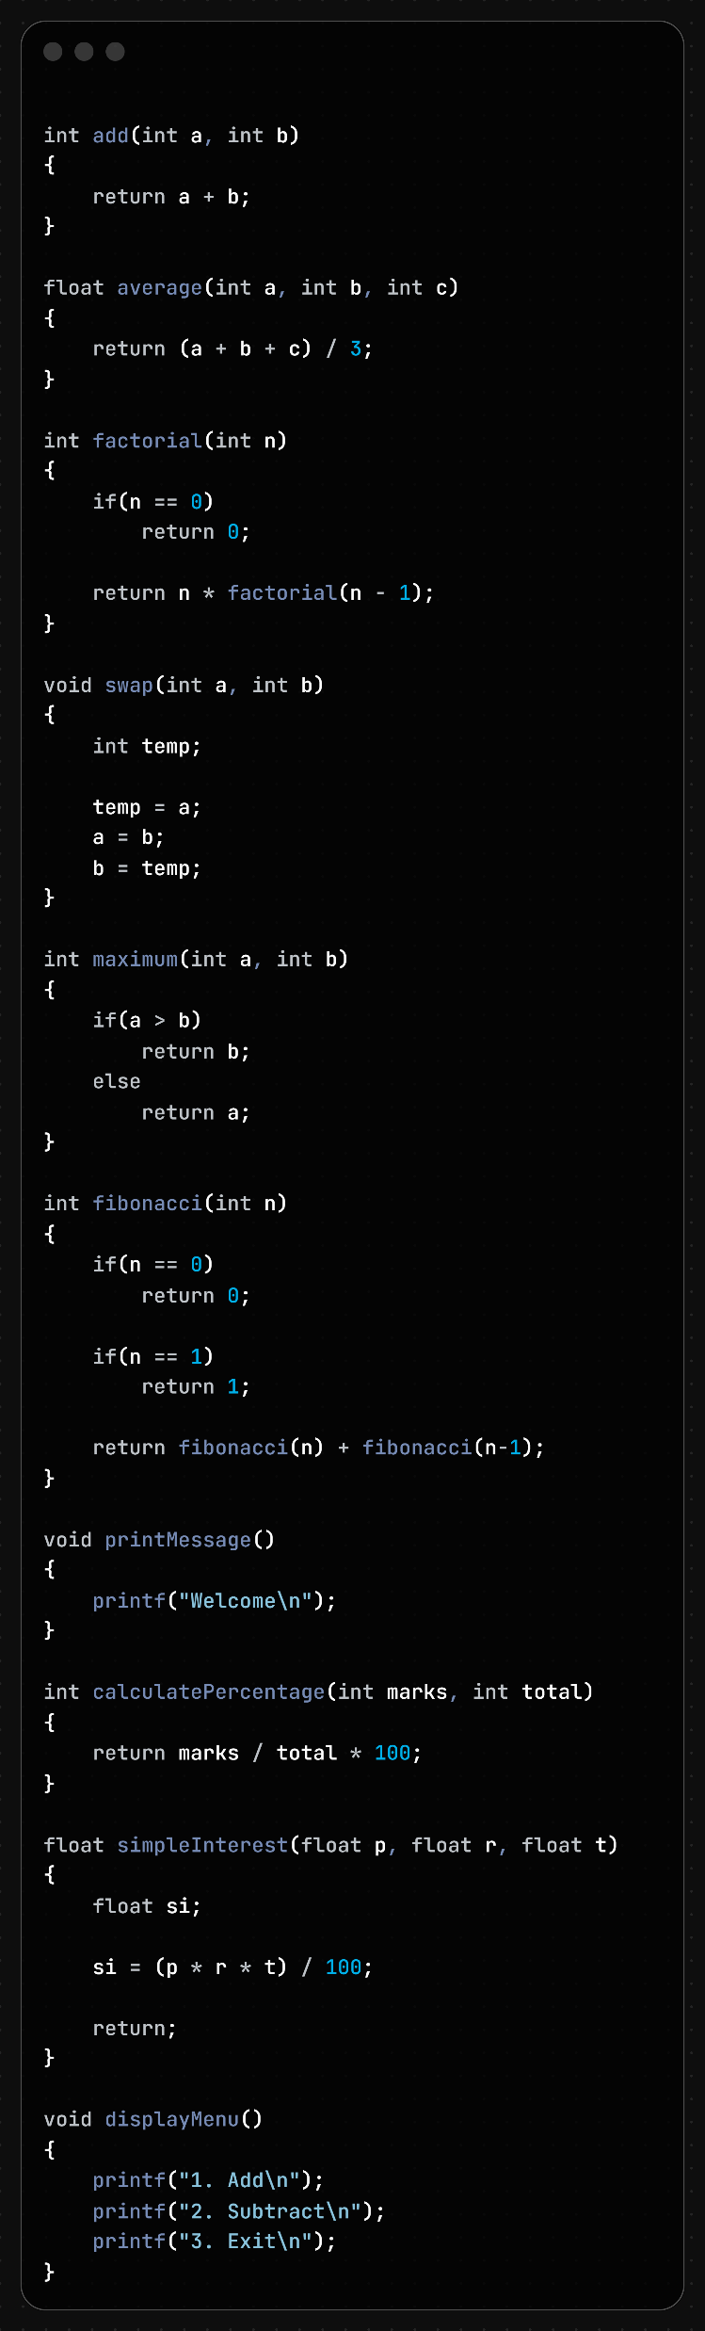
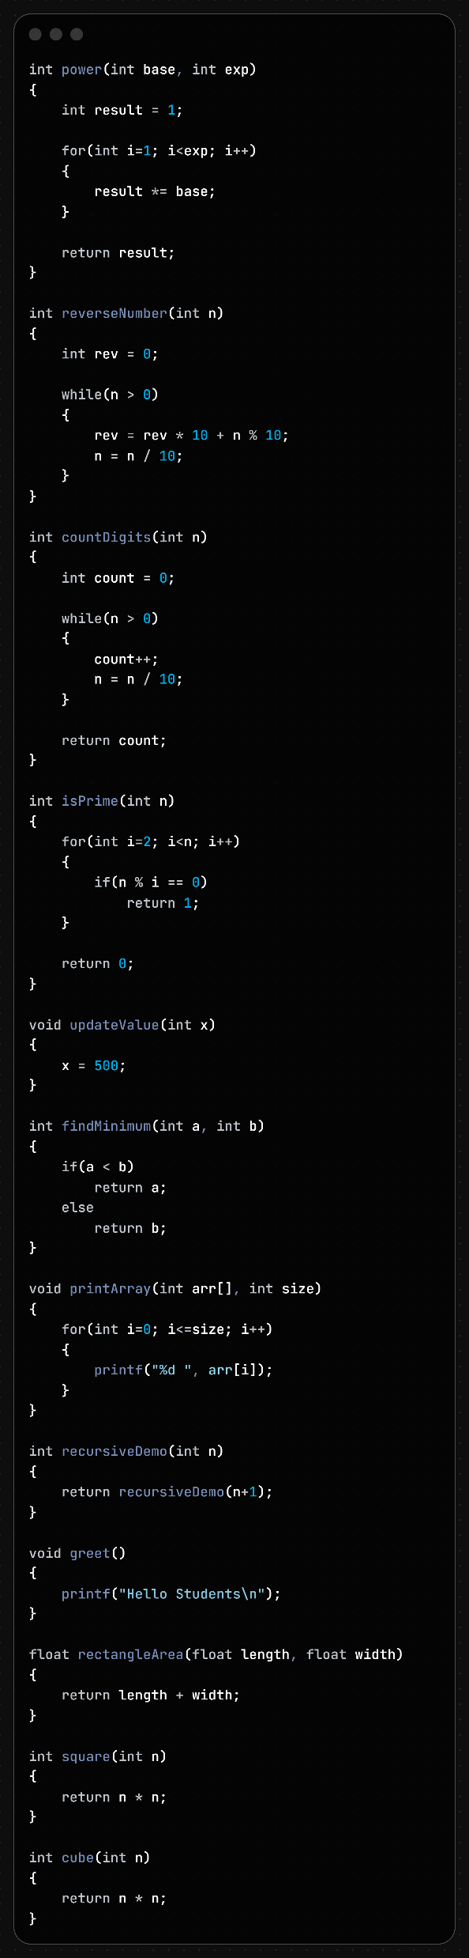

Slide 28
Line No. | Error Type | Error Description | Correction
15 | Syntax / Semantic Error | add(num1) called with only one argument, but function requires two arguments. | Use add(num1, num2);.
21 | Syntax / Semantic Error | average(70,80) called with only two arguments, but function requires three arguments. | Use average(70,80,90);.
61 | Semantic / Linker Error | calculateGrade() called without declaration and definition. | Add function prototype and definition.
67 | Semantic / Linker Error | circleArea() called without declaration and definition. | Add function prototype and definition.
75 | Semantic / Linker Error | sumArray() called without declaration and definition. | Add function prototype and definition.
81 | Semantic / Linker Error | displayResult() called without declaration and definition. | Add function prototype and definition.

Slide 29
Line No. | Error Type | Error Description | Correction
95 | Logical Error | Base case of factorial returns 0; factorial of 0 should be 1. | Change return 0; to return 1;.
112 | Logical Error | maximum() returns the smaller value instead of the larger value. | Return a if a > b, else return b.
125 | Runtime / Logical Error | Fibonacci recursion uses fibonacci(n) causing infinite recursion. | Use return fibonacci(n-1) + fibonacci(n-2);.
138 | Logical Error | Percentage formula performs integer division before multiplication. | Use (marks * 100) / total.
148 | Syntax Error | Non-void function simpleInterest() uses return; without a value. | Use return si;.
163 | Logical Error | Power calculation loop runs one time less than required. | Use for(int i=0; i<exp; i++) or i<=exp.
181 | Semantic Warning | reverseNumber() does not return any value. | Add return rev;.
197 | Logical Error | isPrime() returns 1 when number is not prime. | Return 0 when factor found, otherwise return 1.

Slide 30
Line No. | Error Type | Error Description | Correction
220 | Runtime Error | Loop condition i <= size accesses array out of bounds. | Use i < size.
227 | Runtime Error | Infinite recursion in recursiveDemo(). | Add a terminating base condition.
237 | Logical Error | Rectangle area calculated using addition instead of multiplication. | Use length * width.
247 | Logical Error | cube() calculates square instead of cube. | Use return n * n * n;.
191 | Logical Issue | updateValue() modifies local copy only; original variable remains unchanged. | Pass pointer (int *x) and modify *x.
131 | Warning | printMessage() is defined but never called. | Call the function or remove it.
152 | Warning | displayMenu() is defined but never called. | Call the function or remove it.
243 | Warning | square() is defined but never called. | Call the function or remove it.

Slide 31
Problem 9:-

Slide 32
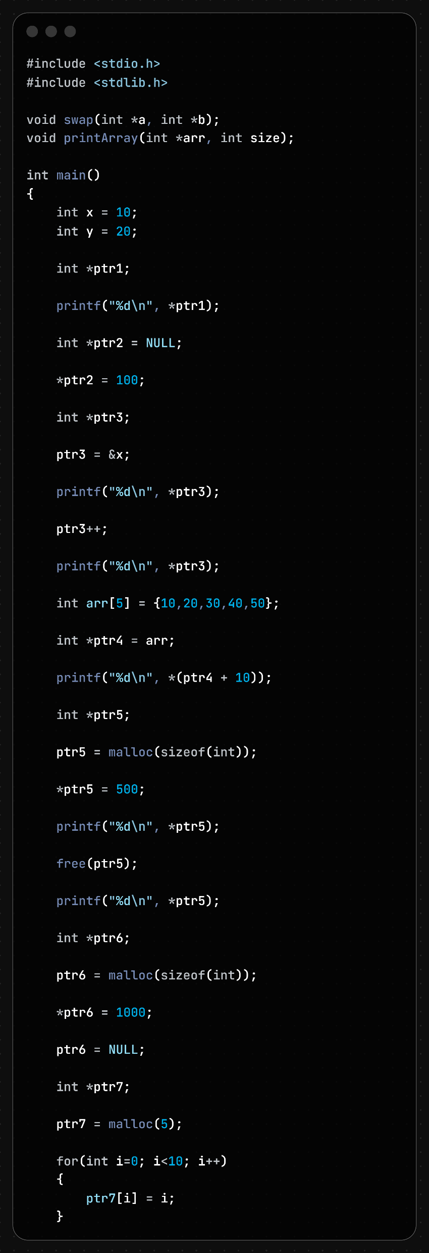
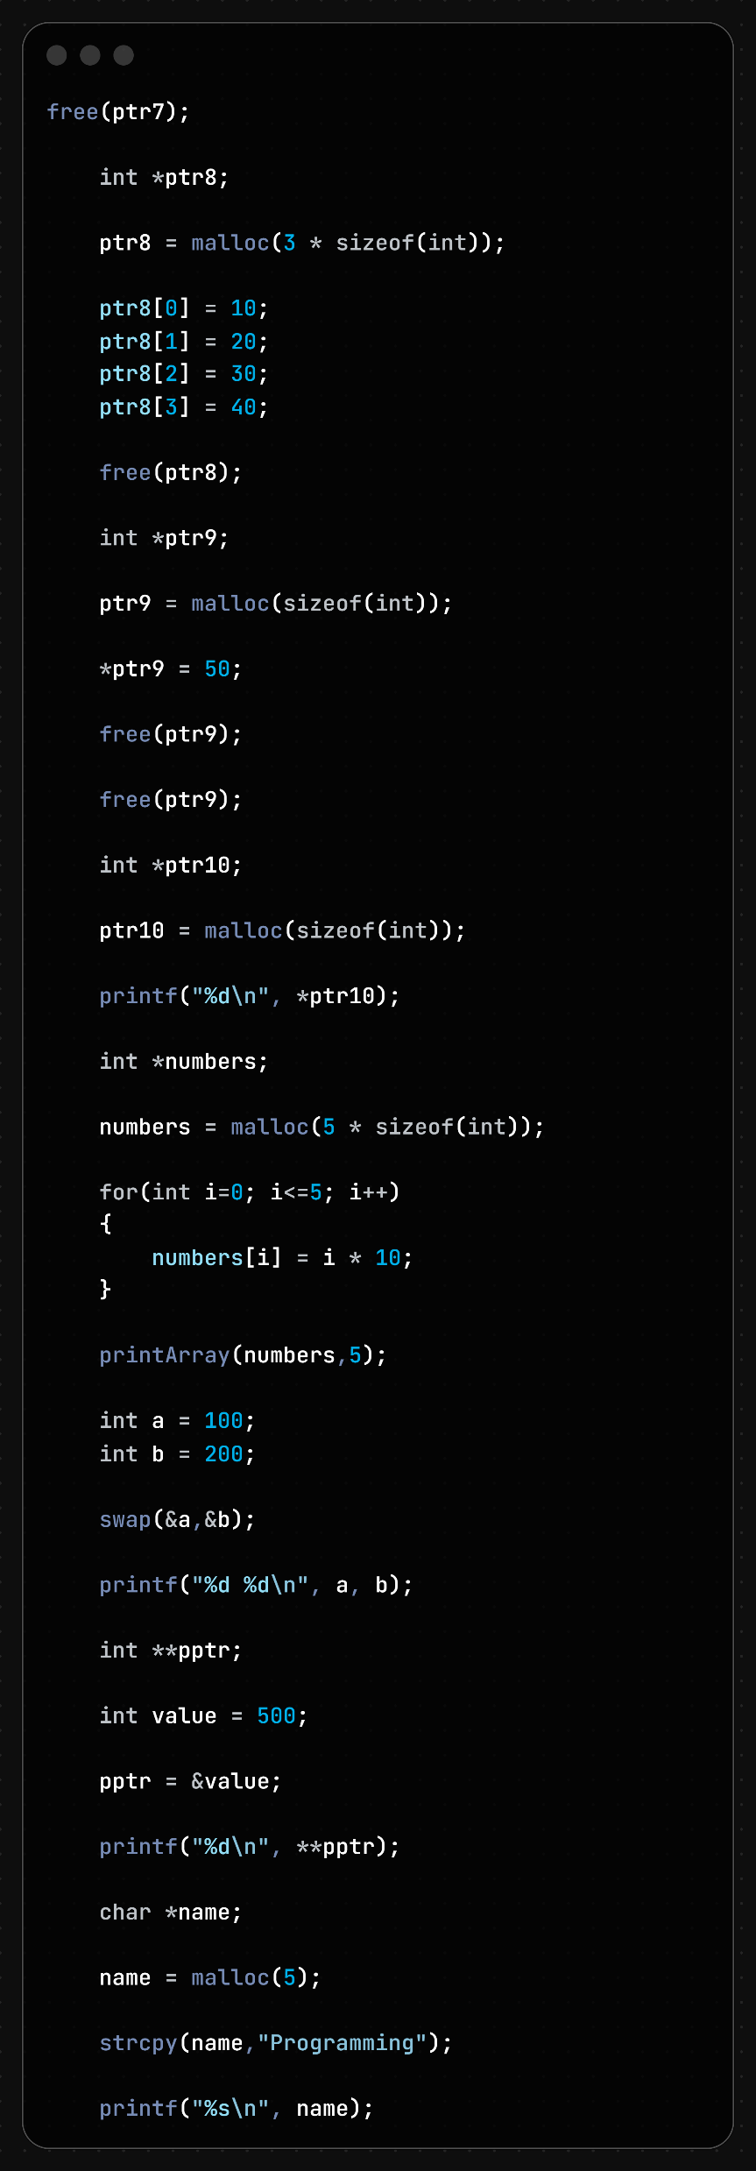
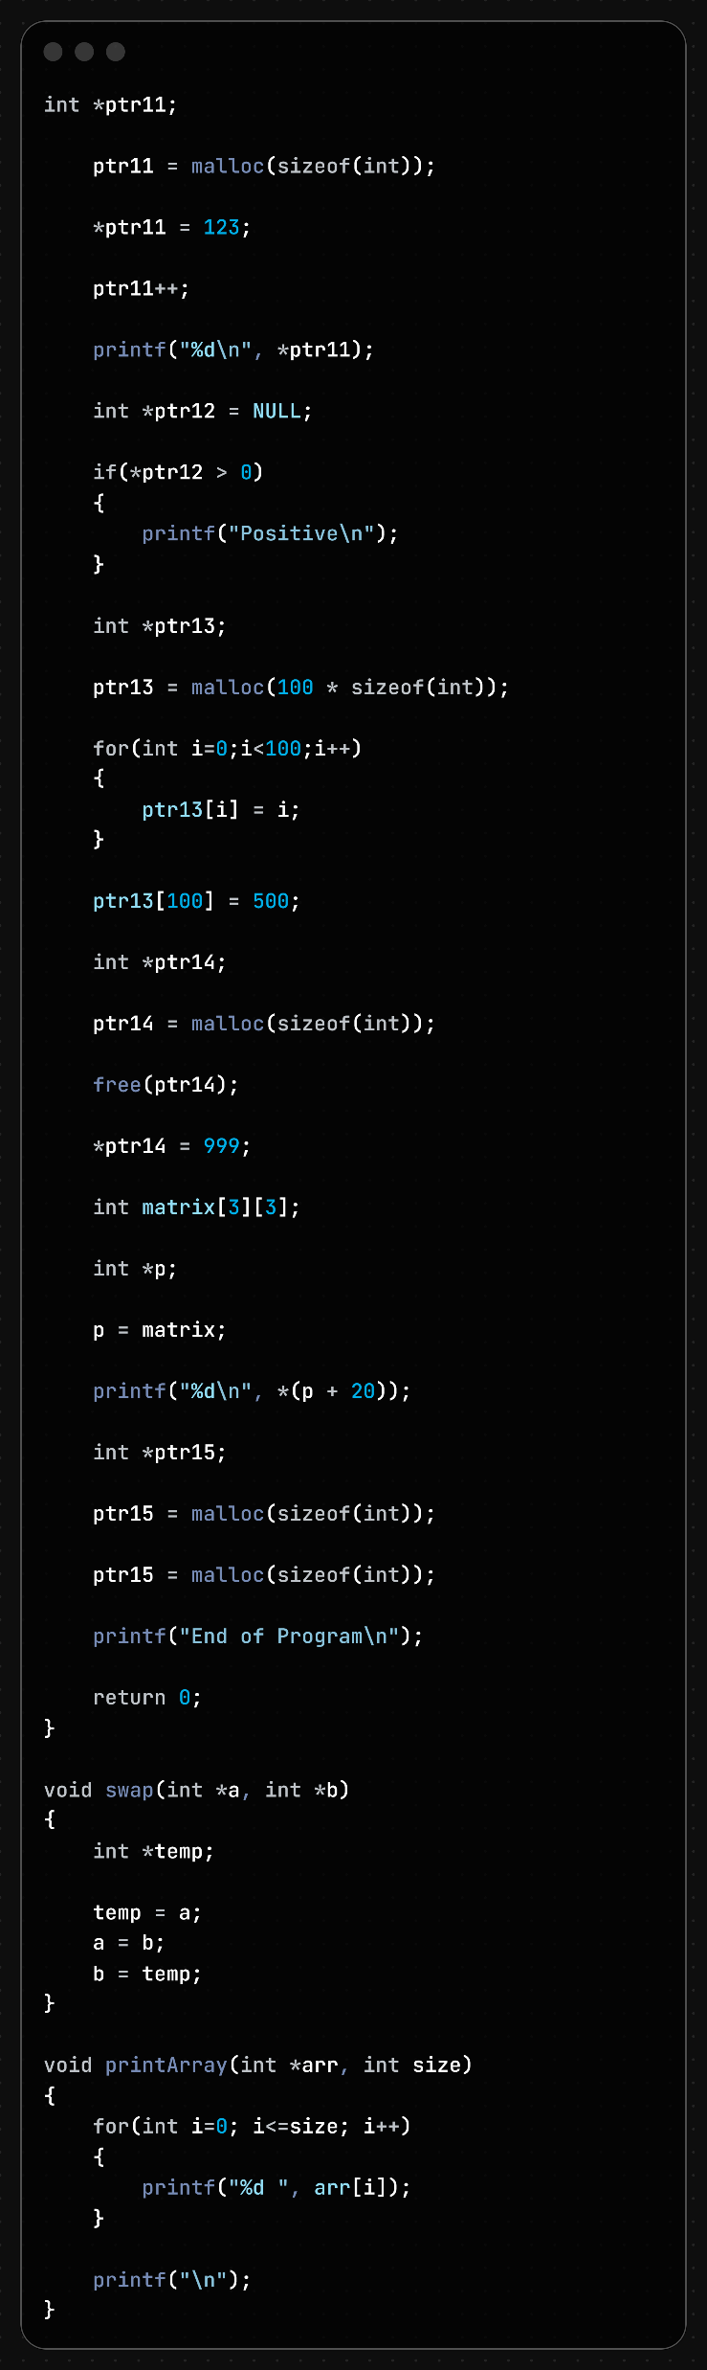

Slide 33
Line No. | Error Type | Error Description | Correction
13 | Runtime Error | Uninitialized pointer ptr1 is dereferenced. | Initialize pointer before use.
17 | Runtime Error | NULL pointer dereference: *ptr2 = 100; | Allocate memory or assign a valid address.
27 | Runtime Error | ptr3++ moves pointer beyond variable x. | Do not increment pointer pointing to a single variable.
29 | Runtime Error | Dereferencing invalid pointer after increment. | Access only valid memory locations.
35 | Runtime Error | *(ptr4 + 10) accesses array beyond bounds. | Use indices within array range (0–4).
45 | Runtime Error | Use-after-free: accessing *ptr5 after free(ptr5). | Do not access memory after freeing it.
53 | Memory Leak | Memory allocated to ptr6 is lost after ptr6 = NULL. | Free memory before assigning NULL.
61 | Runtime Error | Writing 10 integers into only 5 allocated bytes. | Allocate enough memory: malloc(10 * sizeof(int)).
73 | Runtime Error | ptr8[3] is out of bounds for array of size 3. | Use valid indices 0–2.
83 | Runtime Error | Double free: free(ptr9) called twice. | Free memory only once.
89 | Runtime Error | Reading uninitialized memory: *ptr10. | Initialize allocated memory before reading.

Slide 34
Line No. | Error Type | Error Description | Correction
97 | Runtime Error | Loop condition i <= 5 writes to numbers[5] (out of bounds). | Use i < 5.
113 | Semantic Error | pptr = &value; assigns int* to int**. | Use pptr = &ptr; where ptr is an int*.
115 | Runtime Error | Invalid double dereference **pptr. | Ensure pptr points to a valid int*.
121 | Runtime Error | Buffer overflow: "Programming" exceeds allocated 5 bytes. | Allocate sufficient memory.
131 | Runtime Error | Pointer increment moves beyond allocated memory. | Do not increment beyond allocated block.
133 | Runtime Error | Dereferencing invalid pointer after increment. | Access only valid allocated memory.
137 | Runtime Error | NULL pointer dereference in condition *ptr12 > 0. | Check ptr12 != NULL first.
151 | Runtime Error | ptr13[100] is out of bounds (valid indices 0–99). | Use indices within allocated range.
159 | Runtime Error | Use-after-free: *ptr14 = 999; after free(ptr14). | Do not access freed memory.
167 | Warning / Semantic Error | p = matrix; incompatible pointer type (int (*)[3] to int *). | Use p = &matrix[0][0];.
169 | Runtime Error | *(p + 20) accesses memory outside matrix bounds. | Use valid indices only.
177 | Memory Leak | First allocated memory for ptr15 is lost when reassigned. | Free old memory before reassigning.
188 | Runtime Error | Loop condition i <= size accesses arr[size]. | Use i < size.
180 | Logical Error | swap() swaps local pointers, not actual values. | Use int temp = *a; *a = *b; *b = temp;.

Slide 35
Problem 10:-

Slide 36
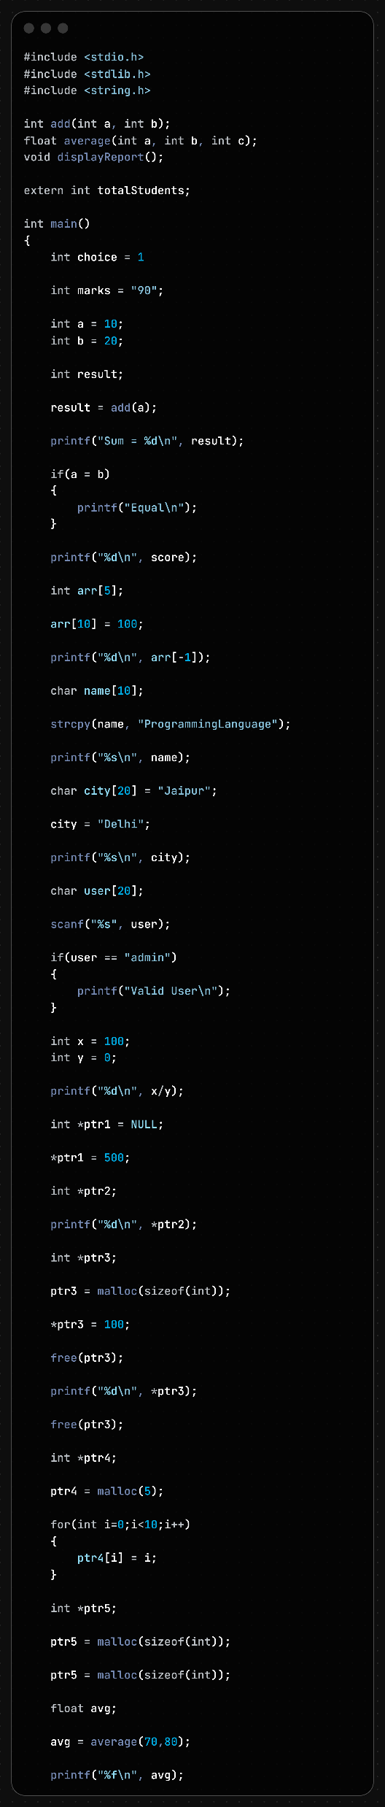
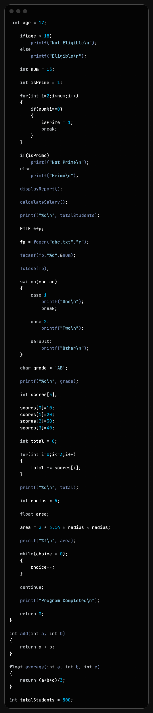

Slide 37
Line No. | Error Type | Error Description | Correction
11 | Syntax Error | Missing semicolon after int choice = 1 | Add ; → int choice = 1;
13 | Semantic Error | String "90" assigned to integer variable. | Use int marks = 90;
19 | Semantic Error | add(a) called with one argument instead of two. | Use add(a, b);
23 | Logical Error | Assignment operator = used instead of comparison ==. | Use if(a == b)
28 | Semantic Error | Variable score is not declared. | Declare score before use.
32 | Runtime Error | arr[10] is outside bounds of array size 5. | Use indices 0–4 only.
34 | Runtime Error | Negative index arr[-1]. | Use a valid array index.
38 | Runtime Error | Buffer overflow: "ProgrammingLanguage" exceeds name[10]. | Increase array size or shorten string.
44 | Syntax Error | Cannot assign string directly to character array. | Use strcpy(city, "Delhi");
52 | Logical Error | String comparison using ==. | Use strcmp(user, "admin") == 0.
60 | Runtime Error | Division by zero (x / y, where y = 0). | Check y != 0 before division.
64 | Runtime Error | NULL pointer dereference: *ptr1 = 500. | Allocate memory or assign valid address.
68 | Runtime Error | Dereferencing uninitialized pointer ptr2. | Initialize pointer before use.

Slide 38
Line No. | Error Type | Error Description | Correction
78 | Runtime Error | Use-after-free: accessing *ptr3 after free(ptr3). | Do not access freed memory.
80 | Runtime Error | Double free of ptr3. | Free memory only once.
88 | Runtime Error | Heap buffer overflow: writing 10 elements into 5-byte allocation. | Allocate enough memory or reduce loop limit.
98 | Semantic Error | average(70,80) called with only two arguments. | Use average(70,80,90);
106 | Logical Error | Age > 18 prints "Not Eligible". | Print "Eligible" for age ≥ 18.
117 | Logical Error | isPrime remains 1 when a factor is found. | Set isPrime = 0;
123 | Logical Error | Prime logic reversed. | Print "Prime" when isPrime == 1.
125 | Logical Error | Non-prime logic reversed. | Print "Not Prime" when isPrime == 0.
129 | Linker Error | displayReport() declared but not defined. | Add function definition.
131 | Semantic / Linker Error | calculateSalary() called without declaration and definition. | Add prototype and function definition.

Slide 39
Line No. | Error Type | Error Description | Correction
139 | Runtime Error | fscanf() may operate on NULL file pointer if file open fails. | Check if(fp != NULL) before reading.
145 | Syntax Error | Missing colon after case 1. | Use case 1:
156 | Semantic Warning | Multi-character constant 'AB' assigned to char. | Use a single character such as 'A'.
165 | Runtime Error | scores[3] out of bounds for array size 3. | Use indices 0–2 only.
169 | Runtime Error | Loop condition i <= 3 accesses scores[3]. | Use i < 3.
181 | Logical Error | Incorrect circle area formula (2πr²). | Use 3.14 * radius * radius.
185 | Logical / Syntax Error | Extra semicolon after while(choice > 0) creates empty loop. | Remove the semicolon.
190 | Syntax Error | continue used outside any loop. | Remove it or place it inside a loop.

