Slide 1
Problem 1 :-

Slide 2
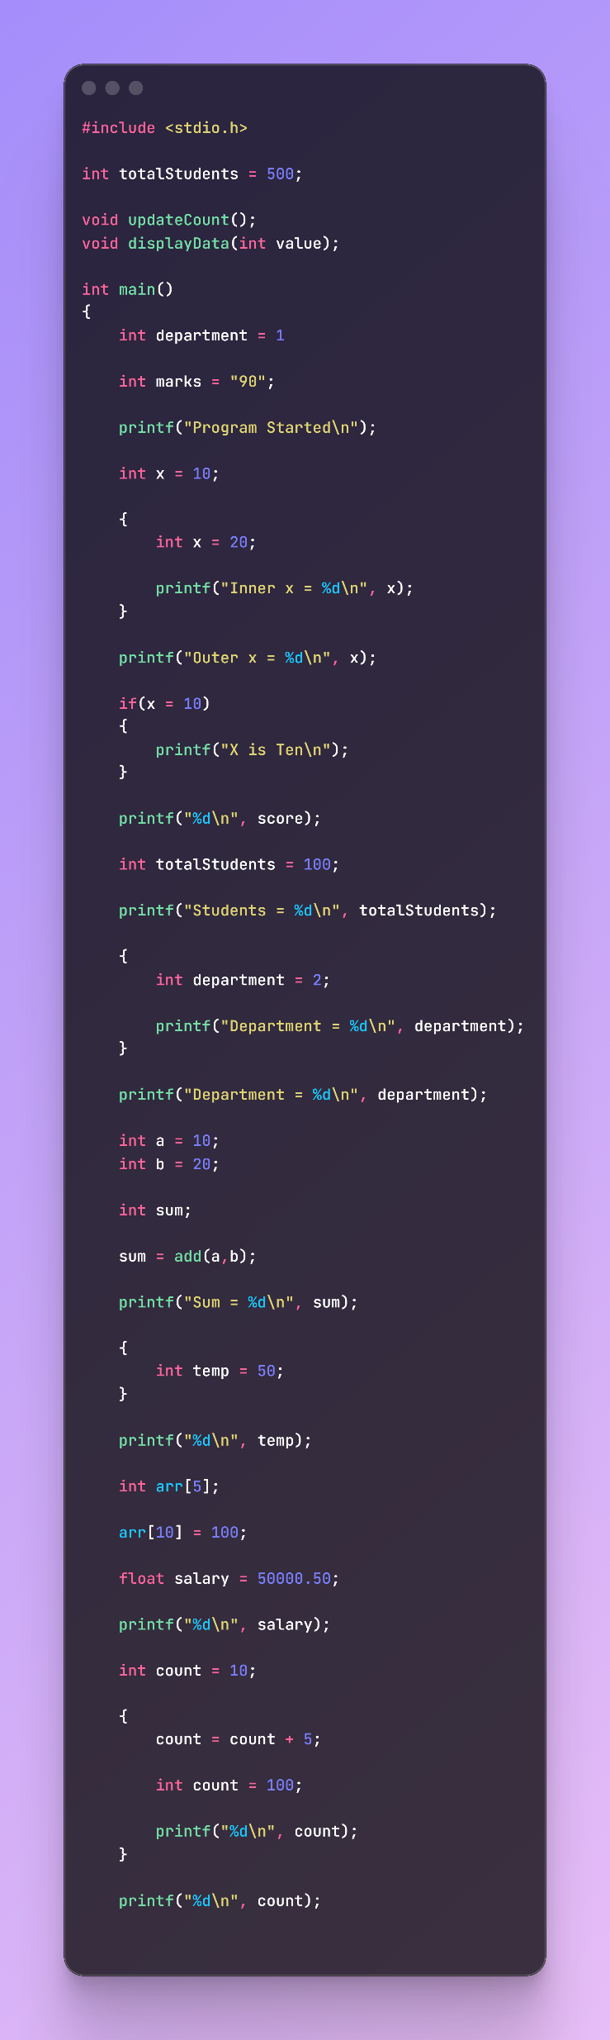
Line No. | Error Type | Error | Correction
9 | Syntax | Missing ; after int department = 1 | int department = 1;
11 | Semantic | int marks = "90"; (string assigned to int) | int marks = 90;
24 | Logical | if(x = 10) uses assignment instead of comparison | if(x == 10)
29 | Semantic | score is undeclared | Declare int score; or use correct variable
47 | Linker | add() called but not defined | Define add() function
56 | Scope | temp used outside its block | Declare temp outside block
60 | Runtime | arr[10] out of bounds for array size 5 | Use index 0–4
64 | Semantic | %d used for float variable | Use %f

Slide 3
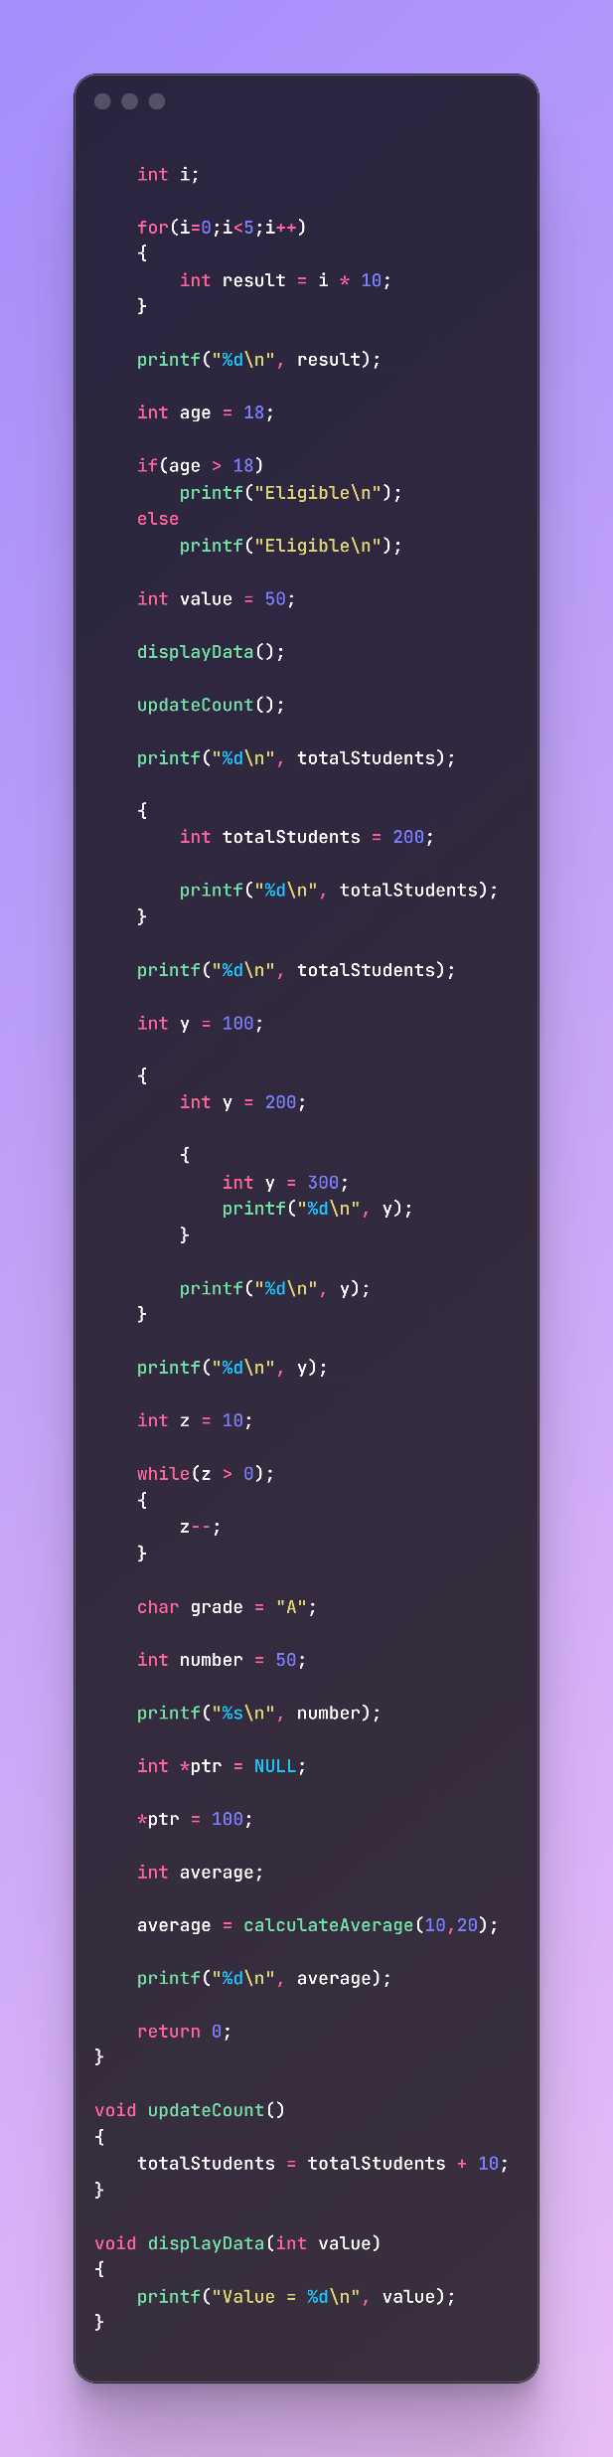
83 | Scope | result used outside loop block | Declare result before loop
89 | Logical | Both if and else print "Eligible" | Else should print "Not Eligible"
93 | Function Call | displayData() called without argument | displayData(value);
125 | Logical | while(z > 0); contains extra semicolon | while(z > 0)
130 | Semantic | char grade = "A"; uses string instead of character | char grade = 'A';
134 | Semantic | %s used for integer variable | Use %d
138 | Runtime | Dereferencing NULL pointer | Allocate memory or assign valid address
142 | Linker | calculateAverage() not declared/defined | Declare and define function
142 | Semantic | Return value assigned to int but function missing | Create proper function returning int

Slide 4
Problem 2 :-

Slide 5
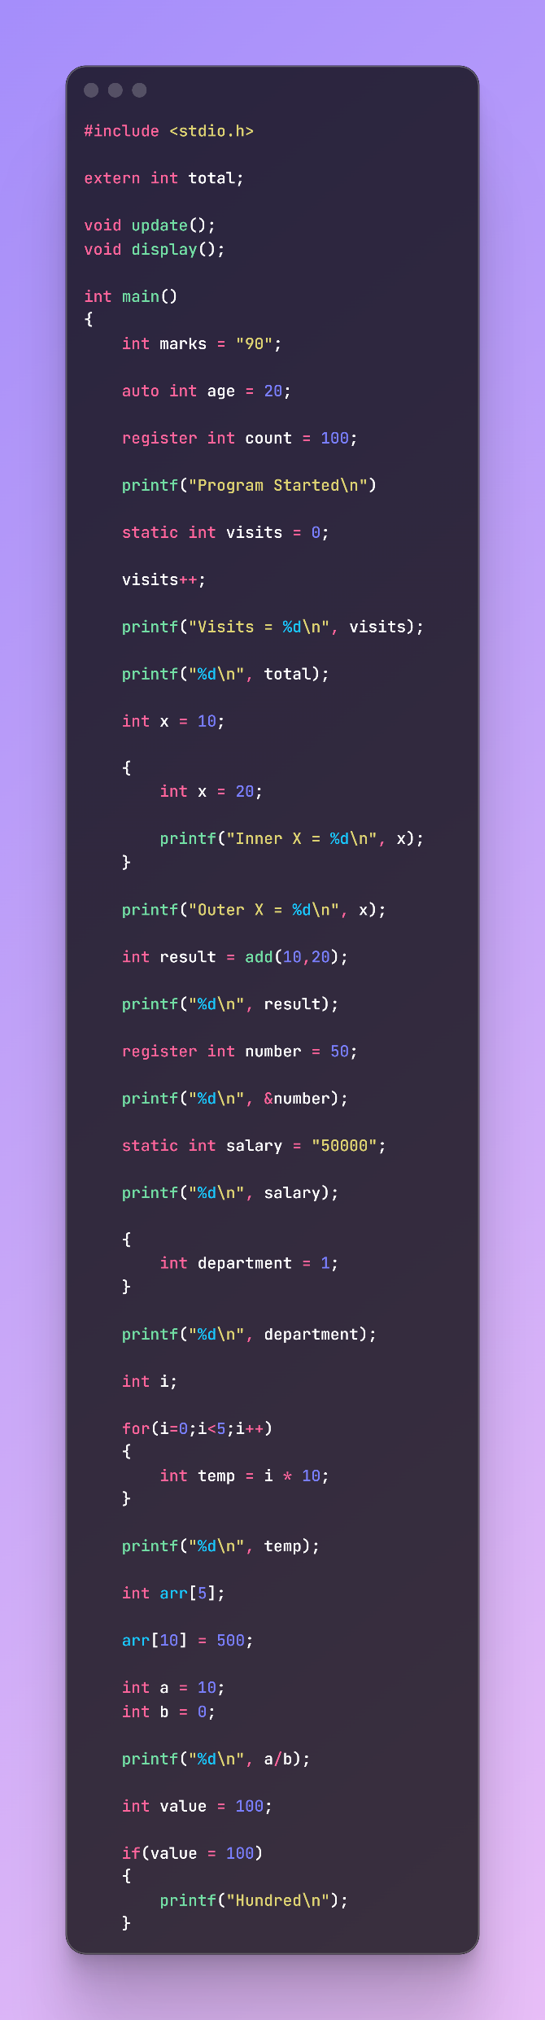
Line | Error Type | Error | Correction
10 | Semantic | int marks = "90"; assigning string to int | int marks = 90;
16 | Syntax | Missing ; after printf("Program Started\n") | Add ;
32 | Semantic | add() called before declaration | Add prototype int add(int,int);
38 | Semantic | Printing address using %d | Use %p and (void*)&number
38 | Semantic | Cannot take address of register variable | Remove &number or remove register
40 | Semantic | static int salary = "50000"; | static int salary = 50000;
48 | Scope | department out of scope | Declare outside block
56 | Scope | temp out of scope | Declare before loop
60 | Runtime | arr[10] = 500; out of bounds | Use valid index 0-4
65 | Runtime | Division by zero a/b | Ensure b != 0

Slide 6
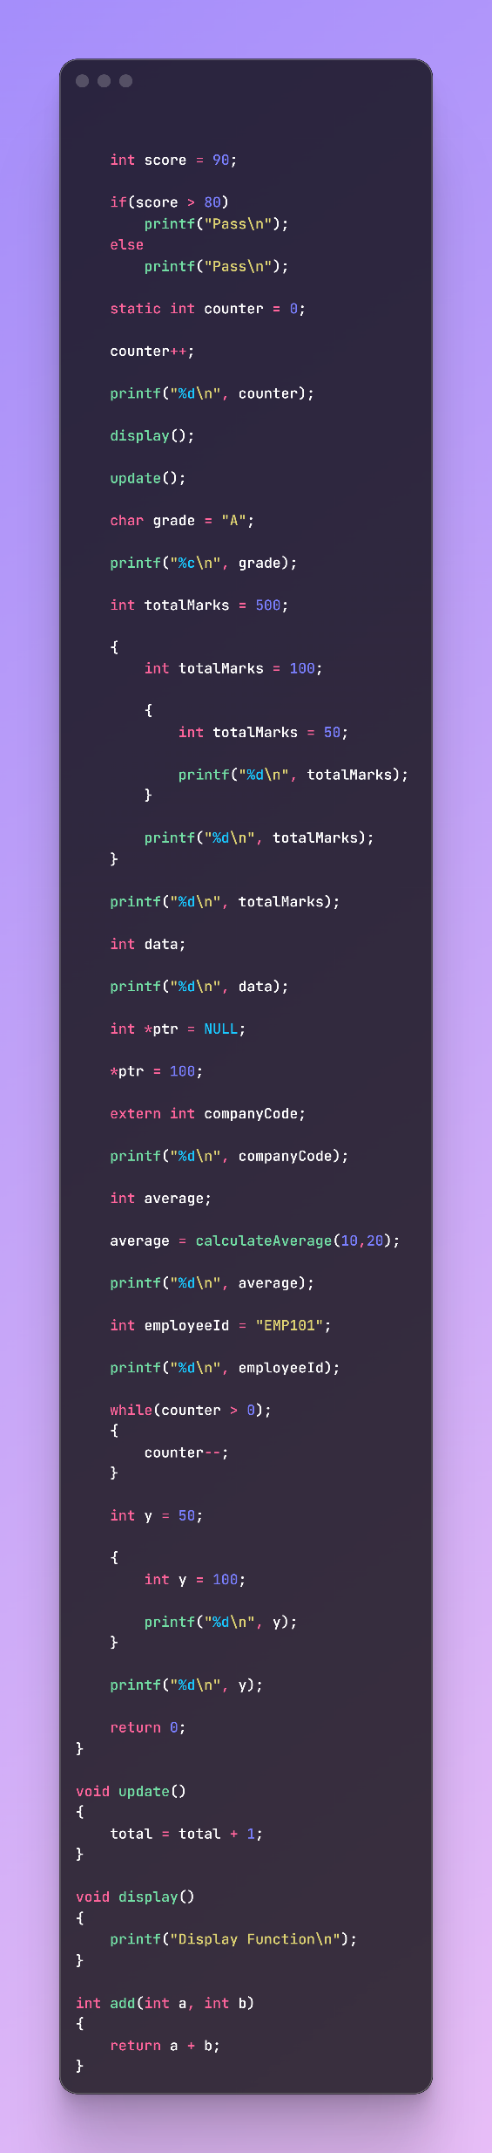
69 | Logical | if(value= 100) assignment instead of comparison | if(value == 100)
79 | Logical | Both branches print "Pass" | Change else message
91 | Semantic | char grade = "A"; | char grade = 'A';
113 | Runtime | Uninitialized variable data | Initialize before use
117 | Runtime | Dereferencing NULL pointer | Allocate memory or assign valid address
119 | Linker | extern int companyCode; not defined | Define globally
123 | Linker | calculateAverage() not declared/defined | Create prototype and function
129 | Semantic | int employeeId = "EMP101"; | char employeeId[] = "EMP101";
136 | Logical | Semicolon after while | Remove semicolon
154 | Linker | total declared extern but not defined | Define int total = 0; globally

Slide 7
Problem 3 :-

Slide 8
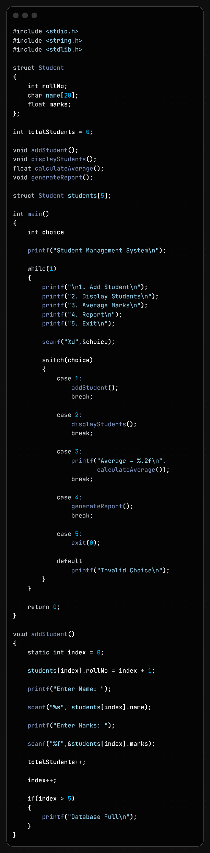
Line No. | Error | Type | Correction
20 | Missing semicolon after int choice | Syntax | int choice;
49 | default missing colon (:) | Syntax | default:
74 | Condition if(index > 5) is wrong | Logical | if(index >= 5)
59 | No check before accessing students[index] | Runtime | Check if array is full before insertion
84 | for(i=0;i<=totalStudents;i++) accesses one extra element | Runtime | for(i=0;i<totalStudents;i++)

Slide 9
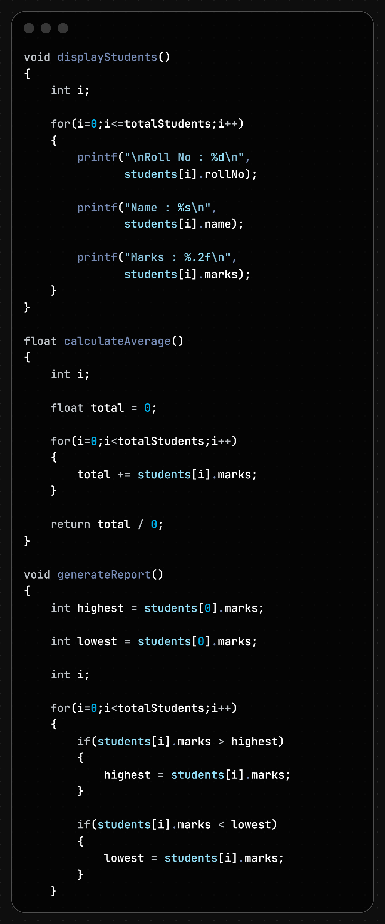
Line No. | Error | Error Type | Correction
105 | Division by zero (total / 0) | Runtime | Use total / totalStudents
105 | No check when totalStudents == 0 | Runtime | Check if(totalStudents > 0) before division
110 | int highest = students[0].marks; loses decimal part | Semantic | Use float highest = students[0].marks;
110 | Accessing students[0] when no students exist | Runtime | Check if(totalStudents > 0) before accessing
112 | int lowest = students[0].marks; loses decimal part | Semantic | Use float lowest = students[0].marks;
112 | Accessing students[0] when no students exist | Runtime | Check if(totalStudents > 0) before accessing
118 | Loop should start from 1 after initialization | Logical | for(i = 1; i < totalStudents; i++)

Slide 10
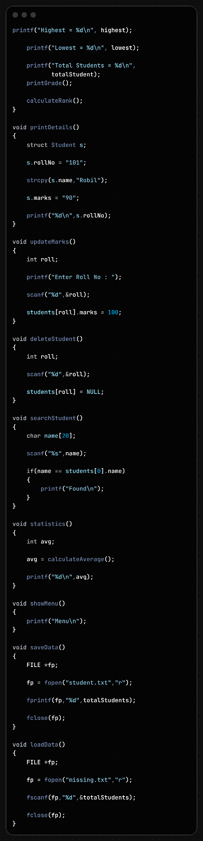
Line No. | Error | Error Type | Correction
130 | Printing float using %d | Format | Use %f
132 | Printing float using %d | Format | Use %f
135 | totalStudent undeclared | Semantic | Use totalStudents
138 | printGrade() not declared | Linker | Add function prototype
138 | printGrade() not defined | Linker | Define the function
140 | calculateRank() not declared | Linker | Add function prototype
140 | calculateRank() not defined | Linker | Define the function
149 | s.rollNo = "101" assigns string to int | Semantic | s.rollNo = 101;
153 | s.marks = "90" assigns string to float | Semantic | s.marks = 90;
168 | students[roll] may access invalid index | Runtime | Validate roll number before access
178 | students[roll] = NULL invalid for structure | Semantic | Use a deletion flag or shift records
188 | Comparing strings using == | Logical | Use strcmp()
198 | Assigning float result to int variable | Semantic | Use float avg;
200 | Printing float using %d | Format | Use %f
216 | File opened in read mode "r" but written using fprintf() | File Handling | Open file with "w"
218 | No check whether fopen() succeeded | Runtime | Check if(fp != NULL)
227 | File "missing.txt" may not exist | Runtime | Verify file exists before reading
229 | fscanf() used without checking file pointer | Runtime | Check if(fp != NULL) before fscanf()

Slide 11
Problem 4 :-

Slide 12
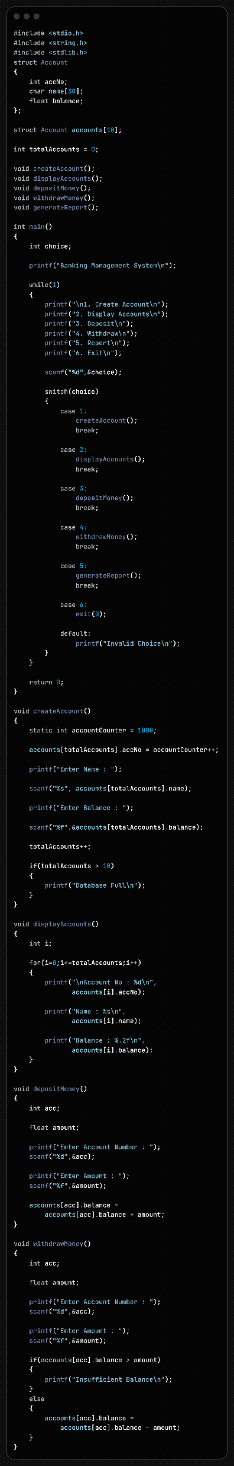
Line No. | Error Type | Error Description | Correction
16 | Linker Error | generateReport() is declared but not defined | Define the generateReport() function
64 | Runtime / Array Bounds | accounts[totalAccounts] may exceed array size if more than 10 accounts are created | Check array limit before inserting a new account
69-74 | Logical Error | Database full check occurs after account creation | Move the check before storing data
80 | Logical / Array Bounds | Loop condition i <= totalAccounts accesses one extra element | Change to i < totalAccounts
106 | Runtime Error | accounts[acc] uses account number as array index | Search for matching account number first
106 | Runtime Error | Invalid index may access memory outside array bounds | Validate account exists before deposit
125 | Runtime Error | accounts[acc] uses account number as array index | Search for matching account number first
127 | Logical Error | Withdrawal condition is reversed (> instead of <) | Use if(balance < amount)
131-132 | Runtime Error | Invalid account index may cause crash or undefined behavior | Validate account number before withdrawal
95-107 | Validation Error | Deposit allows negative amounts | Check amount > 0 before depositing
114-132 | Validation Error | Withdrawal allows negative amounts | Check amount > 0 before withdrawing

Slide 13
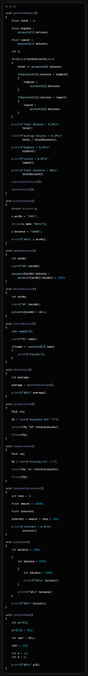
Actual Line No. | Error | Correction
172 | total / totalAccounts may divide by zero | Check totalAccounts > 0 before division
181 | totalAccount undeclared | Use totalAccounts
184 | calculateInterest() not declared/defined | Define function or call correct function
185 | saveAccounts() called without prototype | Add prototype before use
192 | a.accNo = "1001" type mismatch | a.accNo = 1001;
196 | a.balance = "50000" type mismatch | a.balance = 50000;
209 | Account number used as array index | Search account by accNo first
221 | accounts[accNo] = NULL invalid for structure | Delete properly or shift records
230 | name == accounts[0].name compares addresses | Use strcmp()
240 | generateAverage() not declared/defined | Define function and add prototype
254 | File opened in "r" mode but written with fprintf() | Open in "w" or "a" mode
256 | fp may be NULL | Check if(fp != NULL)
266 | "missing.txt" may not exist | Check file opened successfully
268 | fscanf() may use NULL pointer | Validate fp before reading
307 | arr[10] = 500 out-of-bounds access | Use index 0–4
311 | NULL pointer dereference *ptr = 100 | Point to valid memory
316 | Division by zero a/b | Check b != 0

Slide 14
Problem 5:-

Slide 15
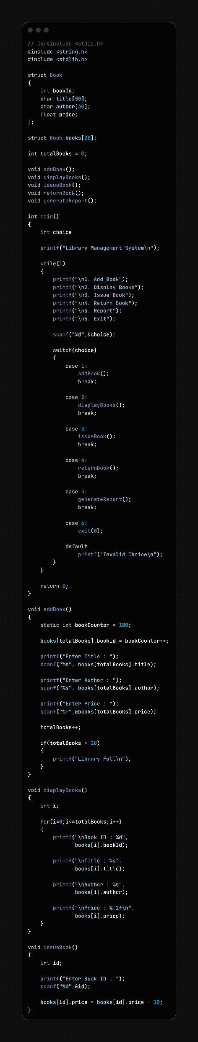
Line No. | Error | Correction
23 | Missing ; after int choice | int choice;
57 | Missing : after default | default:
80 | Library full check occurs after adding the book | Check if(totalBooks >= 20) before insertion
89 | i <= totalBooks accesses one extra element | for(i = 0; i < totalBooks; i++)
110 | Book ID used as array index in issueBook() | Search book using bookId before updating
117 | Price may become negative after repeated issues | Validate price before subtraction
121 | Book ID used as array index in returnBook() | Search book using bookId before updating

Slide 16
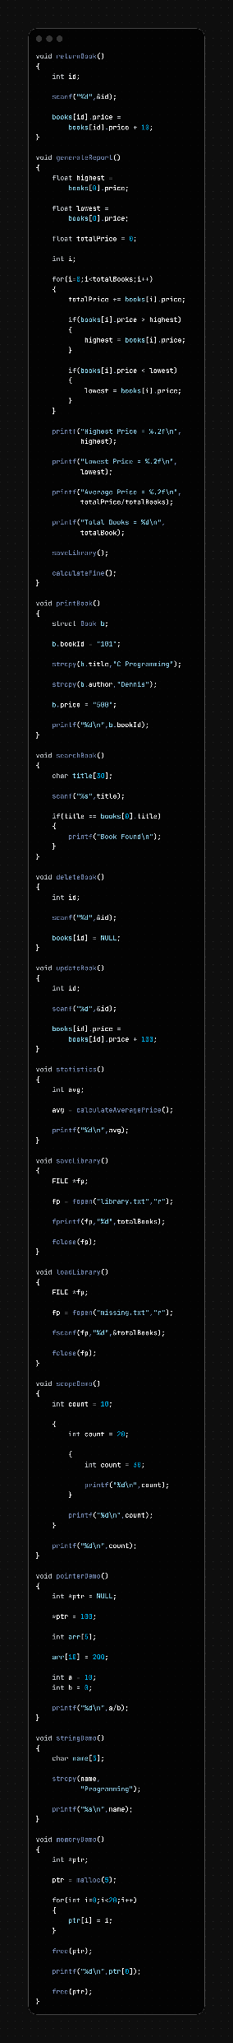
Line No. | Error | Correction
155 | Possible division by zero (totalPrice/totalBooks) | Check if(totalBooks > 0) before division
158 | totalBook undeclared | Replace with totalBooks
160 | saveLibrary() called without prototype | Add void saveLibrary(); prototype
162 | calculateFine() not declared/defined | Define function and add prototype
170 | b.bookId = "101" (string assigned to int) | b.bookId = 101;
176 | b.price = "500" (string assigned to float) | b.price = 500;
187 | String comparison using == | strcmp(title, books[0].title) == 0
199 | books[id] = NULL invalid for structure | Remove book by shifting elements or marking deleted
210 | Book ID used as array index in updateBook() | Search book using bookId before updating
220 | calculateAveragePrice() not declared/defined | Define function and add prototype
230 | File opened in "r" mode but written using fprintf() | Open file using "w" or "a" mode
232 | fp may be NULL | Check if(fp != NULL) before writing
242 | "missing.txt" may not exist | Check file opened successfully
244 | fscanf() may use NULL file pointer | Validate fp before reading
269 | Dereferencing NULL pointer (*ptr = 100) | Allocate memory or point to a valid variable
273 | Array out-of-bounds access (arr[10]) | Use a valid index 0–4
278 | Division by zero (a/b) | Check if(b != 0) before division
286 | Buffer overflow ("Programming" exceeds name[5]) | Increase array size, e.g., char name[20];
296 | malloc(5) allocates only 5 bytes | Use malloc(5 * sizeof(int))
298 | Writing 20 elements into memory for 5 integers | Loop should run only up to allocated size
304 | Accessing memory after free(ptr) | Do not use pointer after free()
306 | Double free (free(ptr) twice) | Free memory only once

