Slide 1


Smart wireless water meter with Web DB
Visvesvaraya Technological University
“Jnana Sangama”, Belagavi – 590018.
Project work Phase - I on
Under the Guidance of
SUBMITTED BY:
HARSHAN S (1VE21EC032)
K Santosh (1VE21EC037)
Manoj kumar c s (1ve21ec052)
SANDEEPKUMAR S (1VE21EC078)
Mrs. Swetha Kulkarni
Assistant Professor
Dept. of ECE,
SVCE, Bengaluru
Dr. Deepti Raj
Assistant Professor
Dept. of ECE,
SVCE, Bengaluru

Slide 2
INTRODUCTION
The Smart Wireless Water Meter with Web Database project is designed to monitor and control water management systems efficiently.
It involves measuring real-time water flow and storing the readings in a database for record-keeping and analysis.
The system can remotely control water pumps, automatically turning them on or off when the tank is either full or empty, optimizing water usage and preventing overflow. Additionally, it measures the contamination levels in water to ensure quality.
All data, including flow rate, tank status, and contamination levels, are displayed on the ThingSpeak IoT platform, enabling remote monitoring and analytics for improved water resource management.

Slide 3
PROBLEM FORMULATION
The smart wireless water meter system addresses the limitations of traditional systems by providing real-time data on water usage, automated refilling, and continuous monitoring of water quality, helping to reduce water waste.
By integrating with a web database and using the ThingSpeak cloud, the system ensures users have continuous access to water usage data and quality status, promoting efficient resource management, sustainable water use, and enhanced safety through proactive monitoring.

Slide 4
OBJECTIVES
To design a system that continuously monitors water usage in real-time.
To provide precise, automated tracing of water usage in real-time.
To determine the water quality of precised container for the usage of water.
To provide a web dashboard that is easy for users to navigate, showing detailed usage statistics.

Slide 5
LITERATURE REVIEW
TITLE AND YEAR | AUTHOR | ADVANTAGES | LIMITATIONS
Ensuring Purity and Health: A Comprehensive Study of Water Quality Testing Labs in Solapur District for Community Well-being. 2024 | M. Shaikh | Protects public health by identifying harmful contaminants. Ensures compliance with environmental and health regulations. Enhances accuracy with advanced technologies. | High costs of equipment and analyses. Limited access to testing facilities in remote areas. Challenges in sample transportation and preservation.
Development of LoRaWAN-based IoT system for water quality monitoring in rural areas 2024 | W. A. Jabbar | Provides real-time data, reduces response time, improves accessibility, and minimizes manual sampling. Suitable for remote areas with limited infrastructure and energy-efficient with solar power. | Challenges in ensuring data reliability, waterproofing, and system durability in diverse environments. Potential for connectivity issues in remote locations with limited network infrastructure.
A Comprehensive Review on Water Quality Monitoring Devices: Materials Advances, Current Status, and Future Perspective 2023 | Rajshekar G | Provides real-time, accurate data for timely decision-making and efficient water management. Reduces the resource-intensive and slow nature of traditional water testing methods. Supports scalable and sustainable solutions for water management in various sectors. | Requires reliable network infrastructure for real-time data transmission. Potential issues with sensor calibration and data accuracy in certain environments. Initial setup and maintenance costs for IoT devices and platforms.

Slide 6
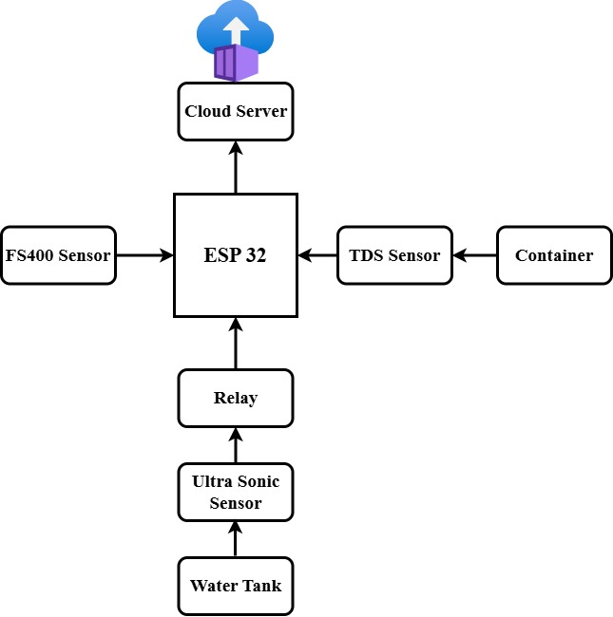
METHODOLOGY
The Smart Wireless Water Meter system utilizes sensors to track water flow, levels, and quality, connected to a microcontroller for wireless data transmission. The data is stored in a web database and monitored in real-time via ThingSpeak. The system automates water pump control based on tank levels. It is tested in real-world conditions to ensure efficient water management and maintain water quality.
Figure.1 Block diagram of smart wireless water meter

Slide 7
The block diagram of the Proposed model consists of:
ESP32: The central microcontroller unit that gathers data from various sensors and communicates with a cloud server
FS400 Sensor: Likely a flow sensor that measures the flow rate of water.
TDS Sensor: Total Dissolved Solids (TDS) sensor connected to a container to measure water quality by detecting the level of dissolved solids.
Ultrasonic Sensor: This sensor measures the water level in the water tank by sending sound waves and detecting their return time.
Relay: Controls the activation of pumps or valves based on water level and quality data.
ThingSpeak IoT: Receives data from ESP32, enabling remote monitoring and analysis of water quality and tank levels.

Slide 8
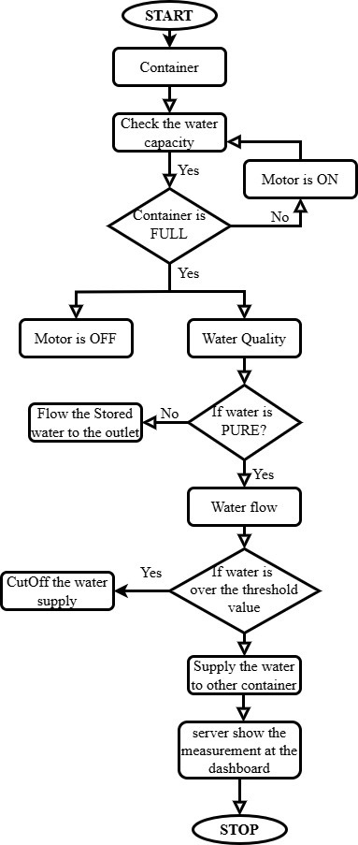
FLOW ALGORITHM
The following flowchart illustrates the steps involved in our operational workflow. Each step is designed to optimize efficiency and accuracy in our process.
Fig.2 Flow Algorithm of the Proposed Model

Slide 9
ADVANTAGES
Real-time water usage, quality, and level monitoring.
Automated filling system reduces wastage and ensures supply.
Active water quality tracking for safe distribution.
Accessible data on ThingSpeak cloud for transparency.
Cost-effective and resource-saving through automation.
APPLICATIONS
Residential water usage and quality monitoring.
Industrial water system management
Smart water distribution for municipalities.
Remote monitoring in rural or underserved areas.

Slide 10
EXPECTED OUTCOMES
The proposed system will address the highlighted issues by providing a scalable, user-friendly solution that enhances water management efficiency, supports sustainability, and promotes safe water usage practices through real-time monitoring, automation, and data accessibility.

Slide 11
REFERENCES
[1] M. Shaikh et al., "Ensuring Purity and Health: A Comprehensive Study of Water Quality Testing Labs in Solapur District for Community Well-being," ResearchGate, 2023, accessed: Nov. 11, 2024.
[2] W. A. Jabbar et al., “Development of LoRaWAN-based IoT system for water quality monitoring in rural areas,” Expert Systems with Applications, vol. 242, p. 122862, May 2024.
[3] A. Thakur and P. Devi, “A Comprehensive Review on Water Quality Monitoring Devices: Materials Advances, Current Status, and Future Perspective,” Critical Reviews in Analytical Chemistry, pp. 1–26, May 2022, doi: 10.1080/10408347.2022.2070838.
[4] Rajshekar G et al., “IOT Based Water Quality Monitoring System using Thingspeak,” Vol 4, no 5, pp 3952-3957, May 2023.
[5] Rohith M et al., “smart wireless water meter with web db iot,” Vol 3, Issue 6, pp 3963-3970, June 2022.
[6] M. A. Hassan et al., "Real-Time Smart Water Management System with Web-Based Monitoring and Control," IEEE Transactions on Smart Grid, vol. 15, no. 4, pp. 2319-2328, January 2025.

