Slide 1

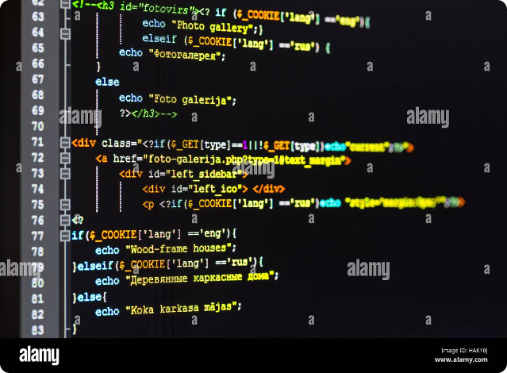
Brute Force Algorithms
Brute force algorithms are straightforward methods that try every possibility until the solution is found. They are often simple to understand and implement but can be inefficient for large datasets.

Slide 2

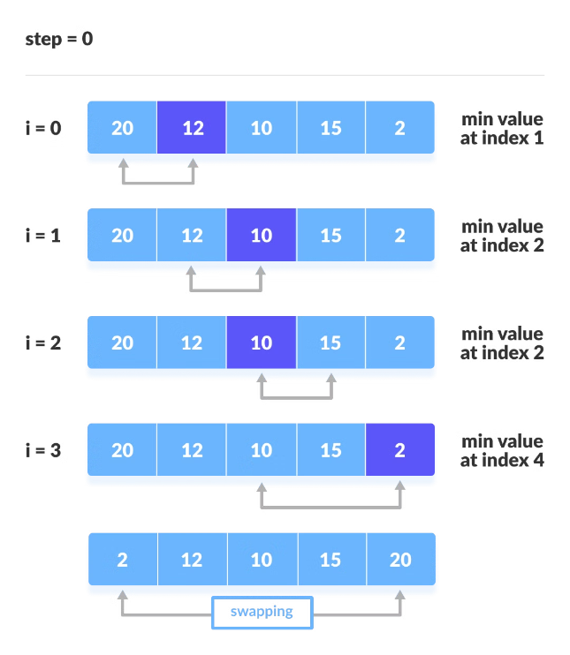
Selection Sort
1
Find Minimum
The algorithm iterates through the unsorted portion of the array and finds the smallest element.
2
Swap
The smallest element is swapped with the element at the beginning of the unsorted portion.
3
Repeat
This process is repeated for the remaining unsorted portion until the entire array is sorted.

Slide 3

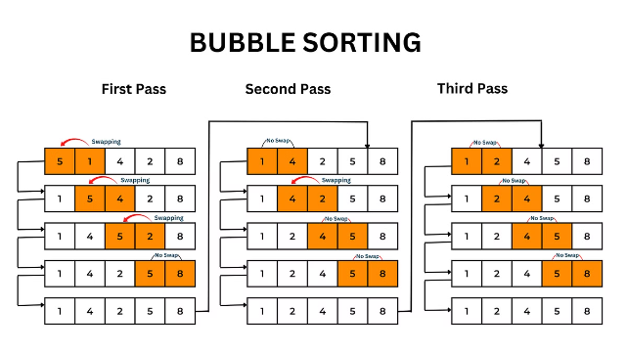
Bubble Sort
1
Compare and Swap
Adjacent elements are compared, and if they are in the wrong order, they are swapped.
2
Iterate Through Array
This process is repeated for all pairs of adjacent elements in the array.
3
Repeat Until Sorted
The entire array is iterated through until no more swaps occur, indicating the array is sorted.

Slide 4
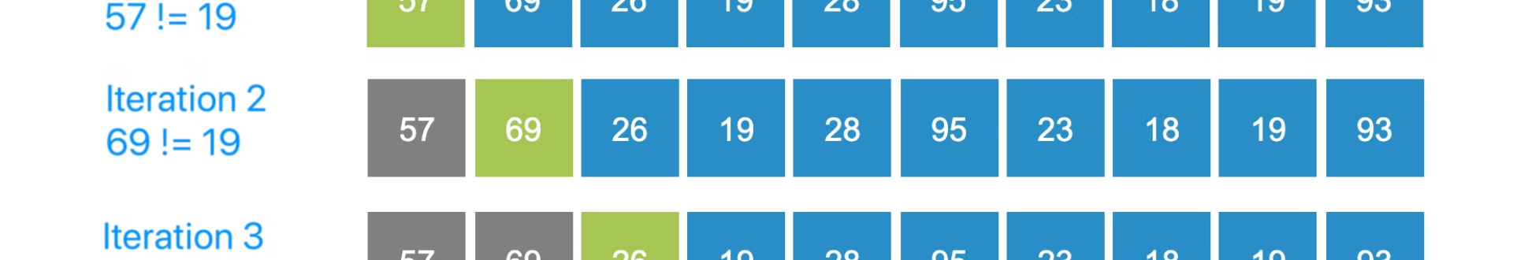




Sequential Search
Start
Compare
Match Found
No Match
The search begins at the first element of the array.
Each element is compared with the target value.
If a match is found, the index of the element is returned.
If the end of the array is reached without finding a match, a special value is returned to indicate the target was not found.

Slide 5
Brute-Force String Matching
Pattern Matching
Character Comparison
Match Found
Brute-force string matching compares every possible position of the pattern within the text string.
For each position, characters of the pattern are compared one by one with the corresponding characters in the text.
If all characters of the pattern match the corresponding characters in the text, a match is found.

Slide 6

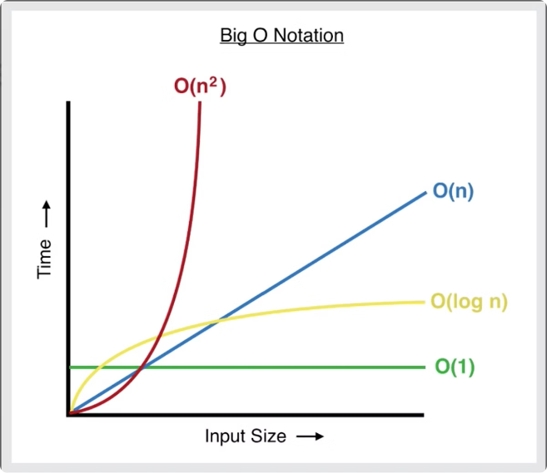
Time Complexity
Selection Sort
O(n^2) - For an array of size n, it takes n^2 comparisons and swaps in the worst case.
Bubble Sort
O(n^2) - Similar to Selection Sort, it has a quadratic time complexity in the worst case.
Sequential Search
O(n) - In the worst case, it might need to examine all n elements of the array.
Brute-Force String Matching
O(m*n) - For a pattern of length m and text of length n, it performs m*n comparisons in the worst case.

Slide 7


Advantages of Brute Force
1
Simple Implementation
Brute force algorithms are often easy to understand and implement, even for beginners.
2
Direct Approach
They directly address the problem without using any clever optimizations or shortcuts.
3
Suitable for Small Datasets
For small datasets, their efficiency might be sufficient, and their simplicity outweighs the performance concerns.

Slide 8

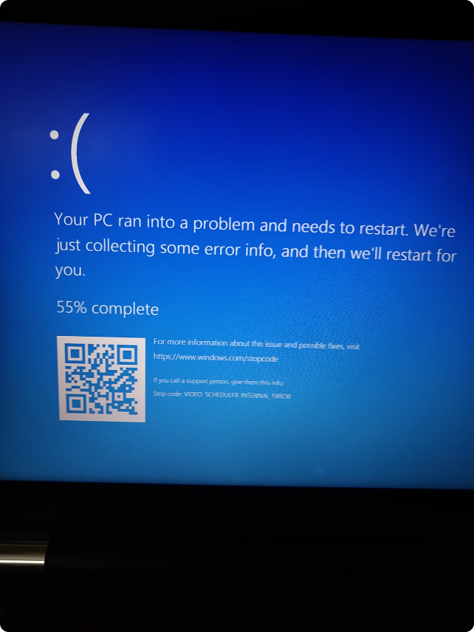
Disadvantages of Brute Force
1
Inefficient for Large Datasets
As the dataset size grows, their performance degrades significantly.
2
Time-Consuming
They can be very time-consuming for large datasets, making them impractical for many real-world applications.
3
Limited Applicability
They are not always suitable for complex problems where more efficient algorithms exist.

