Slide 1

WSO2 API Manager 4.2.0 Developer Advanced
Rate Limiting
WSO2 Training

Slide 2
Introduction

Slide 3
What is Rate Limiting?
Rate Limiting allows you to control the number of successful hits to an API during a given period, typically in cases such as the following:
To protect your APIs from common types of security attacks such as certain types of denial of service (DOS) attacks.
To regulate traffic according to infrastructure availability.
To make an API, application, or a resource available to a consumer at different levels of service, usually for monetization purposes.

Slide 4
Rate Limiting in WSO2 APIM
Based on a Central Policy Server called the Traffic Manager.
Includes a powerful Siddhi runtime-based decision engine.
Flexibility to design rate limiting policies based on request count, bandwidth, roles, billing plans, custom policies, and so on.
Supports rate limiting as well as instantaneous blocking of requests.
When configuring rate limiting for an API Gateway cluster we facilitate maintaining required counters in a distributed Redis cluster.

Slide 5
Features and concepts of Rate Limiting
There are three levels in rate limiting
API/Resource level
Subscription level
Application level
Conditional rate limiting based on HTTP headers, query parameters, JWTs, and IPs
Deny Policies (APIs, Applications, IPs and Users )
Burst Controlling
Back-end rate limiting
Custom policies

Slide 6
Traffic Manager

Slide 7
Traffic Manager
The Traffic Manager is dedicated to API request event processing, rate limiting policy evaluation and decision making through the Siddhi runtime.
If a particular request is rate limited, then the Traffic Manager sends those details to a JMS topic.
Every Gateway node is subscribed to this JMS topic; hence the Gateway nodes get notified of rate limiting decisions through JMS messages.
Notes:
In a nutshell, the Traffic Manager executes the rate limiting policies against data coming with every event and takes decisions based on the applicability of each rate limiting policy available in the system.

Slide 8
Traffic Manager
The rate limiting decision message that comes to the Gateway contains the throttle key, throttle window expiry time and the throttle state.
These properties will be used by the throttle handler to take decisions about incoming messages to the Gateway.
Binary or thrift transport can be used to publish this data from the Gateway to the Traffic Manager; in the implementation, this data publishing has been implemented asynchronously, in order to remove the overhead of data publishing from the API request path.

Slide 9
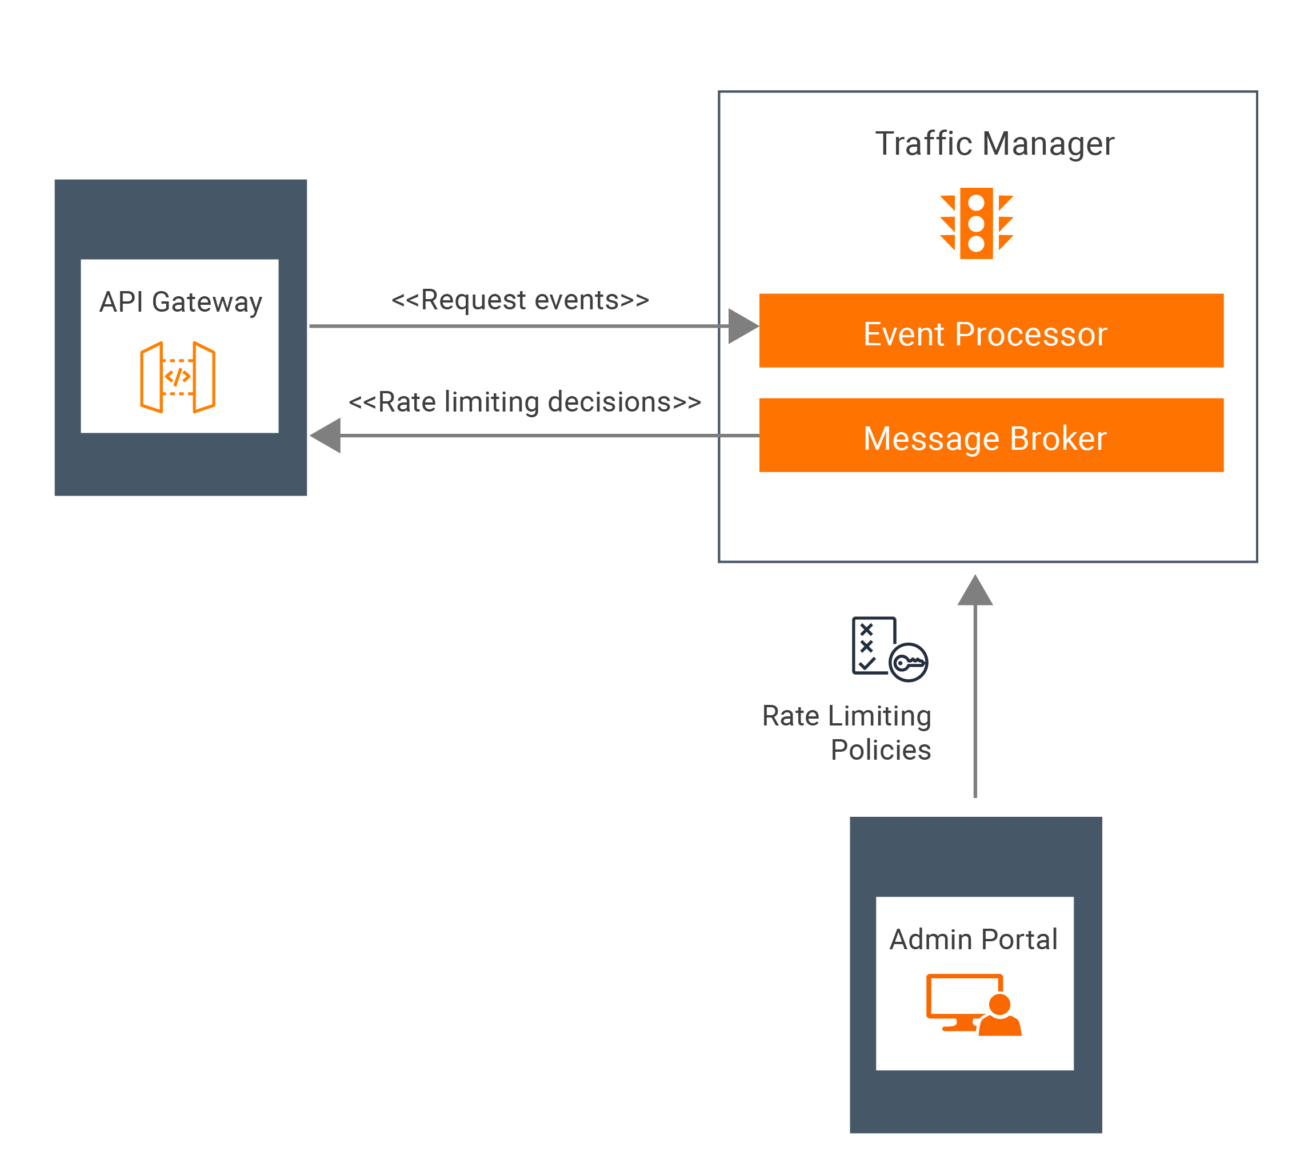
Traffic Manager
Traffic Manager

Slide 10
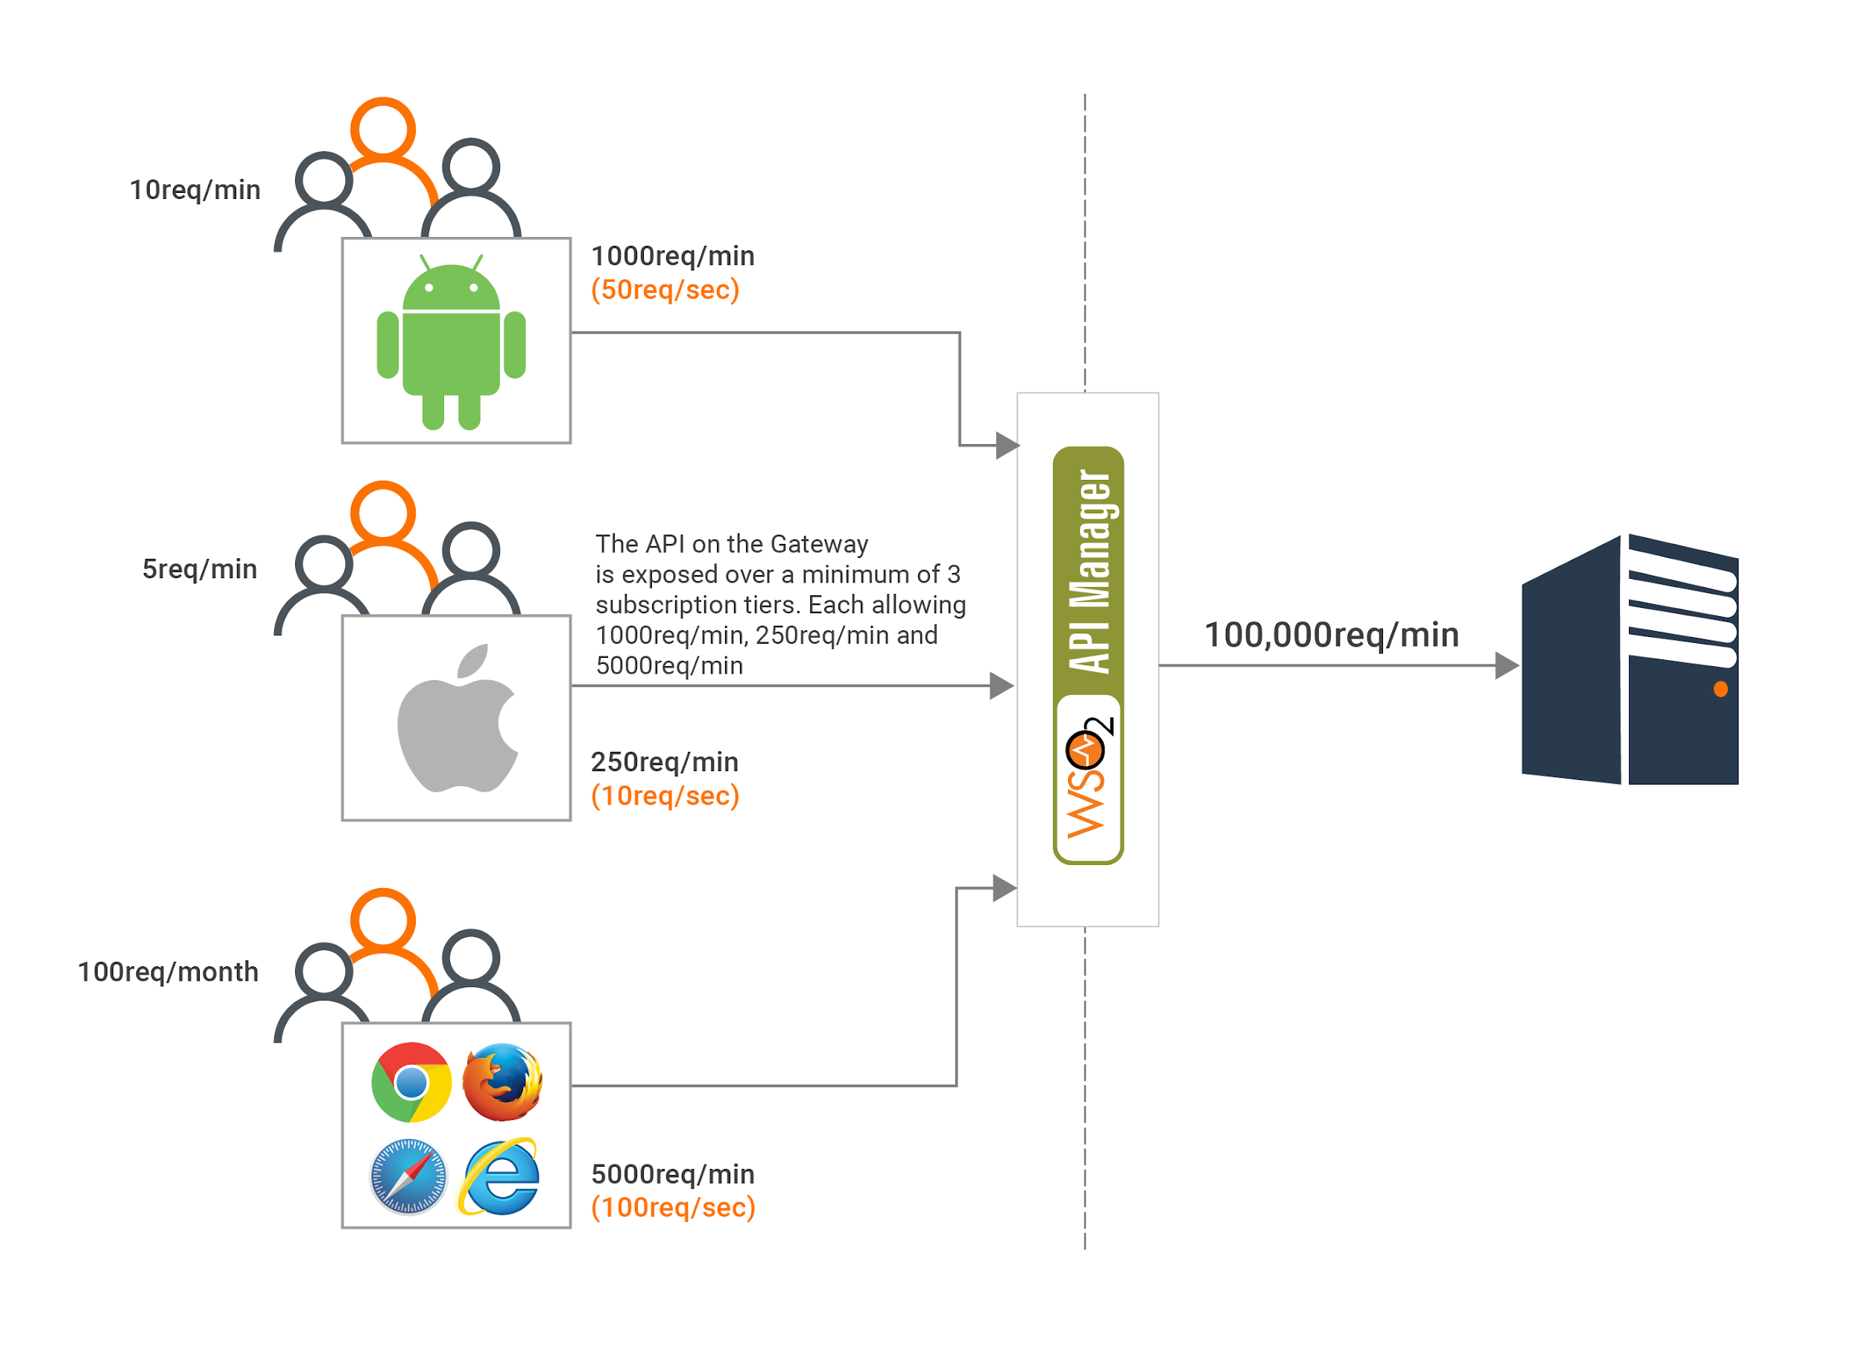
Rate Limiting

Slide 11
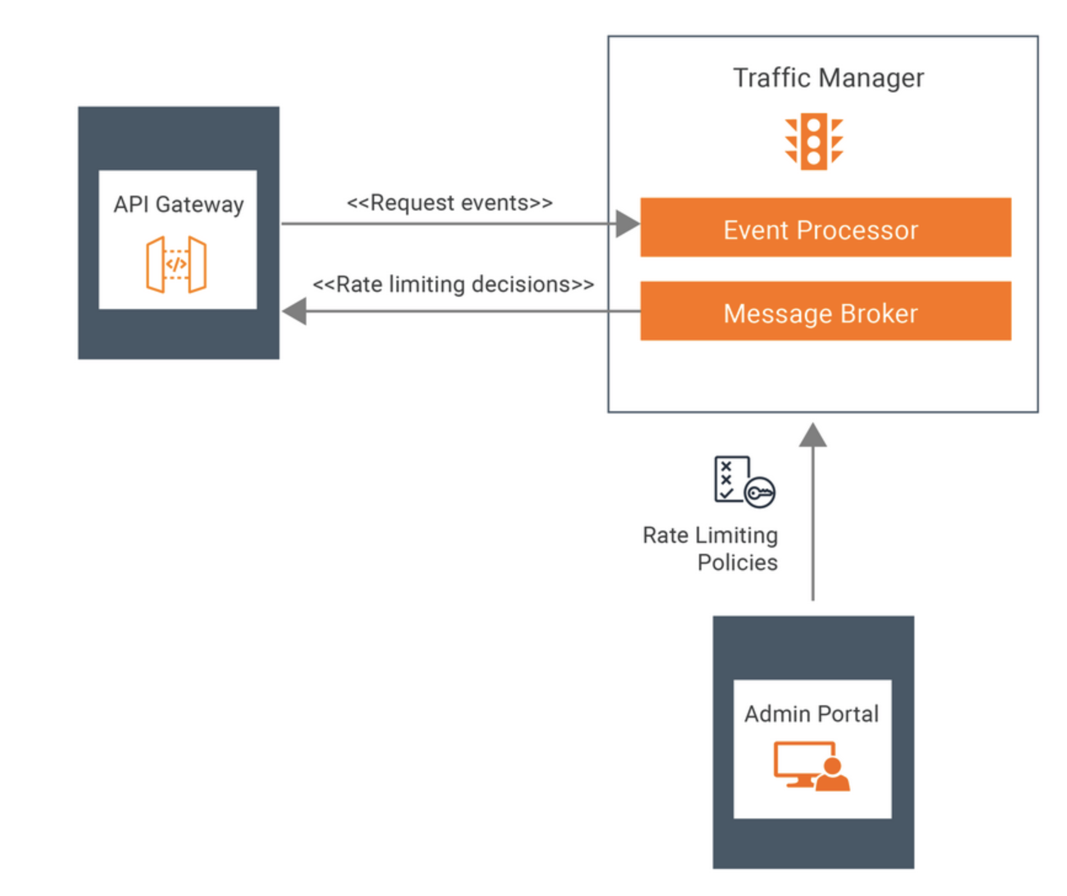
How Rate Limiting works

Slide 12
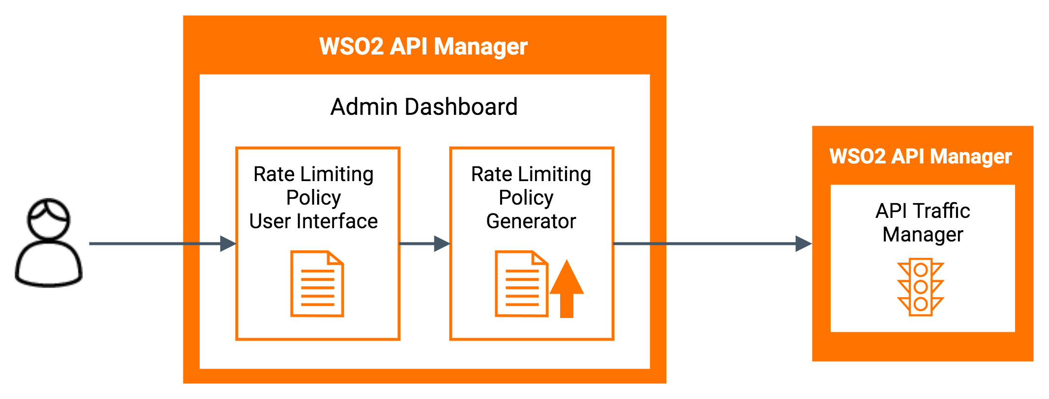
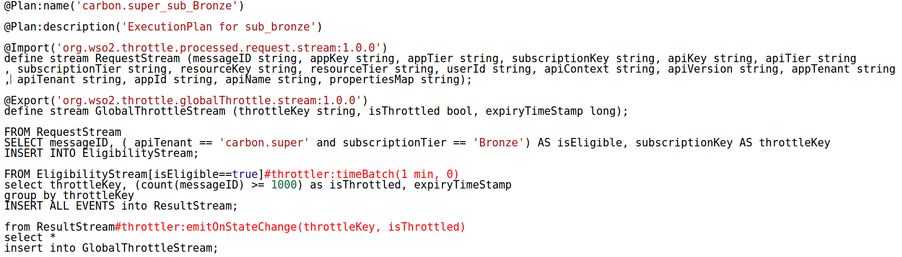
Deploying a Rate Limiting Policy
Converts Policy to a Siddhi Query

Slide 13
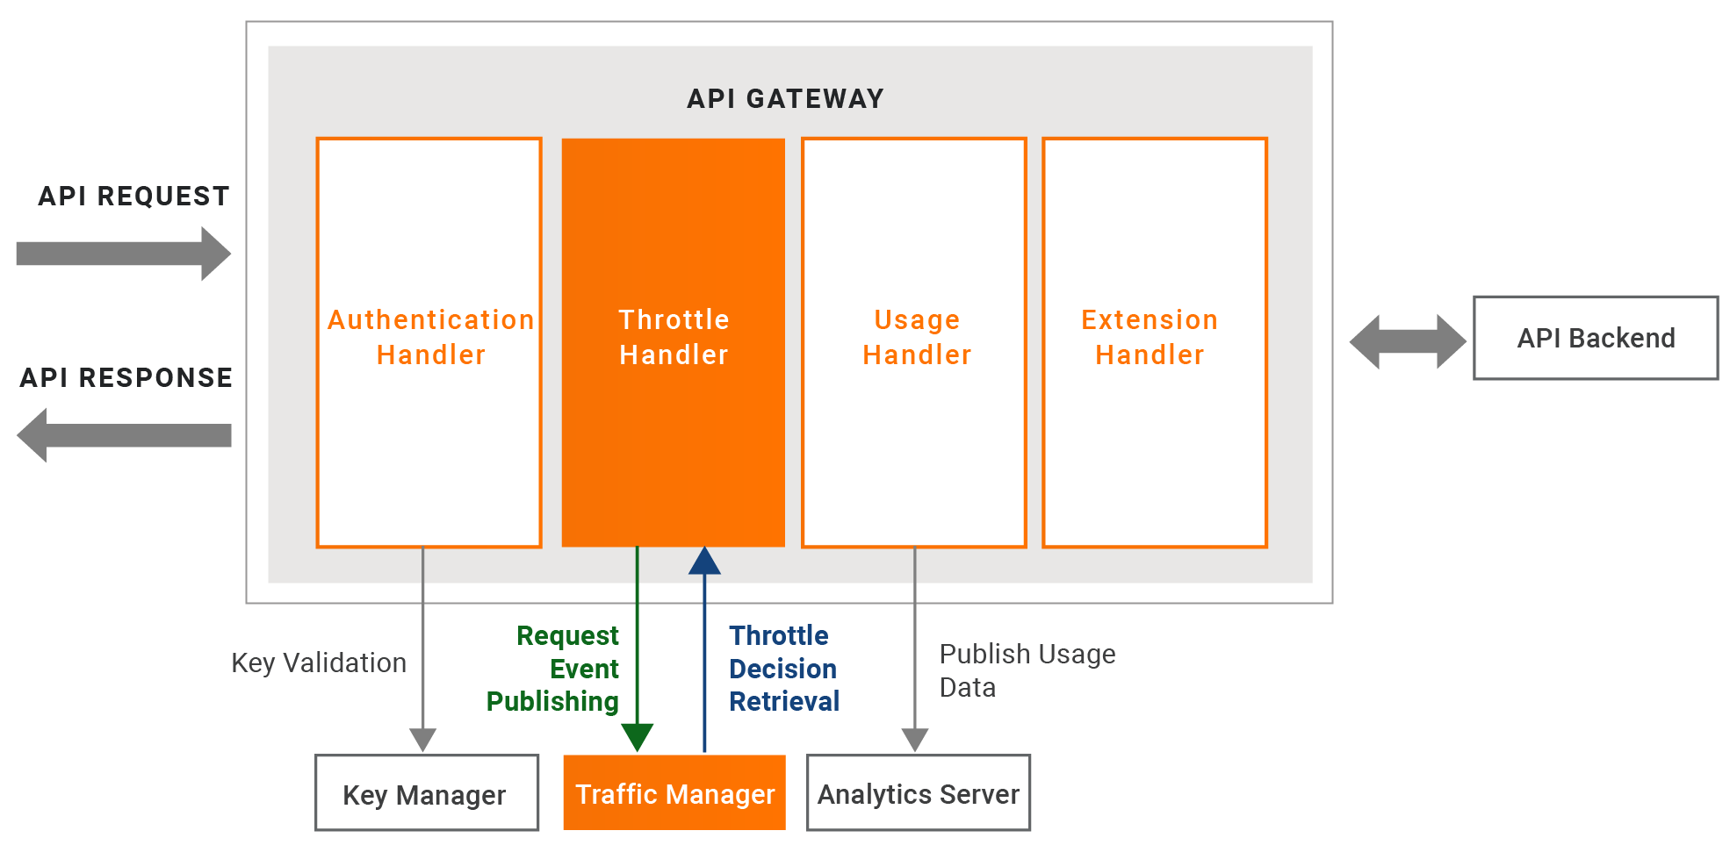
Rate Limiting Flow in API Request Flow
Rate Limiting

Slide 14
Rate Limiting Data Publishing
Throttle
Handler
Data required to make rate limiting decisions needs to be published to the Traffic Manager Component
Traffic Manager has the responsibility of making rate limiting decisions
Each Gateway in a deployment asynchronously publishes data required to make rate limiting decision for every API request to the Traffic Manager
Synchronous
HTTP Client
Synchronous
API Backend
API Request
Asynchronous
Rate Limiting Data Publisher
Asynchronous Data Publishing
Traffic Manager
Rate Limiting Data Receiver
Decision Engine

Slide 15
Policy Evaluation and Notify Decisions
The Siddhi Runtime in the Traffic Manager processes events from Gateways.
Policies deployed in Traffic Manager are executed on each event.
An event with the rate limiting decision will be notified to Gateways through a JMS topic.
Each Gateway maintains a rate limiting data map to check whether a request is within the allowed quota.
Gateways update the rate limiting data map from the JMS Topic, which is notified by the Traffic Manager.

Slide 16
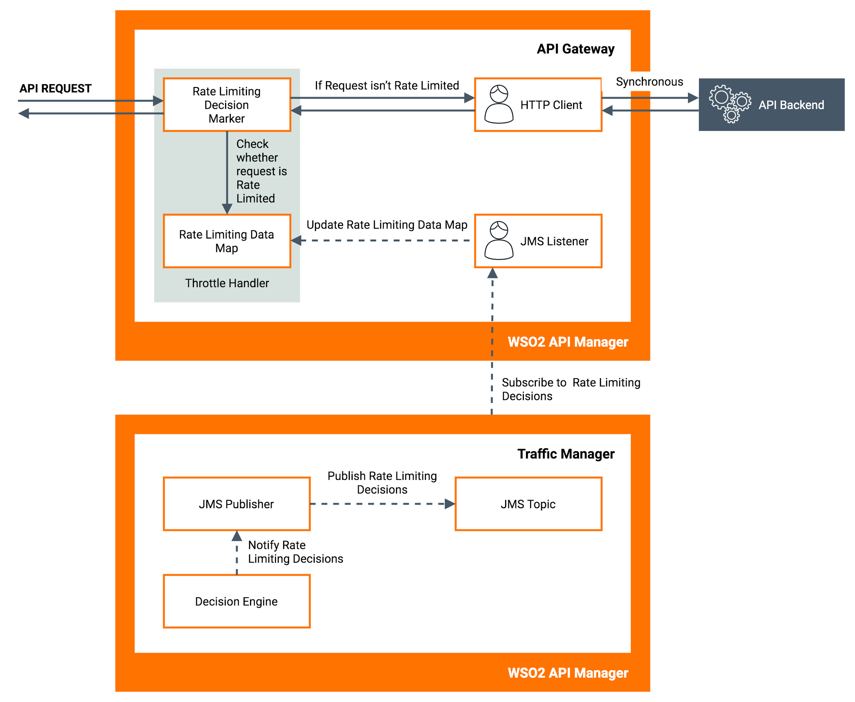
Policy Evaluation and Notifications

Slide 17
Rate Limiting Policies

Slide 18
API/Resource Level Rate Limiting Policies
These policies can be attached to an entire API (i.e., all resources of an API) or to the individual resources separately.
Supports request count and bandwidth based rate limiting.
Complex rate limiting policies can be defined based on,
IP Address/Range
Query Parameters
HTTP Headers
JWT Claims
Supports multiple combinations of above
API - level rate limiting Adding a new advanced rate limiting policy

Slide 19
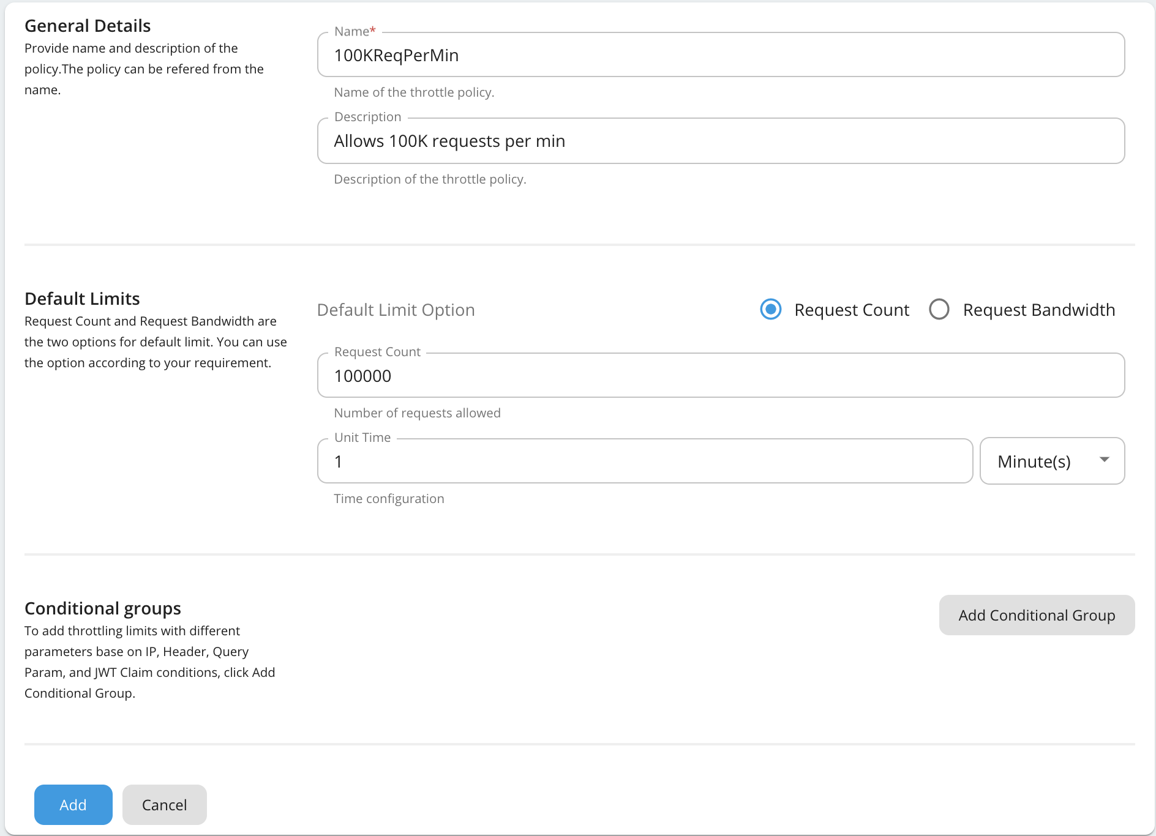
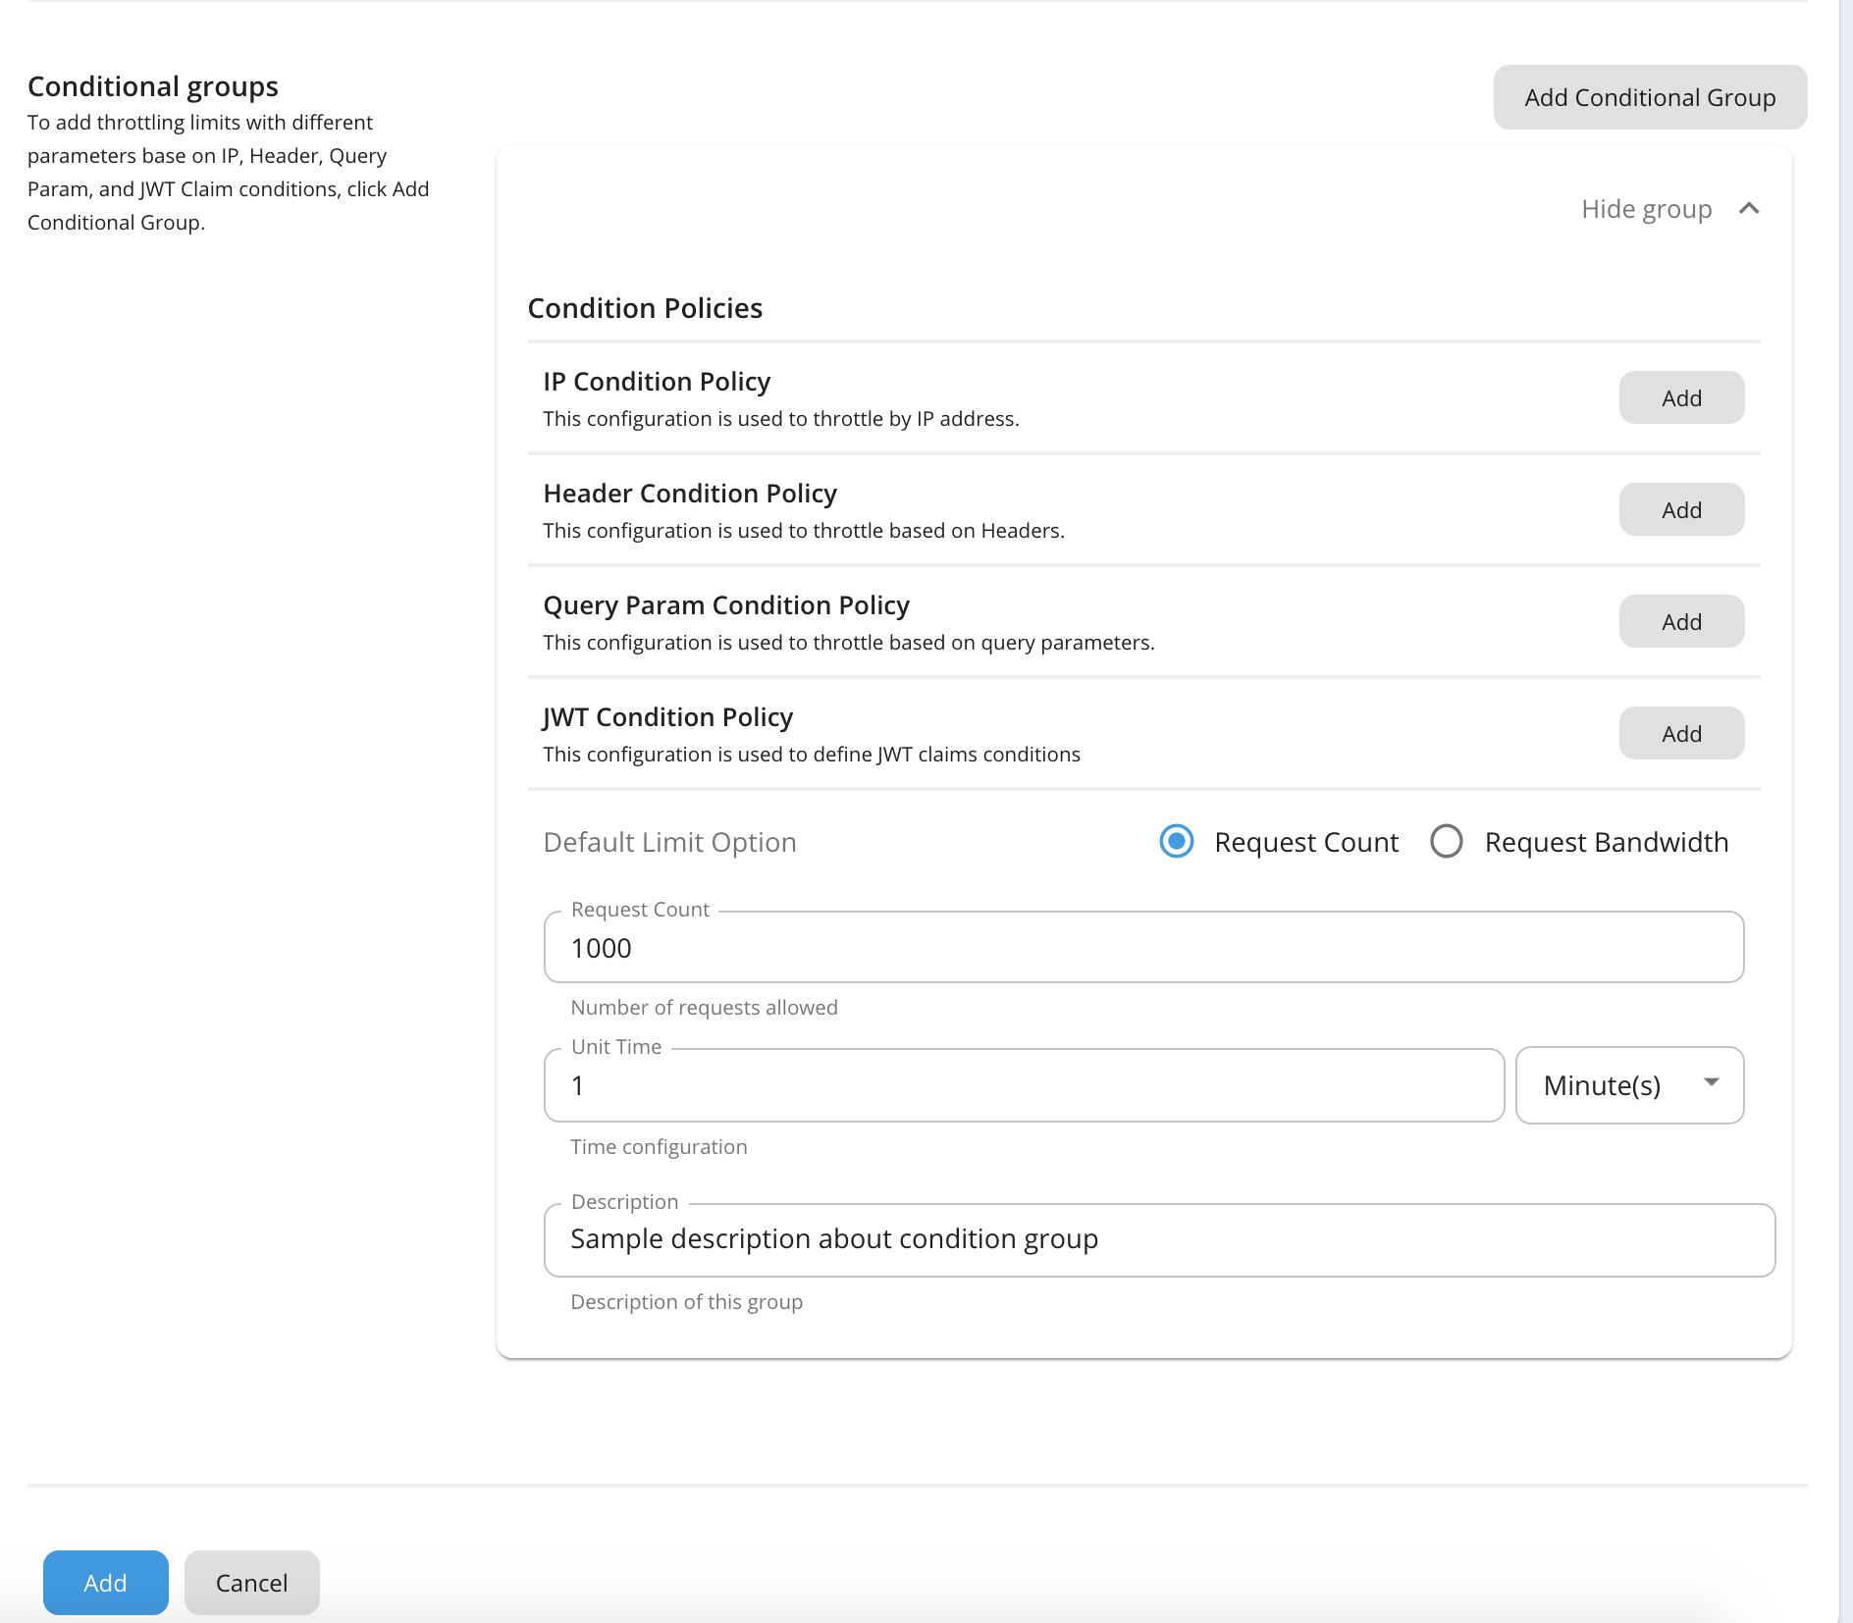

Slide 20
Advanced Rate Limiting Policies
IP Address and Address Range
You can control/restrict access to your API or its selected resources for a given IP address or address range. IP Address and Address Range
2. HTTP Request Headers
Advanced policies allow you to apply limits to APIs by filtering requests based on HTTP headers. HTTP Request Headers
3. JWT Claims
Advanced rate limiting policies based on JWT claims allow you to filter requests by JWT claim values and apply limits for requests JWT Claims
4. Query Parameters
Filtering based on query parameters almost always apply to HTTP GET requests when doing search type of operations. Query Parameters

Slide 21
Subscription Level Policies
Supports request count, bandwidth and event count based rate limiting
Supports burst control (with TPS)
E.g., 100 req/min policy with 10 req/s burst control
Supports “Stop on Quota Reach”
Supports API labelling as “Free” or “Paid” or “Freemium”
Supports custom attributes
Supports role based visibility
Subscription - level rate limiting Adding a new subscription-level rate limiting tier
Notes:
Role based visibility

Slide 22
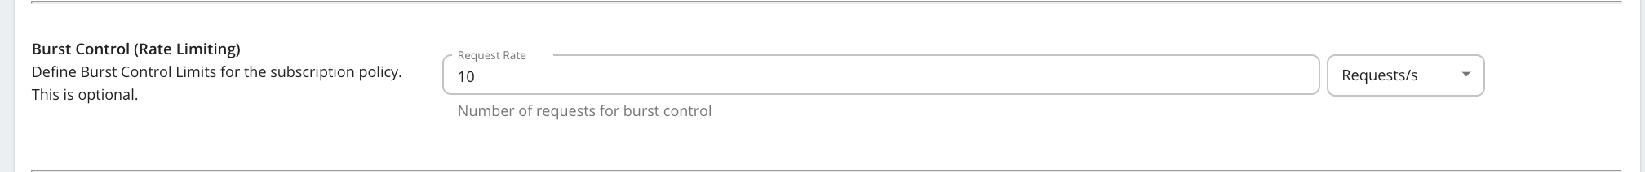
Burst Control (Rate Limiting)
Burst control limits are enforced for subscription tiers in order to distribute the load across the specified time period.
Enforcing a rate limit protects the back-end from sudden request bursts and controls the usage at a subscription and API level.
Burst control limits can be set only to control the number of requests for a given period of time and does not allow you to control the data bandwidth for a given time period.
Sudden spikes in usage or attacks from users can also be handled via rate limiting. You can define a spike arrest policy when creating a subscription level tier.
With burst control, you can define tiers with a combination of, for example, a 1000 requests per day and 10 requests per second.
Burst Control

Slide 23
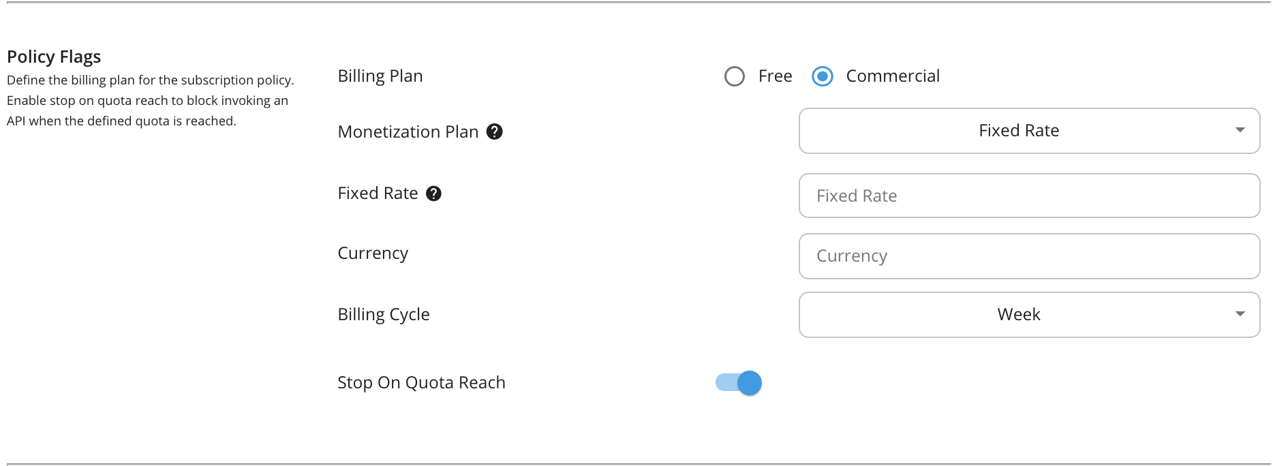
Billing Plan
This field only makes sense if you have API Monetization enabled.
The available billing plans are Free, Commercial, and Freemium.
An API is tagged/labelled as Free, Paid, or Freemium depending on its subscription tiers (e.g., Unlimited, Gold, etc.), which are the tiers selected when creating an API.

Slide 24
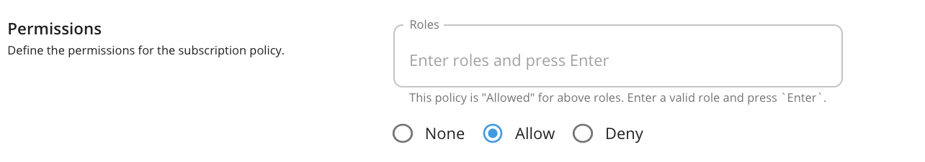
Permissions (Role visibility)
You can allow or deny permission for specific roles.
Once a permission is allowed or denied to a role, users with that role will or will not be able to subscribe to the API using that policy.

Slide 25
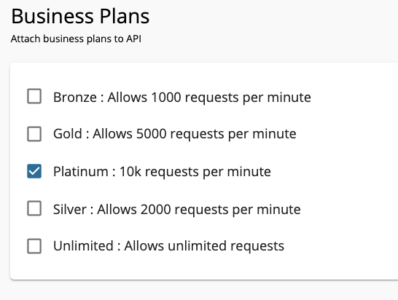
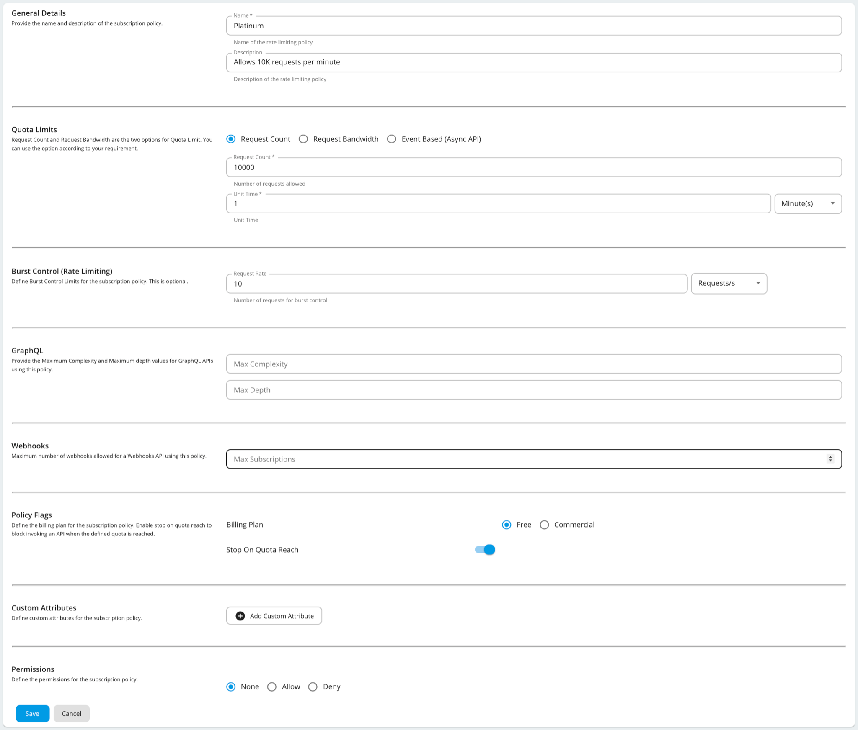
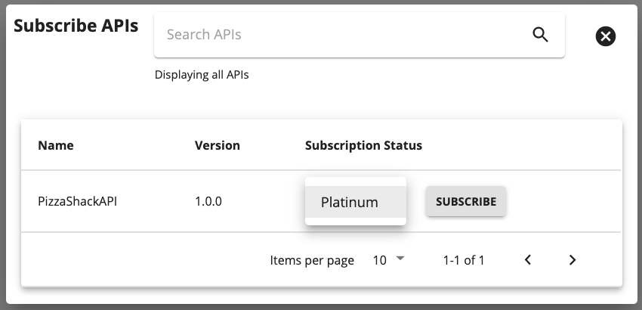
Publisher Portal
Developer Portal

Slide 26
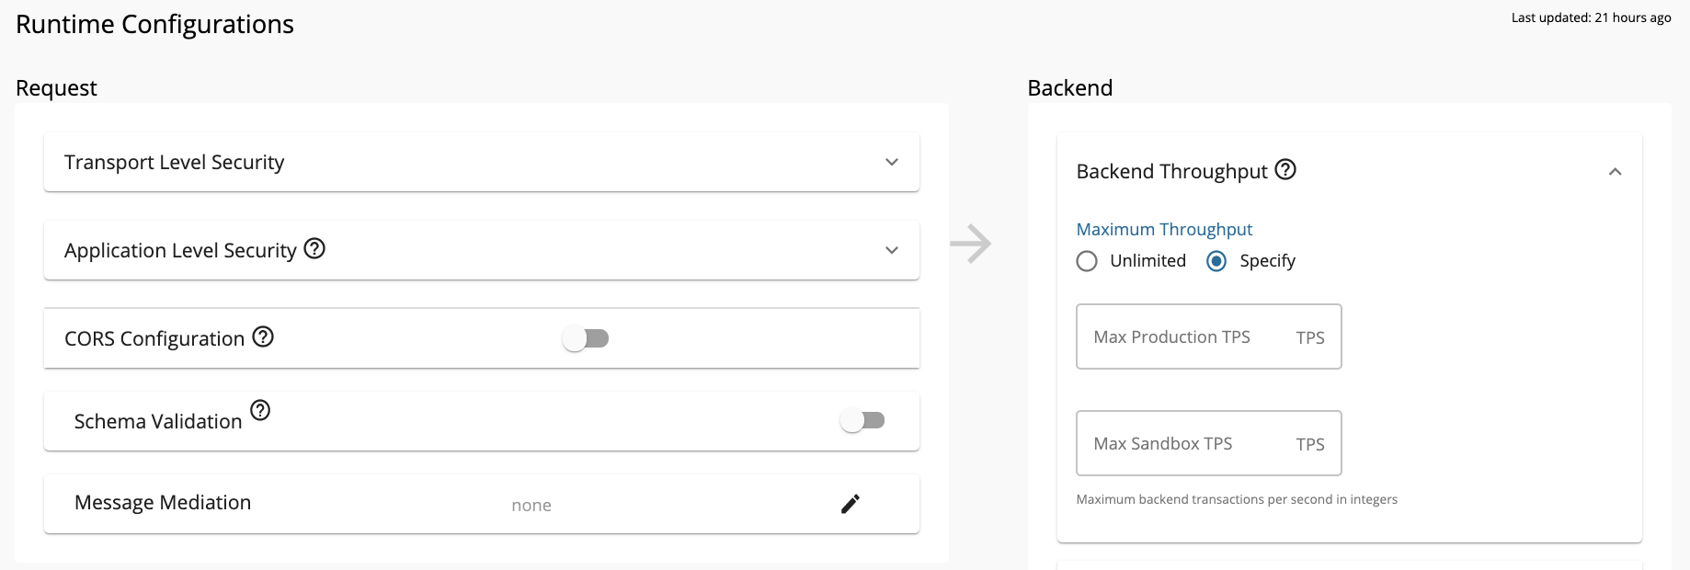
Maximum Backend Throughput
The maximum backend throughput, limits the total number of calls a particular API in the API Manager is allowed to make to the backend.
This setting limits the quota the backend can handle.
The counters maintained when evaluating the maximum backend throughput are shared across all nodes of the Gateway cluster and applied across all users using any application that accesses that particular API.
This setting is available in the API Publisher.
Setting Maximum Backend Throughput Limits

Slide 27
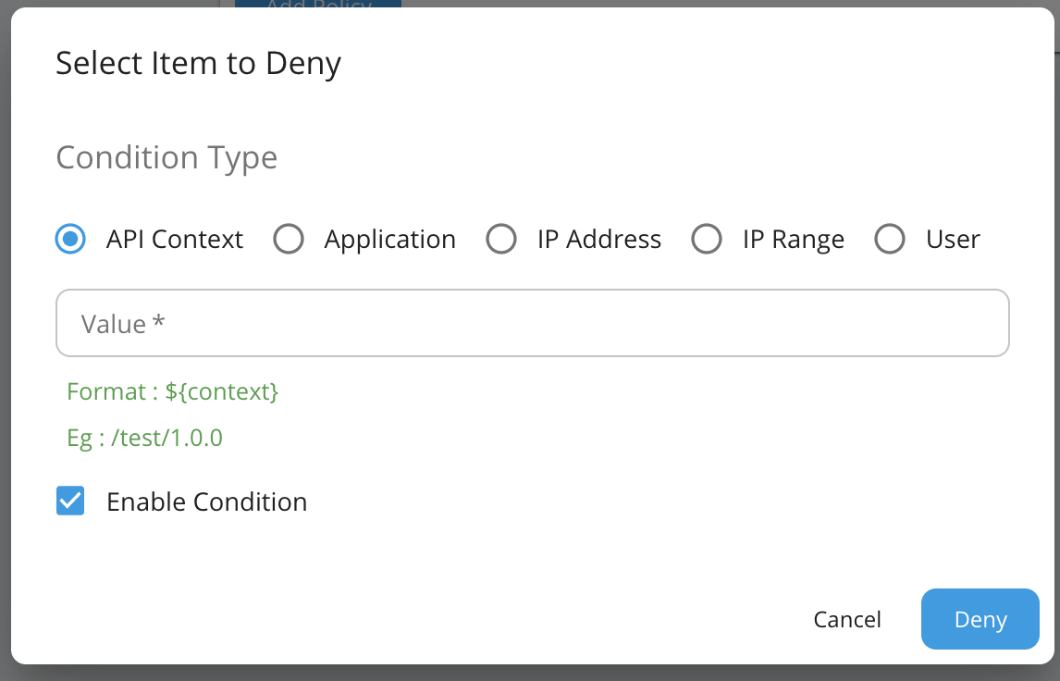
Blocking Conditions
Used to block API requests instantaneously.
Support blocking API invocations by User, API context, Application and IP address.
Provides ability to control unusual behaviors of API Invocations.
Blocking conditions will be applied globally for any API call coming to the API Gateway.

Slide 28
Blocking Conditions Retrieval Flow
Rate limiting Decision Maker
API Request
Check whether request is rate limited
Load initial Block Conditions
API Key Manager
Retrieve Block conditions
Rate limiting Data Map
JMS Listener
Update Block Condition data map
AM_DB
Throttle Handler
API Gateway
Subscribe to rate limiting decisions
Save Block conditions
Block Event JMS Publisher
JMS Topic
Publish Block Condition
Notify Block
condition
API Admin Portal
Block Conditions Event Receiver
Publish blocking events
Traffic Manager

Slide 29
Custom Policies
Provide the flexibility to write user defined policies.
Written using Siddhi query language.
These policies apply globally for every API, Application, User,.. etc.
Custom rate limiting policy contains two major parts
Siddhi query
Key template
Key templates defines a unique key that needs to be equal to the throttle key in the Siddhi Query
Custom Rate Limiting

Slide 30
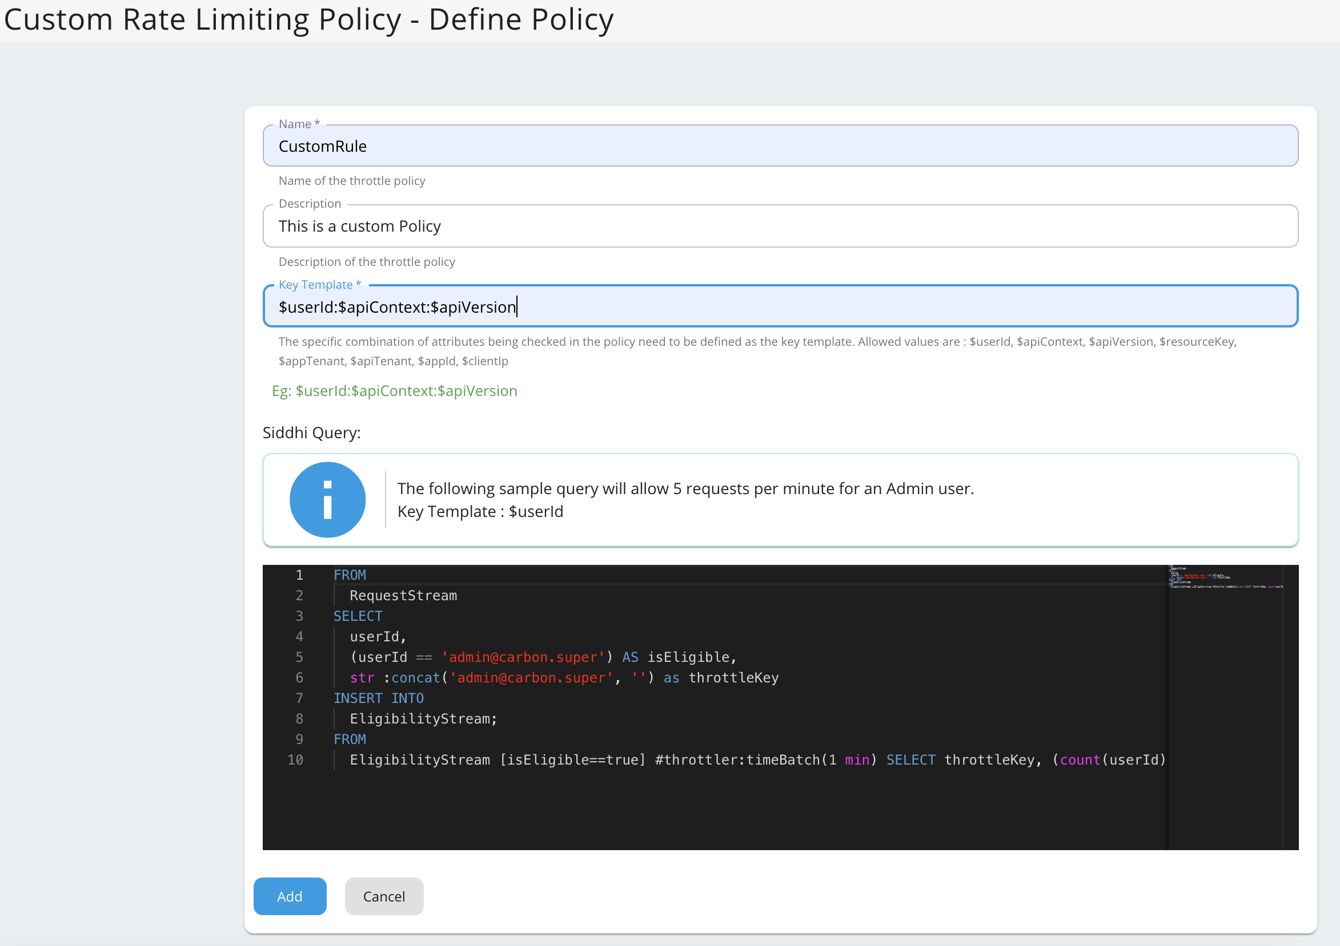

Slide 31
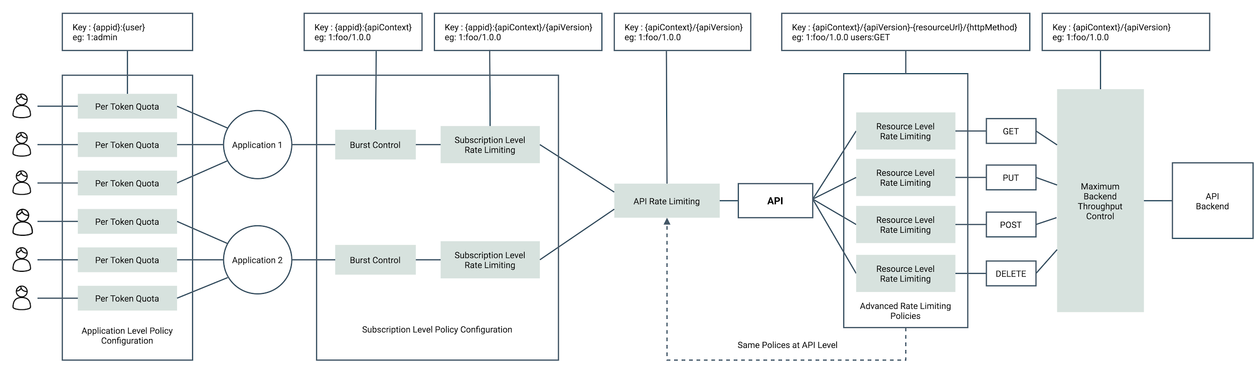
Rate Limiting Policies Applicable at Different Levels

Slide 32
Deployment Architecture - Active-Active

Slide 33
Deployment Architecture : Active-Active
GW1
TM (Active)
GW2
TM (Active)

Slide 34
Deployment Architecture: Active-Active
Event publishing (Active)
Event publishing (Failover)
GW1
TM (Active)
GW2
TM (Active)

Slide 35
Deployment Architecture: Active-Active
Event publishing (Active)
Event publishing (Failover)
GW1
Event syncing
SE
BR
SE
Siddhi Engine
SE
BR
Message Broker
BR
GW2
SE
BR

Slide 36
Deployment Architecture: Active-Active
Event publishing (Active)
Event publishing (Failover)
GW1
Event syncing
SE
BR
SE
Siddhi Engine
BR
Message Broker
Rate Limiting decision publishing (Active)
Rate limiting decision publishing (Failover)
GW2
SE
BR

Slide 37
Deployment Architecture: Active-Active
Event publishing (Active)
Event publishing (Failover)
GW1
Event syncing
SE
BR
SE
Siddhi Engine
SE
BR
Message Broker
BR
Rate Limiting decision publishing (Active)
Rate Limiting decision publishing (Failover)
GW2
SE
BR
Rate Limiting decision (Active)
Rate Limiting decision (Failover)

