Slide 1

WSO2 API Manager 4.2.0 Developer Advanced
Scalability
WSO2 Training

Slide 2

Scaling
Most of the time we need to scale gateway and key manager as they get large number of requests
To scale horizontally means to add more nodes to a system, such as adding a new node to a gateway cluster
To scale vertically means to add resources to a single node in a system, typically involving the addition of more computing power.

Slide 3
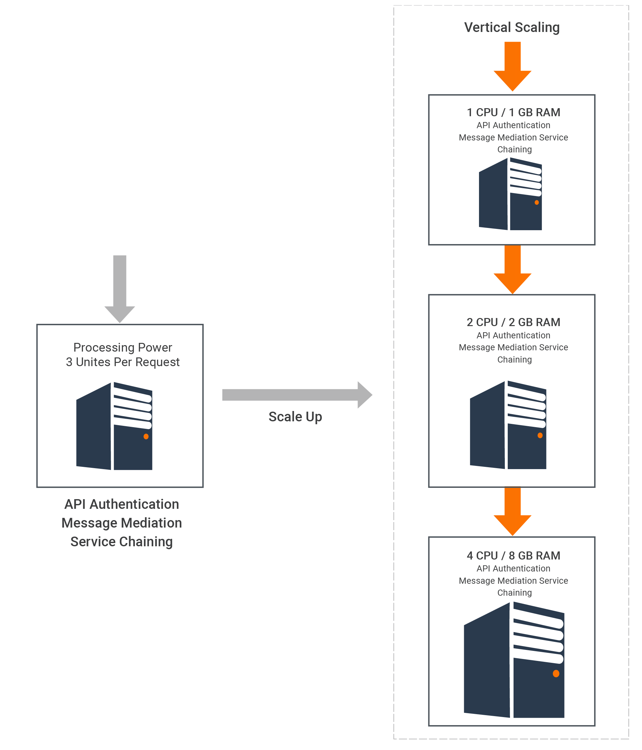
Vertical Scaling

Slide 4
Vertical Scaling
Scaling vertically means adding more computing power to a single node in a system, typically by adding more RAM.
Since there are additional resources through vertical scaling, it can accommodate more requests.

Slide 5
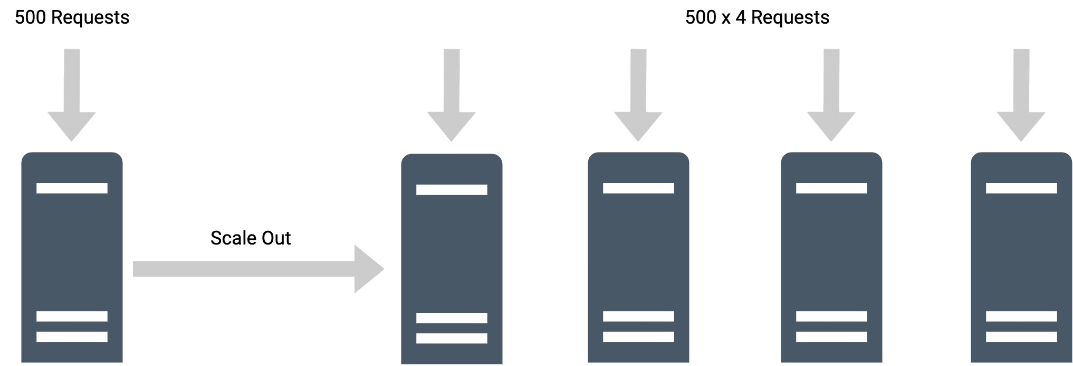
Horizontal Scaling

Slide 6
Horizontal Scaling
To scale horizontally means to add more nodes to a system, such as adding a new node to a Gateway cluster.
If we take Gateway as an example, we can add more nodes to the Gateway cluster on demand.
Then the load balancer should be able to detect newly added nodes and route requests to them.
We can apply this pattern to the Gateway, Key Manager, Developer Portal, and Publisher.

Slide 7
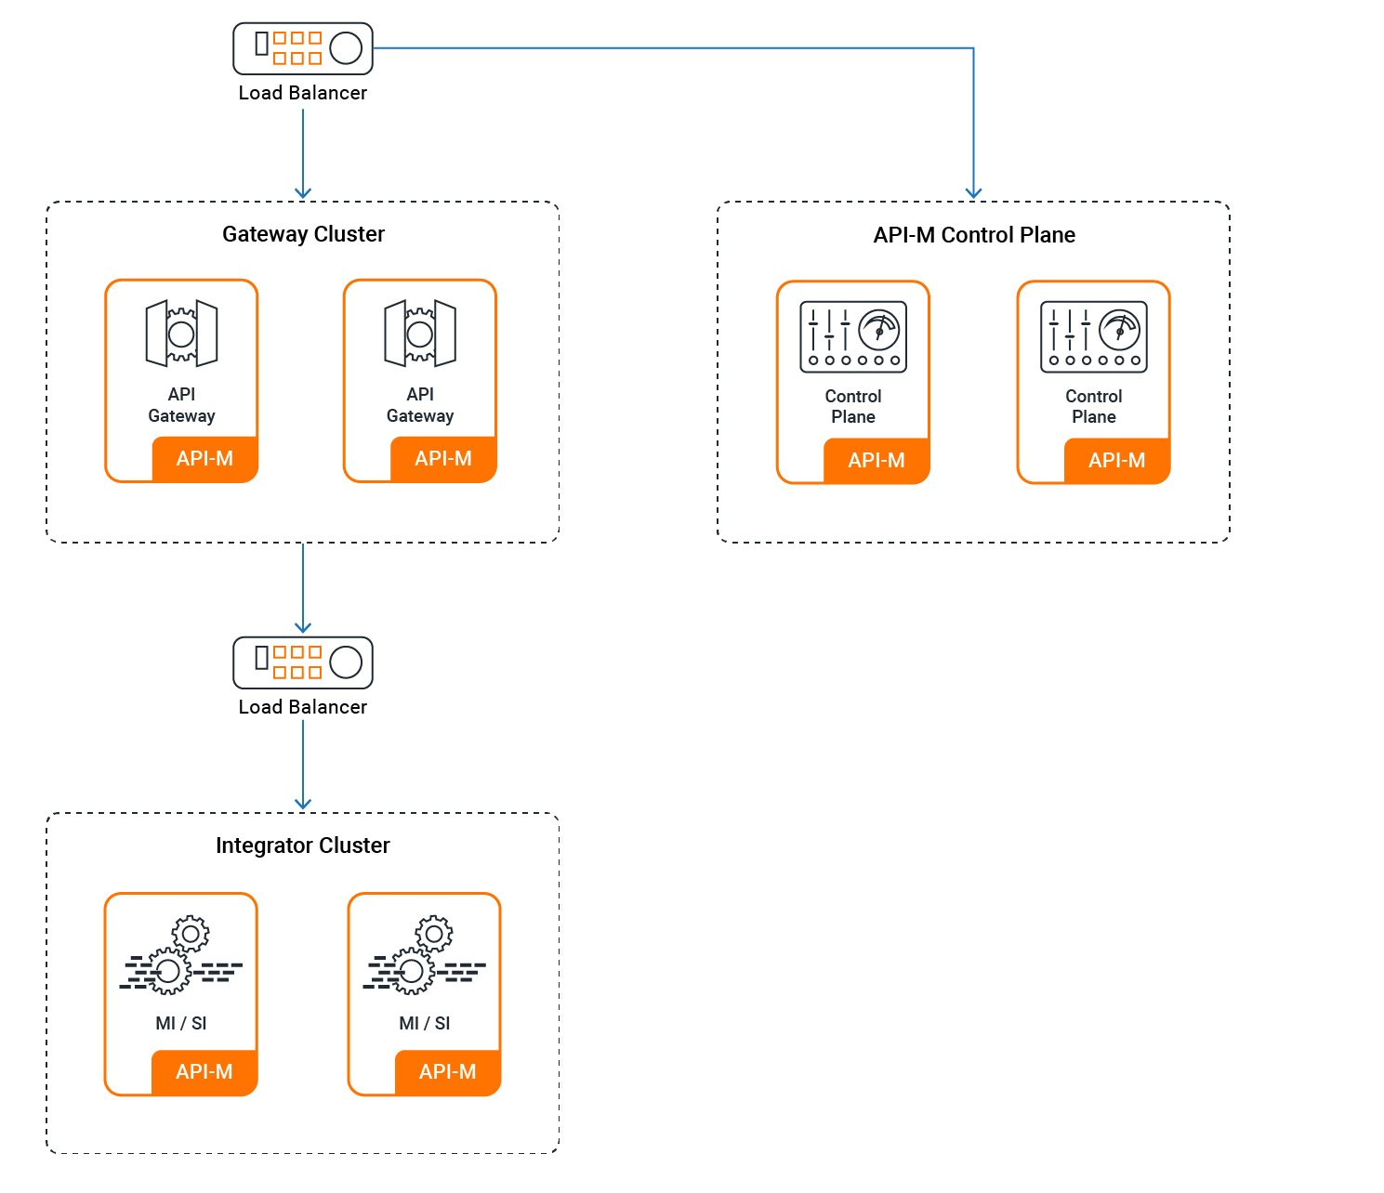
https://apim.docs.wso2.com/en/4.2.0/install-and-setup/setup/deployment-overview/#standard-ha-deployment-with-multitenancy

