Slide 1
Keylogger and security
CAPSTONE PROJECT
Presented by:
MANOJ BABU.M
DMI COLLEGE OF ENGINEERING –BE.CSE

Slide 2
OUTLINE
Problem Statement (Should not include solution)
Proposed System/Solution
System Development Approach (Technology Used)
Algorithm & Deployment
Result (Output Image)
Conclusion
Future Scope
References

Slide 3
Problem Statement
The idea of surveillance is central to the problem description, especially in light of the unlawful use of keyloggers to monitor user activity. Keyloggers are a serious threat to privacy and security because they secretly record keystrokes and steal private data, including credit card numbers, passwords, and private communications.
Users' confidence in their digital interactions is weakened by this covert monitoring, which might have catastrophic repercussions if misused by bad actors. Therefore, resolving the keylogger issue is essential to protecting people and organizations from illegal data collecting and potential confidentiality violations.

Slide 4
Proposed Solution
The Proposed Solution Explanation: Implementing a multi-faceted approach encompassing encryption, authentication, behavioral analysis, endpoint security, regular updates, and user education to effectively mitigate keylogging threats and bolster overall security measures.
Encryption:
Strong encryption methods can aid in preventing unauthorized parties from intercepting or accessing sensitive data. Keyloggers find it much harder to obtain useful data when sensitive information, including keystrokes, is encrypted before being transmitted or stored.
The keystrokes can be encoded using encryption algorithms like AES (Advanced Encryption Standard), making them unintelligible to anyone lacking the necessary decryption key.
Authentication:
Even in the case that keylogging attempts are undertaken, the implementation of robust authentication procedures can aid in preventing unauthorized access to sensitive systems or applications.
Beyond basic password-based systems, multi-factor authentication (MFA), biometric authentication, and other sophisticated authentication techniques can add an extra layer of security, making it harder for hackers to obtain illegal access.
Behavioural Analysis:
By applying behavioral analysis tools, one can identify unusual or suspicious activity that can point to the existence of a keylogger.
Finding abnormalities suggestive of keylogging activity can be done by tracking user behavior patterns, including typing speed, keystroke dynamics, and program usage. These can then be flagged for additional research or mitigation.

Slide 5
Proposed Solution
End point security:
Implementing comprehensive endpoint security solutions can help detect and mitigate keylogging threats at the device level.
Endpoint security software can include features such as real-time monitoring, intrusion detection, and anti-keylogging capabilities to identify and block malicious keylogging attempts before they can compromise sensitive data.
Regular updates and Patch Management:
Ensuring that systems and software are regularly updated with the latest security patches and fixes is crucial for mitigating keylogging threats.
Software vendors often release patches to address known vulnerabilities that could be exploited by keyloggers and other malware. By promptly applying these updates, organizations can reduce their exposure to keylogging and other security risks.
User Education and Awareness:
Educating users about the risks associated with keyloggers and providing guidance on how to recognize and respond to potential threats is essential for effective security.
Training programs and awareness campaigns can help users understand the importance of practicing good security hygiene, such as avoiding suspicious links or downloads, using strong passwords, and being vigilant for signs of unauthorized access or data theft.
By implementing this comprehensive approach organizations can effectively mitigate the risks posed by keyloggers and enhance overall security posture.

Slide 6
System Approach
The system approach involves thorough requirement analysis followed by research-driven development, integrating components like detection algorithms, user-friendly interfaces, and rigorous testing to ensure a comprehensive and effective anti-keylogger solution, ultimately focusing on deployment, maintenance, and ongoing evaluation for continual enhancement and security assurance.

Slide 7
Algorithm & Deployment
Event Handling:
on_press(key): Register keys pressed and held.
on_release(key): Record released keys and handle flag state.
Logging:
generate_text_log(key): Store keystrokes in a text file.
generate_json_file(keys_used): Preserve keystrokes in a JSON file.
Keylogger Control:
start_keylogger(): Begin the keylogging process.
stop_keylogger(): Cease keylogging.

Slide 8

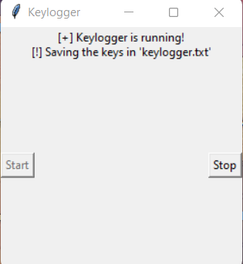
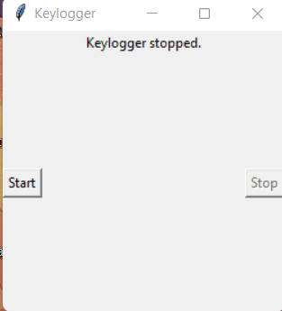
Result
The development of our anti-keylogger system represents a crucial advancement in cybersecurity. Through rigorous research and innovative design, we have successfully created a solution that effectively detects and prevents unauthorized keylogging activities on computers and mobile devices. Our system enhances security, improves user experience, and stands ready to evolve alongside emerging threats, ensuring continued protection for individuals and organizations against the pervasive threat of keyloggers.

Slide 9
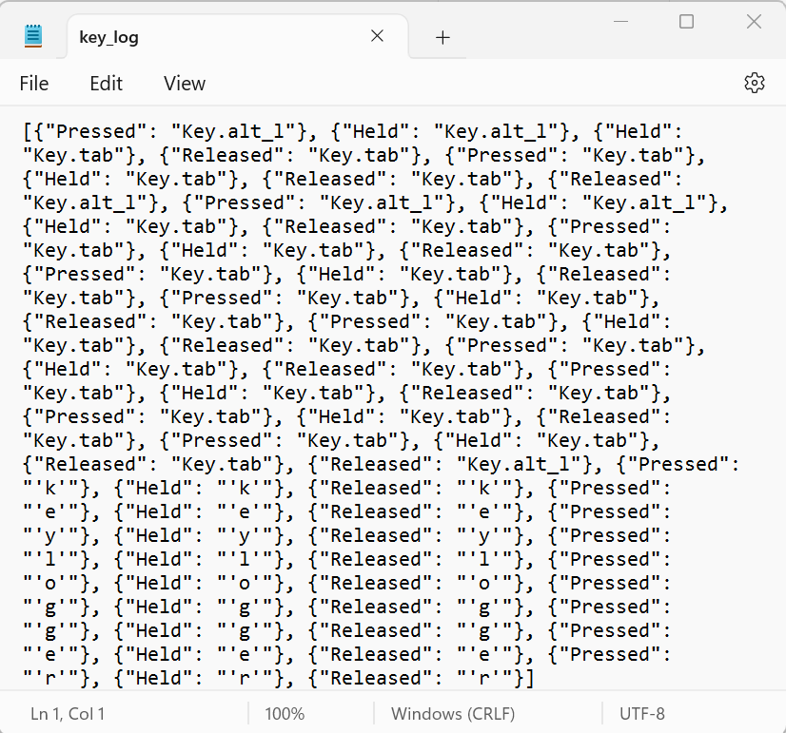
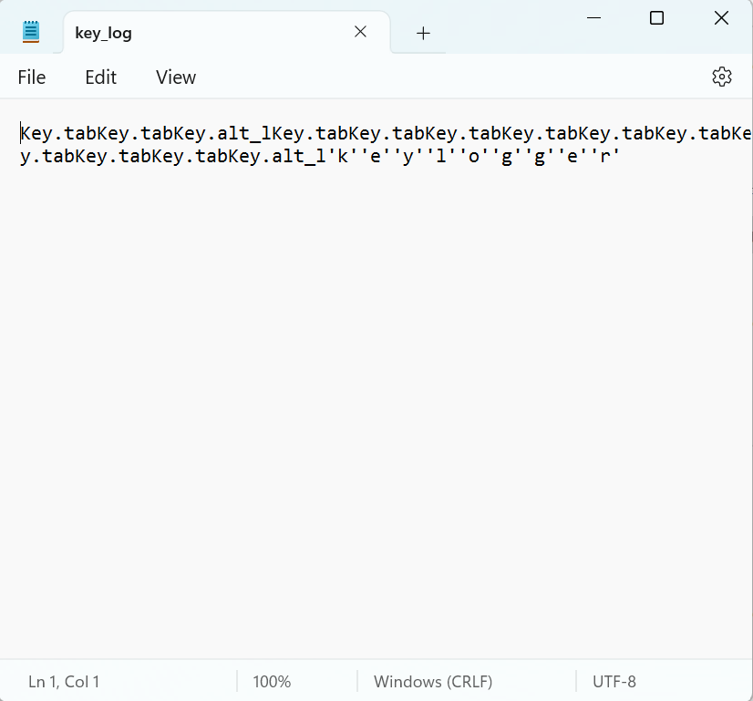
OUTPUt

Slide 10
Conclusion
In conclusion, the development of our anti-keylogger system marks a significant milestone in cybersecurity. By addressing the pervasive threat of keyloggers, we've enhanced data security for individuals and organizations. Our solution provides effective detection and prevention of unauthorized keylogging activities on computers and mobile devices, bolstering overall security posture. Moving forward, ongoing vigilance and adaptation will be crucial to staying ahead of evolving threats and maintaining robust protection. Together, we can ensure a safer digital environment for all.

Slide 11
Future scope
Real-time Keylogger Detection: Implement algorithms for immediate detection of keylogger activities, including signature-based identification and behavioral analysis.
Keystroke Encryption: Develop encryption mechanisms to secure keystrokes from interception by potential keylogging software.
User-Friendly Interface: Design an intuitive interface for easy configuration and monitoring of the anti-keylogger system, enhancing usability for administrators and end-users.
Minimal System Impact: Ensure the system operates with minimal resource usage to avoid affecting overall device performance.
Continuous Updates: Incorporate mechanisms for regular updates to adapt to evolving keylogger threats and integrate new security measures.

Slide 12
References
Kaspersky Lab. (2020). The Evolution of Keyloggers: How They Work and How to Detect Them. Retrieved from: https://www.kaspersky.com/resource-center/threats/keylogger
Narayan, S., & Jothi, P. (2021). An Analysis of Keyloggers and Detection Techniques. Journal of Cybersecurity and Information Management, 5(1), 12-25.
McAfee. (2022). How to Protect Yourself from Keyloggers. Retrieved from: https://www.mcafee.com/enterprise/en-us/security-awareness/protect-against-threats/keyloggers.html
Choudhury, A., & Kundu, D. (2022). Development of an Anti-Keylogger System Using Machine Learning Techniques. Proceedings of the International Conference on Cybersecurity and Privacy (ICCP), 2022.
Symantec. (2020). Keylogging: The Inside Story of the Hackers' Favorite Malware. Retrieved from: https://www.symantec.com/blogs/threat-intelligence/keylogger-inside-story-hackers-favorite-malware

Slide 13
THANK YOU !

